Slide 1
Device Organisation
Ms Sastre

Slide 2
Lets get Organised!
Have all your folders organised.
Access to all your books.
Important apps pinned to taskbar.
Passwords changed.

Slide 3

Tips for your device
Keep your device charged up!
Keep your device muted during classes.
Keep your schoolwork neat and tidy.

Slide 4

Access to All your books:
Educate.ie
Folens
Edco
CJ Fallon
And more

Slide 5
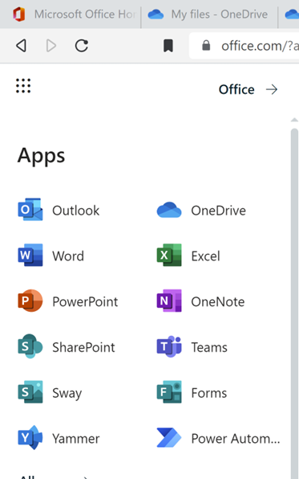
How to access Office 365
Go to Office.com
Browser VS Installed Apps
Go-to for all your school applications including OneDrive and Teams.

Slide 6
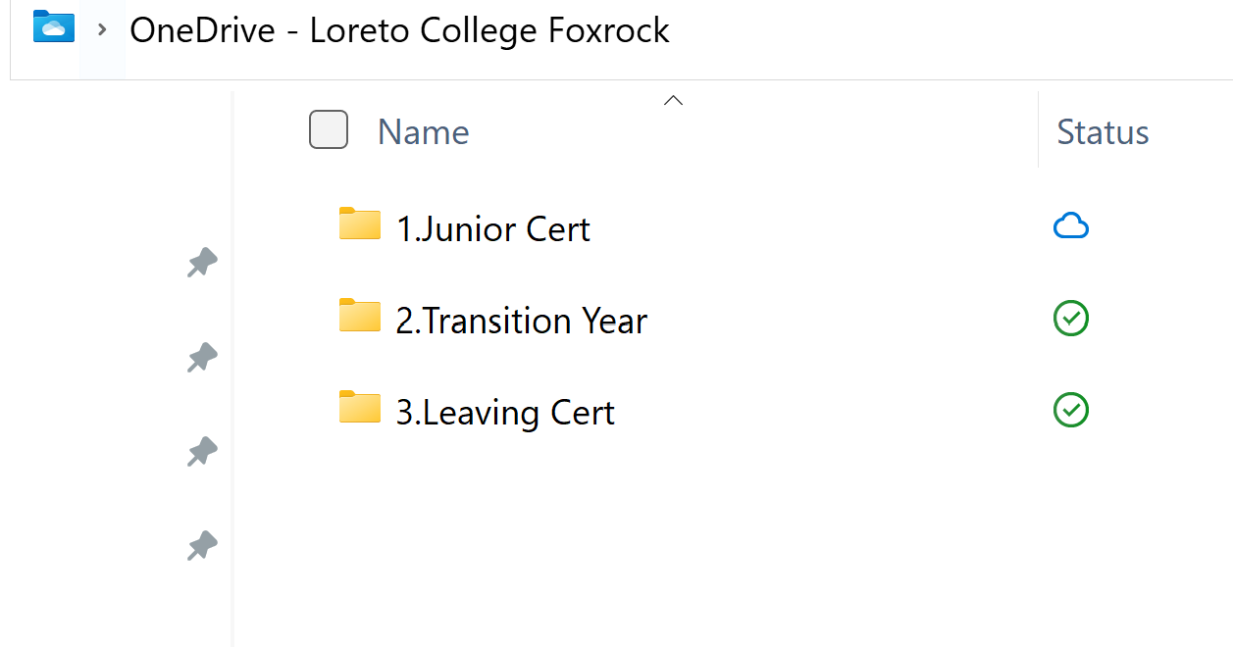
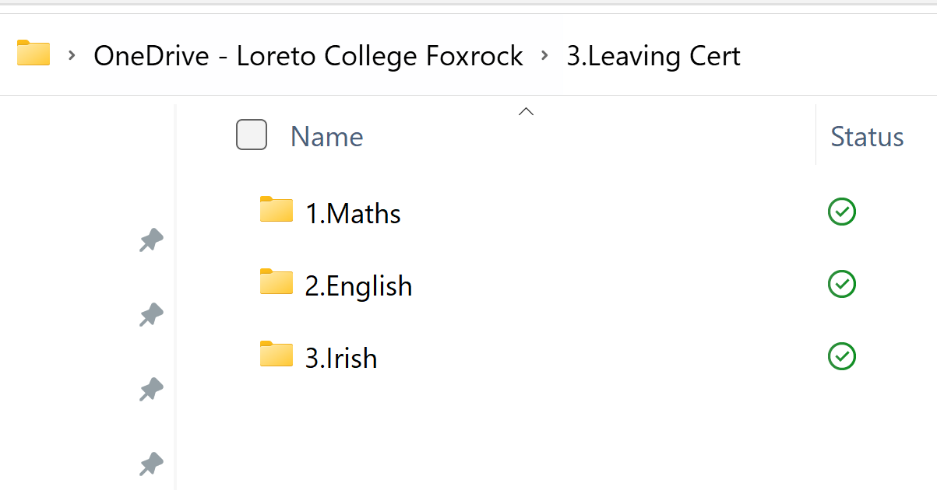
Organising your folders on OneDrive
This is what I expect to see.
Split up into years.
Then split up into subjects.
Start with a number and capitol letter.

Slide 7

Change your passwords
Change your passwords that the school gave you.
Don’t use passwords like:
Password
1234
22042001
Use passwords like:
Bella14
Ch33s3
Lucy@14

Slide 8

Write a checklist in your journal
I have changed my passwords.
I have my folders organised.
I have all my books.
I have pinned my important applications.

