Slide 1

Online Safety
Ms Sastre

Slide 2

Internet Trust
How much information have you given away?
Pair into groups and write down at least 3 things.
What could the internet use all your data for?

Slide 3

Advertisement or Hacking
Websites sell your data to advertisers.
Some people will use your data for hacking.
When you have forgotten your password…What is the process?

Slide 4
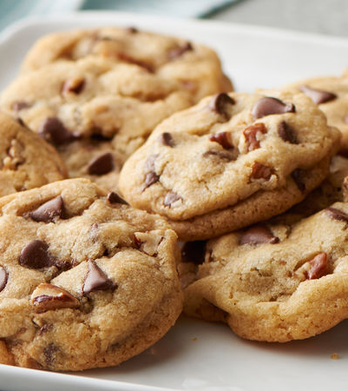
Cookies!
Cookies are tracking you as you use a website.
They will always be difficult to reject. This is on purpose.
Why do you accept them?

Slide 5

They are watching your every move
Bag checkout
Error
Other websites that you visit.

