Slide 1
Scratch
Ms Sastre

Slide 2
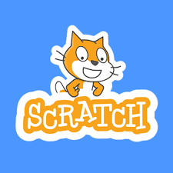
What is Scratch?
Coding language with a simple visual interface.
Allows users to create digital stories, games and animations.
Promotes computational thinking and problem solving.

Slide 3
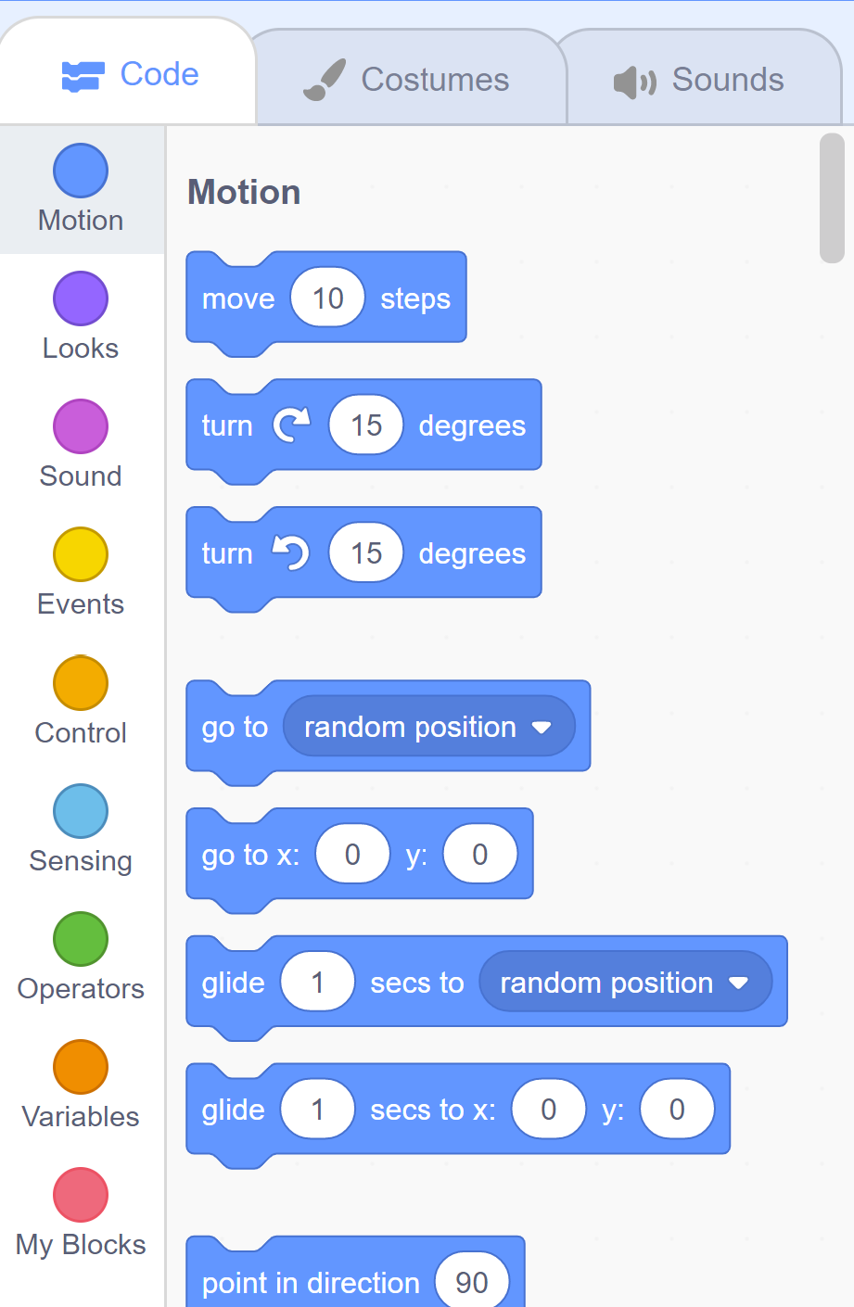
Scratch Project
Create a scratch program.
It can be a game, animation, digital story etc.
Your project must have at least one of each code category.
The exception is the My Blocks category.

Slide 4
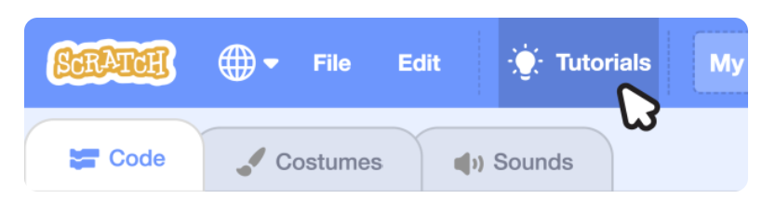
Tutorials & Inspiration
There are very helpful tutorials on Scratch for you to learn.

Slide 5

Time Limit
You will have this class and the next class to finish it.
2 classes in total.
You will submit your project link on teams. Your teacher will create an Assignment on teams for you to post it in.
We will present the projects on the board on the third class.

Slide 6
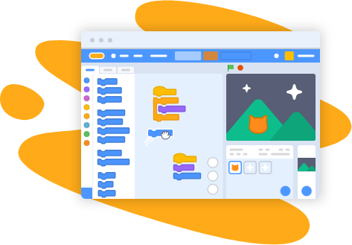
Let’s get started!
Create an account using your school email.
This will prevent you from losing any progress on your project as it will be saved to your account.
Get started at: https://scratch.mit.edu/

