Slide 1


Delay Prediction 2023 Q3
Distance & Rush Hour – our biggest enemies?

Slide 2
Shipper Notification Proposal
In Q3 of 2023, 62.64% of deliveries were on time.
Over 1/3rd were late. Shippers need to be notified when a delay will occur.
We propose to automatically notify Shippers of a delayed delivery when a collection is detected as late.
On time collections resulting in late deliveries: 25%
Late collections resulting in late deliveries: 57%
Deliveries are twice as likely to be delayed when the collection is late.

Slide 3
Recommendations 1:
Improve Communication with Shippers:
Automatic Delay Notifications: Implement the proposed system to automatically notify shippers of potential delays when a collection is late. This will improve transparency and customer satisfaction.
Focus on Early Collections and Deliveries:
Schedule Adjustments: Prioritize early morning collections (before 8 am) and later evening deliveries (after 5 pm) to avoid delays. Weekends might be suitable for collections due to lower lateness rates, and weekdays for deliveries.
Optimize Routes for Mid-Range Distances:
Route Analysis: Investigate the reasons behind higher lateness rates for deliveries in the 200-300 km range. This could involve factors like traffic patterns, depot locations, or driver schedules. Optimize routes for these distances to improve on-time deliveries.

Slide 4
Recommendations 2:
Saturday Collection Operations:
Leverage Saturday Collections: Since Saturday collections have lower lateness rates, consider strategically scheduling more collections for this day.
Investigate Friday and Saturday Delivery Lateness:
Weekend Strategy: Analyze the reasons behind high lateness rates for Friday and Saturday deliveries. Is it weekend traffic or other logistical challenges? Develop targeted solutions to address these issues.
Consider Overall Lateness:
Focus on Improvement: While the overall on-time delivery rate (63%) isn't terrible, there's room for improvement. Increased customer satisfaction and potentially attracting new business will be gained if we can target the above issues

Slide 5
Deeper Dive into the reasons for lateness…

Slide 6
Why are shipments delayed?
In order of importance, the following factors:
Distance
Hour of the Delivery & Collection (Morning/Noon/Night)
Day of the Week of Delivery & Collection
Is rush hour a factor?

Slide 7
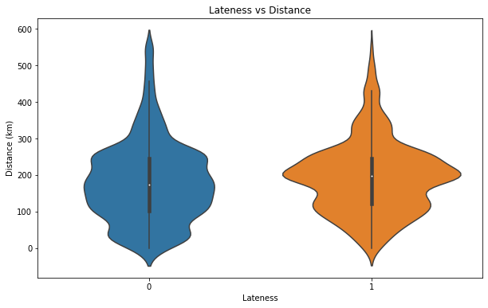
Distance vs Lateness
On-time
Late
The orange graph shows that deliveries around middle-ground, 200-300km are most likely to be late.
Surprisingly, longer distance (500km+) and shorter distances (0-100km) are more dense in the Not-Late category, see the bottom and top of the blue graph is wider than the orange.

Slide 8
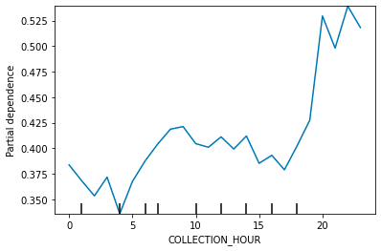
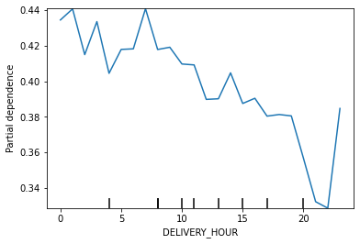
Time of Collection & Delivery
These plots show the effect of the time of day (along the bottom of the graphs) on lateness of deliveries.
Orders collected in early morning tend to be on time, but orders collected at after 8pm are more likely to be late.
Conversely, orders set to be delivered in the early morning tend to be late, but orders set to be delivered in the later evening tend to be on time.
Rush Hour appears to play no strong effect.

Slide 9
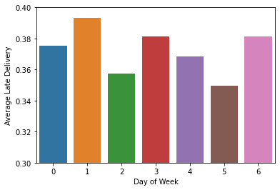
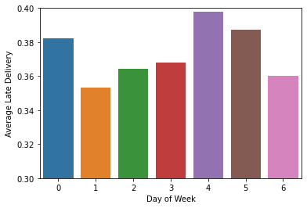
Day of the Week
Collection Day of Week
Going from Monday to Sunday (0 – 6), the lateness doesn’t differ hugely (between 35-40% lateness for all)
Collection day has a different level in lateness to Delivery. Saturday collections are some of the lowest levels of lateness, and Sunday some of the highest (as they lead into the busy start of the week perhaps?)
Friday and Saturday have the highest lateness for delivery day, likely due to weekend traffic
Delivery Day of Week

