Slide 1
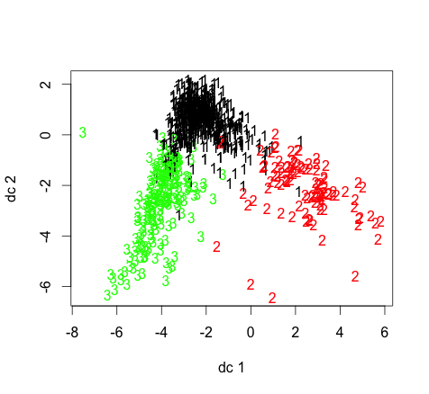



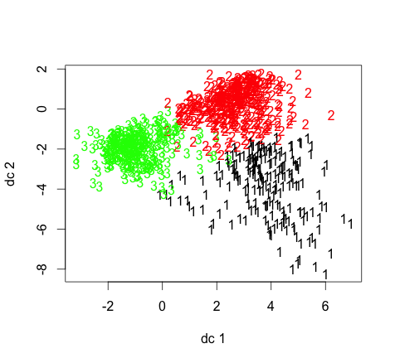



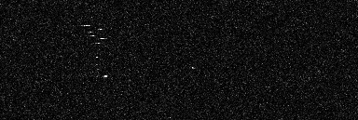
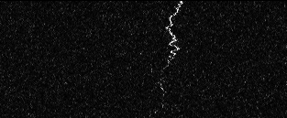

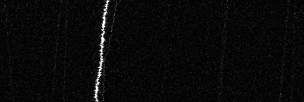
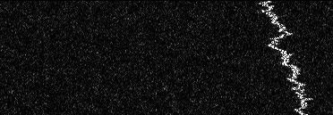
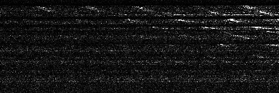
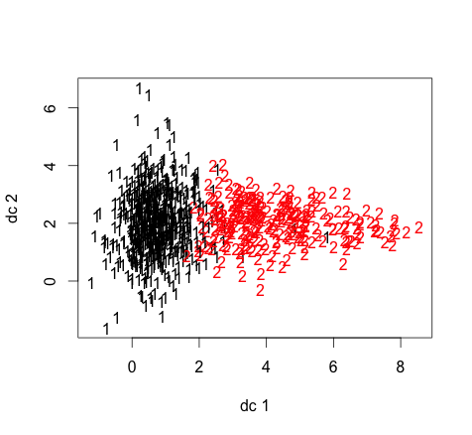

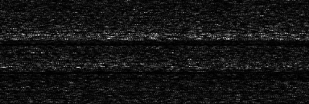
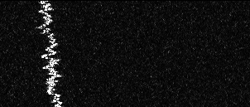


Machine Recognition of “Squiggles” in SETI Signal Data
Travis Chen, Kenny Smith, Jason Wang
Motivation
Classification
Clustering
The question, “are we alone?,” has boggled scientists for centuries. The Search for Extraterrestrial Intelligence (SETI) Institute operates the Allen Telescope Array, a set of 42 antennas, to observe star systems for radio signals which may provide evidence of ET intelligence. The key problem is identifying recurring patterns in the signal stream that are not associated with known interferences, such as aircraft RFI, radio waves, etc. Recently, an unknown subset of signals inelegantly referred to as “squiggles” has become prevalent. We seek to study squiggles and their origin in two ways:
Baseline
Logistic Regression on 129 scaled raw time series points
Model | ACC | AUC
Unregularized | 0.875 | 0.504
Lasso (L1) | 0.875 | 0.5
Ridge (L2) | 0.875 | 0.5
Results are plotted using the first two linear discriminant functions
Hierarchical Ward D2, Manhattan
s = 0.127
Figure 3: The full dataset was split 90% training, 10% test. Using the training set, we applied 10-fold cross validation to tune model parameters. The ACC and AUC values regard the initial validation test set. Our baseline models classify the entire test set as nonsquiggles, which comprise 90% of the training set.
s = 0.059
s = 0.416
Intermediate
Logistic Regression on 63 discrete Fourier transform
samples
Model | ACC | AUC
Unregularized | 0.955 | 0.967
Lasso (L1) | 0.953 | 0.963
Ridge (L2) | 0.959 | 0.962
Figure 7: We can observe three clusters composed of 1. faint, quickly modulating signals, and 2. faint, slowly-modulating signals, and 3. strong low-bandwidth signals.
Classify Squiggle vs Nonsquiggle
Identify Squiggle Subgroups
K-Means, Euclidean
s = 0.230
Squiggle
Data
Non-Squiggle
Figure 4: We applied a discrete Fourier transform, sampling 63 times between 0 and π. This alteration in feature space resulted in a significant improvement.
s = 0.438
8490 Spectrograms
883 Squiggles
7607 Nonsquiggles
Squiggles were hand-curated by a team of NASA scientists
Final Model
We used a total of 72 predictors in our squiggle vs nonsquiggle classifier. Boosting and L2-regularized logistic regression resulted in the highest accuracy and AUC, respectively at >99% each.
s = 0.362
Figure 8: The clusters found using k-means correspond roughly to those we found using Ward D2 clustering and Manhattan distance.
Hierarchical Ward D2, Euclidean
s = 0.253
Figure 1: Each spectrogram image is 768x129 pixels, which corresponds to ~100 MHz in bandwidth (x-axis) and 93 seconds in time (y-axis).
s = 0.382
Approach
Source/Model | Feature | Logistic (Lasso) | Logistic (Unreg. + Ridge) | SVM | Tree-Based
Image | Signal Width | • | • |  | •
Discretization Algorithm | Loss | • | •
Linear Model |  | • | • | • | •
White Noise Process
ARIMA (1, 1, 1) Process
 |  | • | • | • | •
 |  |  | • | •
 |  |  | • | •
Long Memory Process
FFT |  |  | •
Figure 9: Here we observe two distinct clusters composed of 1. low-bandwidth signals and 2. high-bandwidth slowly modulating signals.
Spectrogram
Time Series
Insights
We performed chi-square tests to determine relationships between temporal characteristics and squiggle subgroups derived from Hierarchical Ward D2, Euclidean clustering. We found several strong correlations shown at right.
Characteristic | p-value
August | 5.75E-03
4 AM - 8 AM | 2.31E-06
8 AM - 12 PM | 5.79E-06
12 PM - 4 PM | 7.32E-16
L-Polarization | 1.24E-03
R-Polarization | 3.14E-05
Discretization
Algorithm
129 time slices
Choose path to minimize
L(α,β) =
-α*(Intensity)-β*(Neighbor Intensities)+(1-α-β)(Deviation)²
Figure 10: In particular, we note that squiggles from the red cluster tend to occur in a 4-hour timespan.
Figure 2: The dynamic programming algorithm traces the optimal 129-time slice vertical path. We tuned our parameters toα= 0.5, β= 0.
Figure 5: The two most significant predictors across all models are highlighted above. A • denotes that a feature was deemed significant by a particular classifier.

