Slide 1
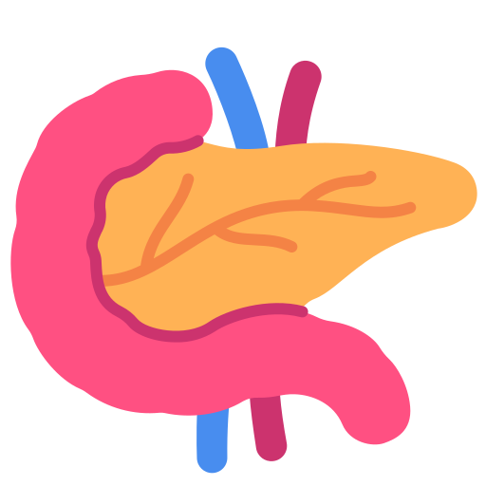
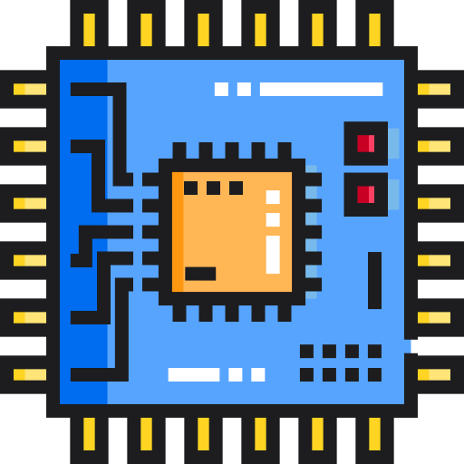
Artificial pancreas with Arduino
Niccolò Ciavarelli, Alessandro Mancini
Course of Electronics for Applied Physics, A. A. 2023/24
niccolo.ciavarelli@studio.unibo.it
alessandro.mancini16@studio.unibo.it

Slide 2
Presentation outline
Brief description of the pancreas;
the importance of an artificial pancreas for people with diabetes;
electrical circuit implemented with Arduino;
preliminary measurement and offset problem;
data collection and analysis;
conclusions of the project

Slide 3

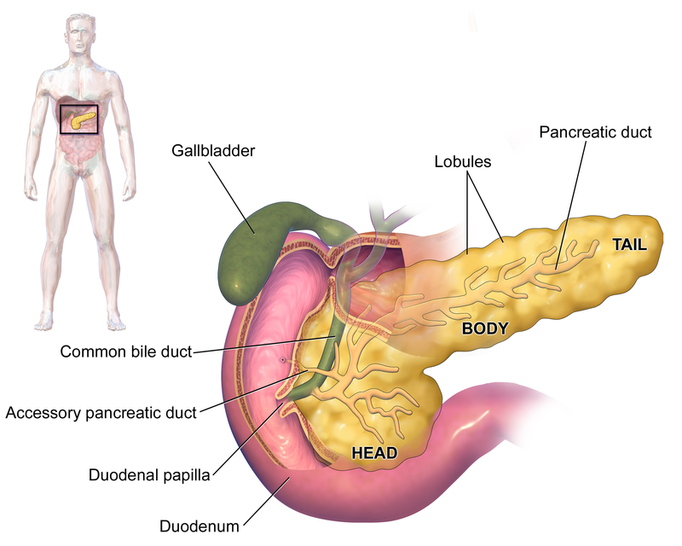
The pancreas
It is an organ which, among the other functions, regulates the concentration of glucose in blood through two hormones:
insulin: peptide hormone considered to be the main anabolic hormone of the body. It regulates the metabolism of carbohydrates, fats and protein by promoting the absorption of glucose from the blood into liver, fat and skeletal muscle cells.
glucagon: peptide hormone, produced by alpha cells of the pancreas. It raises the concentration of glucose and fatty acids in the bloodstream. Its effect is opposite to that of insulin.

Slide 4
Diabetes
Diabetes is a condition for which the human body is unable to self regulate the concentration of glucose in blood. If untreated it can lead to severe symptoms and problems related to hyperglycemia or hypoglycemia. Diabetes exists in two forms:
type 1: chronic autoimmune disease in which the immune system attacks the insulin-secreting beta cells of the pancreas. Insulin is needed to keep blood sugar levels within optimal ranges, and its lack can lead to high blood sugar. Type 1 diabetes can develop at any age but is most often diagnosed before age 40. For people living with type 1 diabetes, insulin injections are critical for survival
type 2: most common form of diabetes. The causes for high blood sugar in this form of diabetes are usually a combination of insulin resistance and impaired insulin secretion. Over time, pancreatic beta cells may become ”exhausted” and less functional. The management of type 2 diabetes involves a combination of lifestyle measures, medications if required and potentially insulin.

Slide 5
The importance of an artificial pancreas
People with diabetes need to continuously monitor the concentration of glucose in blood and assume insulin after meals.
Knowing how much insulin to assume is critical to maintain the glucose concentration in a safe range. This is why electronic systems called artificial pancreases exist. They come in different variants but usually have these 3 components:
continuous glucose monitor (cgm) that measures the glucose concentration every few minutes;
program which calculates how much insulin is needed;
insulin infusion pump.

Slide 6

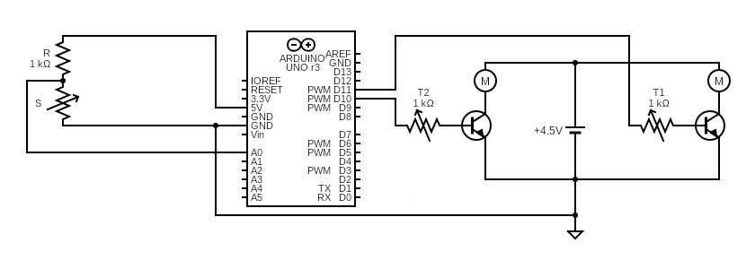
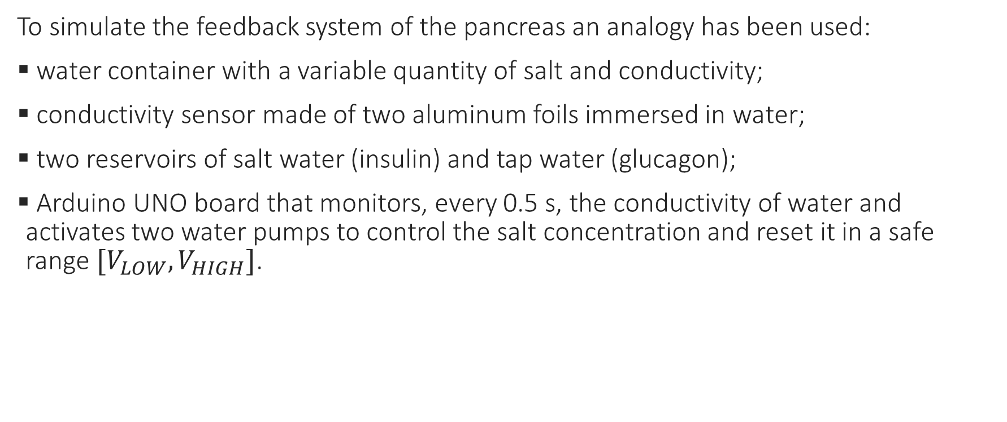
Devised circuit
To simulate the feedback system of the pancreas an analogy has been used:
water container with a variable quantity of salt and conductivity;
conductivity sensor made of two aluminum foils immersed in water;
two reservoirs of salt water (insulin) and tap water (glucagon);
Arduino UNO board that monitors, every 0.5 s, the conductivity of water and activates two water pumps to control the salt concentration and reset it in a safe range $[V_{LOW}, V_{HIGH}]$.

Slide 7
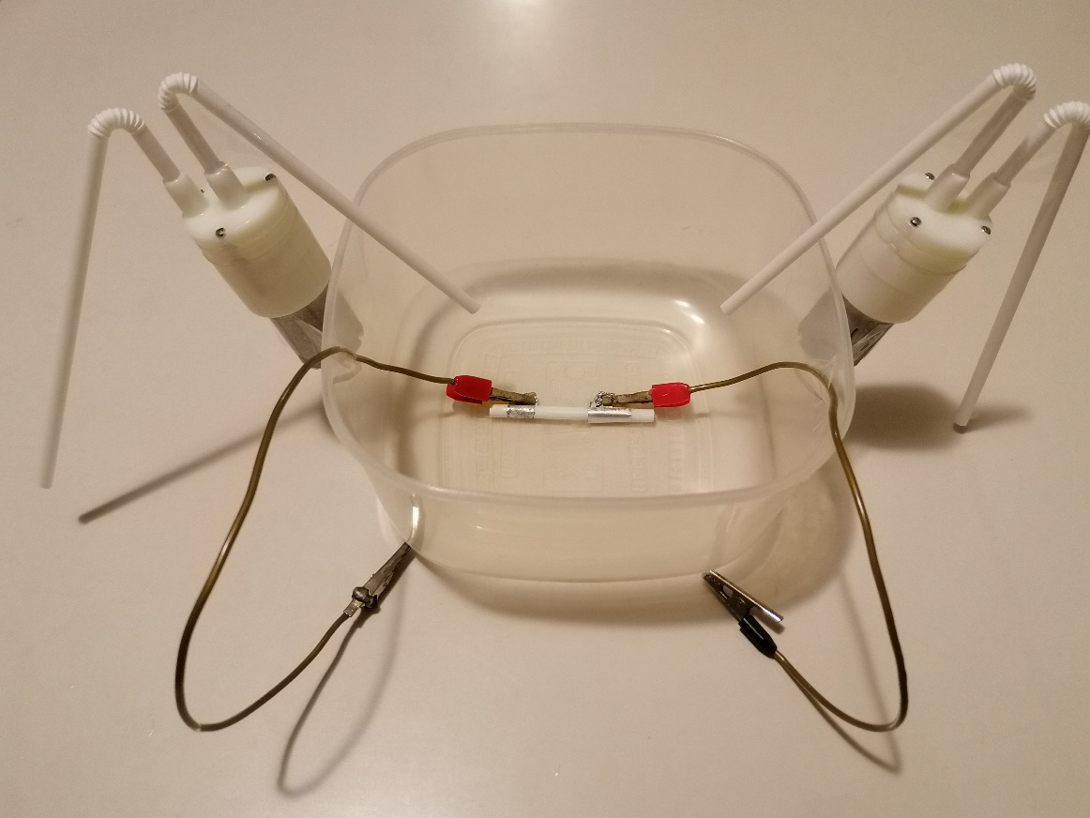
Materials used
Conductivity sensor;
two water pumps with ratings 3 V, 650 mA, 3-6 W;
external 4.5 V battery;
two 2n2222a NPN transistors;
two 1 kOhm potentiometers;
Arduino UNO board.

Slide 8
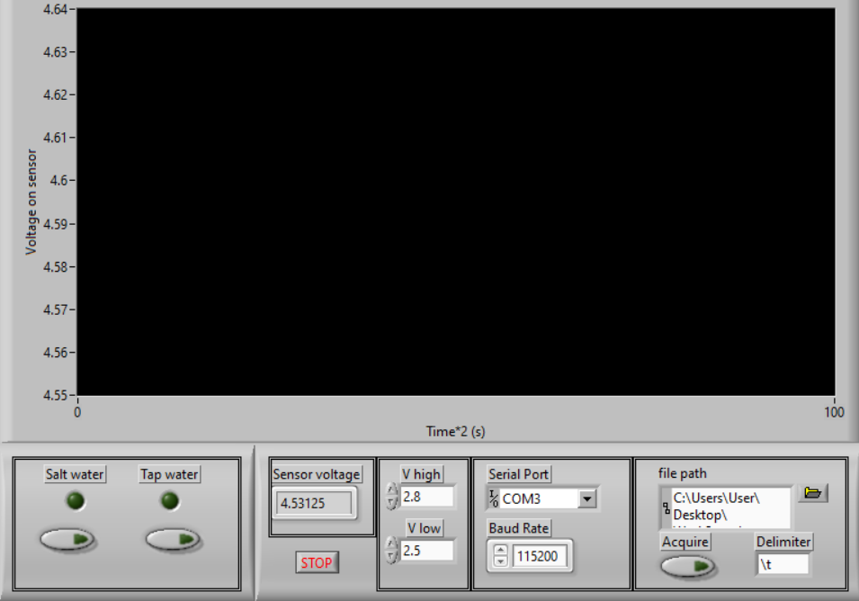
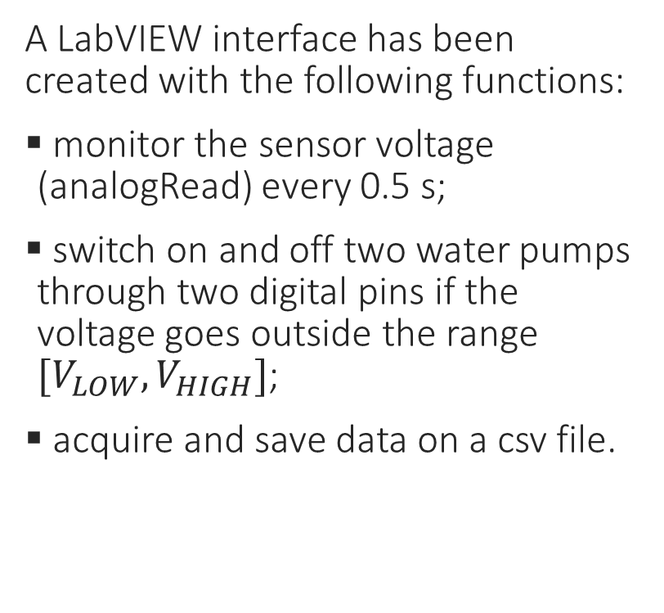
LabVIEW interface
A LabVIEW interface has been created with the following functions:
monitor the sensor voltage (analogRead) every 0.5 s;
switch on and off two water pumps through two digital pins if the voltage goes outside the range $[V_{LOW}, V_{HIGH}]$;
acquire and save data on a csv file.

Slide 9

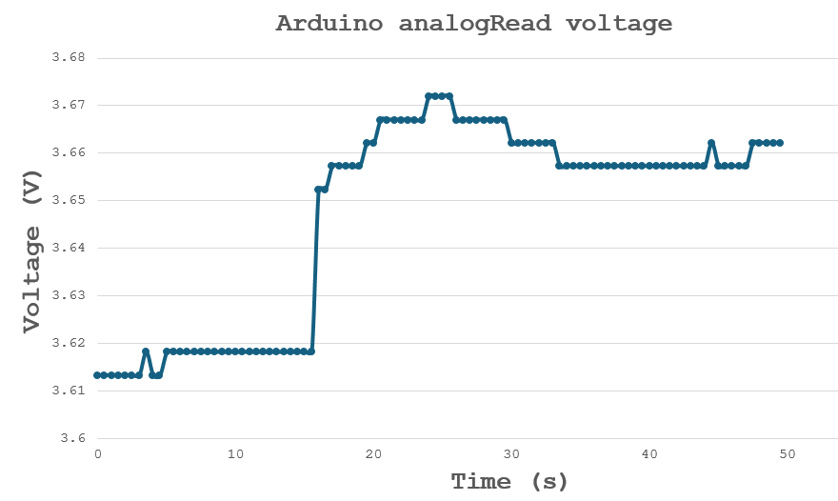
Preliminary analysis and offset problem
The experiment has initially been run without pumps and a positive offset in the analogRead has been evidenced when the digital pins output a current on the transistors’ bases.
This offset, initially ~ 50 mV, has been reduced to ~ 20-30 mV with the use of potentiometers to create a resistance on the transistors’ bases, but it could not be removed.

Slide 10

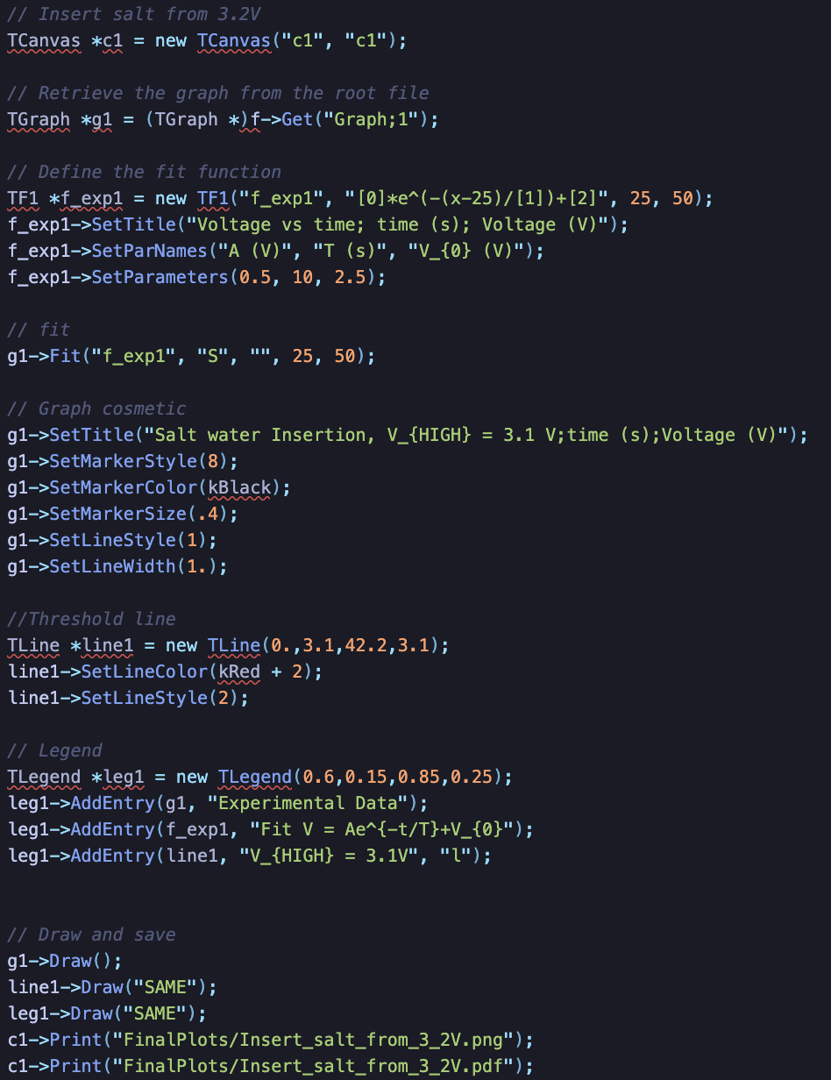
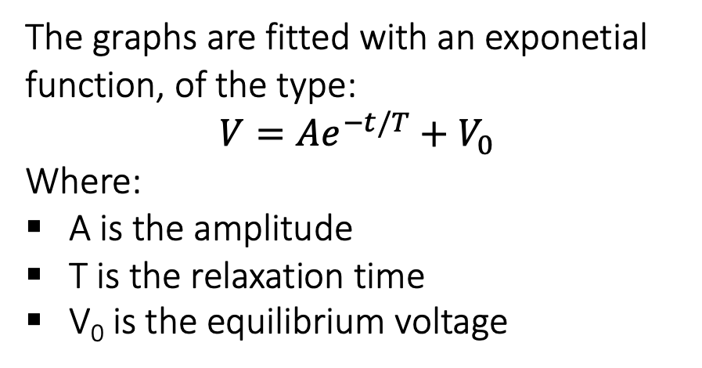
Software analysis
The framework used is ROOT CERN
The code developed is in C++ and aims to:
create readable plots
fitting the graphs
The graphs are fitted with an exponetial function, of the type:
$$V=Ae^{−t/T}+V_{0}$$
Where:
A is the amplitude
T is the relaxation time
V₀ is the equilibrium voltage
Note: through QuickPlot code you can make plots with thresholds lines
Part of the analysis code

Slide 11

Data collection and analysis
Some data concerning some particular situations have been collected
Salt water insertion
Tap water insertion

Slide 12
Salt water insertion 1
Insulin insertion situation:
glucose (voltage) over the limit
Threshold V_{HIGH} = 3.1 V
Relax. Time T = 32.88 s
Eq. Tension 2.865 V

Slide 13
Salt water insertion 2
Insulin insertion situation:
glucose (voltage) over the limit
Threshold V_{HIGH} = 3 V
Relax. Time T = 11.7 s
Eq. Tension 2.75 V

Slide 14
Salt water insertion 3
Insulin insertion after a meal situation:
glucose (voltage) raise from the safe area to over the limit.
Threshold V_{HIGH} = 2.86 V

Slide 15
Tap water insertion
Threshold V_{LOW} = 2.1 V
Relax. Time T = 7.41 s
Eq. Tension 2.098 V (under the threshold, so the system will continue to add tap water)
Glucagon insertion situation:
glucose (voltage) drop under the limit.

Slide 16
Full feedback plot
V_{HIGH} = 2.0 V
V_{LOW} = 1.7 V
Safe region

Slide 17

Zoom of the full feedback plot in the safe region
V_{HIGH} = 2.0 V
V_{LOW} = 1.7 V

Slide 18
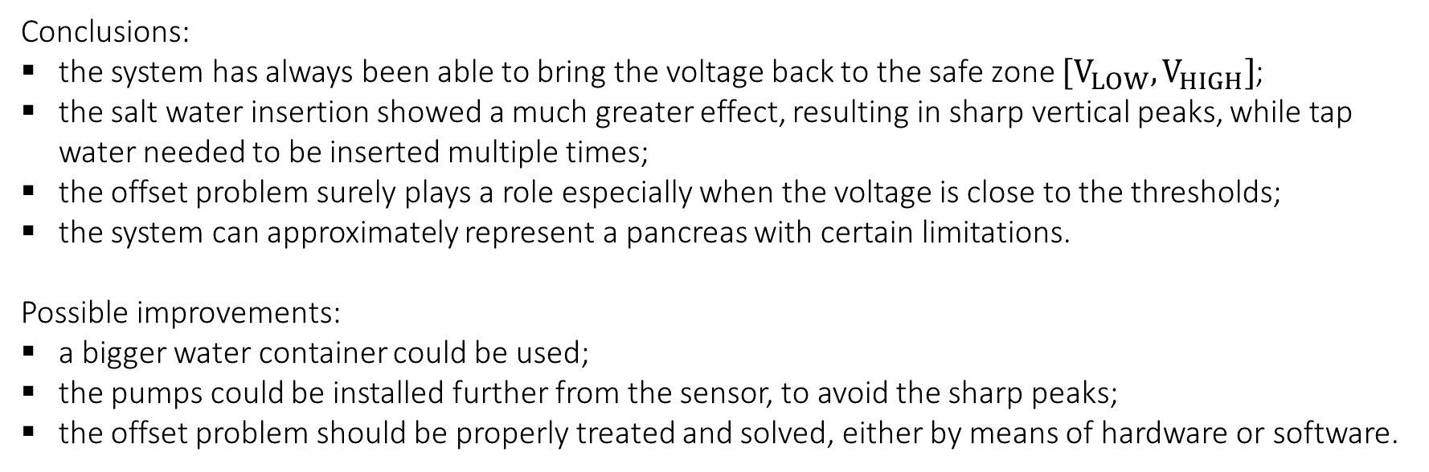
Conclusions and possible improvements
Conclusions:
the system has always been able to bring the voltage back to the safe zone $[V_{LOW},V_{HIGH}]$;
the salt water insertion showed a much greater effect, resulting in sharp vertical peaks, while tap water needed to be inserted multiple times;
the offset problem surely plays a role especially when the voltage is close to the thresholds;
the system can approximately represent a pancreas with certain limitations.
Possible improvements:
a bigger water container could be used;
the pumps could be installed further from the sensor, to avoid the sharp peaks;
the offset problem should be properly treated and solved, either by means of hardware or software.

Slide 19
END
Thanks for watching

