Slide 1



Allstate Claims severity
By
Chinedum Ibeabuchi

Slide 2




Problem
Claims Time
Client Satisfaction
Goal
Predict cost/Severity of a claim (“Loss”)

Slide 3



A leading Personal Insurer in the U.S. Founded in 1931 Many products: auto, home, live, etc. Headquarters: Northbrook, IL

Slide 4
DATA

Slide 5
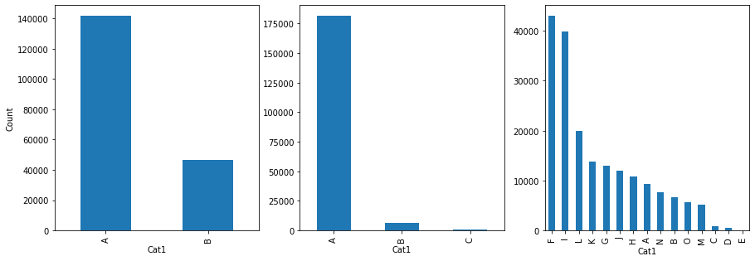
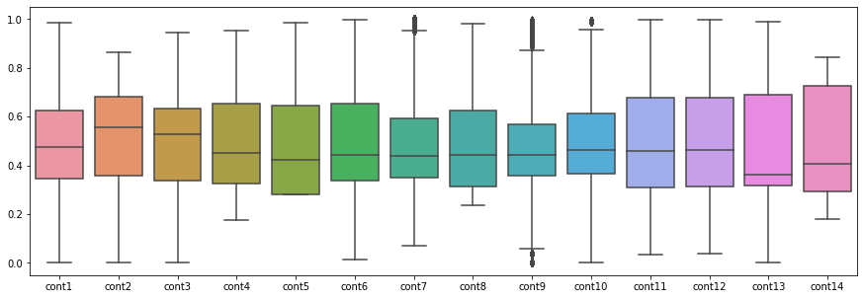
Kaggle De-identified 188318 records 116 Categorical Features 14 Continuous Feature Continuous Target “Loss”

Slide 6
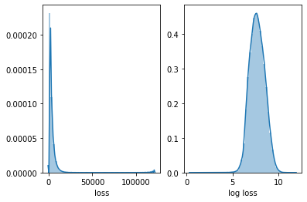

Slide 7
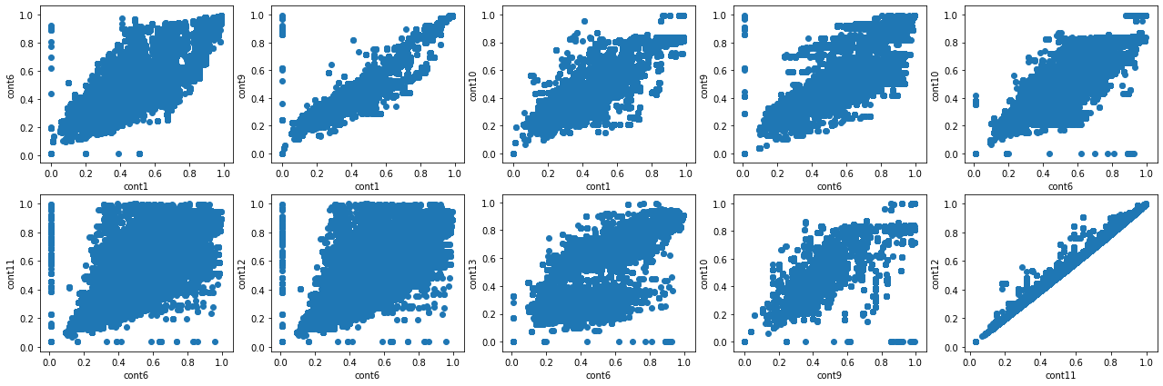

Slide 8
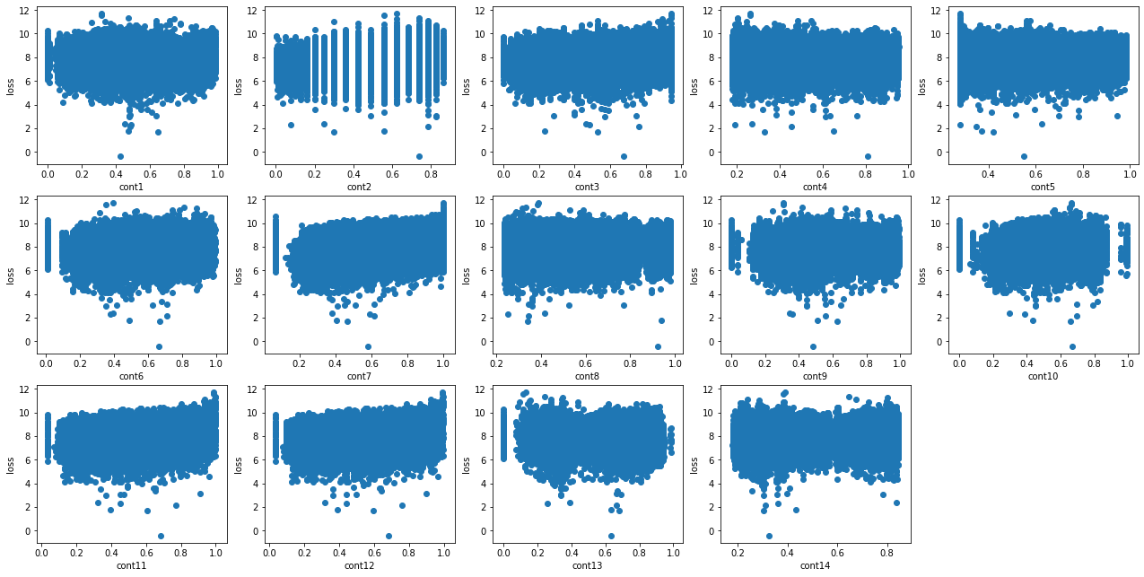

Slide 9
Features of Interest
Cat110
Contains 51 unique answer options
Cont2
Continuous yet takes on only 33 distinct values
Cont11 and Cont12
Very high correlation

Slide 10
Approach

Slide 11
Model | MAE Train | MAE Test
Linear Regression | 1231.55 | N/A
Ridge Regression | 1236.55 | 1258.93
Lasso Regression | 1810.30 | 1807.93
Decision Tree | 1240.38 | 1298.71
Random Forest | 491.62 | 1209.42
XGBoost | 1083.91 | 1170.48
# of Features | MAE Training | MAE Test
1185 | 1087.21 | 1175.86
125 | 1094.72 | 1185.92
Parameter | Values
max_depth | 5, 6, 7
gamma | 1, 2, 3
eta | 0.25, 0.3, 0.35
alpha | 0, 0.2, 0.4

Slide 12
Model

Slide 13

 | Final Model
Algorithm | XGBoost
Booster | gbtree
Max Depth | 7
Alpha | 0
Gamma | 2
Eta | 0.25
 | MAE
Train | 1099.12
Test | 1185.02

Slide 14
conclusion

Slide 15

RESULTS
NOT VERY ACCURATE FOR INDIVIDUAL RECORDS
FUTURE INVESTIGATION
WHAT IS THE TRADE OFF OF TREATING HIGHER VALUES AS OUTLIERS?
BETTER RESULTS WITH A DIFFERENT MEASURE OF ACCURACY?

