Slide 1

Mortgage Delinquency
By Chinedum Ibeabuchi

Slide 2
2.2% of mortgages nation wide were 30 – 89 days delinquent in January 2020
Problem
Potential to default
Potential fraud
Hurts both parties
Goal
To create a model, with the assistance of machine learning, that will predict which borrowers will be delinquent in early mortgage payments
https://www.consumerfinance.gov/data-research/mortgage-performance-trends/mortgages-30-89-days-delinquent/

Slide 3
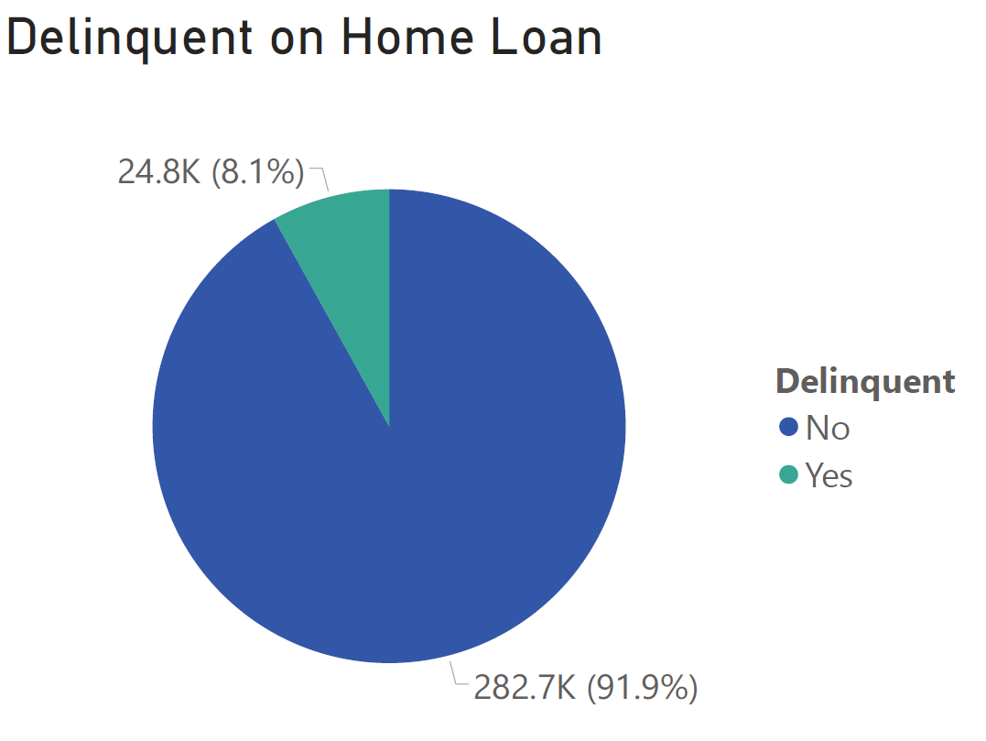
Data
Kaggle
307,511 Application Records
120 Features
Most records not Delinquent

Slide 4
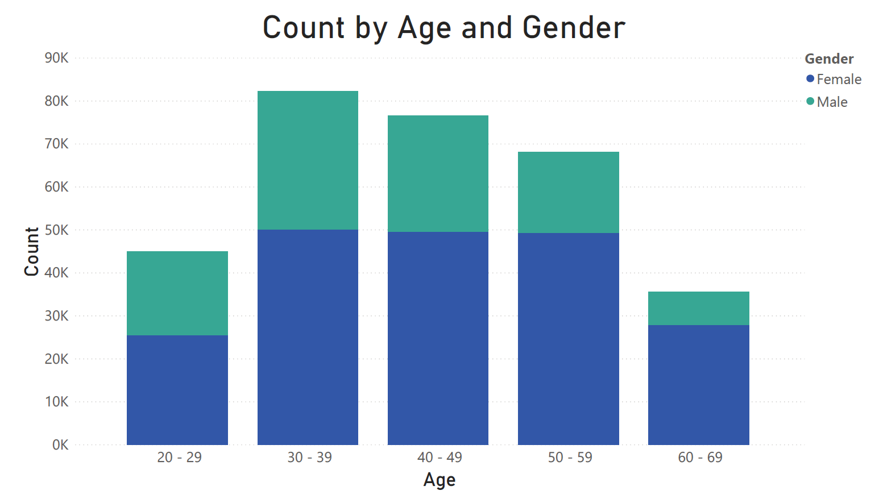

Slide 5
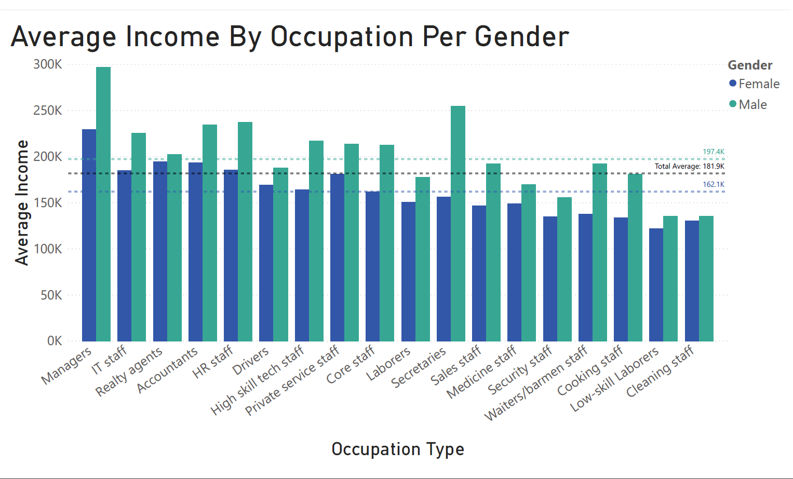

Slide 6
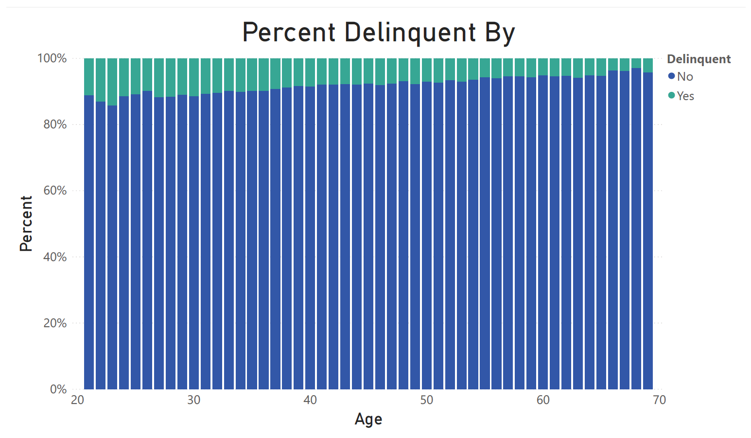

Slide 7
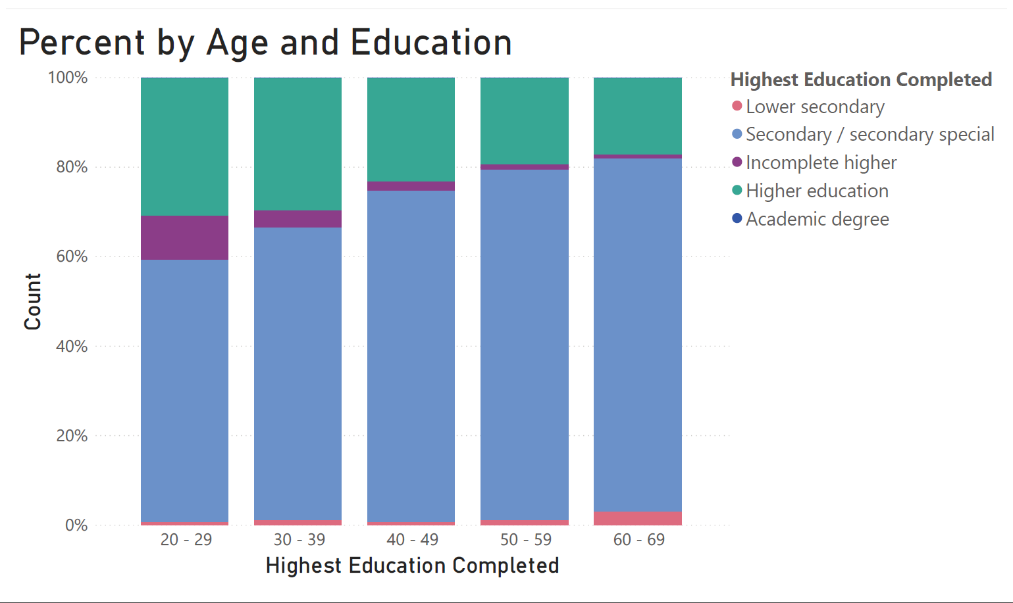

Slide 8
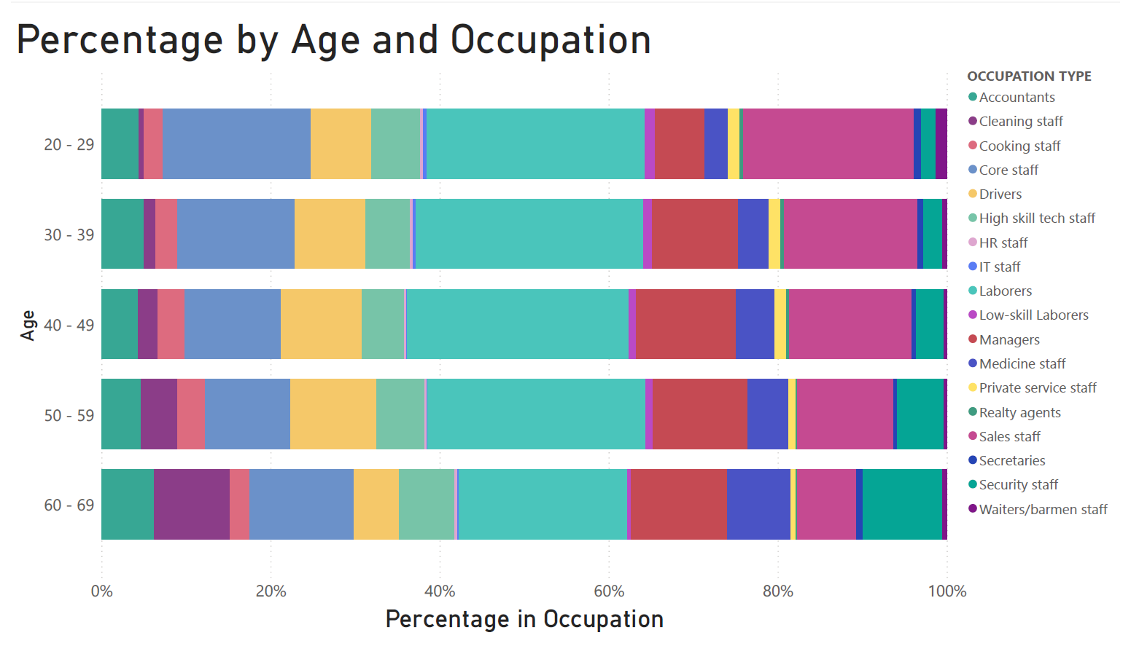

Slide 9
Important Features
Age
Length of Employment
Rating of the region where the client lives (1 – 3)
Income Type (working/pensioner)
Gender
Highest Education (Higher Education)
How many people social circle were 30/60 days past due

Slide 10
Approach
Classifier Algorithm | ROC AUC (Test)
Ridge | 0.73
Stochastic Gradient Descent | 0.64
Gaussian Naïve Bayes | 0.69
Decision Tree | 0.54
AdaBoost | 0.74
Random Forest | 0.71
XGBoost | 0.74
Data Prep
Default parameters
Top three
SMOTE/ADASYN

Slide 11
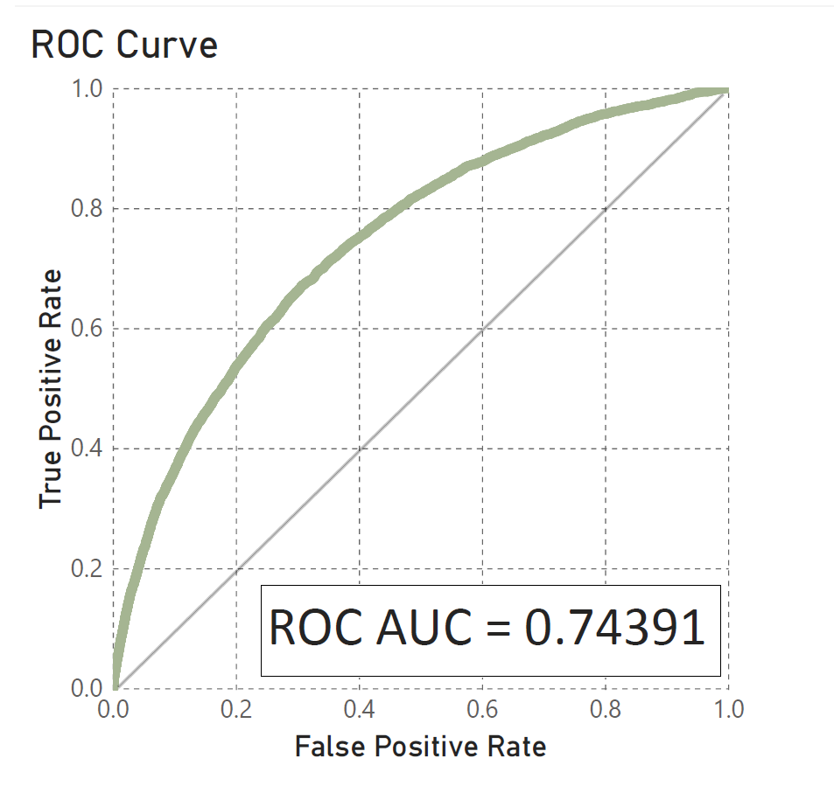
Summary
XGBoost Classifier
Test/Train ROC AUCs similar
No improvement from SMOTE/ADASYN

Slide 12

Discussion
Fraudulent/Hand-hold
Engineer additional features
Penalized Models
Other scores (Recall)
SMOTE/ADASYN

Slide 13
Questions?

