Slide 1
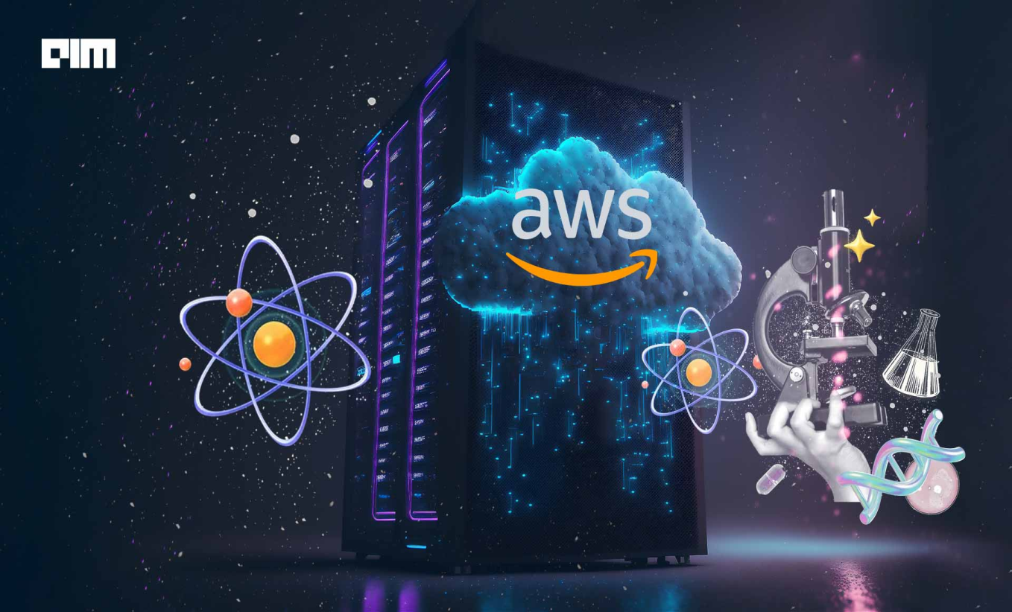
Amazon Web Services

Slide 2
Contents
Overview of AWS
Why so many regions ?
Why multiple Azs ?
AWS Services
Regions and Availability Zones (AZ)
Virtual Machine

Slide 3
Overview of AWS
Amazon Web Services (AWS) is a comprehensive cloud computing platform offered by Amazon.com.
It provides a wide range of cloud services, including computing power, storage, databases, networking, analytics, machine learning, artificial intelligence, Internet of Things (IoT), security, and more.
AWS operates a global infrastructure that spans multiple regions and availability zones. ∙ Each region consists of multiple data centers that are geographically dispersed. ∙ This infrastructure allows customers to deploy applications in various locations around the world for improved performance, resilience, and data locality.
Region refers to a geographical location where AWS data centers are located. Each AWS region is a separate and independent geographic area with multiple Availability Zones (AZs) within it.
example: Asia pacific (Mumbai), US East (N. Virginia), Europe (London), Asia Pacific (Sydney)
Data center is a physical location where organizations store, manage, and process large amounts of data and information.
An Availability Zone (AZ) is an isolated data center within an AWS region.
example: Asia Pacific (Mumbai) Region-----ap-south-1a,ap-south1b,ap-south-1c

Slide 4
Why so many regions ?
Latency: AWS has regions globally to reduce latency, which is the delay before a transfer of data begins following an instruction for its transfer. Closer data centers mean faster data transfer for users.
Fault Tolerance and High Availability: Regions increase fault tolerance (the ability to operate even when there are failures) and high availability (ensuring an operational continuity). If one region fails, another can take over, keeping services running.
Compliance and Data Sovereignty: AWS offers multiple regions to meet compliance (following laws and regulations) and data sovereignty (storing data within a country's borders) requirements. Users can choose regions based on legal and regulatory needs.
Scalability: Having multiple regions allows AWS to support scalability, meaning it can handle increasing workloads by adding resources in these regions.
Service Optimization: Different regions can offer localized services based on regional demand, optimizing service delivery and performance.

Slide 5
Why multiple Azs ?
Redundancy: Availability Zones provide redundancy. This means if one AZ experiences a problem (like a power outage), the others keep working, ensuring that services remain online without interruption.
Fault Tolerance: This is about making sure services can keep running even when there are failures. By spreading resources across different AZs, AWS makes sure that a single event (like a natural disaster) doesn't affect all resources.
Low Latency Networking: AZs are connected through low latency links. This ensures that communication between AZs is very fast, allowing for quick data transfer and synchronization, which is crucial for many applications to work efficiently.
Scalability: With multiple AZs, AWS users can easily scale their applications up or down. This flexibility helps in managing traffic spikes or reducing capacity during low usage times without affecting performance.
Data Durability and Backup: By storing data across multiple AZs, AWS ensures high data durability. This means that data is safely backed up and can be recovered in case of loss in one AZ.

Slide 6
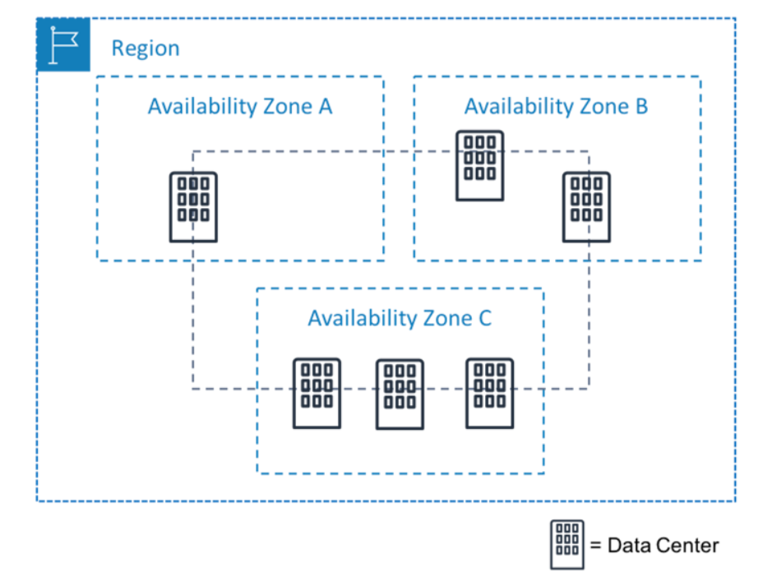
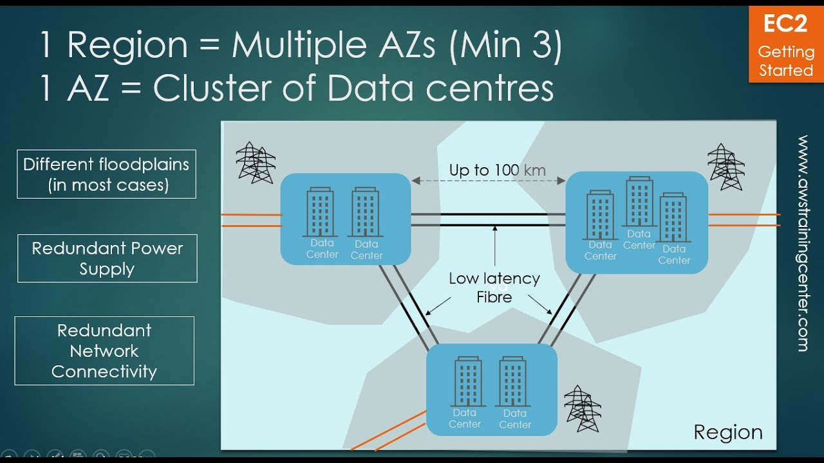
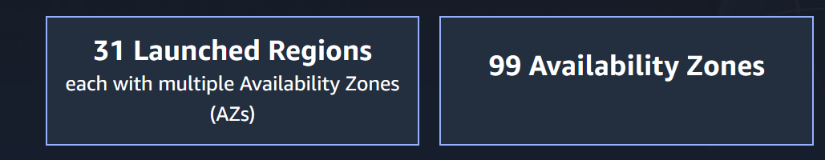
Regions and AZ

Slide 7
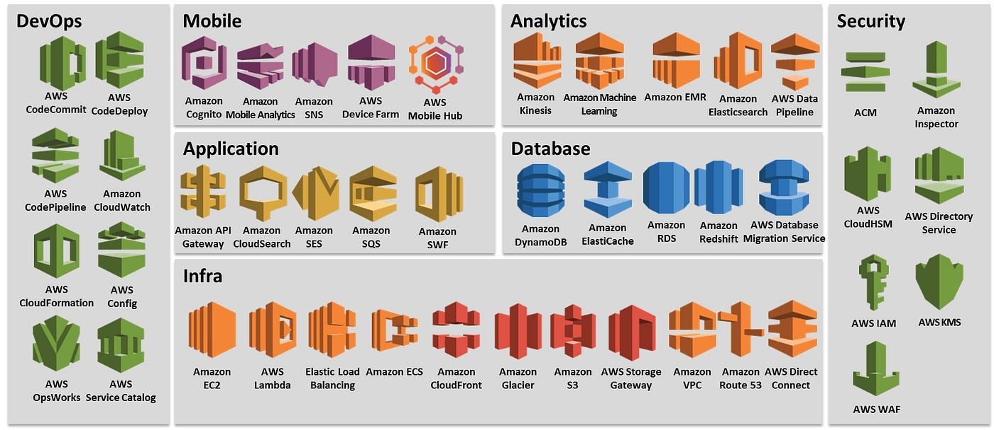
AWS Services

Slide 8
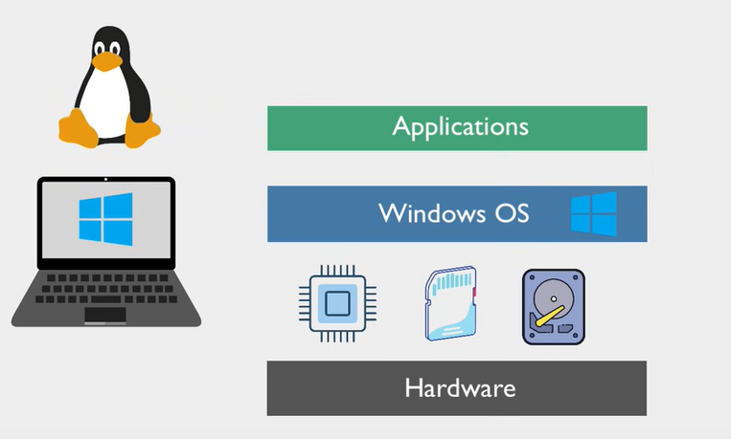
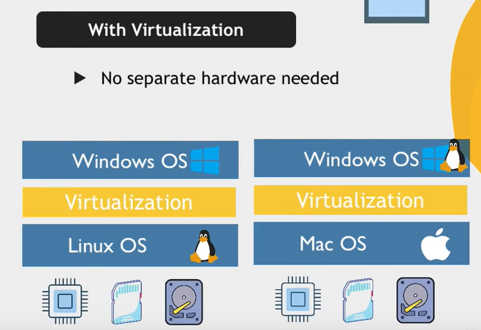
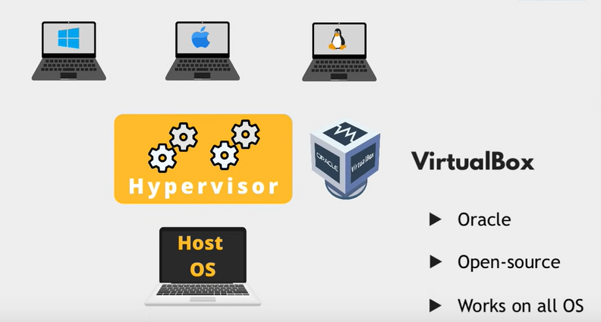
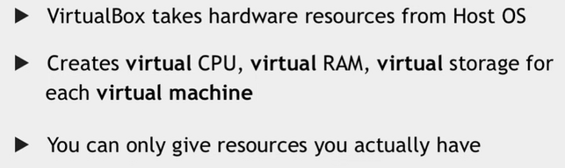
Virtualization

Slide 9
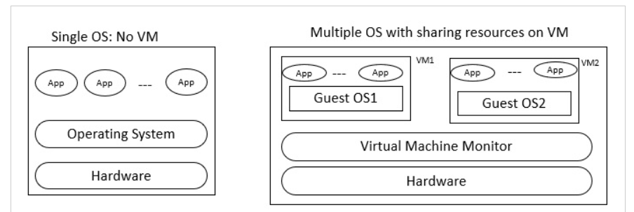
Virtual Machine
A virtual machine (VM) is a software emulation of a physical computer system.
It allows you to run multiple operating systems or instances of an operating system on a single physical machine, known as the host machine.
Each virtual machine operates independently and has its own virtual hardware, including processors, memory, storage, and network interfaces.
Each virtual machine can run its own operating system and applications, just like a physical computer.

