Slide 1

Oracle Data Integrator
ELT Tool

Slide 2

Objectives
About ODI 11g
ODI Process
ODI Components
ETL Vs ELT

Slide 3
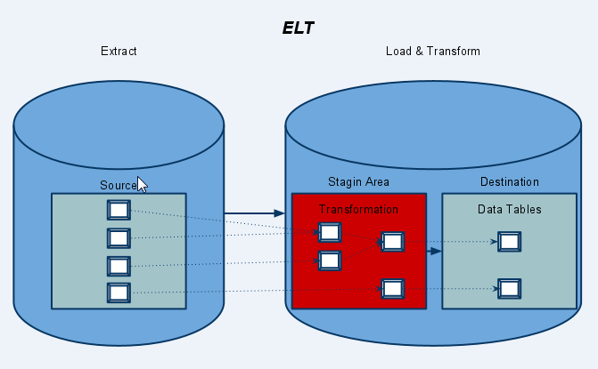
ODI 12C
Oracle Data Integrator (ODI) is an Extract, load and transform (ELT) (in contrast with the ETL common approach) tool produced by Oracle.
Improves performance and reduces data integration costs
High-performance bulk data movement and data transformation
Service-oriented data integration and management
Heterogeneous platform support for enterprise data integration
E-LT architecture for improved performance and lower TCO

Slide 4
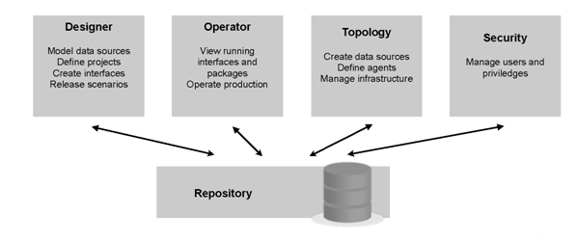
ODI Components
ODI Studio( provides four Navigators for managing the different aspects and steps of an ODI integration project)
Design Navigator
Operator Navigator
Topology Navigator
Security Navigator
ODI Agents(used for executing mappings and packages)
ODI Console(web-based console for running published packages)
ODI Repositories(contain definitions of models, interfaces and other objects)

Slide 5
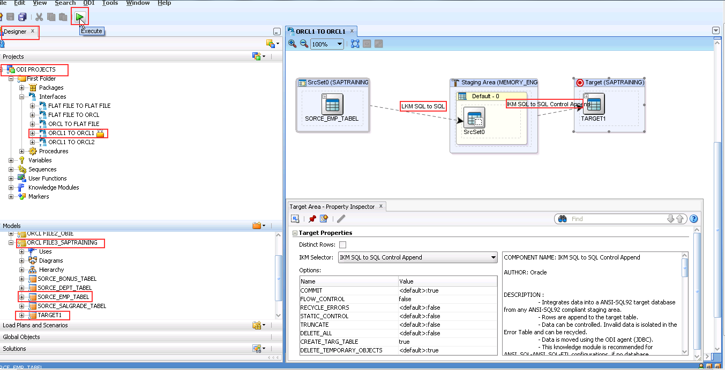
Designer Navigator
Used for designing ODI data project, Transformation and
mapping objects
Create data stores and import (reverse) metadata on
data objects from source systems
Define variables, sequences, functions
Interfaces and packages
Use knowledge modules to move data from source to target

Slide 6
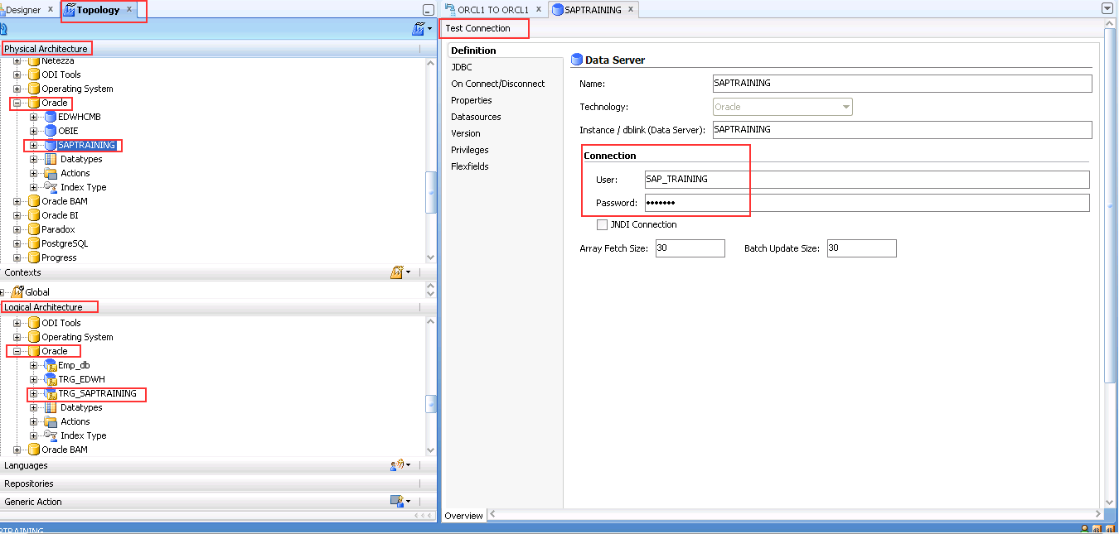
Topology Navigator
Defines the physical and logical architecture
for the ODI system
Connections through to databases, OLAP servers,
applications, files etc.
Logical aliases for these connections
Contexts(environments)
Stand alone and JEE agents

Slide 7
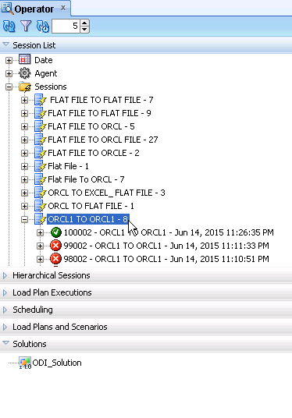
Operator Navigator
Monitor the execution of interfaces, static controls and packages
Import and run compiled packages
Drill-into the actual code executed at each KM step
View errors, warnings and execution metrics

Slide 8
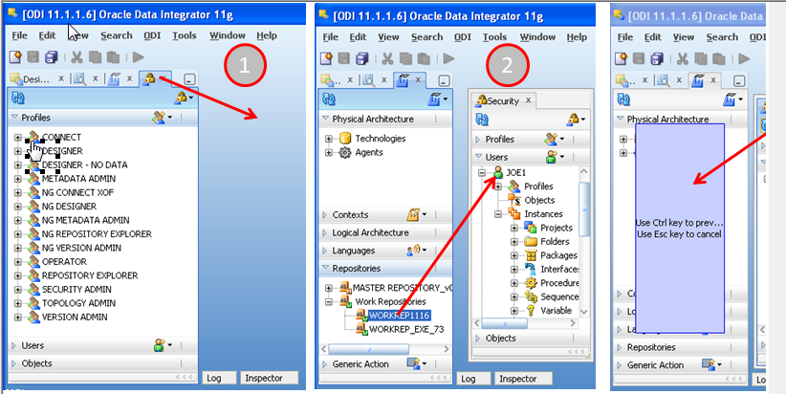
Security Navigator
It is tool for managing the security of the Oracle Data Integrator.
Using Security Navigator we can create users
and profiles and assign privileges.
It is used to create profiles and provide
rights to users to access ODI objects and features.
This navigator is usually used by security administrators.

Slide 9
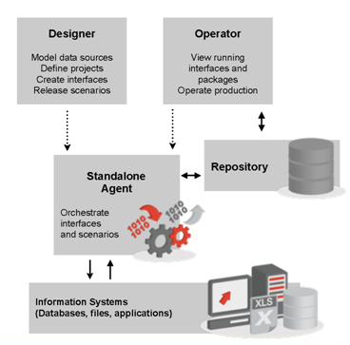
ODI Agents
Java process (applications) that are used for executing interfaces and packages
ODI Studio comes with an embedded agent, or you can install them stand alone on one or more servers
ODI 11g introduces option to install into weblogic server

Slide 10
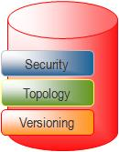
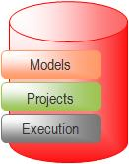
ODI Repositories
The ODI Repository is composed of one Master Repository and several Work Repositories. Objects developed or configured through the user interfaces are stored in one of these repository types.
Master repository
platform
Security information including users, profiles and rights for the ODI
platform
Topology information including technologies, server definitions, schemas, contexts, languages and so forth.
Models, including schema definition, data stores structures and
metadata, fields and columns definitions, data quality constraints, cross references, data lineage and so forth
Projects, including business rules, packages, procedures, folders,
Knowledge Modules, variables and so forth
Scenario execution, including scenarios, scheduling information and logs
Work Repository

Slide 11
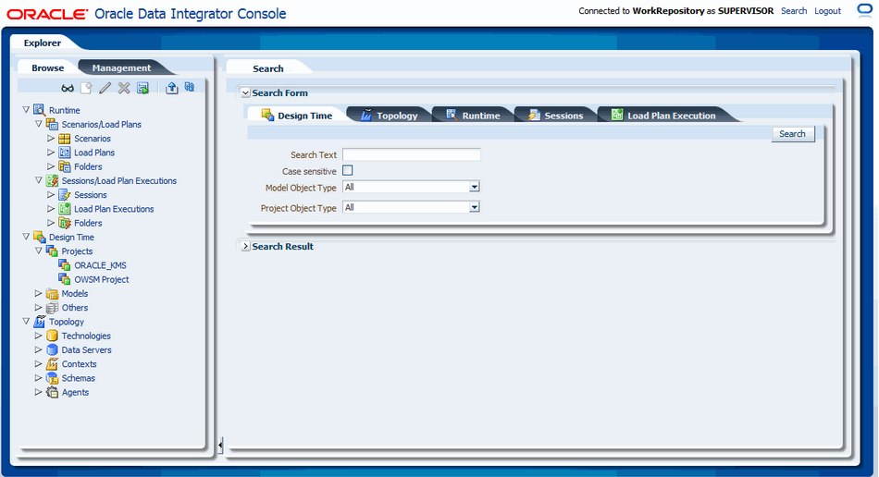
ODI Console
Oracle Data Integrator Console is a web based User Interface which allows Business Users to read the repository.
Administrators use Oracle Data Integrator Console to create and import repositories and to configure the Topology (data servers, schemas)
To manage scenarios and Load Plans, monitor sessions and Load Plan runs, and manage the content of the error tables generated by Oracle Data Integrator.

Slide 12
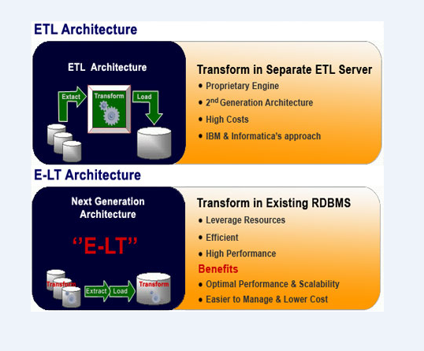
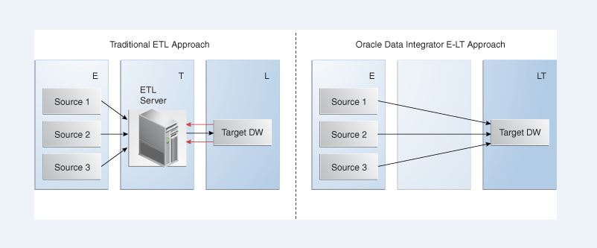
ETL Vs ELT

Slide 13

ODI Architecture
Graphical Modules
Designer
Reverse-Engineer
Develop Projects
Release Scenarios
Operator
Operate production
Monitor sessions
Topology Manager
Define the infrastructure of the IS
Security Manager
Manage user privileges
Repository
Notes:
The four ODI GUIs – Designer, Operator, Topology Manager and Security Manager, are based on Java. They can be installed on any platform that supports Java Virtual Machine 1.4, including Windows, Linux, HP-UX, Solaris, pSeries and so on.
Designer is the GUI for defining metadata, and rules for transformation and data quality. It uses these to generate scenarios for production, and is where all project development takes place. It is the core module for developers and metadata administrators.
Operator is used to manage and monitor ODI in production. It is designed for production operators and shows the execution logs with errors counts, the number of rows processed, execution statistics etc. At design time, developers use Operator for debugging purposes.
Topology Manager manages the physical and logical architecture of the infrastructure. Servers, schemas and agents are registered here in the ODI Master Repository. This module is usually used by the administrators of the infrastructure.
Security Manager manages users and their privileges in ODI. It can be used to give profiles and users access rights to ODI objects and features. This module is usually used by security administrators.
All ODI modules store their information in the centralized ODI repository.

Slide 14
Metadata Navigator
Any Web Browser
Browse metadata lineage
Operate production
Repository
Any RDBMS
Scheduler Agent
Handles schedules
Orchestrate sessions
Metadata Navigator
Web access to the repository
Submit Executions
Java - Any Platform
Return Code
Execute Jobs
J2EE Application Server
Information System
Notes:
Metadata Navigator is a Java J2EE application that provides web access to ODI repositories. It allows the users to navigate projects, models, logs, and so on. By default, it is installed on Jakarta Tomcat Application Server.
Business users, developers, operators and administrators use their web browser to access Metadata Navigator. Via its comprehensive web interface, they can see flow maps, trace the source of all data and even drill down to the field level to understand the transformations that affected the data.
It is also possible to trigger and monitor processing jobs from a web browser through Metadata Navigator.

Slide 15
Components: A Global View
Designer
Reverse-Engineer
Develop Projects
Release Scenarios
Operator
Operate production
Monitor sessions
Topology Manager
Define the IS infrastructure
Security Manager
Manage user privileges
Any Web Browser
Browse metadata lineage
Operate production
Java - Any Platform
Repository
Any RDBMS
Scheduler Agent
Handles schedules
Orchestrate sessions
Metadata Navigator
Web access to the repository
Java - Any Platform
J2EE Application Server
Information System
Repository Access
HTTP Connection
Execution Query
Notes:
By putting these pieces together, you now have a global view of the components that make up ODI: The graphical components, the repository, the Scheduler Agent, and finally Metadata Navigator.

Slide 16
ODI Repositories
Security
Topology
Versioning
Master Repository
Models
Projects
Execution
Execution
Work Repository
(Development)
Execution Repository
(Production)
Work Repositories are always attached to a Master Repository
Two type of Repositories: Master and Work
Notes:
The ODI Repository is composed of a Master Repository and several Work Repositories. These repositories are databases stored in relational database management systems.
All objects configured, developed or used by the ODI modules are stored in one of these two types of repository. The repositories are accessed in client-server mode by the various components of the ODI architecture.
There is usually only one Master Repository, which contains the following information:
Security information including users, profiles and access privileges for the ODI platform.
Topology information including technologies, definitions of servers and schemas, contexts and languages.
Old versions of objects.
The information contained in the Master Repository is maintained with Topology Manager and Security Manager. All modules access the master repository, as they all need the topology and security information stored there.
The Work Repository is where projects are worked on. Several work repositories may coexist in the same ODI installation. This is useful, for example, to maintain separate environments or to reflect a particular versioning life cycle.
A work repository stores information for:
Data models, which include the descriptions of schemas, datastore structures and metadata, fields and columns, data quality constraints, cross references, data lineage and so forth.
Projects, which include Descriptive Rules, packages, procedures, folders, knowledge modules, variables and so on.
Execution, which means scenarios, scheduling information and logs.
The contents of a work repository is managed with Designer and Operator. It is also accessed by the agent at run-time.
When a work repository is only used to store execution information (typically for production purposes), it is called an Execution Repository. Execution repositories are accessed at run time with Operator and also by agents.
An important rule to remember is that all work repositories are always attached to exactly one master repository.

Slide 17
Example of a Repository Set Up
Security
Create and archive versions of models, projects and scenarios
Topology
Import released and tested versions of scenarios for production
Versioning
Master Repository
Import released versions of models, projects and scenarios for testing
Models
Models
Execution
Projects
Projects
Execution
Execution
Execution Repository
(Production)
Work Repository
(Development)
Work Repository
(Test & QA)
Development – Test – Production Cycle
Notes:
This diagram gives an overview of a typical repository architecture where development, testing and production are carried out in separate work repositories. When the development team finishes working on certain projects, it releases them into the master repository. The testing team imports these released versions for testing in a separate work repository, thus allowing the development team to continue working on the next versions. When the test team successfully validates the developed items, the production team then exports executable versions (called scenarios) into the final production work repository.
This repository structure corresponds to a simple development-test-production cycle.

