Slide 1
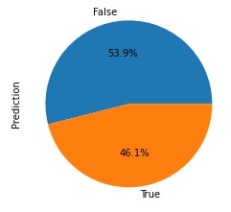
Last 2 Seasons

Slide 2
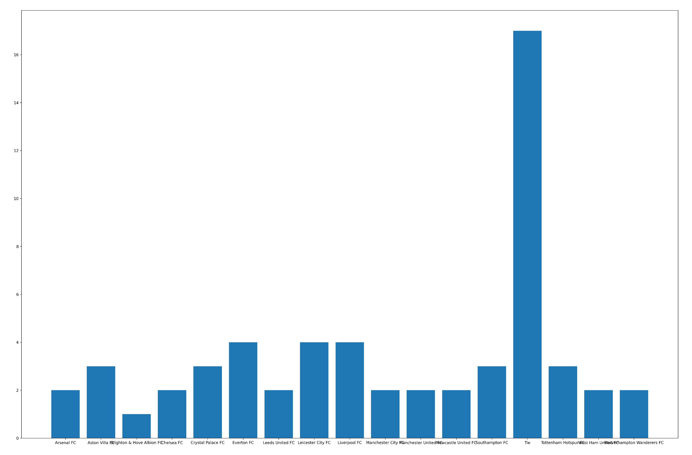
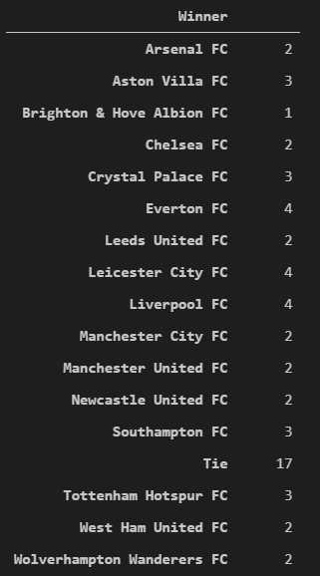
This Season

Slide 3
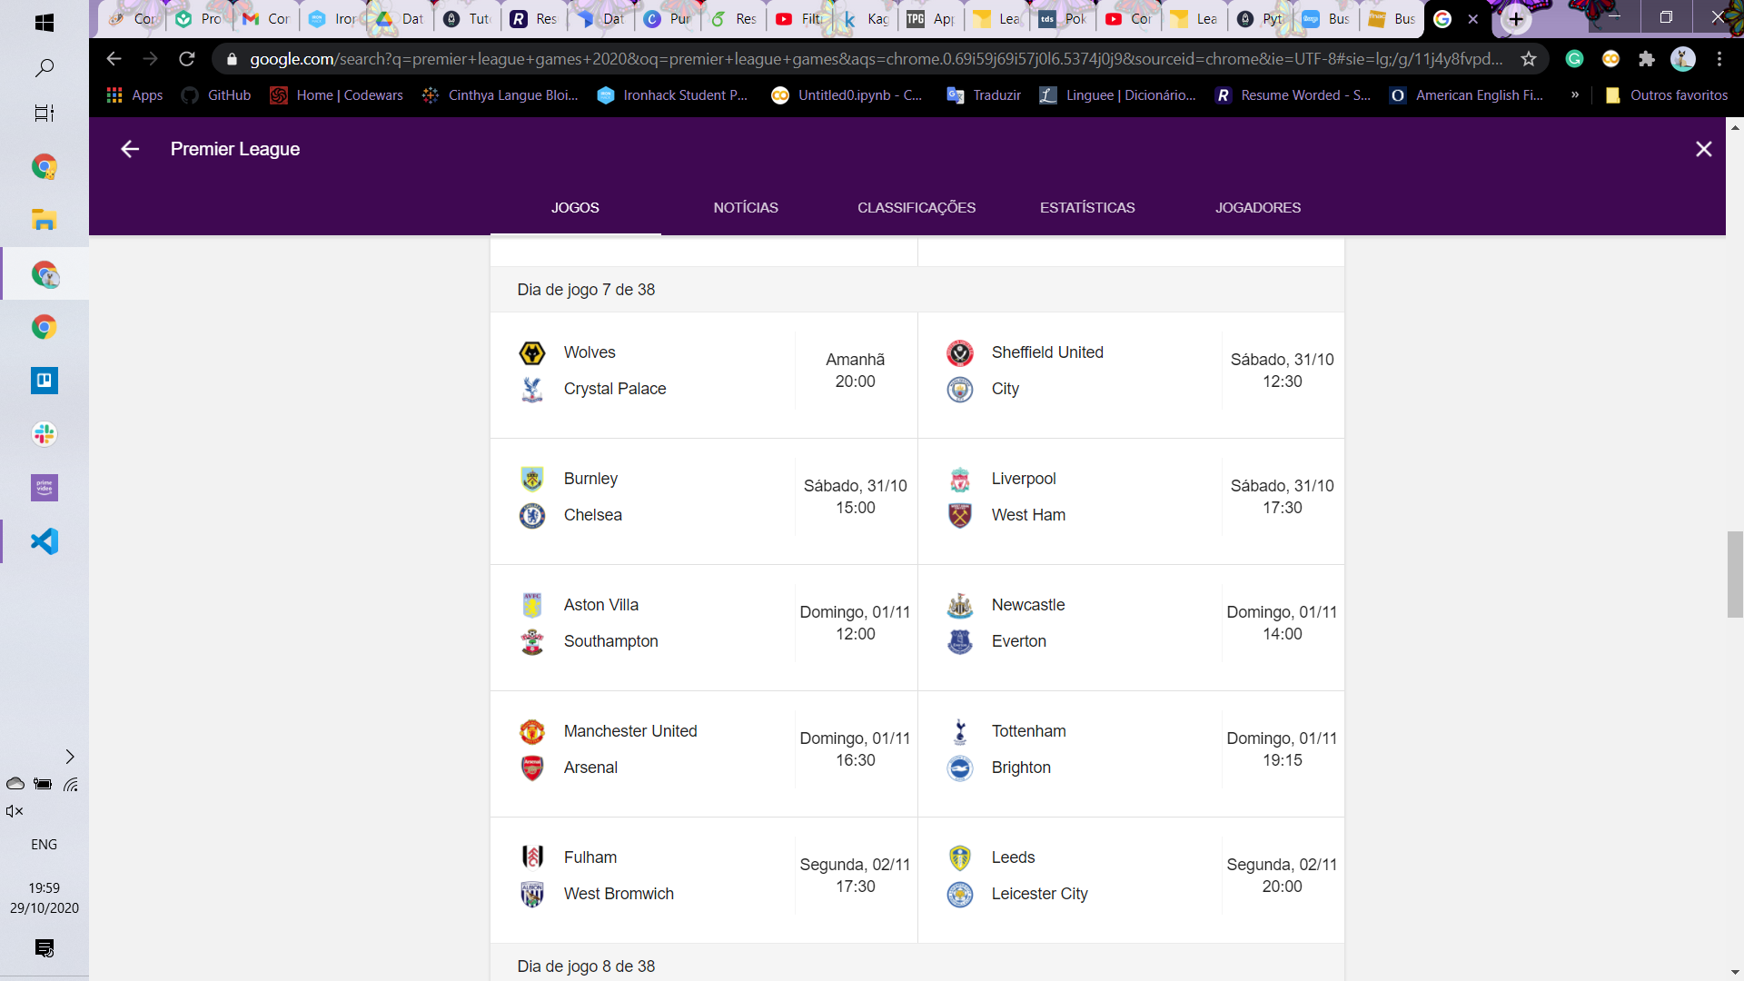
Next Weekend Matches

Slide 4
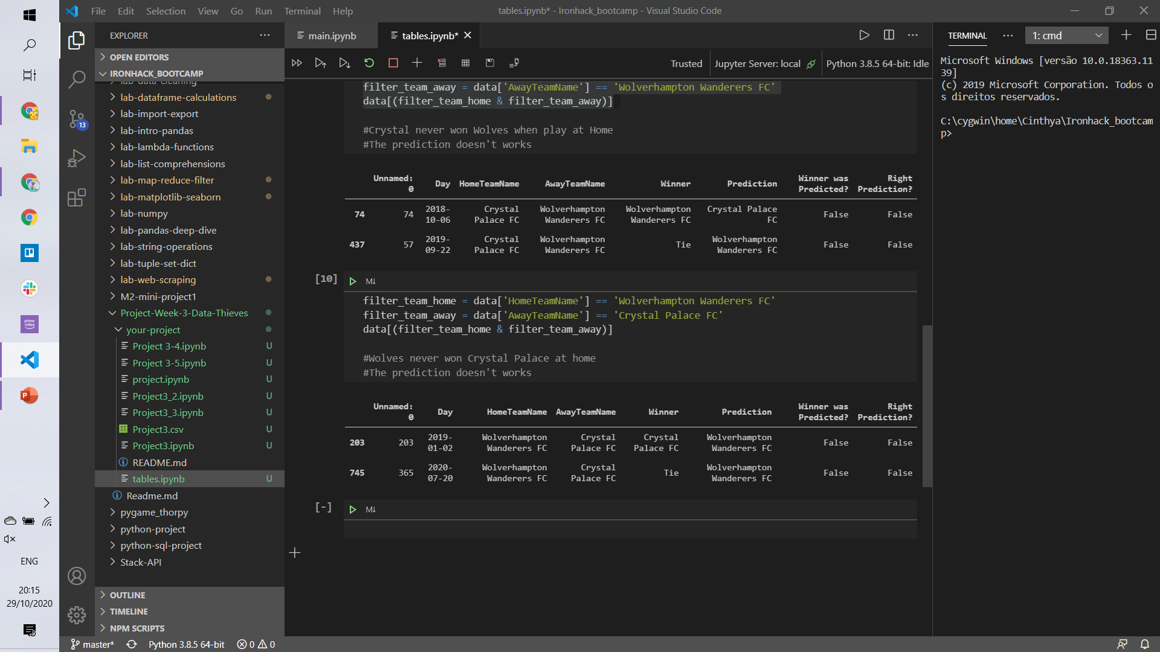
Either teams never won games when they were at Home, so bet in Crystal Palace because the Home game is Wolves
The prediction doesn’t work… So if the prediction for the next game is Crystal, bet on Wolves

Slide 5
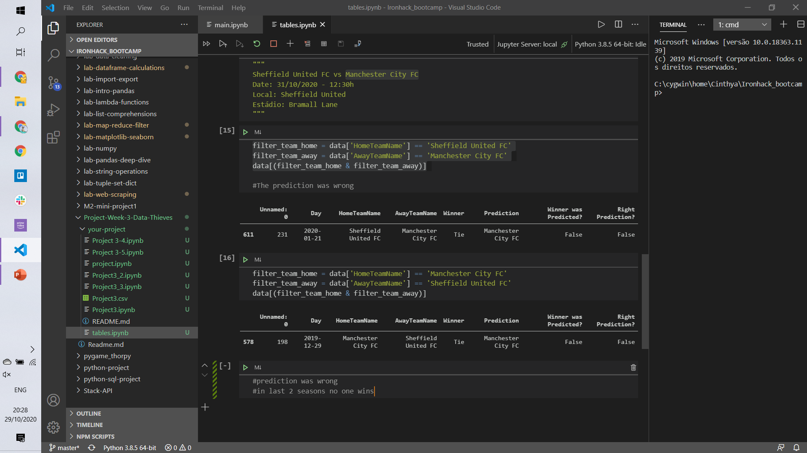
Bet on Tie

Slide 6
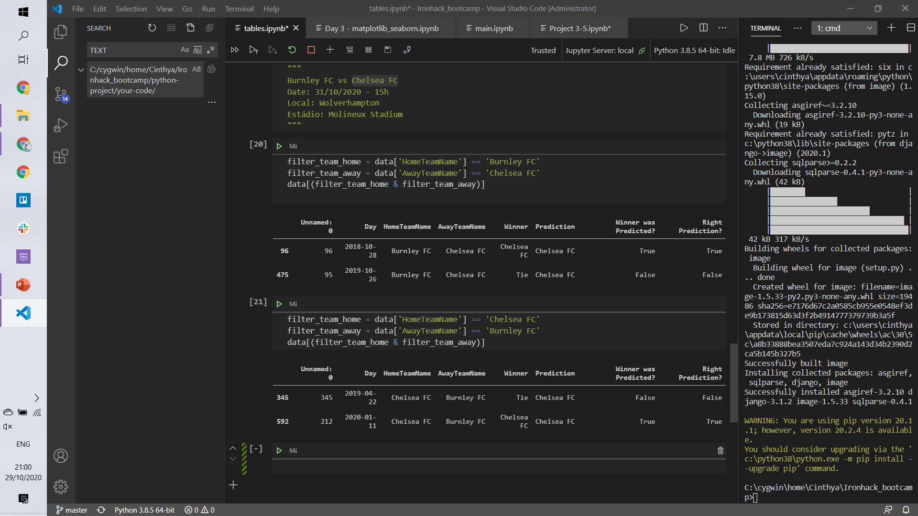
Bet on Chelsea

Slide 7
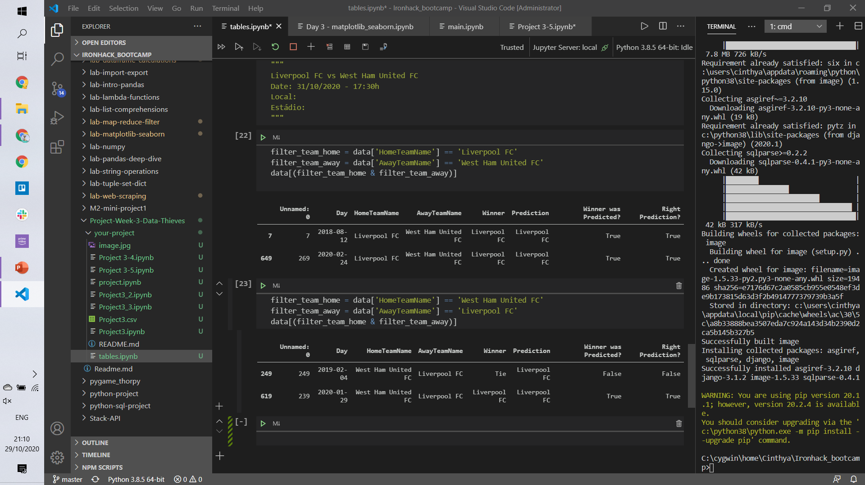
Bet on Liverpool

Slide 8
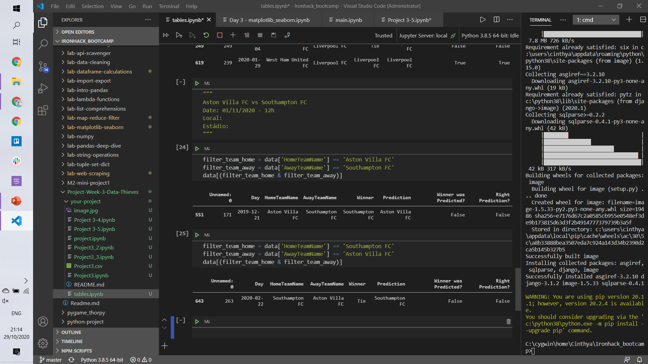
Bet on Southampton

Slide 9
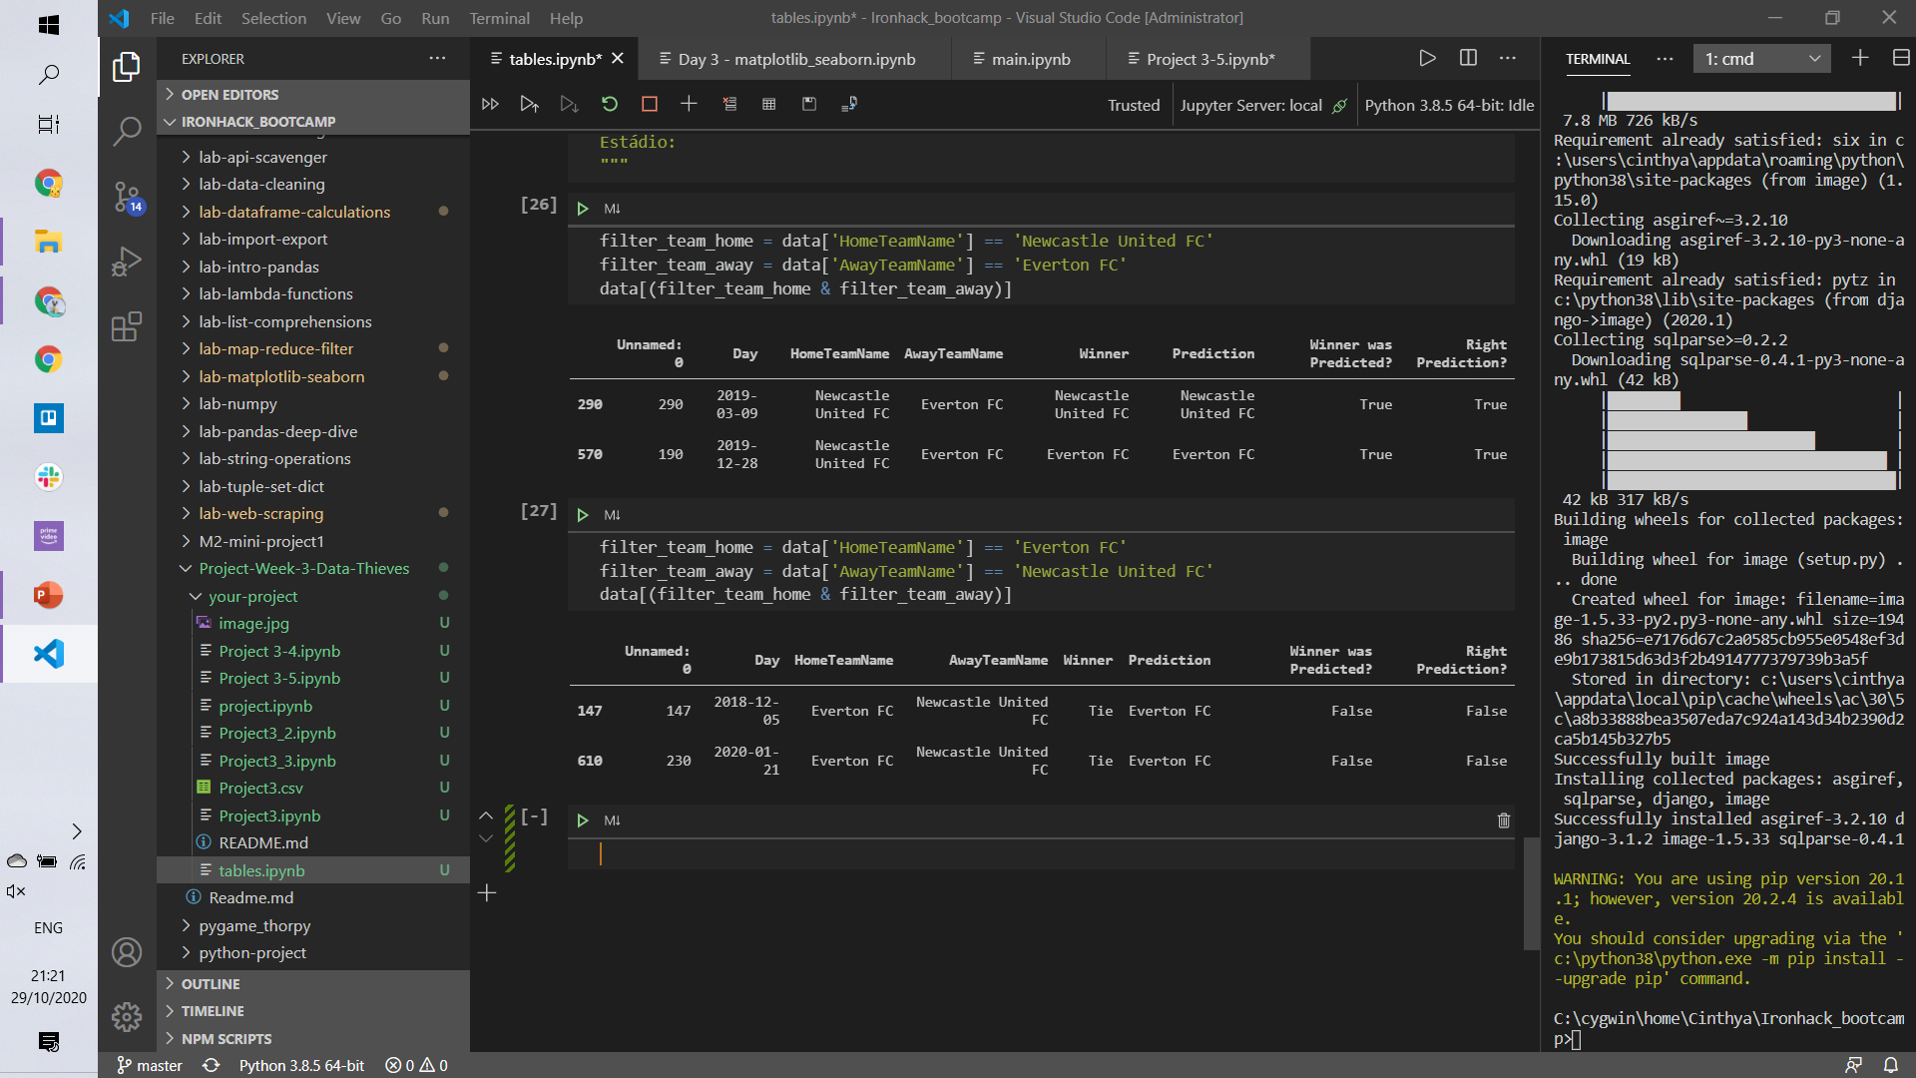
Not sure… In this season: Newcatsle wons 1 at home and Everton wons 2 away
Bet on Tie

Slide 10
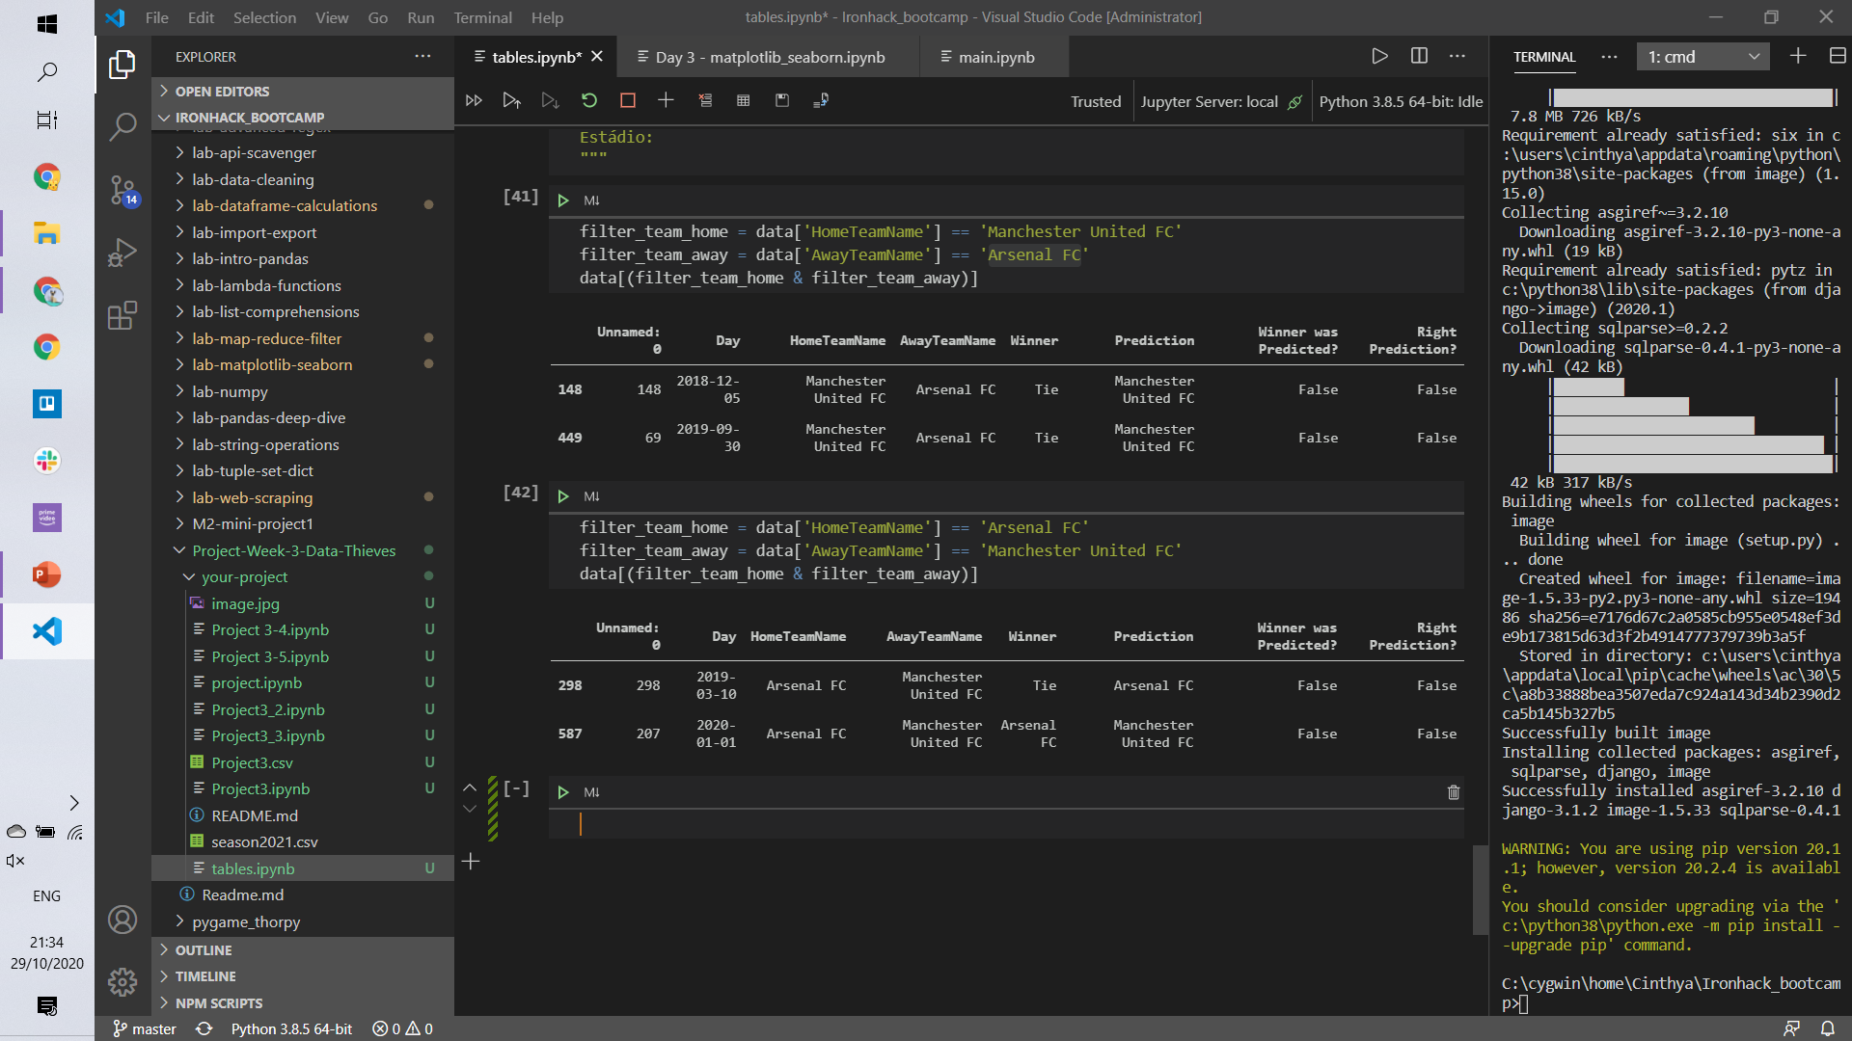
Bet on Arsenal

Slide 11
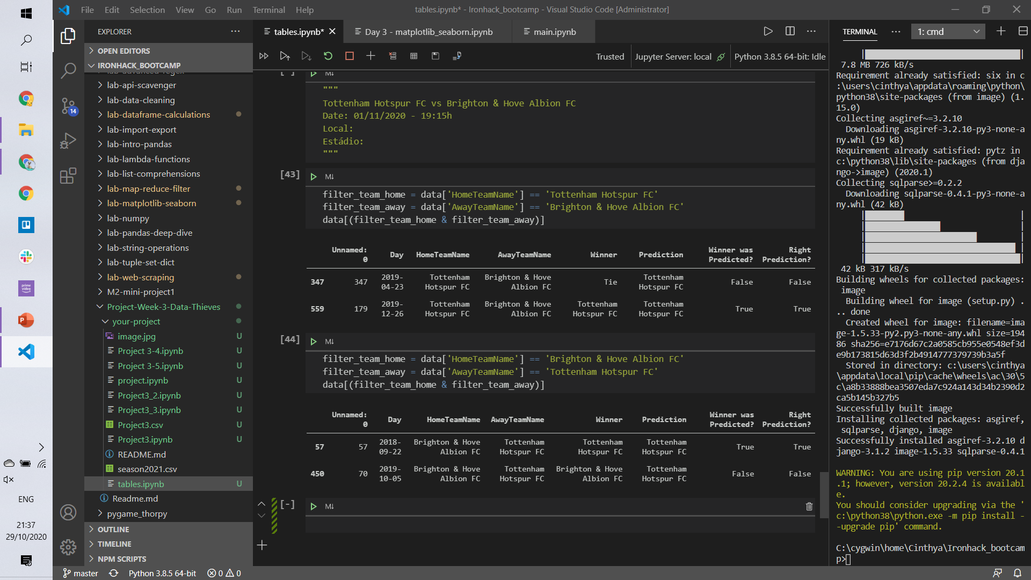
Bet on Tottenham

Slide 12
Now let’s all bet on predictions and get rich!!! something fun – simulate on a bet app this choices and check how much we will win if it’s correct

