Slide 2
Widgets
MAIN MENU
Intro
Reader
Contributor
AVM
Hastaneler
Adliye
Havalimanı
Tapu Daireleri
Üniversiteler
Belediye Binaları
Kaymakamlık&Nüfu
Metro Çıkışları

Slide 3
AVM
Type here…
Ara
Optimum
Cevahir
Atlaspark

Slide 4
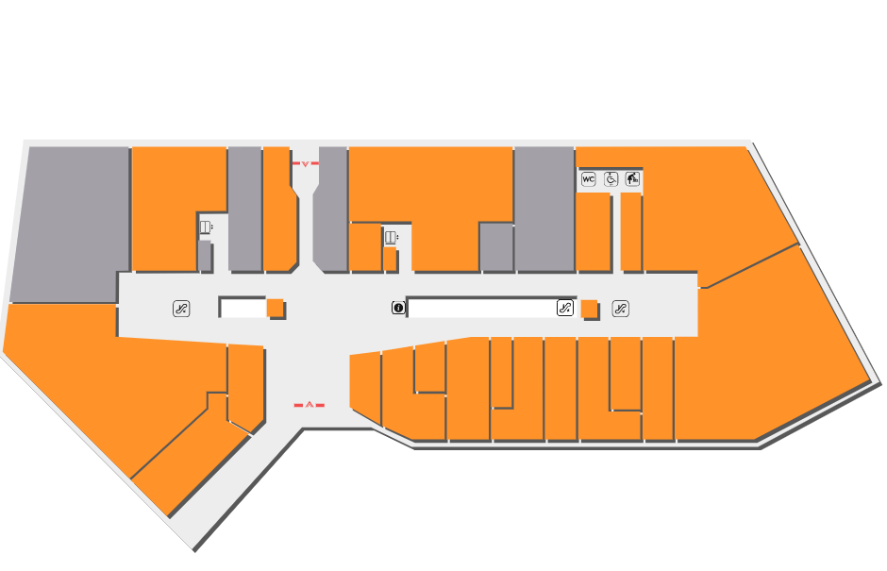
Atlaspark
Layout
Activity
http://www.atlasparkavm.com/kat-planlari

Slide 5
ATLASPARK
ShoppingMall X
Activity
Floors
Stores
4
Flr4Strs= [A, B, C, D, …… , X, Y, Z]
3
Flr3Strs= [A, B, C, D, …… , X, Y, Z]
2
Flr2Strs= [A, B, C, D, …… , X, Y, Z]
Flr1Strs= [A, B, C, D, …… , X, Y, Z]
1
Flr0Strs= [A, B, C, D, …… , X, Y, Z]
0
FlrZ1Strs= [A, B, C, D, …… , X, Y, Z]
FlrZ2Strs= [A, B, C, D, …… , X, Y, Z]
-1
AtlasparkStores= [Flr4Strs, Flr3Strs, …, FlrZ2Strs]
-2

Slide 6
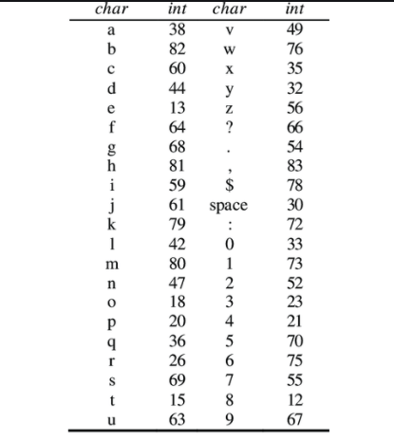
StoreName Encryption & Color Assign
Steps to perform:
1- Shorten the store name to three string/Char digit.
2- Assign first char numeric value to Red(R) color value, similarly second char to Green(G), and third to Blue(B)
3- Create Matrix for each store including color values M(R,G,B)

Slide 7
A=[abc, adl adn, ……zpu]
B=[0885, 1045, 0607,….9753]
Adl
Adl
İndex(A)=55
ColorID=B(55)

Slide 8
Main Activity
avm
magaza
Avmler=[Xavm={K1=(store1, store2,….), K0, Z1…}, Yavm, Zavm…]
AVMLER
Tüm Magazalar
Avm ara
Magaza ara
Magazalar=(store1, store2, ………………………………………..store987)
kat
mgz
Store1=(Xavm, Yavm, ………………………………………..Zavm)
X Avm
i
X mgz
Y Avm
kat
mgz
Y mgz
i
kat
mgz
Z Avm
i
Z mgz
X Avm Katları
X Avm Mağazaları
K1
Magaza ara
X mgz
K0
i
X Avm Kx Mağazaları
Z1
Magaza ara
X mgz
i

