Slide 1
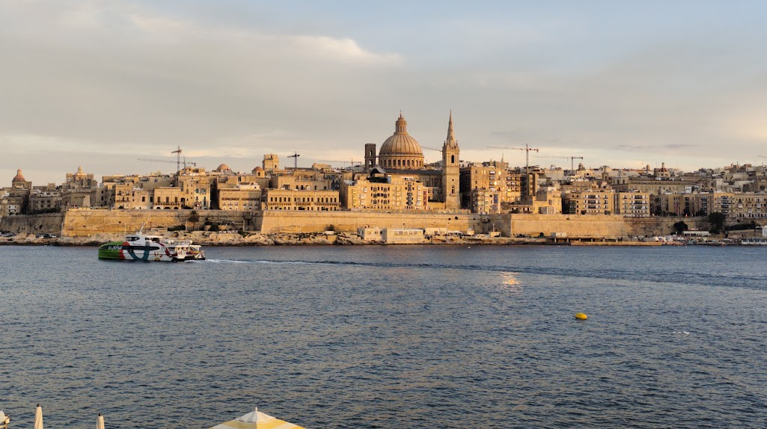


The Valletta harbour system
Model concept, first results and open questions
Cicero Martins Jr Università degli Studi di Palermo
Visiting researcher, Oceanography Malta Research Group, University of Malta
8 October 2026
Notes:
The model concept, the results obtained on the geometry, the open boundary, the Senglea record and the mesh, and the matters on which the continuation depends.

