Slide 1
WETWISE · WP3 · Maltese pilot
The Valletta harbour system
Model concept, and the questions to settle
Cicero Martins Jr Università degli Studi di Palermo
Research period at the Oceanography Malta Research Group, University of Malta
25 September 2026
Notes:
The deck covers the intended model and the matters to be settled before its construction.

Slide 2
ORIGIN
A framework, carried across archetype
The solver and the assembly are unchanged. The physics is not.
The framework comes from the Stagnone di Marsala digital twin, where a coupled Delft3D FM and SWAN model was built for a shallow vegetated lagoon.
Carrying it to a second lagoon would test little. A reviewer could anticipate the outcome. Carrying it to a deep engineered harbour tests whether the pipeline is reusable or was fitted to one site.
What transfers is the assembly. What does not transfer is itself a result, and it is recorded rather than hidden.
 | Stagnone | Valletta
Depth | sub-metre | 12 to 20 m
Bed | seagrass canopy | engineered, quay walls
Boundary signal | tide | long wave, atmospheric
Circulation driver | wind | the same long wave
The transfer effort is logged stage by stage as transferred, re-parameterised, or not applicable. That log is the methodological result.
Notes:
Context. The thesis contribution is framework reusability, and Valletta constitutes the harder test.

Slide 3
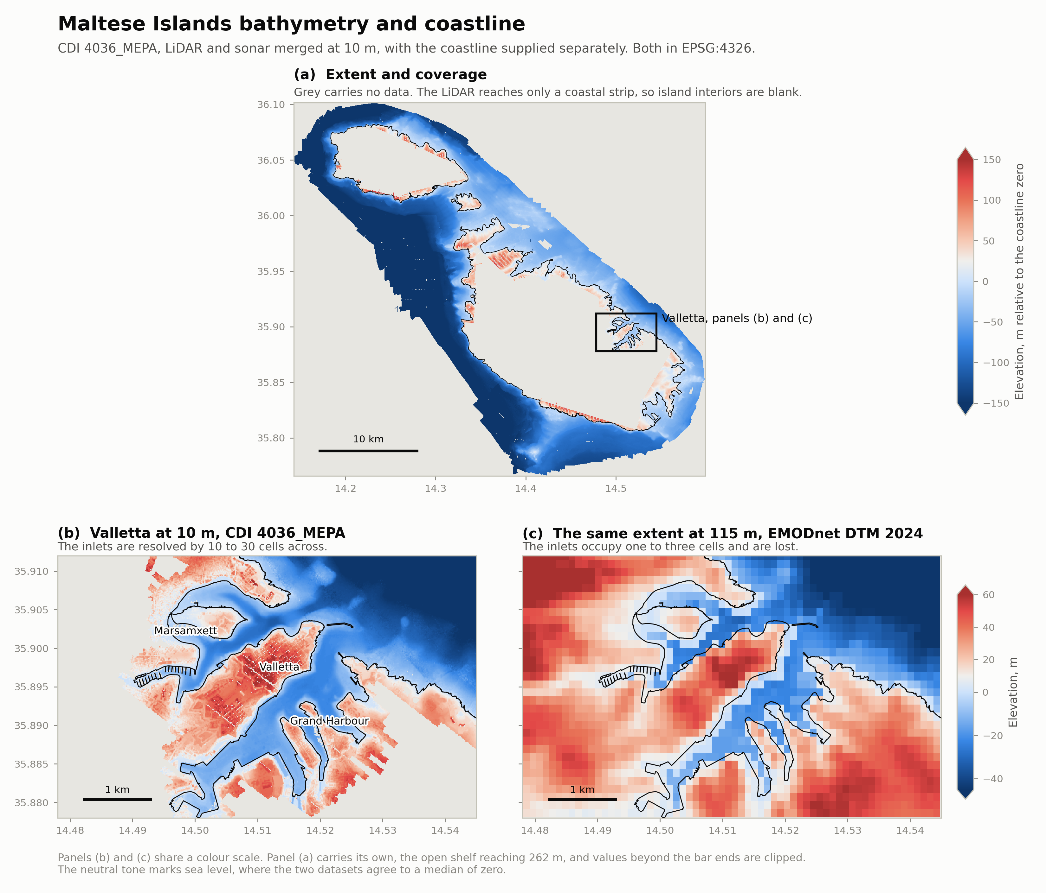
AVAILABLE DATA
Bathymetry and coastline, co-registered
Supplied by the host group on 22 and 23 September.
10 m
Two coordinate hazards
The grids carry no datum. Interpreted as WGS84 they are displaced by 197 m, without error.
Bathymetry is ED50, the coastline is WGS84. Neither overlays the other untransformed.
merged LiDAR and sonar,
CDI 4036_MEPA
174 to 256×
more resolved water cells
than the public product
99.5 %
land and water agreement
with the coastline
Grand Harbour 1.64 km², mean depth 15.9 m. Marsamxett 1.32 km², mean depth 13.3 m.
Notes:
The 10 m data came from the group's own contribution to EMODnet. The public product gives the inlets one to three cells.

Slide 4
THE PHENOMENON
The milgħuba is a meteotsunami
Rissaga in the Balearics, marrobbio on the Sicilian shelf. Not basin sloshing in general.
1
2
3
Proudman resonance
Shoaling
Basin resonance
An atmospheric disturbance travelling at √(gh) pumps the sea beneath it.
Green's law amplifies the wave as it climbs the approach.
The harbour geometry amplifies what arrives at its mouth.
The Malta Plateau, 99 to 190 m, is resonant with disturbances of 94 to 155 km h⁻¹.
From the plateau into the harbours, a factor of 1.75 to 1.84.
Quarter-wave and Helmholtz estimates agree at 12 to 18 minutes.
At Ciutadella, Menorca, the three compound to an order of magnitude. No equivalent decomposition has been published for Malta.
Notes:
The three-stage chain organises the study and determines the domain.

Slide 5
RESONANT PERIODS
The harbours do not resonate in the observed band
Quarter-wave periods, T = 4L∕√(gh), against the 0.2 to 2 cph band reported by Drago.
Element | L | h | Period | Frequency
Plateau to Sicily, quarter wave | 90 km | 150 m | 156 min | 0.38 cph | within
Plateau to Sicily, half wave | 90 km | 150 m | 78 min | 0.77 cph | within
Near plateau | 25 km | 120 m | 49 min | 1.24 cph | within
Grand Harbour | 3.2 km | 16 m | 17 min | 3.49 cph | outside
Marsamxett | 3.2 km | 13 m | 18 min | 3.26 cph | outside
A 1 km inlet | 1.0 km | 12 m | 6 min | 9.76 cph | outside
The consequence
The harbours respond to a shelf-scale oscillation rather than generating one.
A domain confined to the harbours holds no resonator in the band, and the available boundary product carries no energy there.
The domain must contain the plateau.
Tested against its two plausible failures. A Helmholtz idealisation returns 12 to 18 minutes also, and the harbours amplify by less than a tenth across most of the band.
Notes:
The domain follows from this table. Whether the group's harbour records carry energy near 17 minutes is the first outstanding question.

Slide 6
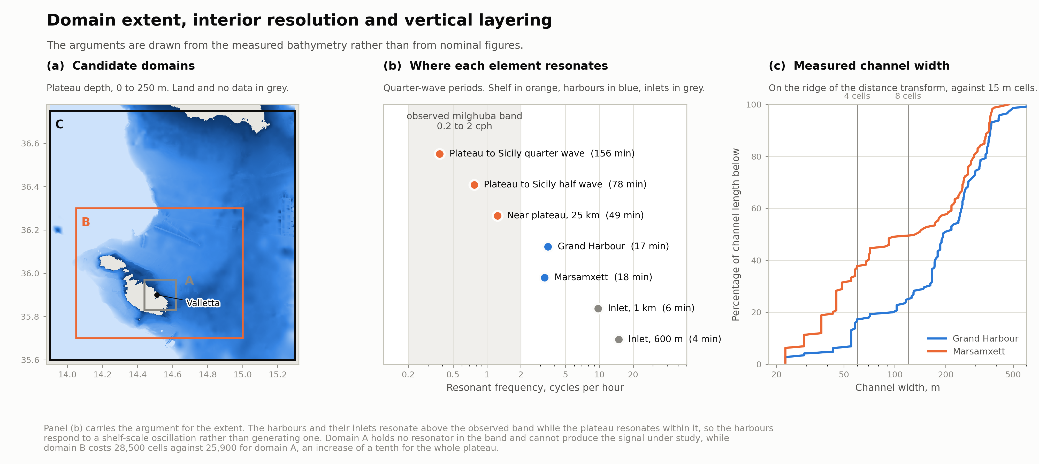
MODEL CONCEPT, EXTENT
Extent over the plateau, and its cost
Notes:
Domain B, roughly 86 by 66 km, east to 15 degrees, short of the escarpment. Stopping there is also what keeps sigma layers defensible.

Slide 7
MODEL CONCEPT, DISCRETISATION
The geometry sets the resolution
A 17-minute wave in 16 m of water is 12.8 km long. The planform of the inlets is what must be resolved.
Measured channel width
Mesh and time step
Half the channel length of Marsamxett is narrower than 135 m, and a third narrower than 50 m.
Four to five cells carry the conveyance of a channel, eight to ten resolve the flow across it.
Approximately 28,500 cells. A time step of 6 to 12 s at Courant 5 to 10 in the finest cells, which samples a 17-minute wave about a hundred times per cycle. The 10 m of the source data is the floor; below 15 m a mesh interpolates rather than resolves.
Zone | Target
Inlets and entrances | 15 m
Harbour basins | 30 m
Nearshore, within 2 km | 100 m
Coastal, 2 to 15 km | 300 m
Open plateau | 1500 m
Vertical, 12 to 15 sigma layers
The count is set by residence time, not by the seiche, which is barotropic. Fifteen layers give roughly one metre at the bed in the basins.
Sigma is defensible only because the domain stops short of the escarpment, where the plateau gradient is one part in a thousand.
Notes:
A question for Deltares concerns whether sigma holds from 15 m to 150 m, or whether a z-sigma hybrid is indicated.

Slide 8
RESEARCH QUESTION
Attribution of amplification
Of the amplification between the open sea and the heads of the Valletta harbours, how is it partitioned between Proudman resonance over the plateau, shoaling on the approach, and resonance of the basins themselves, and which atmospheric disturbance speeds and directions maximise that chain?
The formulation it replaces
Prior work to be cleared
Whether the model reproduces the observed signal is binary and asymmetric. Affirmed, it confirms what is expected of a mature solver. Denied, it is blamed on the configuration.
It interrogates the instrument rather than the system, and has no constituency beyond modellers.
It is relocated to the methods.
Maltese coastal seiches were modelled in 2007, in a two-dimensional depth-averaged POM, for Mellieħa and St Paul's Bay, forced by a prescribed offshore long wave.
Repeating that at Valletta in three dimensions would be incremental.
The generation side is untouched, because the prior work imposes the wave rather than producing it, and it therefore remains unaddressed.
Notes:
The applied companion is a map of exposure by inlet and quay. The fallback, with independent value, is harbour renewal under the Water Framework Directive.

Slide 9
EXPERIMENTAL DESIGN
A parametric sweep in place of a hindcast
ERA5 does not resolve the atmospheric gravity waves that trigger the phenomenon. That has been the largest standing risk.
1
Sweep
Impose a moving pressure disturbance and vary its speed, direction, width and duration.
Bearing beyond the present study
A response surface is a property of the geometry. Climate change acts on the distribution of the forcing.
The two separate, so the surface is computed once and any later study with synoptic projections may convolve them without repeating the hydrodynamics.
No climate scenario need be run through the model.
2
Response surface
The output is a transfer function of the geometry, independent of any particular storm.
3
Observations invert
They cease to be the forcing and become the test: do recorded events occur under the conditions identified as resonant?
The milgħuba floods Msida, at the head of Msida Creek inside Marsamxett, together with Marsaskala, Xemxija, Marsaxlokk and Sliema.
Notes:
A sweep of six speeds by eight directions amounts to forty-eight runs, barotropic and uncoupled, and therefore inexpensive.

Slide 10
OUTSTANDING QUESTIONS
Six questions and their bearing on the study
1
Is there a sea level record inside the Grand Harbour, and at what sampling interval?
2
What is the full extent of prior work on the milgħuba, published or not?
A spectrum would settle whether the basins carry energy near 17 minutes. The 0.2 to 2 cph band is observed at Mellieħa, on another coast, and the present analysis can only infer.
The contribution rests on the generation side being open. That claim comes from a literature search, not from the authors, who are in this room.
3
What is the sampling interval of the PORTO sea level stations?
4
Is there documented damage or disruption inside the commercial port?
The seiche band is 0.2 to 2 cph. Coarser than one minute and the model loses its observational target in its own frequency range.
Flooding is documented at Msida and elsewhere. Mooring failure or interrupted operations would be held by Transport Malta and the terminals.
5
What is the levelling datum behind the bathymetry, and how does its zero relate to the tide gauges?
6
Would the group regard the attribution question as a contribution, or as their own intention?
The files declare ellipsoidal heights and the data are orthometric. What remains is the offset against the gauges used for validation.
Establishing this early avoids a duplication of intent.
Notes:
These items determine what the study can be. The remainder is resolvable by execution.

Slide 11
IMMEDIATE SEQUENCE
Before the mesh is built
Late September
Seiche climatology from the Portomaso and PORTO archives. No model is required.
19 October
Delft3D User Days abstract.
Early October
Merged bathymetry over the domain, gaps intersected with the coastline.
2 to 4 November
Delft3D User Days at Deltares, with the four configuration questions.
Late October to November
Mesh, Riemann boundary verified by synthetic pulse, first runs.
Documents, figures and the reproducible analysis are in the project repository.
Notes:
Block B3 loses four working days to Delft and holds fifteen rather than nineteen.

