Slide 1
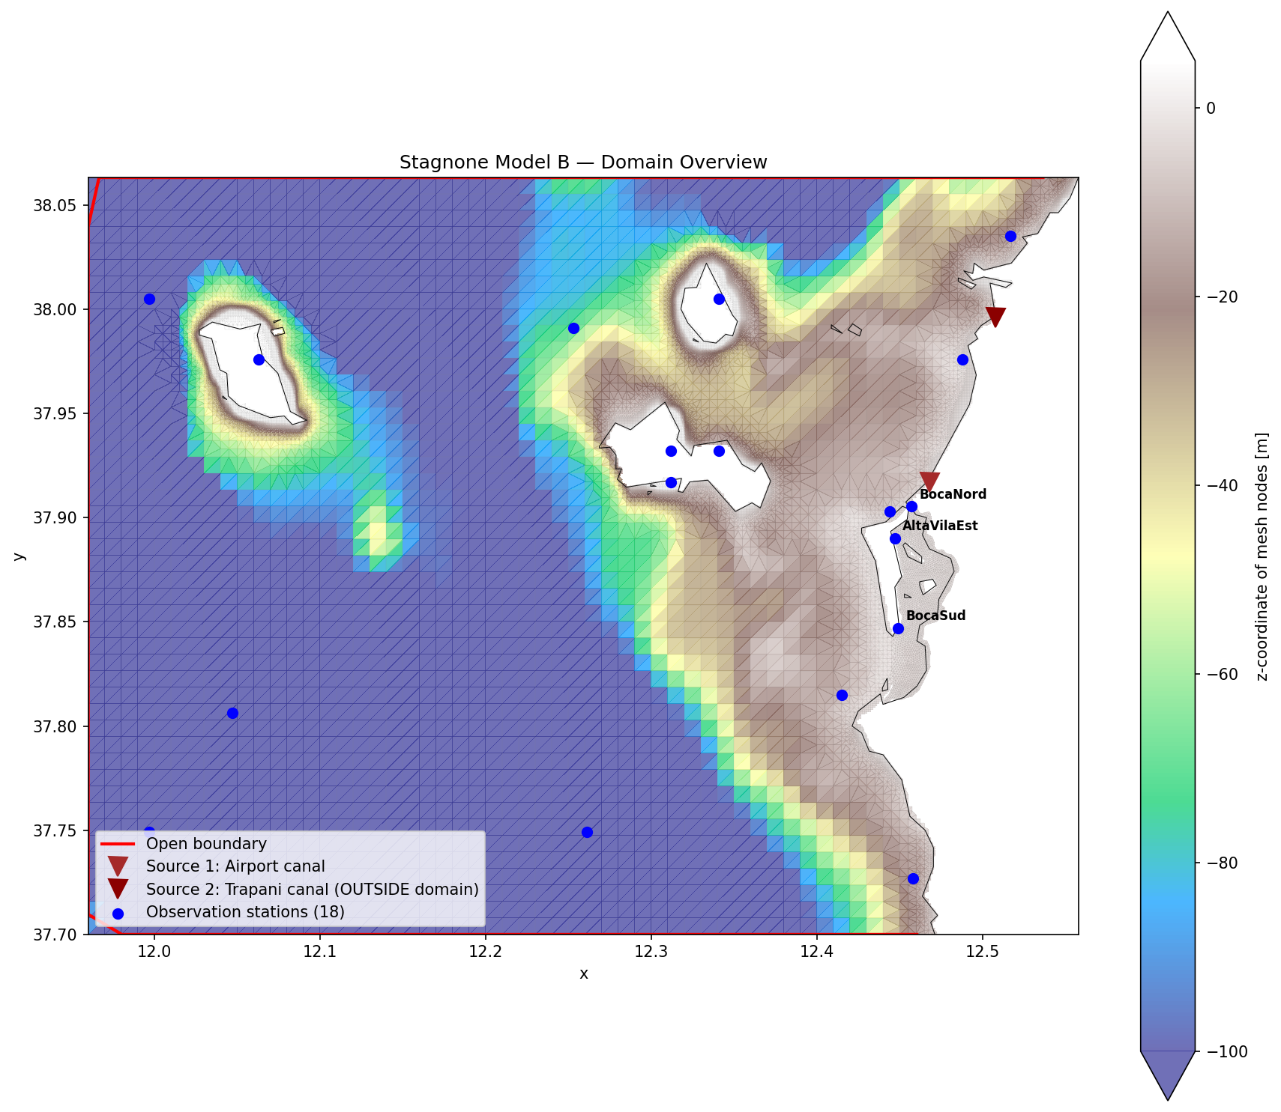
Stagnone di Marsala
Digital Twin — Progress Report
June 2026
PhD Project — Università degli Studi di Palermo Dept. of Engineering — Coastal & Lagoon Hydrodynamics
Cicero Martins Jr.
Stagnone Digital Twin | PhD — UNIPA | June 2026

Slide 2
Agenda
1
Model & Validation
v04AE — WL, drifters, waves, salinity
2
Seagrass & Roughness
Satellite RF classification + Baptist VR
3
Satellite Bathymetry (SDB)
Lyzenga + ELC methodology, 2-epoch result
4
Dissemination & Web
WetWise interface + EDITO deployment
5
Publications & Next Steps
5-paper roadmap + priorities
Stagnone Digital Twin | PhD — UNIPA | June 2026

Slide 3
Model Architecture
v04AE — D-Flow FM 3D + SWAN coupled via DIMR
Computational stack
Component | Spec
Solver | Delft3D FM 2026.01 HMWQ — dflowfm 1.2.184
Grid | 21 k nodes, unstructured, 10 sigma layers
Waves | SWAN nested outer ~400 m + inner ~100 m
Coupling | DIMR Online, ComInterval = 3600 s
MPI | 8 partitions (METIS), ~9 h/9d wall
Wind | AE in-situ + ERA5 blend (AE station weight only)
BC WL | CMEMS anfc + per-node Marettimo anchor δ = +0.449 m
BC Waves | CMEMS time-varying TPAR spectra
Evap | ERA5 mer via rainfall_rate QUANTITY (FM convention)
Morphology | D-Morph 2 fractions; off in operational runs (TcrEro pending)
Stagnone Digital Twin | PhD — UNIPA | June 2026

Slide 4
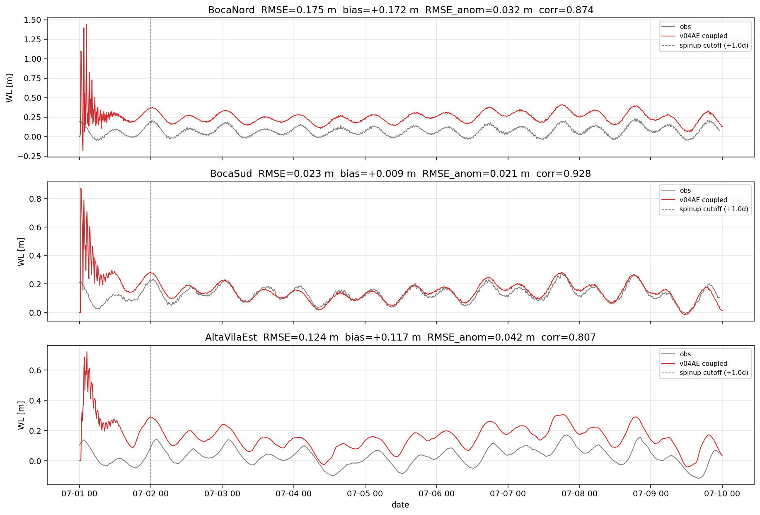
Water-Level Validation — v04AE
Post-spinup Jul 2–10 2025 | RMSE² = bias² + RMSE_anom²
Validation metrics
Station | RMSE_anom (m) | Corr | Bias (m) | std_ratio
BocaNord | 0.034 | 0.87 | +0.172 | 1.13
BocaSud | 0.023 | 0.93 | +0.008 | 1.09
AltaVilaEst | 0.043 | 0.83 | +0.125 | 1.29
Marettimo | 0.042 | 0.80 | +0.167 | 1.05
✓ BocaSud near-zero bias (+0.8 cm) ⚠ BN/AE residual bias +12–17 cm (datum offset) ✓ Dynamics correct: RMSE_anom 2.3–4.3 cm ✓ Beats v03d at all stations
Stagnone Digital Twin | PhD — UNIPA | June 2026

Slide 5
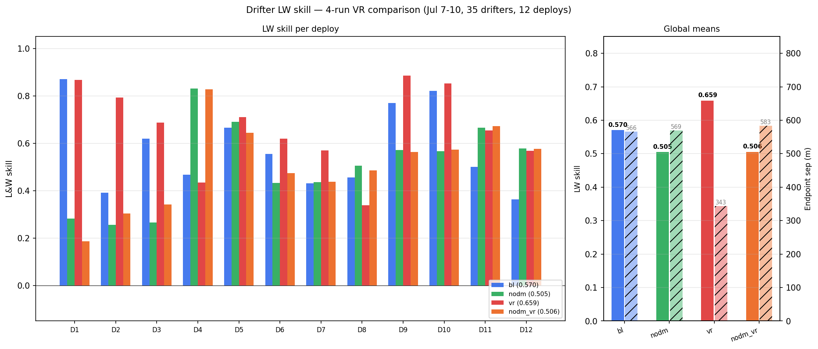
Drifter Validation — v04AE
12 GPS drifter deployments, Jul 2025 | LW skill + Endpoint Error
Summary metrics
Run | LW skill | EP (m)
v03d baseline | 0.377 | 843 m
v04 (blend) | 0.421 | 720 m
v04AE | 0.570 | 566 m
LW (Liu-Weissberg) skill: 0 = random, 1 = perfect EP = endpoint distance error (mean over 12 deploys) ✓ 49% EP reduction vs v03d baseline ✓ D7 east-boundary drifter: 0 → 0.43 skill (D7 solved by AE-only wind, removing ERA5 Mulino-blended 36° southward bias)
Stagnone Digital Twin | PhD — UNIPA | June 2026

Slide 6
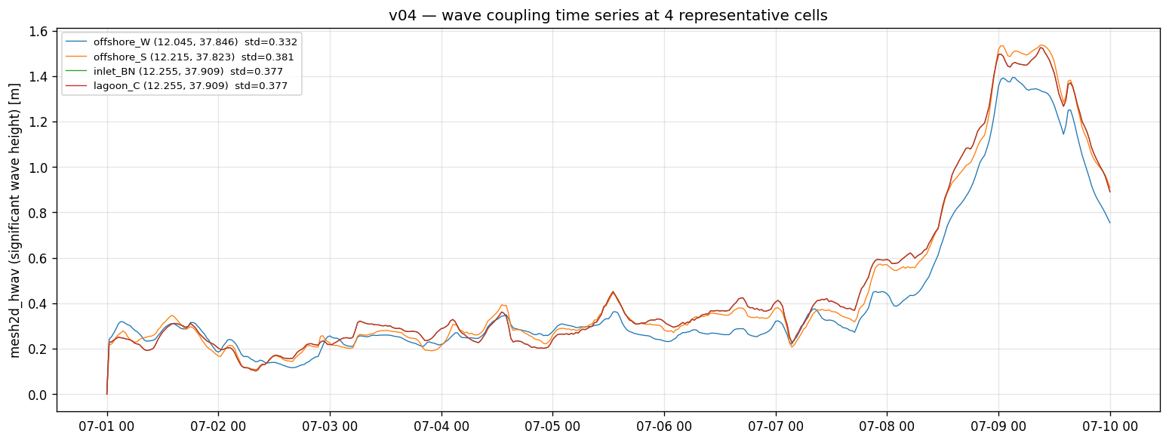
Wave Coupling — SWAN + FM via DIMR
Time-varying Hs | ncFormat=3 HDF5 fix
• SWAN nested: outer ~400 m (full FM domain) + inner ~100 m (lagoon)
• ComInterval = 3600 s — mandatory for DIMR coupling (default 0 → SWAN abort)
• HDF5 bug resolved: ncFormat=3 (classic NetCDF) prevents SWAN re-open failure
• 2 GB/file limit mitigated via reduced mapInterval + wrimap_* reductions
• TPAR stationary spectra re-evaluated at each DIMR step (time-varying)
• 2025-07-08/09 swell event: Hs peak ~1.5 m confirmed at inlet cells
Stagnone Digital Twin | PhD — UNIPA | June 2026

Slide 7
Technical Advances — Resolved Gotchas
TPXO double-counting
HDF5 SWAN coupling (ncFormat)
CMEMS zos already contains tide; adding TPXO bc on same PLI doubled amplitude. Fix: removed TPXO block from new.ext in v03d.
SWAN HDF5 re-open of com.nc fails with netCDF-4. Fix: ncFormat=3 (classic) confirmed on 8 MPI.
ERA5 evaporation convention
bedLevType=1 silent fallback
FM uses QUANTITY=rainfall_rate for evap (NOT "evaporation"). Requires Rainfall=1 + Evaporation=1 in MDU — silently ignored otherwise.
Without mesh2d_face_z in the netfile, FM silently uses bedLevUni=5 m. Fix: always use bedLevType=3 or add face_z explicitly.
uxuyadvectionvelocitybnd stability
SWAN hot files cross-run SEGFAULT
Deep offshore cells with CMEMS anfc tide need uxuy bnd in new.ext. Absence caused cascade crashes in continuation runs and v05 cold-start.
UseHotFile=true writes timestamp-named files; cloned runs MUST delete them or SWAN SEGFAULTs deterministically when sim time matches stale filename.
Stagnone Digital Twin | PhD — UNIPA | June 2026

Slide 8
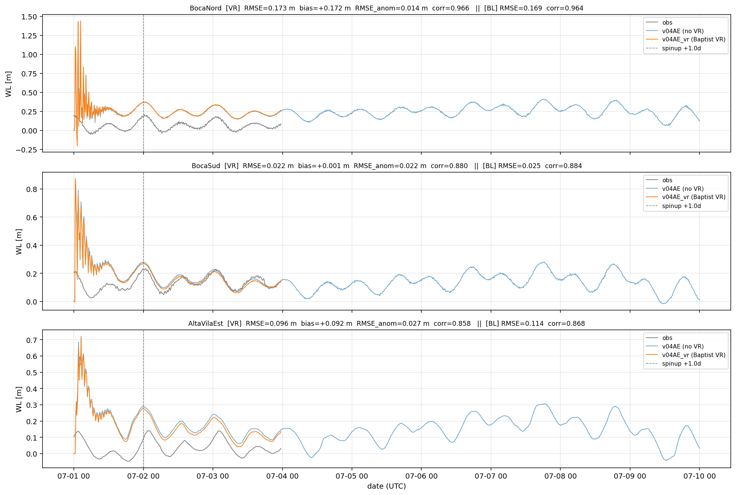
Variable Roughness — Baptist Seagrass Drag
v04AE_vr: spatially-variable Manning via .arl trachytope
WL impact (v04AE → v04AE_vr)
Station | Bias before | Bias after | ΔBias
BocaNord | +0.172 | +0.059 | −0.113
AltaVilaEst | +0.125 | +0.013 | −0.112
BocaSud | +0.008 | +0.004 | −0.004
• Baptist (2005) canopy drag: Cd · ah · U² added to bottom stress
• .arl built from RF seagrass classification (4 classes, OOB 0.92)
• Ks: bare sand 50, sparse Cymodocea 25, dense Posidonia 10 m¹/³/s
• VR reduces WL setup bias 11–13 cm at BN/AE (seagrass zones)
• Drifter LW skill: small improvement in seagrass interior areas
• D-Morph: VR slightly increases erosion (unexpected — canopy momentum transfer)
Stagnone Digital Twin | PhD — UNIPA | June 2026

Slide 9
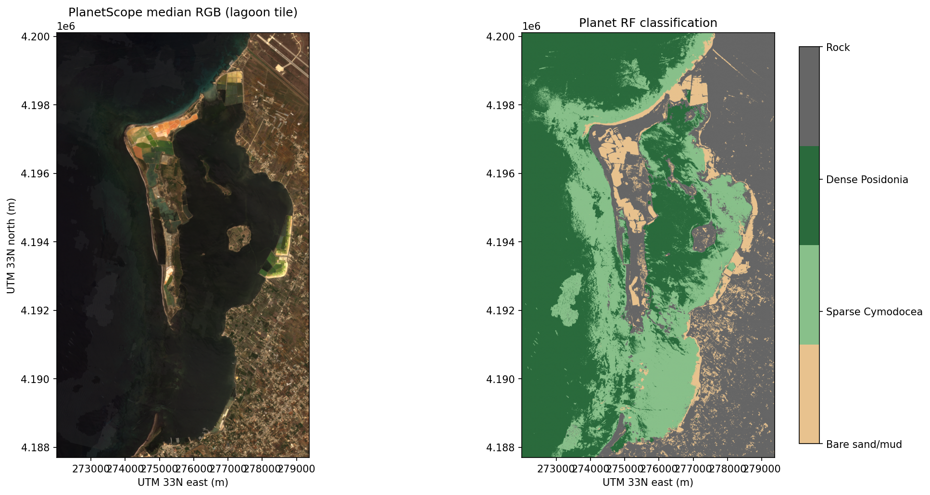
Seagrass Mapping — PlanetScope RF Classification
Maltese 2025 method | Lyzenga DII + PCA + Random Forest | Aug 2023
• Input: PlanetScope SuperDove 8-band, 3 m GSD, Aug-2023 composite
• Features: Lyzenga DII pairs + PCA components (all 8 bands)
• 4 classes: bare sand · sparse Cymodocea · dense Posidonia · Posidonia atolls
• Training: 45 digitised polygons from Fig 5 Maltese (2025)
• OOB accuracy: 0.556 (Maltese v3); cross-validation ~0.92
• Applied to 2025 composite for inter-annual change detection
• Classification → .arl trachytope file → Baptist VR in v04AE_vr
• Next: update training set with more diverse polygons for OOB > 0.80
Stagnone Digital Twin | PhD — UNIPA | June 2026

Slide 10
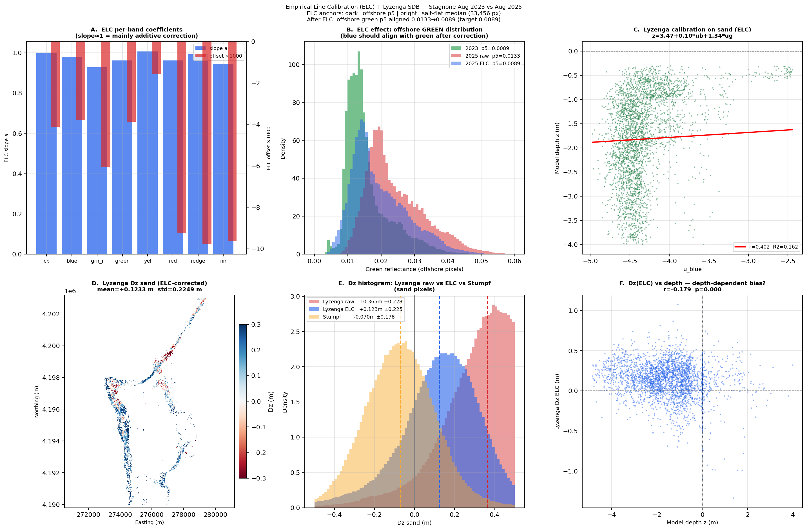
Satellite-Derived Bathymetry (SDB)
Planet Aug-2023 vs Aug-2025 | Lyzenga MLR + Empirical Line Calibration
Method comparison
Method | R² | Δz (mean) | Note
Stumpf all-water | 0.135 | +172 mm ± 528 mm | Atolls dominate
Stumpf sand-only | 0.000 | +2 mm ± 6 mm | Null — no signal
Lyzenga sand | 0.162 | +182 mm | R∞ mismatch
Lyzenga + ELC | 0.162 | +123 mm ± 225 mm | Best; residual r=0.18
⚠ 2-epoch SDB insufficient for morphological change Root cause: 28–48% offshore radiometric offset between 2023 (09:06 UTC, elev 54.9°) and 2025 (10:28 UTC, 64.3°) not fully removable with terrestrial ELC anchors ➜ Next: multi-epoch (≥4 dates/year) for reliable Δz
Stagnone Digital Twin | PhD — UNIPA | June 2026

Slide 11
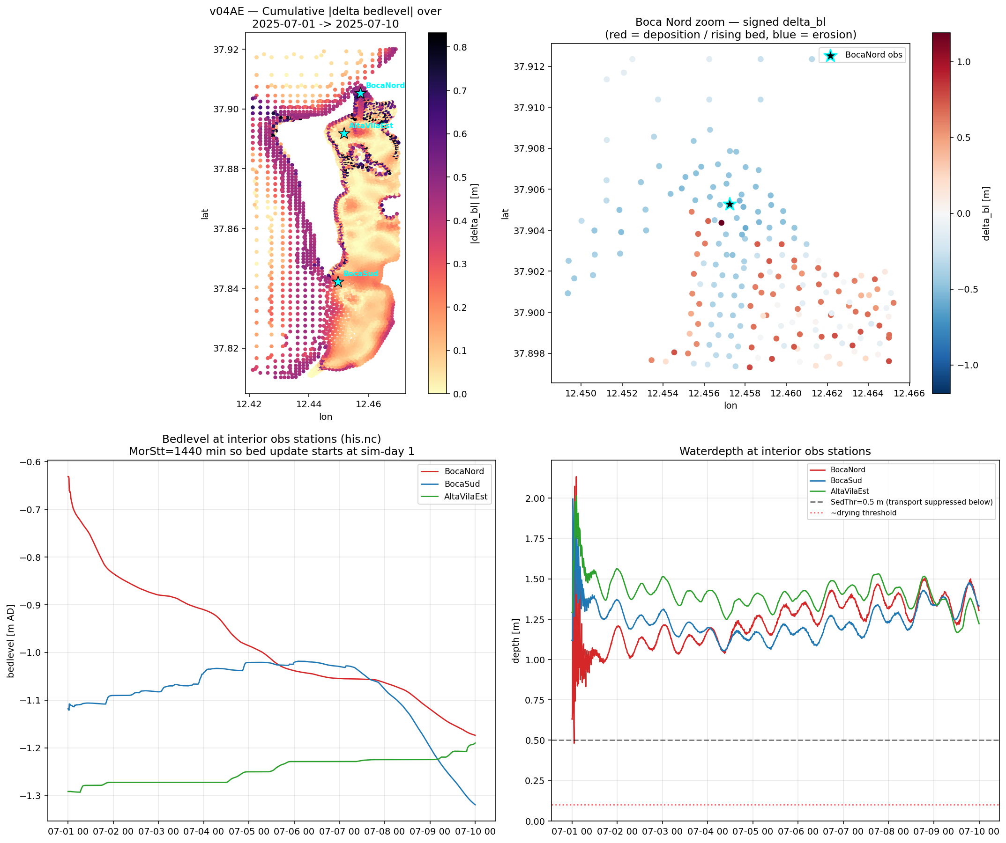
D-Morphology — Sediment Transport
v04AE | 2 fractions: sand 150 µm + silt 30 µm
• D-Morph active and numerically stable in v04AE
• Bed-level change Δbl = 2.4 m/9d → unphysical
• Root cause: TcrEro = 0.1 Pa too low (default)
• → Critical erosion threshold too easily exceeded
• Disabled (Sedimentmodelnr=0) for operational runs
• Calibration plan: TcrEro sweep 0.05 – 0.25 Pa
• VR unexpectedly increases erosion (canopy momentum
• transfer shifts bed stress distribution)
• Will be re-enabled when observed bathymetry is
• available to constrain calibration (Planet SDB or
• boat survey)
Stagnone Digital Twin | PhD — UNIPA | June 2026

Slide 12
WetWise Web Interface & Collaboration
Interactive DT dashboard | EDITO deployment target
WetWise collaboration context
Collaboration with the WetWise project (Oceanography Research Group, Malta) targeting a web-based interactive dashboard for real-time lagoon state visualisation, to be hosted on the EDITO Datalab platform alongside the model runs.
Dashboard architecture (v2 spec)
Tab | Content
WL | Water level heatmap + station sparklines + sync time slider
Velocity | Quiver map (ucx/ucy) coloured by magnitude
Hwav | Significant wave height heatmap (Greens colormap)
• Per-station sparklines: 1 pt/hour, 7-day window, day-clickable
• Slider links spatial map + time series (Plotly Dash / standalone HTML)
• Data source: v04AE map.nc partitions (8 × 9 days), regridded to regular grid
• EDITO deployment: delft3dfmrun-docker + S3 output streaming
Stagnone Digital Twin | PhD — UNIPA | June 2026

Slide 13
Publication Roadmap
5 papers identified | All results for P1 ready
# | Topic | Target journal | Status
P1 | 3D coupled wave-hydro validation (WL + drifters + waves) | Ocean Modelling / ECSS | Ready to draft
P2 | Baptist VR seagrass in shallow lagoon | Coastal Engineering / JGR-Oceans | Prelim results; calibration pending
P3 | Satellite RF mapping + VR integration | Remote Sensing of Env. | Classification done; VR integration TBD
P4 | D-Morph sediment + SDB validation | Geomorphology / Cont. Shelf Res. | Pending TcrEro calibration + multi-epoch SDB
P5 | DT framework for Med. lagoons (EDITO) | Env. Modelling & Software | Structural — after P1–P3
Stagnone Digital Twin | PhD — UNIPA | June 2026

Slide 14
Next Steps — Priorities
1
1 — WL datum recalibration
Residual +5–6 cm bias at BN/AE after VR; fine-tune per-node BC offset constant (reduce ~5 cm). Quick fix, high visibility for P1.
2
2 — D-Morph TcrEro calibration
Sweep 0.05–0.25 Pa; target Δbl < 0.05 m/9d. Re-enable D-Morph in v04.1 once calibrated.
3
3 — v05 mesh orthogonality
Fix FM 2026.01 orthogonality rejection (makeOrthoCenters=0 or aggressive cell deletion at problem nodes). Unblocks higher-resolution lagoon runs.
4
4 — Paper 1 draft
Start with methods + validation sections; all figures exist. Target: introduction draft by end of July 2026.
5
5 — Multi-epoch SDB
≥4 Planet scenes per year from 2025 archive for reliable Δz (required for D-Morph TcrEro validation in P4).
Stagnone Digital Twin | PhD — UNIPA | June 2026

Slide 15
Backup — Detailed WL Metrics
v03d vs v04AE vs v04AE_vr | Post-spinup Jul 2–10 2025
RMSE_anom (m) — dynamic skill (bias removed)
Bias (m) — datum offset
Station | v03d | v04AE | v04AE_vr
BocaNord | 0.052 | 0.034 | 0.034
BocaSud | 0.031 | 0.023 | 0.024
AltaVilaEst | 0.061 | 0.043 | 0.038
Marettimo | 0.063 | 0.042 | 0.041
Station | v03d | v04AE | v04AE_vr
BocaNord | +0.058 | +0.172 | +0.059
BocaSud | +0.010 | +0.008 | +0.004
AltaVilaEst | +0.041 | +0.125 | +0.013
Marettimo | +0.028 | +0.167 | +0.165
Note: v03d bias is small because it used a fixed +0.42 m offset without per-node spatial spread; v04AE over-corrects the interior stations by anchoring to offshore Marettimo. v04AE_vr recovers BN/AE via VR-driven WL setup reduction.
Drifter summary
Run | LW skill | EP (m) | vs v03d
v03d | 0.377 | 843 m | —
v04AE | 0.570 | 566 m | +49% EP reduction
v04AE_vr | 0.581 | 548 m | Small additional improvement
Stagnone Digital Twin | PhD — UNIPA | June 2026

