Slide 1
Variable Annealing Length and Parallelism in Simulated Annealing
Vincent A. Cicirello, Ph.D.
Professor of Computer Science / Behavioral Neuroscience
cicirelv@stockton.edu http://www.cicirello.org/

Slide 2
Introduction
We introduce a restart schedule of run lengths for an adaptive simulated annealer.
Eliminates need to know/predict available time a priori.
We extend the restart schedule to parallel implementation.
The variable annealing length restart schedule leads to improved anytime behavior early in the run.
Discuss experiments with an NP-Hard scheduling problem with sequence-dependent setups.

Slide 3
Background: Simulated Annealing (SA)
Annealing: process of slowly cooling a heated metal.
Heating metal allows shaping, while cooling slowly minimizes internal stress / more stable final state.
SA: stochastic search inspired by annealing process.
Temperature parameter controls acceptance of neighbors.
High temperature early in run = random search
Low temperature late in run = stochastic hill climb
Cool too quickly = converge too soon to local optima
Cool too slowly = excessive run length

Slide 4


Background: SA Annealing Schedules
Most common annealing schedules:
Exponential cooling:
Linear cooling:
Boyan’s Modified Lam Annealing Schedule (Boyan 1998):
Temperature fluctuates up/down to track a theoretical “ideal” neighbor acceptance rate
Acceptance rate decreases exponentially from 1.0 (random search) to 0.44 during first 15% of run, and held at 0.44 for next 50% of run.
Declines exponentially for last 35% of run (stochastic hill climb).
$$T_{i+1}=α T_{i}$$
$$T_{i+1}=T_{i}−∆T$$

Slide 5
Related Work: Restarts
Restarting SA:
Many have shown one long run of SA usually outperforms multiple short independent runs.
Effective SA restarts likely involves dependent runs.
E.g., Sadeh et al (‘97) models expected cost improvement, abandons less promising runs, reanneals other prior runs.
Restarting other forms of search quite effective:
Restarting backtracking CSP search (e.g., Luby schedule)

Slide 6
Related Work: Parallel SA
Three categories of parallel SA:
Parallel neighbor evaluations
E.g., speculative moves (Ludwin & Betz 2011)
Parallel multistart (with dependent runs)
E.g., regular intervals sharing best solution among parallel instances (Jha & Menon, 2014)
Optimizing subproblems in parallel
E.g., graph partitioning (Rahimian et al 2015)

Slide 7

Approach: Variable Annealing Length
Rationale: long run of SA typically outperforms multiple short runs, but difficult to accurately predict available time.
Variable Annealing Length (VAL):
Multistart SA with increasing run lengths.
The length of restart r, in number of SA evaluations is:
The multistart SA follows the sequence of run lengths: {1000, 2000, 4000, 8000, … }
$$\text{MaxEvals}\left(r\right)=1000 ∗ 2^{r}$$

Slide 8

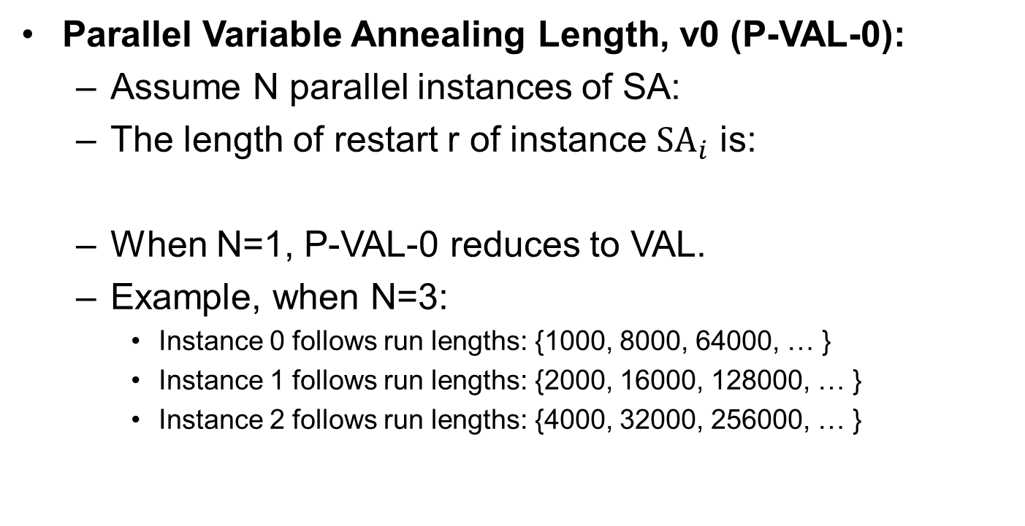

Approach: Parallel VAL, version 0
Parallel Variable Annealing Length, v0 (P-VAL-0):
Assume N parallel instances of SA:
The length of restart r of instance ${\text{SA}}_{i}$ is:
When N=1, P-VAL-0 reduces to VAL.
Example, when N=3:
Instance 0 follows run lengths: {1000, 8000, 64000, … }
Instance 1 follows run lengths: {2000, 16000, 128000, … }
Instance 2 follows run lengths: {4000, 32000, 256000, … }
$$\{{\text{SA}}_{0},{\text{SA}}_{1},…,{\text{SA}}_{N−1}\}$$
$${\text{MaxEvals}}_{i}\left(r\right)=1000 ∗ 2^{i+r∗N}$$

Slide 9
Approach: P-VAL-0’s flaw
P-VAL-0 is flawed:
Assuming long run superior to multiple short runs, benefit of parallelization is from completing long runs earlier.
As # parallel instances goes to infinity, the longest run completed by P-VAL-0 finishes twice as early as VAL.
For N=4 parallel instances, the longest run completed by P-VAL-0 finishes 1.875 times as early as VAL.
For N=8 parallel instances, … finishes 1.992 times as early.
We hit the limiting behavior with relatively few parallel instances.

Slide 10
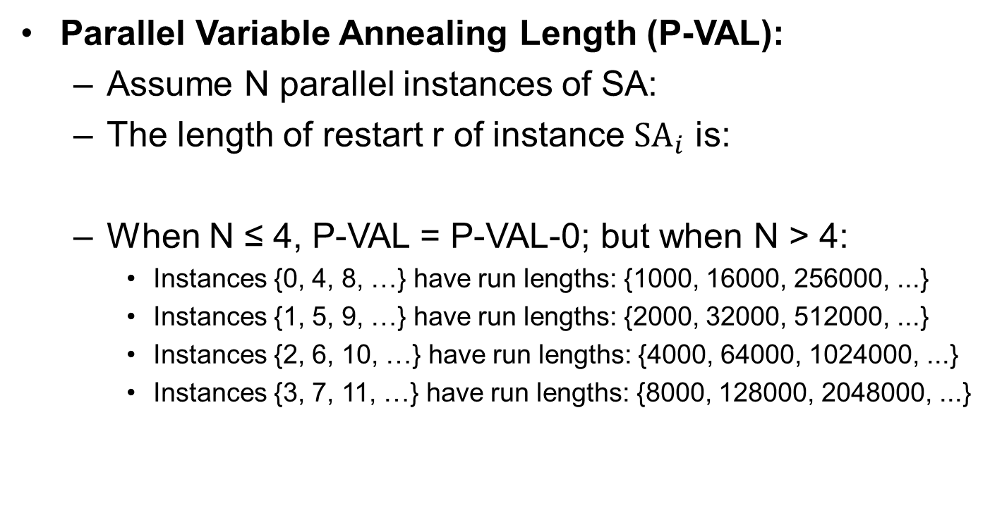
Approach: Parallel VAL
Parallel Variable Annealing Length (P-VAL):
Assume N parallel instances of SA:
The length of restart r of instance ${\text{SA}}_{i}$ is:
When N ≤ 4, P-VAL = P-VAL-0; but when N > 4:
Instances {0, 4, 8, …} have run lengths: {1000, 16000, 256000, ...}
Instances {1, 5, 9, …} have run lengths: {2000, 32000, 512000, ...}
Instances {2, 6, 10, …} have run lengths: {4000, 64000, 1024000, ...}
Instances {3, 7, 11, …} have run lengths: {8000, 128000, 2048000, ...}
$$\{{\text{SA}}_{0},{\text{SA}}_{1},…,{\text{SA}}_{N−1}\}$$
$${\text{MaxEvals}}_{i}\left(r\right)=1000 ∗ 2^{(i mod 4)+r∗min⁡(N,4)}$$

Slide 11
Experiments
Problem: Scheduling with sequence-dependent setups, minimizing weighted tardiness
Used common benchmark set
Best exact solver, dynamic programming, > 2 weeks CPU time solving hardest instances. (Tanaka & Araki, 2013)
Variety of algorithms applied to problem: neighborhood search (Liao et al, 2012), iterated local search (Xu et al 2014), ACO (Liao & Juan 2007), among others

Slide 12
Experiments
Platform: Ubuntu 14.04 server, 2 Xeon L5520 quad-core (2.27GHz), 32GB; Java 8, Java HotSpot 64-bit Server VM
Sequential (N=1) and parallel (N=4, N=8) experiments.
For each algorithm, 10 runs on each of 120 instances, logging best solution at 1 second intervals over 60 s.
Compare VAL, P-VAL-0, and P-VAL to the following:
Fixed annealing length (FAL-x) of x of total run, with restarts
E.g., FAL-1=one long run, FAL-½=run length half total time
Parallel fixed annealing length (P-FAL-x)

Slide 13
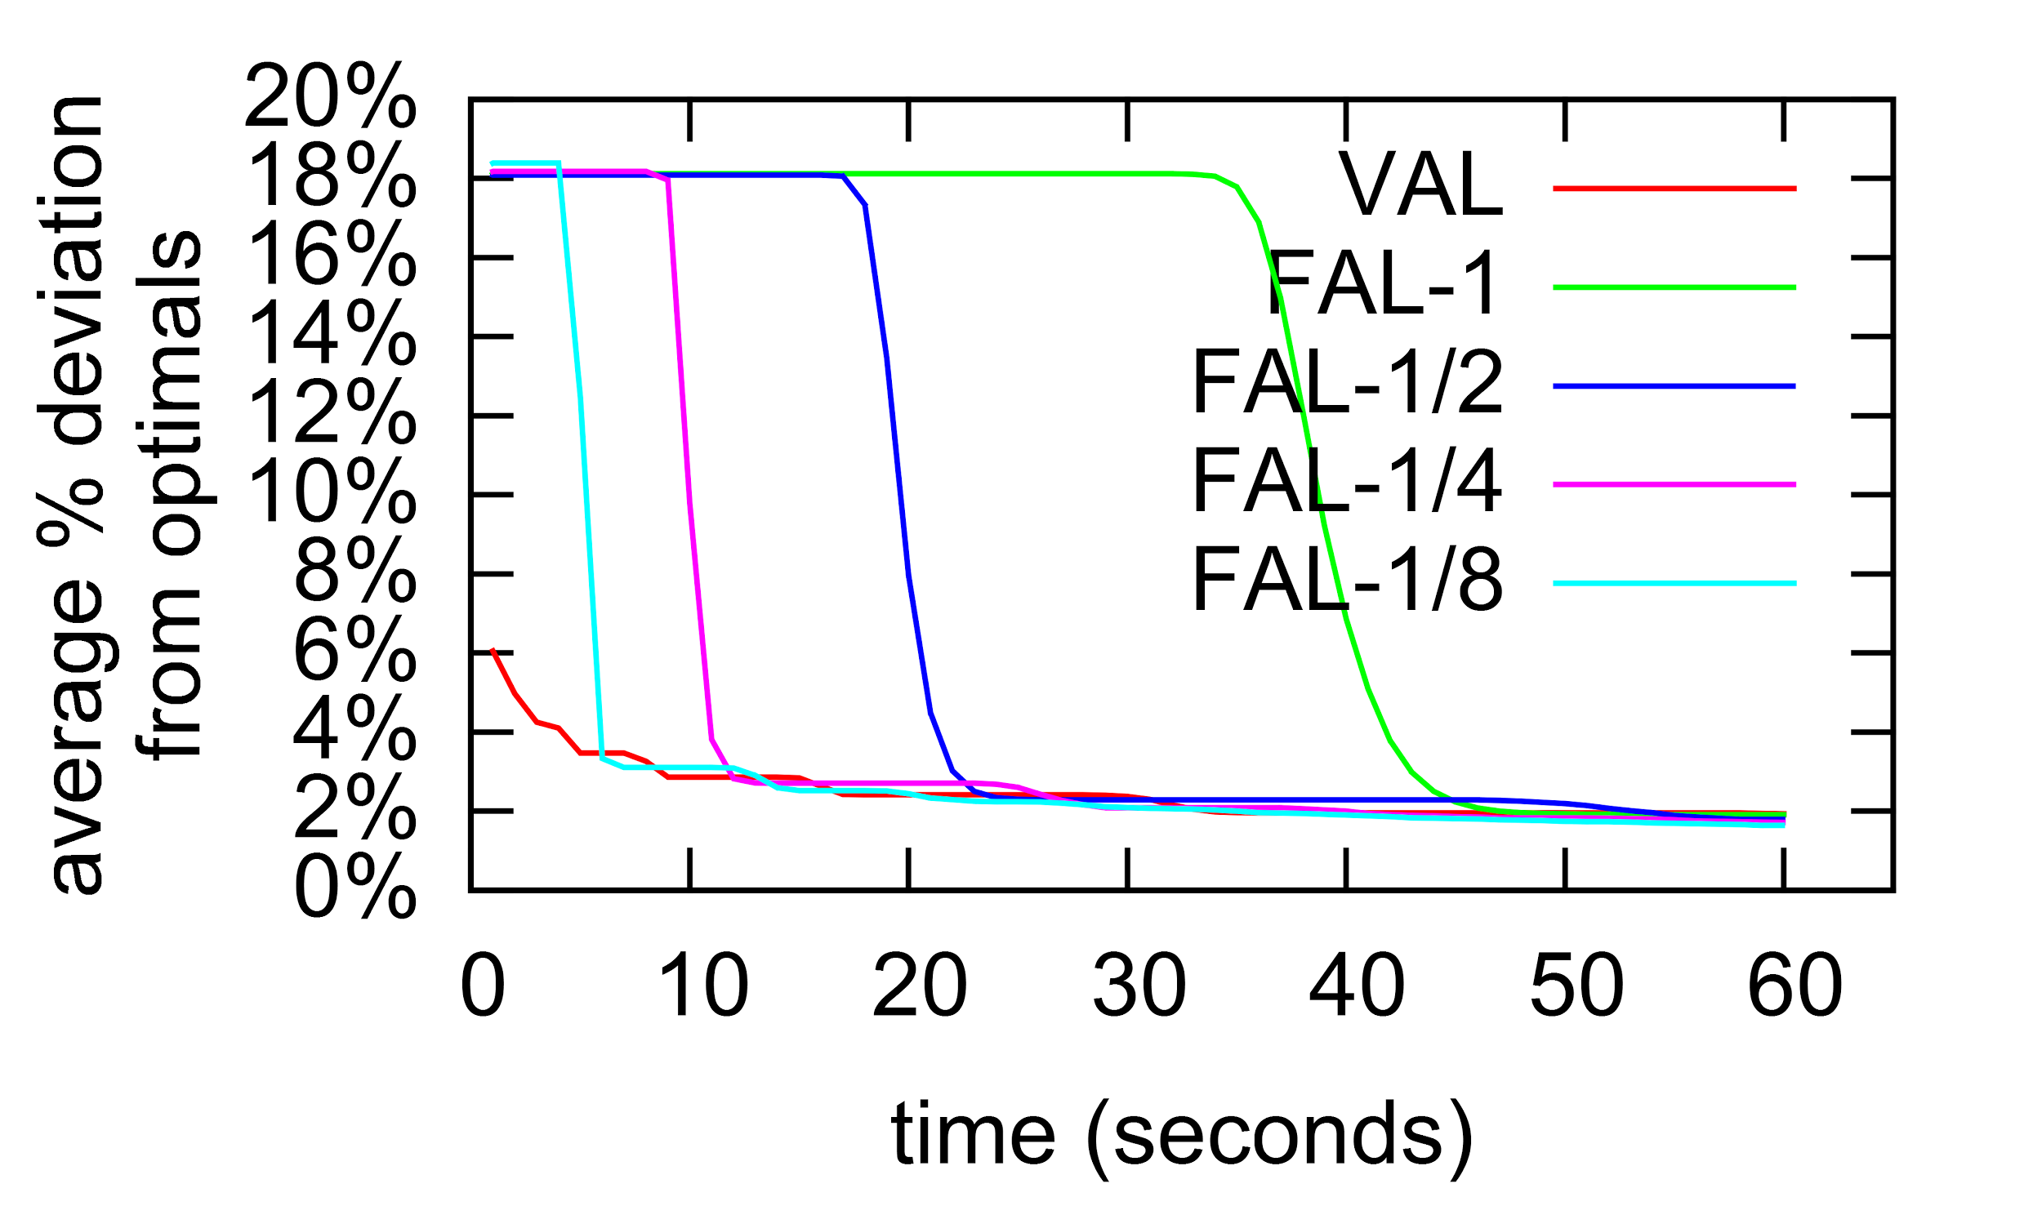
Sequential Results
VAL dominates fixed annealing length early.
No significant difference, at end of run (last 12s), between VAL and FAL-1 (p>0.35)
Not visually evident: Single long fixed length does outperform restarts of short fixed length at end.

Slide 14
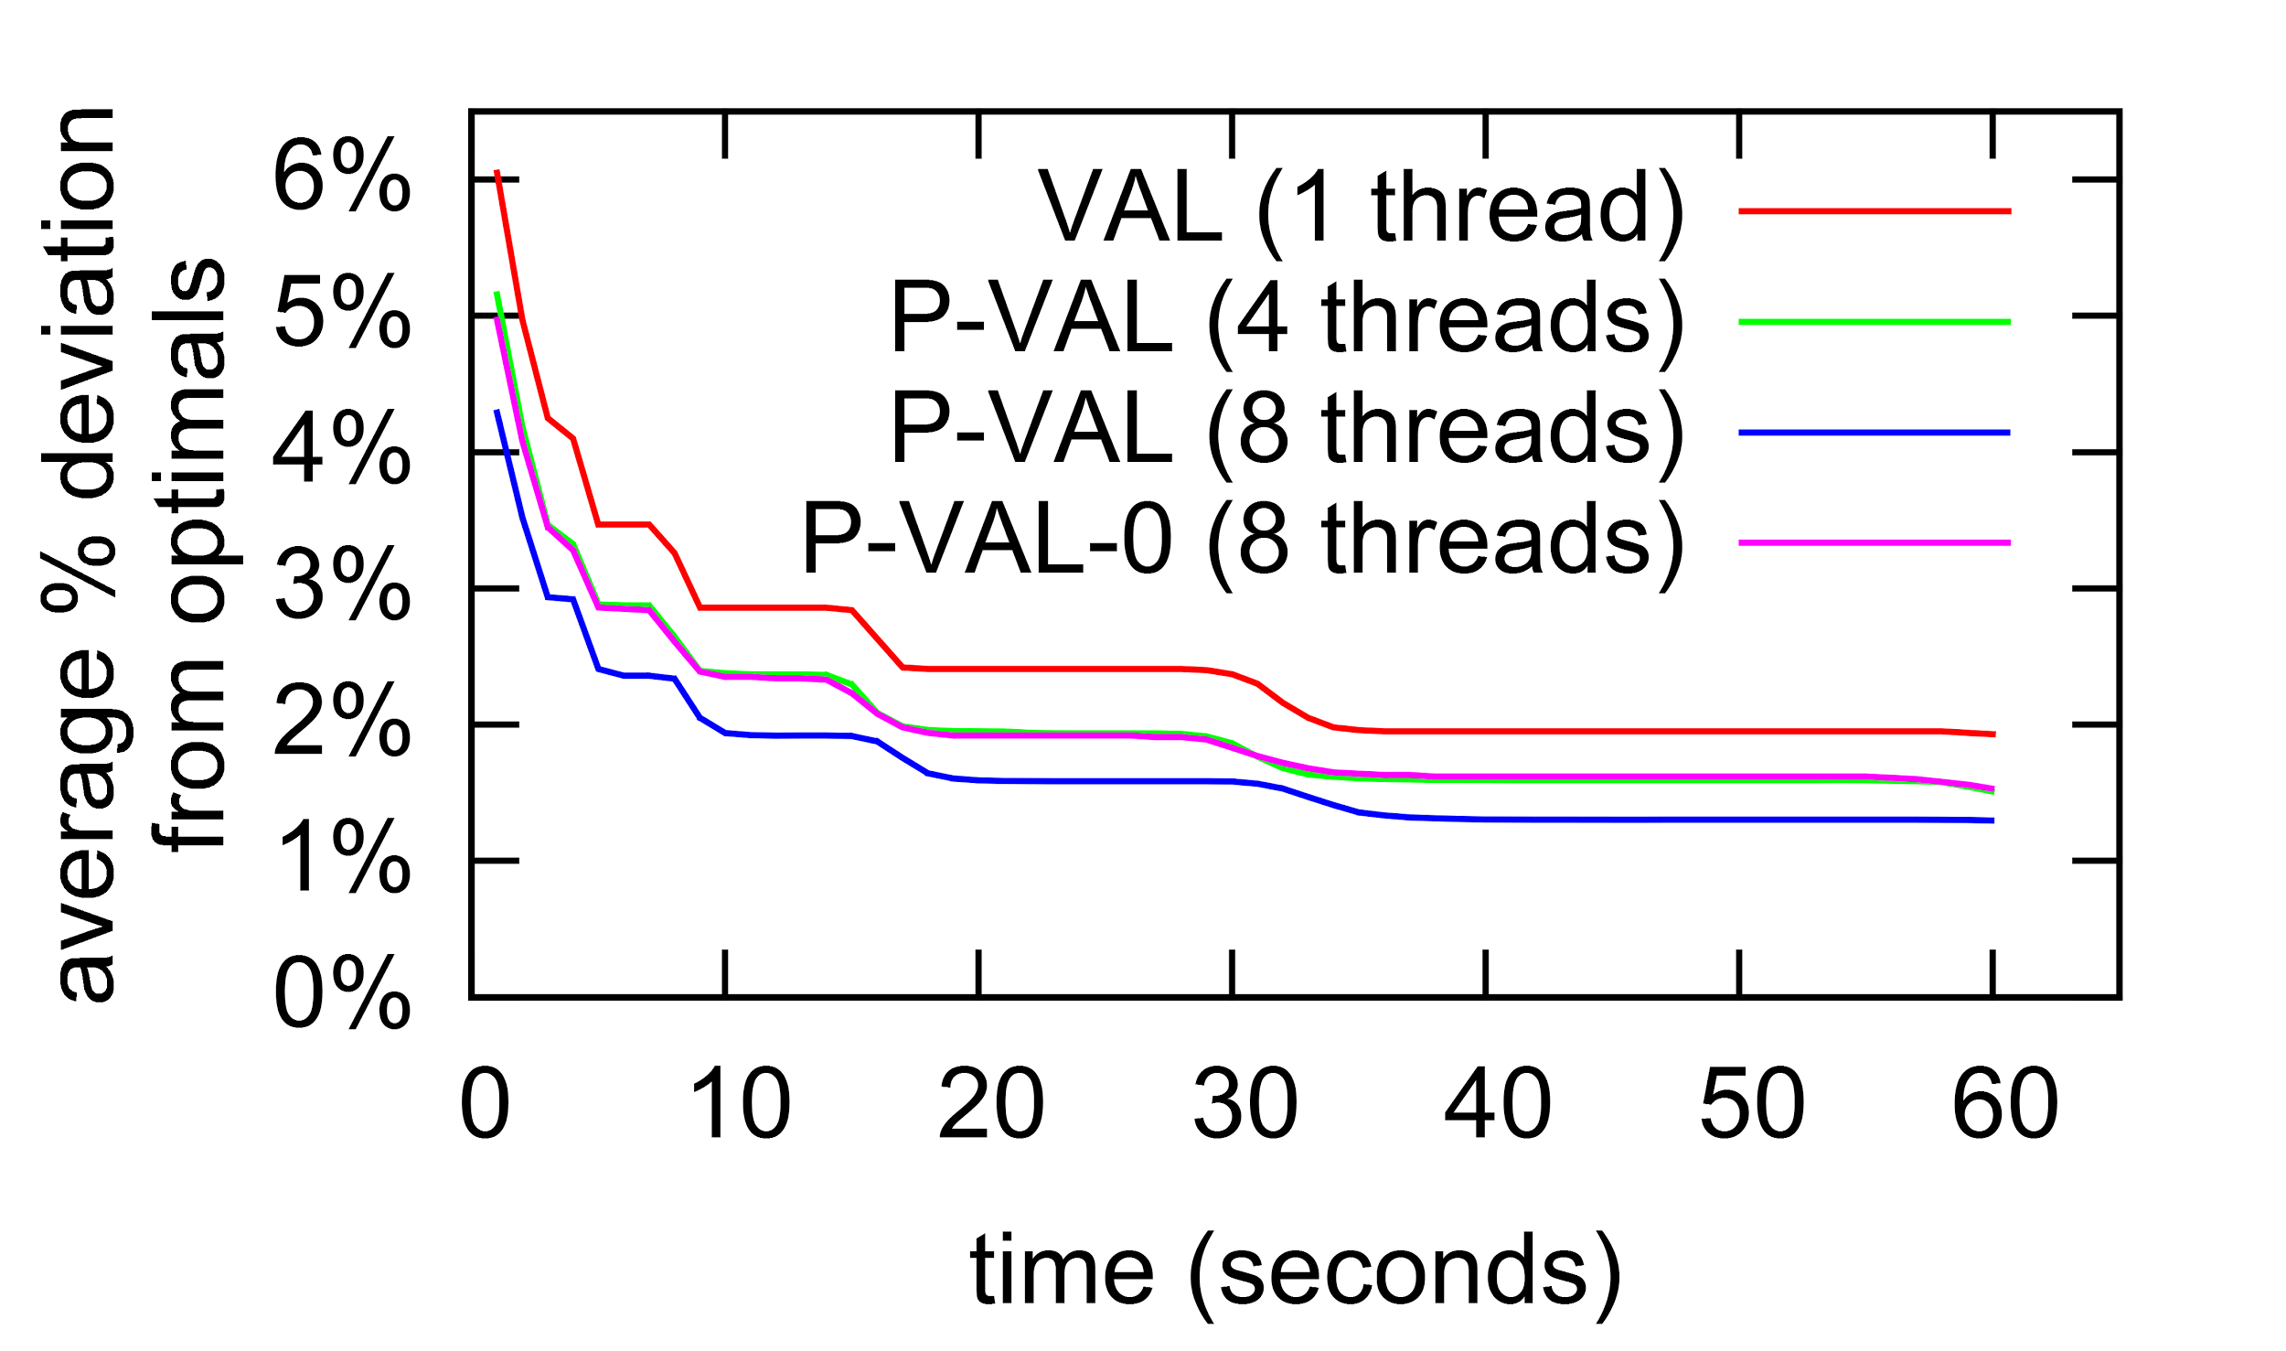
P-VAL vs P-VAL-0
P-VAL-0 with N>4 parallel runs doesn’t improve performance
e.g., P-VAL-0 with N=8 no better than N=4 (green/pink)
P-VAL continues to see performance gains for N>4 parallel runs.

Slide 15
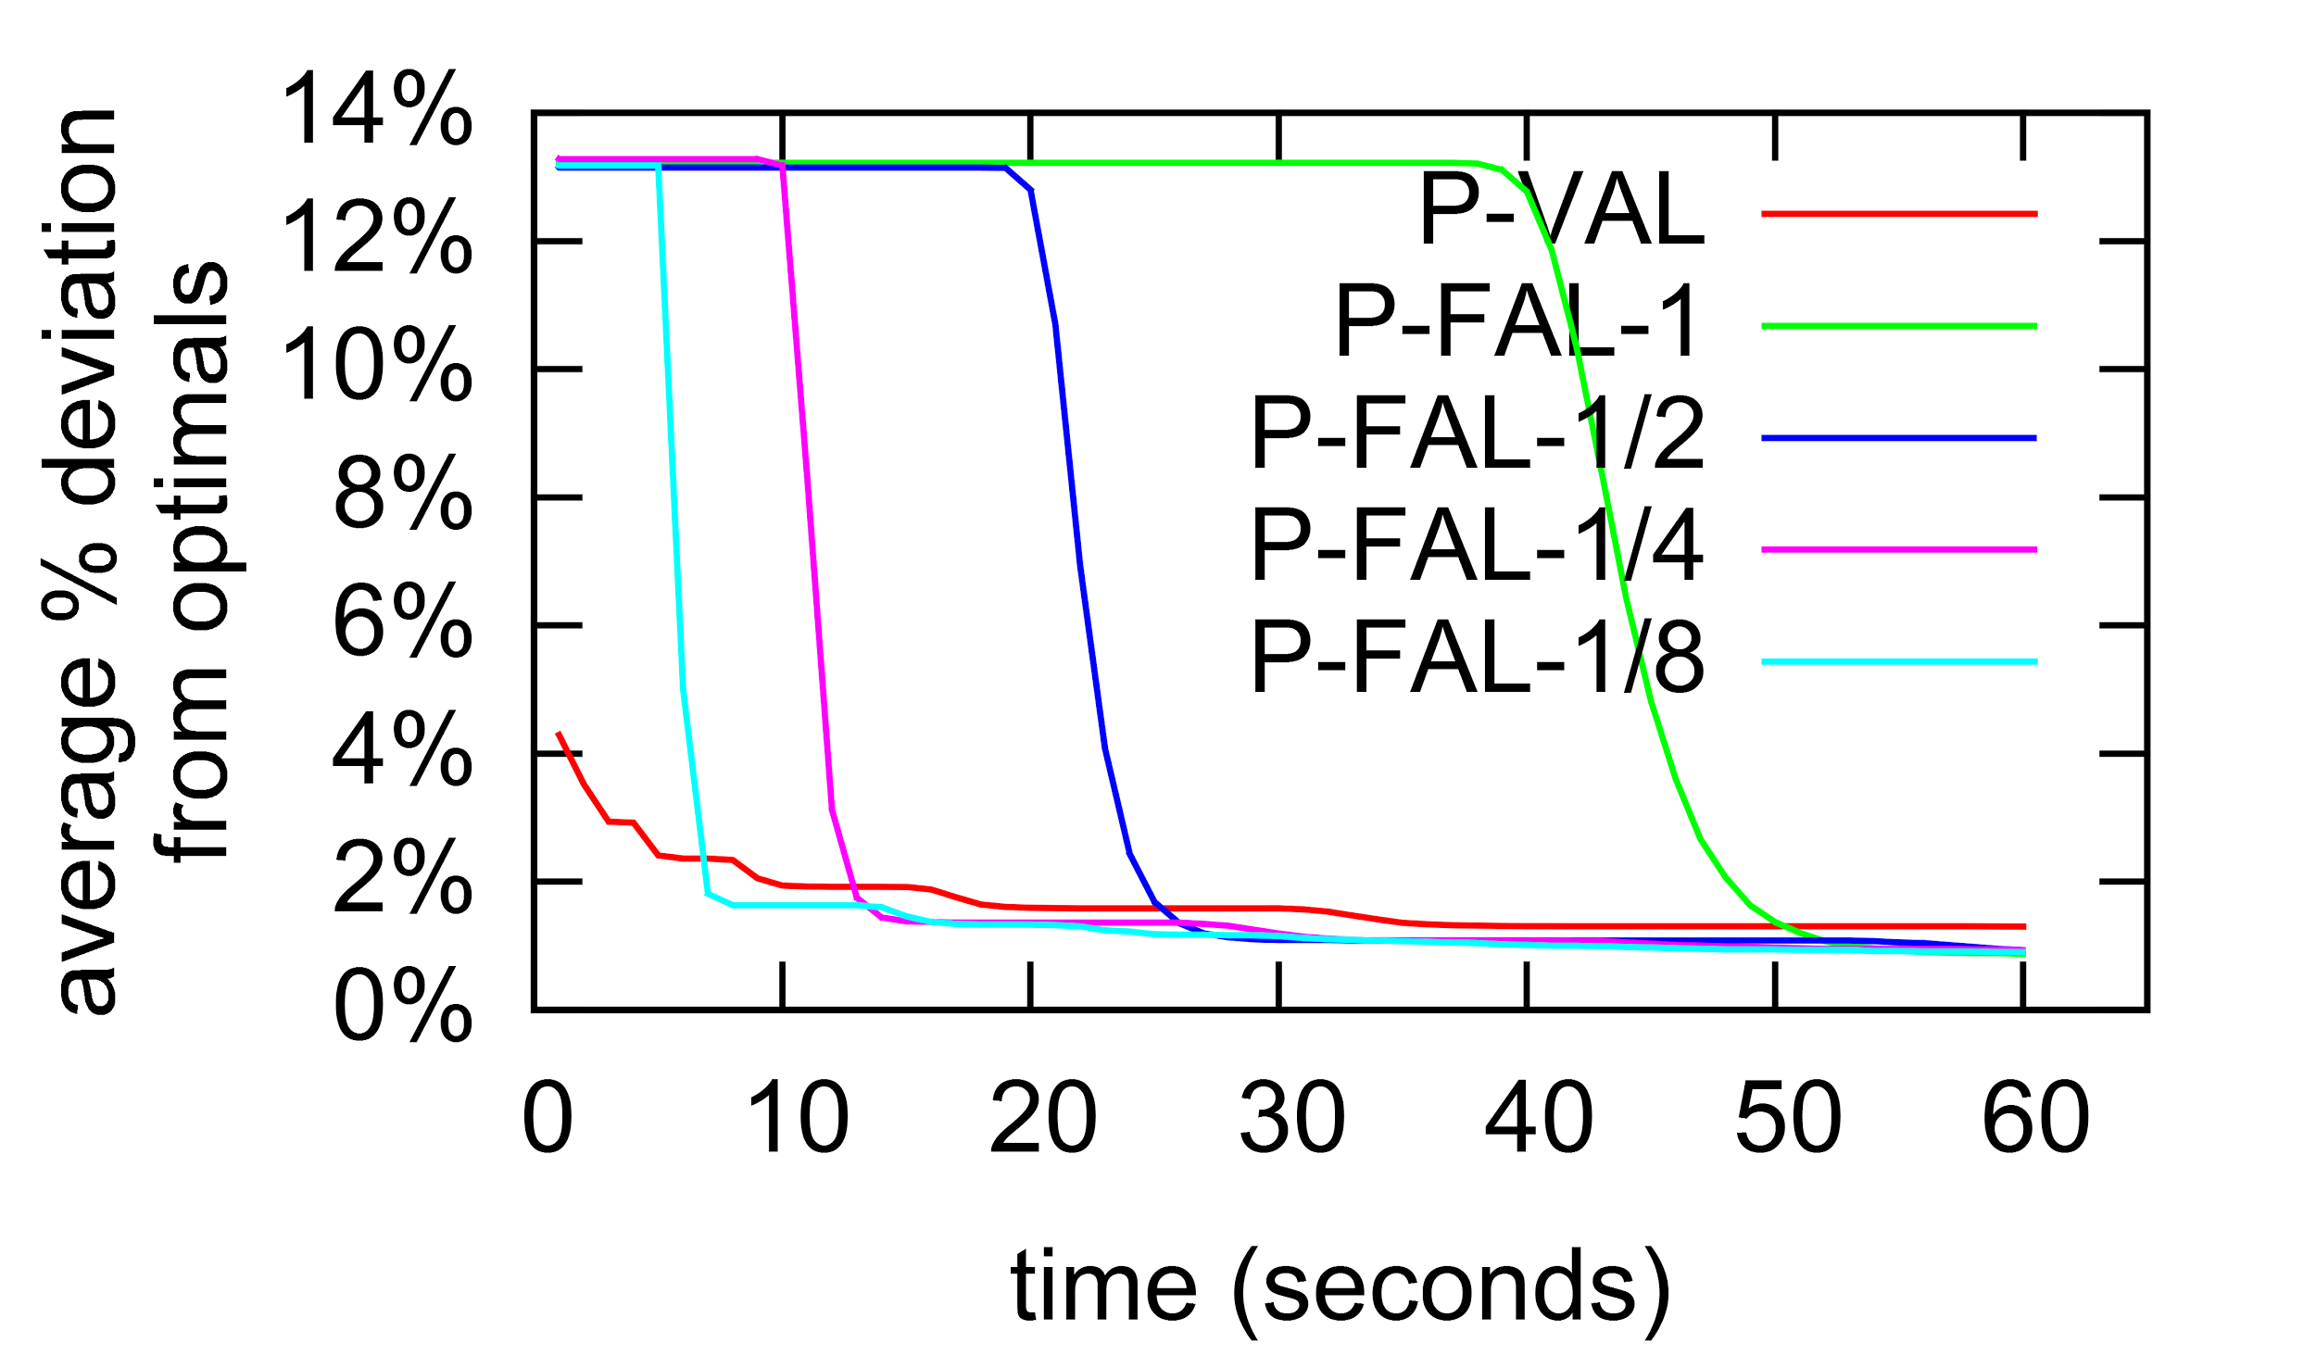
Parallel Results
Results with N=8
Unlike sequential case, P-VAL does not approx. performance of fixed length restarts at run end.
P-VAL dominates approx. 80% of P-FAL’s first run
For 48s vs P-FAL-1
For 24s vs P-FAL-½
For 12s vs P-FAL-¼
For 6s vs P-FAL-⅛

Slide 16
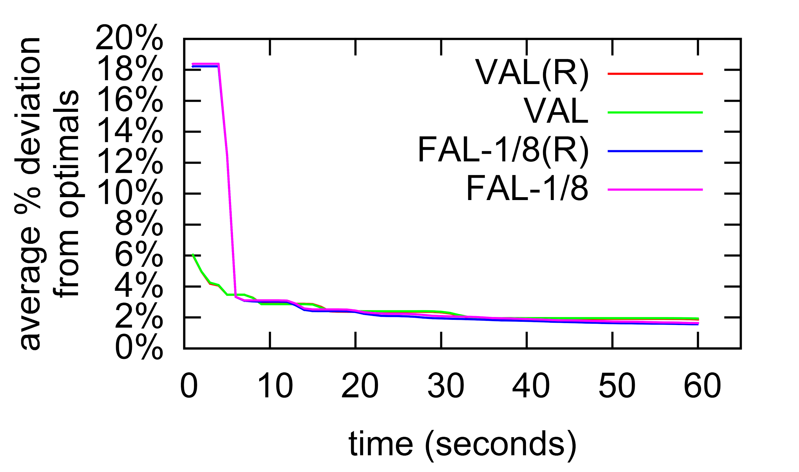
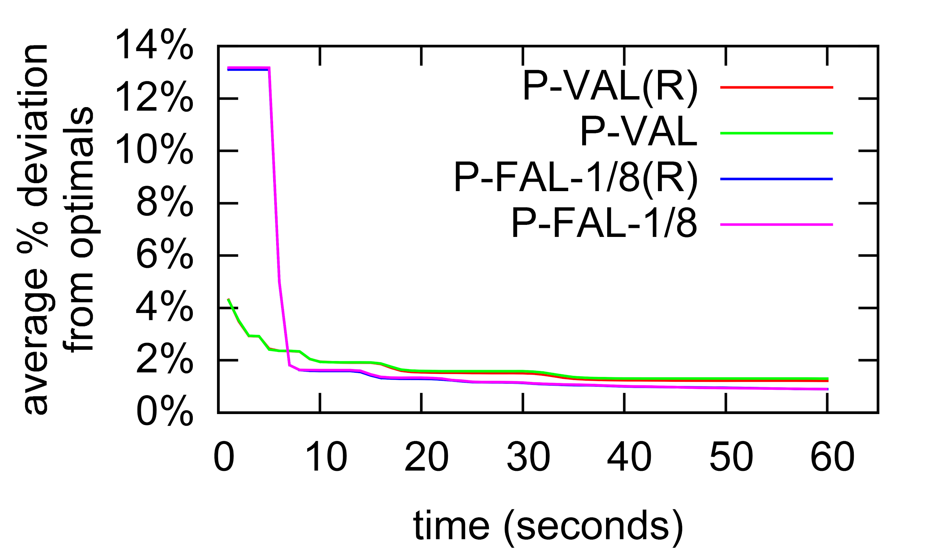
Reannealing vs Independent Runs
All results so far are for independent runs.
Also considered restarts that reanneal the current best of run solution
Including across parallel runs.
Sequential results:
No significant difference for VAL with reannealing vs independent runs.
Same is true for FAL-⅛ with reannealing vs independent runs.
Same is true in parallel

Slide 17
Conclusions
Proposed a multistart SA, with variable annealing length
Eliminates need to know/predict available time for run
Issue not limited to Modified Lam (e.g., common exponential schedule becomes stochastic hill climb too soon if α too low).
Short early runs quickly find “good” solution, and increasing run length approximates final performance of long SA runs.
Proposed parallel implementation
Long fixed length runs better at end of run, but variable length restarts exhibits stronger anytime performance.

Slide 18
Questions

