Slide 1
Classification of Permutation Distance Metrics for Fitness Landscape Analysis
Vincent A. Cicirello, Ph.D.
Professor of Computer Science / Behavioral Neuroscience
cicirelv@stockton.edu https://www.cicirello.org/

Slide 2
Introduction
Bio-inspiration: fitness landscapes and Mendelian genetics
Fitness landscapes and evolutionary computation
With simple example with bit-strings
Fitness landscapes and the permutation representation
Mutational distance and permutations
Classifying permutation distance metrics
Principal component analysis to identify groups of closely related metrics
Example fitness landscape analysis with problems in the identified classes
Wrap-up and Conclusions

Slide 3
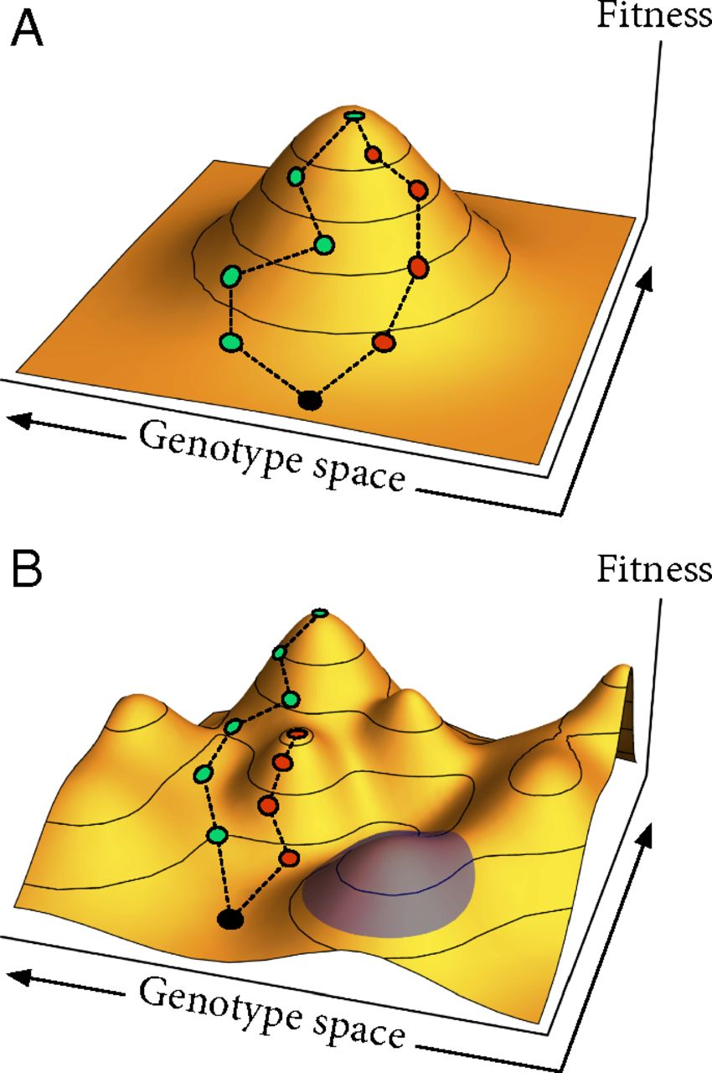
Fitness Landscapes and Mendelian Genetics
The concept of a fitness landscape originated with Sewall Wright (Genetics, 1931): “Evolution in Mendelian Populations.”
Fitness landscape defined by: (a) set of genotypes, (b) mutational distance between them, and (c) their fitness in an environment.
Landscape structure depends on fitness effects of mutations and mutation interactions.
Space of possible genotypes on horizontal axes, and the associated fitness on the vertical axis.
Figure Credit: J. Van Cleve, and D. B. Weissman, “Measuring Ruggedness in Fitness Landscapes.” PNAS 2015;112:24. [©2015 National Academy of Sciences]

Slide 4
Fitness Landscapes and Evolutionary Computation
Evolutionary computation directly uses the concept of a fitness landscape.
Mapping genotype to fitness
“Nearby” genotypes correspond to low mutational distance
Mapping biological concept to evolutionary computation:
Set of genotypes = space of solutions in chosen representation
Mutational distance between them = metric on the representation
Fitness in an environment = fitness function for problem you’re solving
Fitness landscape analysis:
Set of tools/techniques for studying effects of landscape structure on problem solving effectiveness

Slide 5
Mutational Distance Example
A simple mutational distance example with the common bit-string representation of a genetic algorithm (GA).
GAs commonly represent problem solutions with strings of bits.
Fitness landscape must map space of possible genotypes (bit-strings) to fitness, which requires two things:
Fitness function (problem dependent, based on optimization objective)
Measure of mutational distance between bit-strings
Distance for bit-strings:
GA mutation for bit-strings: random bit flip
Hamming distance: Number of locations with different bits
S1: 0010010000
S2: 0010010100
S3: 1000010100
d(S1,S2) = 1
d(S2,S3) = 2

Slide 6
Distance for Permutations
For some problems, representing solutions with permutations is a better match than bit-strings.
E.g., Traveling salesperson (TSP): solution is a permutation of cities
One-to-one mapping problems, such as largest common subgraph (e.g., keep vertices of G1 in fixed order, mapping is then a permutation of G2’s vertices)
Many scheduling problems involving optimizing a sequence of tasks/activities
How do you measure mutational distance between permutations?
Unlike bit-strings, many permutation mutation operators exist.
Option 1: Choose a metric based on genetic operator used by search.
Option 2: Explore different landscapes (with different metrics) using results to better choose which operator to use (e.g., operator with smoother landscape).

Slide 7
Mutational Distance = Edit Distance
Edit Distance:
The edit distance between two structures, s1 and s2, is the minimum number of edit operations necessary to transform s1 to s2.
Originated in string matching community (e.g., Wagner & Fischer, JACM 1974).
Mutational distance for fitness landscape analysis is ideally an edit distance where the mutation operator(s) are the edit operations.
Bit-strings:
Hamming distance is an edit distance on bit-strings where edit operation is a bit flip.
Permutations:
For some permutation operators, there are corresponding edit distances.
For other permutation mutation operators, computing edit distance is NP-Hard.

Slide 8
Mutational Distance for Permutation Operators
Sampling of mutation operators for permutations, along with corresponding edit distances (where available).
Mutation operator | Edit distance
Swap | Interchange distance: O(n)
Insertion | Reinsertion distance: O(n lg n)
Adjacent Swap | Kendall Tau distance: O(n lg n)
Reversal | NP-Hard
Block-move | NP-Hard
k-Change | NP-Hard??? 2-changes closely related to reversals, 3-changes closely related to block-moves

Slide 9
Classification of Permutation Distance Metrics
Others have informally referred to permutation optimization problems as belonging to different classes based on most important permutation features:
R-Permutation (Campos et al, 2005):
Problems like TSP where permutation represents a set of edges (“R” for relative), e.g., cities A and B adjacent in permutation means edge from A to B regardless of where it exists.
A-Permutation (Campos et al, 2005):
Problems where absolute (“A”) position within permutation is important (e.g., one-to-one mapping)
P-Permutation (Cicirello, 2016):
Problems where precedence among elements is important, a property that many scheduling problems have (e.g., perhaps job A occurring sometime prior to B, C, and D is important to fitness).
Can we classify the available permutation metrics? And how does such a classification relate to the different problem types?

Slide 10
Classification of Permutation Distance Metrics
Can we classify the available permutation metrics? And how does such a classification relate to the different problem types?
Approach:
Gather the available permutation distance metrics.
Use principal component analysis (PCA) to identify groups of related metrics.
Two approaches to computing correlation matrix:
Computing distances of all 10! permutations of length 10 to a reference permutation.
Computed via randomly sampling the space of permutations of length 50.
Examine how different metrics affect fitness landscapes for problems from known problem classes.
e.g., Do metrics from an identified class affect landscape in a similar way?

Slide 11
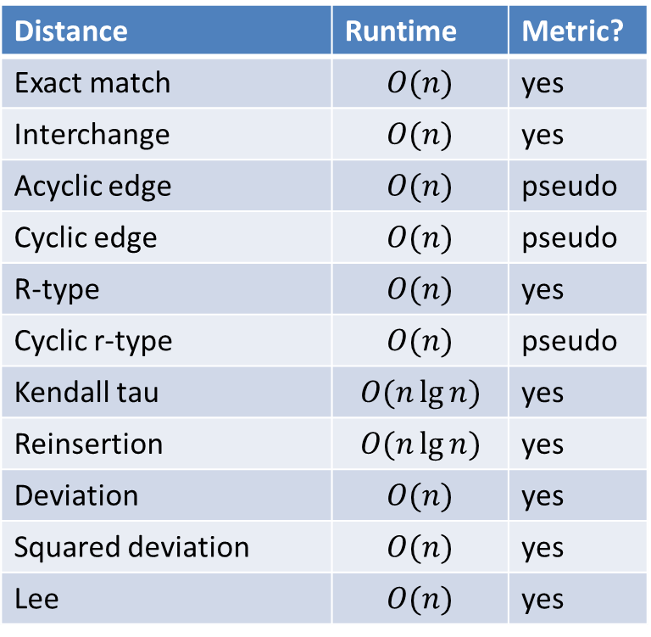
Permutation Distances Considered
Distance | Runtime | Metric?
Exact match | $$O(n)$$ | yes
Interchange | $$O(n)$$ | yes
Acyclic edge | $$O(n)$$ | pseudo
Cyclic edge | $$O(n)$$ | pseudo
R-type | $$O(n)$$ | yes
Cyclic r-type | $$O(n)$$ | pseudo
Kendall tau | $$O(n\lg{n})$$ | yes
Reinsertion | $$O(n\lg{n})$$ | yes
Deviation | $$O(n)$$ | yes
Squared deviation | $$O(n)$$ | yes
Lee | $$O(n)$$ | yes
Note: See paper for details
of the distance metrics.

Slide 12
Permutation Distance Metric Classification
Distance | PC1 | PC2 | PC3 | PC4 | PC5
Exact match | 0.6234 | 0.1691 | 0.6579 | -0.1439 | 0.1052
Interchange | 0.5196 | 0.1227 | 0.7355 | -0.0536 | 0.2910
Acyclic edge | 0.1784 | -0.8385 | 0.1644 | 0.4218 | -0.0470
Cyclic edge | 0.1682 | -0.8415 | 0.1450 | 0.4276 | -0.0337
R-type | 0.2654 | -0.8600 | -0.0699 | -0.3479 | 0.0382
Cyclic r-type | 0.2410 | -0.8602 | -0.0808 | -0.3469 | 0.0377
Kendall tau | 0.8808 | 0.1638 | -0.3775 | 0.1281 | 0.1695
Reinsertion | 0.7774 | -0.1497 | -0.3070 | -0.3472 | -0.0377
Deviation | 0.9435 | 0.2332 | -0.1322 | 0.1491 | -0.0481
Squared dev. | 0.8649 | 0.2099 | -0.3434 | 0.2236 | 0.1640
Lee | 0.7063 | 0.1812 | 0.2619 | -0.0436 | -0.6207
Table shows correlation between metrics and the first 5 principal components.
PC1 (P-permutation):
Among strongest correlations is Kendall tau, number of inverted element pairs.
PC2 (R-permutation):
Strongest correlations to the metrics that focus on relative element positions
PC3 (A-permutation):
Exact match clearly focuses on absolute positions (it’s non-binary Hamming)
PC4 (R-permutation, undirected subtype)
PC5 (P-permutation, cyclic subtype)

Slide 13
Example Fitness Landscape Analysis
Fitness Distance Correlation
Five small optimization problems with known optimal solutions
L1: R-permutation landscape, undirected
Simple TSP
L2: R-permutation landscape, directed
Simple Asymmetric TSP
L3: A-permutation landscape
Small artificial mapping problem (see paper)
L4: P-permutation landscape, acyclic subtype
Small artificial problem where element precedence affect fitness
L5: P-permutation landscape, cyclic subtype
Distance | L1 | L2 | L3 | L4 | L5
Exact match | 0.15 | 0.19 | 0.69 | 0.30 | 0.48
Interchange | 0.12 | 0.09 | 0.53 | 0.22 | 0.37
Acyclic edge | 0.61 | 0.35 | 0.01 | 0.00 | 0.02
Cyclic edge | 0.62 | 0.38 | 0.00 | 0.00 | 0.00
R-type | 0.54 | 0.63 | 0.01 | 0.08 | 0.01
Cyclic r-type | 0.56 | 0.66 | 0.00 | 0.07 | 0.00
Kendall tau | 0.34 | 0.24 | 0.22 | 0.90 | 0.39
Reinsertion | 0.34 | 0.53 | 0.21 | 0.64 | 0.39
Deviation | 0.39 | 0.19 | 0.35 | 0.84 | 0.61
Squared dev. | 0.32 | 0.16 | 0.23 | 0.89 | 0.39
Lee | 0.46 | 0.23 | 0.38 | 0.41 | 0.86

Slide 14
Conclusions
We produced a classification of the available permutation distance metrics.
All metrics are available in an open source Java library, JavaPermutationTools
API documentation: https://jpt.cicirello.org/
Repository: https://github.com/cicirello/JavaPermutationTools
Code for our principal component analysis also available.
Classification can help in selection of a metric for fitness landscape analysis.
Classification can help in choosing mutation operators.
Explore how fitness landscape topology is affected by distance metric.
If landscape is “smoother” with metrics of a given class, choose mutation operator that corresponds most closely to those metrics.
Classification may also help in choosing GA crossover operators.
Large variety pf permutation crossover operators with complex behavior.

Slide 15
Questions?

