Slide 1
Impact of Random Number Generation on Parallel Genetic Algorithms
Vincent A. Cicirello, Ph.D.
Professor of Computer Science / Behavioral Neuroscience
cicirelv@stockton.edu https://www.cicirello.org/

Slide 2
Introduction
Genetic algorithms (GA), and other forms of evolutionary computation, solve problems through simulated evolution.
Evolve populations of solutions using evolution inspired operators, such as mutation, crossover, selection, etc.
We introduce a Parallel GA with adaptive control parameters for an NP-Hard scheduling problem, based on an existing Sequential GA.
We show careful choice of pseudorandom number generator (PRNG) can accelerate GA runtime by up to 25% (sequential) and 20% (in parallel).
Genetic algorithm operators involve significant random behavior.
Rarely considered by GA implementers, replying simply on PRNGs in standard language libraries, which are slow relative to alternatives.

Slide 3
Usage of Random Numbers in GAs
GAs are population based: Evolve a population over many generations.
Selection: Selects the population for next generation.
Random selection process biased toward members with higher fitness.
Mutation: Small random changes to population members.
For common bit-string representation, this involves iterating over all bits of all population members in each generation (1 random value per bit)
Other representations less extreme: Permutation mutation involves between 1 and 3 random values per population member per generation
Crossover: Combine “genes” from pair of parents to form pair of children.
Involves generating random cross sites (i.e., random indices into bit-string, permutation, etc).

Slide 4
Background: Random Number Generation
Pseudorandom Number Generators (PRNG) in standard libraries:
C, C#, and pre-2011 C++: linear congruential
C++11: linear congruential as well as Mersenne Twister
Java: linear congruential (Random class), SplitMix (ThreadLocalRandom since 1.7 and SplittableRandom since 1.8)
Python: Wichmann-Hill (prior to version 2.3), Mersenne Twister (version 2.3 onward)
PRNG Characteristics:
Linear congruential (LCG): Slow, low quality randomness
Wichmann-Hill: combines multiple LCG, better quality, but still slow
Mersenne Twister: faster, and good quality (passes Dieharder tests)
SplitMix: much faster, and good quality (passes Dieharder tests)

Slide 5
More PRNG Background
Some forms of evolutionary computation require generating random numbers from distributions other than uniform.
Gaussian mutation for mutating real valued parameters in evolution strategies requires random values from a Gaussian distribution.
Built-in language support for Gaussians:
C, C#, and pre-2011 C++: None in standard libraries.
C++11: polar method
Java: polar method (Random / ThreadLocalRandom classes, and none in SplittableRandom)
Python: ratio of uniform deviates method
Other much faster algorithms available, such as Ziggurat

Slide 6
Sequential Genetic Algorithms
Our 2 new Parallel GAs are based on 2 existing Sequential GAs.
Shared Features of the GAs:
Permutation representation: Population of permutations.
Selection Operation: Stochastic Universal Sampling (SUS)
Probability of selecting a member of population proportional to its fitness (like weighted roulette wheel), but all at once (e.g., like spinning a wheel with N equidistant pointers).
Reduces selection bias (Baker, ‘87).
More efficient: One random number to select N population members, compared to N random numbers with weighted roulette wheel.
Elitism: We keep the E most-fit unique permutations unaltered.

Slide 7
Mutation and Crossover Operators
Mutation Operator: Insertion
Remove random element of permutation and reinsert at different random location.
Non-Wrapping Order Crossover (NWOX) [Cicirello, GECCO ‘06]

Slide 8
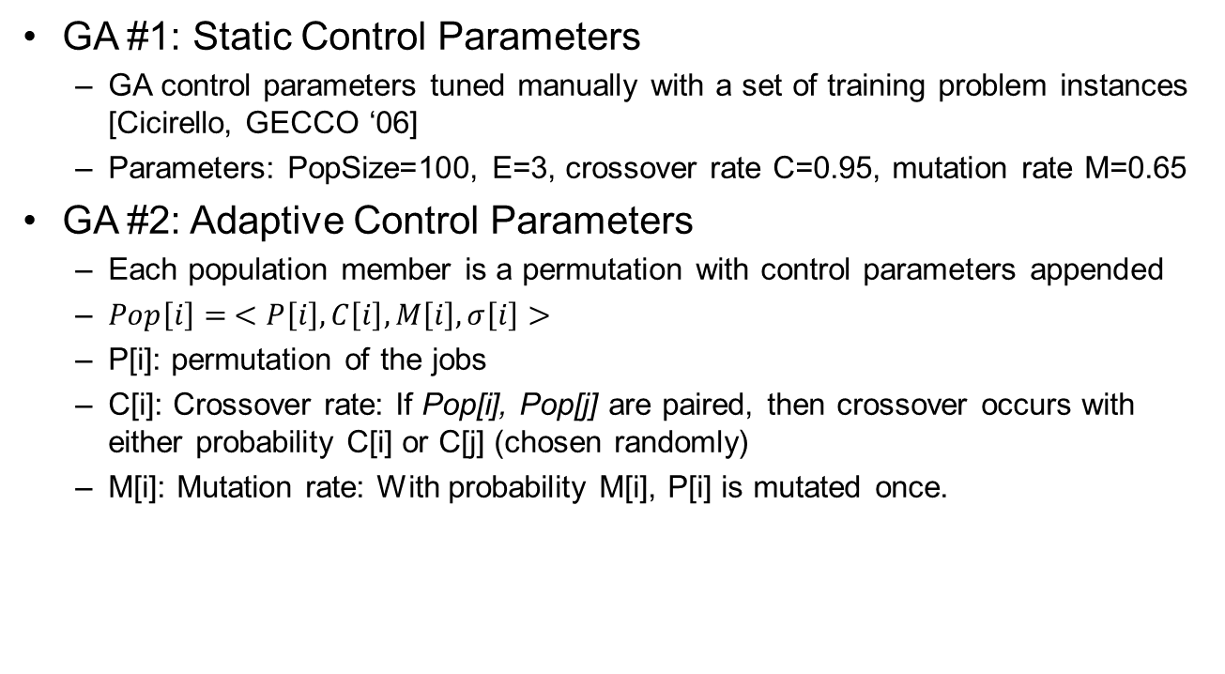
Sequential Genetic Algorithms
GA #1: Static Control Parameters
GA control parameters tuned manually with a set of training problem instances [Cicirello, GECCO ‘06]
Parameters: PopSize=100, E=3, crossover rate C=0.95, mutation rate M=0.65
GA #2: Adaptive Control Parameters
Each population member is a permutation with control parameters appended
$Pop\left[i\right]= <P\left[i\right], C\left[i\right], M\left[i\right], σ\left[i\right]>$
P[i]: permutation of the jobs
C[i]: Crossover rate: If Pop[i], Pop[j] are paired, then crossover occurs with either probability C[i] or C[j] (chosen randomly)
M[i]: Mutation rate: With probability M[i], P[i] is mutated once.

Slide 9
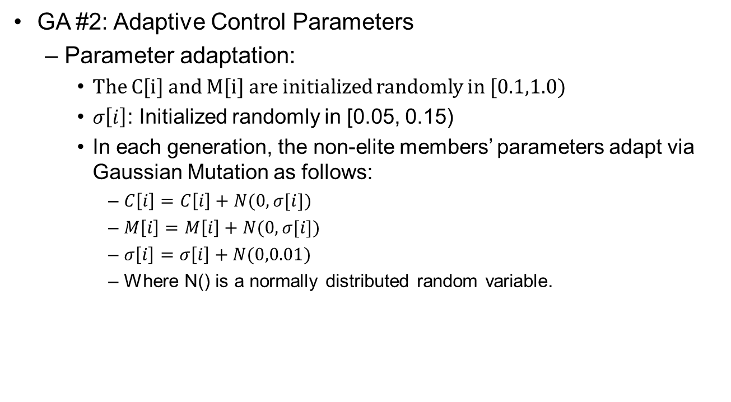
Sequential Genetic Algorithms
GA #2: Adaptive Control Parameters
Parameter adaptation:
The C[i] and M[i] are initialized randomly in [0.1,1.0)
$σ\left[i\right]$: Initialized randomly in [0.05, 0.15)
In each generation, the non-elite members’ parameters adapt via Gaussian Mutation as follows:
$C\left[i\right]=C\left[i\right]+N(0,σ[i])$
$M\left[i\right]=M\left[i\right]+N(0,σ[i])$
$σ\left[i\right]=σ\left[i\right]+N(0,0.01)$
Where N() is a normally distributed random variable.

Slide 10
Parallel Genetic Algorithms (pGA)
pGA #1: Static Control Parameters
Island model with k sub-populations (concurrent evolution of the k populations)
Operators: SUS selection with elitism, NWOX, Insertion mutation
Control parameters: fixed at manually tuned single population values
pGA #2: Adaptive Control Parameters
Island model with k sub-populations (concurrent evolution of the k populations)
Operators: SUS selection with elitism, NWOX, Insertion mutation
Control parameters: encoded within population and evolve with search

Slide 11
Experiments
Platform: Ubuntu 14.04 server, 2 Xeon L5520 quad-core (2.27GHz), 32GB; Java 8, Java HotSpot 64-bit Server VM
PRNGs used in experiments:
Linear Congruential (Java’s Random class)
SplitMix (Java’s ThreadLocalRandom class, also SplittableRandom, but no time difference relative to ThreadLocalRandom)
Algorithms for Gaussian random numbers used in experiments:
Polar method (included in standard library)
Ziggurat method [Marsaglia & Tsang, ‘00]: We ported the GNU Scientific Library’s C implementation to Java.

Slide 12
Experiments
Problem: Scheduling with sequence-dependent setups, minimizing weighted tardiness
NP-Hard
Used common benchmark set (120 problem instances, with varying levels of duedate tightness, setup time severity)
Best exact solver, dynamic programming, > 2 weeks CPU time solving hardest instances. (Tanaka & Araki, 2013)
Variety of algorithms applied to problem: neighborhood search (Liao et al, 2012), iterated local search (Xu et al 2014), ACO (Liao & Juan 2007), among others
Performance metric: Average % deviation from the optimals
Average over 10 runs on each of 98 problem instances (average of 980 runs).

Slide 13
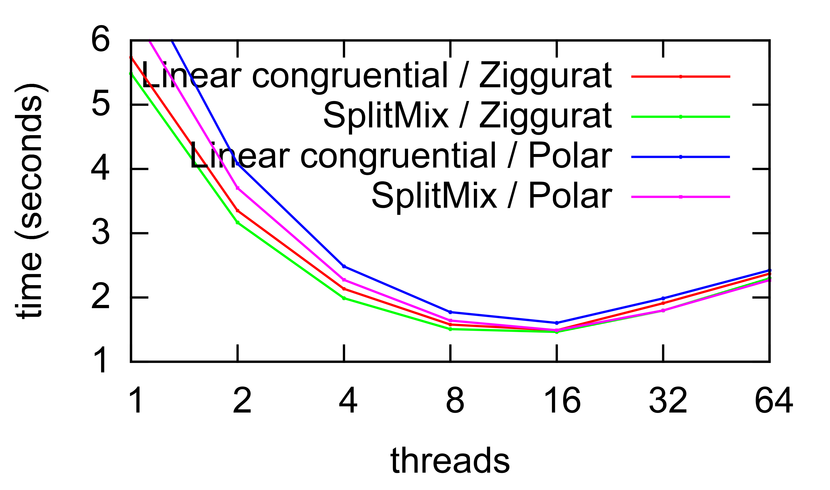
pGA Runtime
Adaptive parameters
Experimental parameters
Subpopulation size = 100,
Total population size = 100 k, where k is number of threads
Generations = 64000 / k
pGA with adaptive parameters (4 threads) is 20% faster with SplitMix & Ziggurat than with LC & Polar.
Sequential GA with adaptive parameters is 25% faster with SplitMix & Ziggurat than with LC & Polar.
At any fixed number of threads, no statistical difference (Wilcoxon signed rank test) on
the scheduling optimization objective across the benchmark.

Slide 14
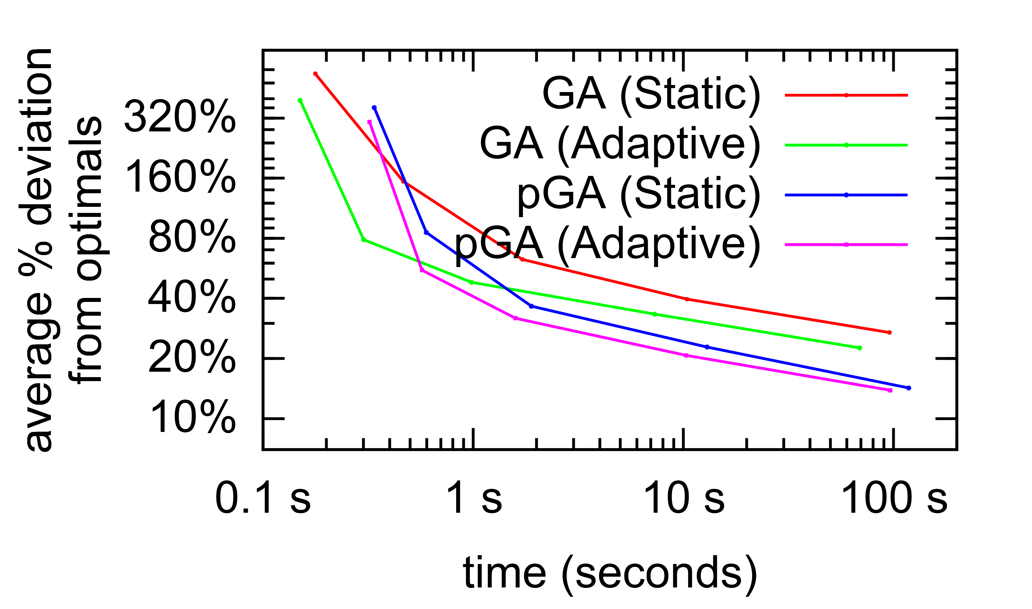
Scheduling performance
Sequential GA settings:
Population size = 100 (as was originally the case)
pGA settings:
Subpopulation size = 100
8 subpopulations (8 threads)
Total population size = 800
Short runs: no benefit to parallelization (due to thread management overhead)
In 8.8s, the adaptive pGA achieves an average percent deviation equivalent to that of a 69s run of the sequential GA.

Slide 15
pGA: Adaptive vs Static Parameters
Average % deviation
From optimals
Runtime
in seconds
The pGA with adaptive parameters leads to better quality solutions than static parameters for any fixed length run in #generations.
The statistical significance of differences decreases with run length
The longer the run, the nearer to the optimals both versions become
The pGA with adaptive parameters requires less time than with static parameters for the same number of generations
Crossover rate tends to decline later in the run with adaptive parameters
G | Adaptive | Static | p | Adaptive | Static
10² | 306.0% | 360.7% | < 10⁻⁸ | 0.3s | 0.3s
10³ | 55.4% | 85.6% | < 10⁻⁸ | 0.6s | 0.6s
10⁴ | 31.8% | 36.6% | < 10⁻⁸ | 1.6s | 1.9s
10⁵ | 20.7% | 22.8% | 0.003 | 10s | 13s
10⁶ | 13.9% | 14.2% | 0.043 | 96s | 118s
G = number of generations
p is p-value from Wilcoxon signed rank test

Slide 16
Conclusions
We introduced a new pGA for an NP-Hard scheduling problem
Only parallel GA for this scheduling problem (several sequential GAs exist).
Multipopulation pGA with adaptive control parameters
The pGA achieves approximately linear speedup (for 8 threads) relative to its sequential counterpart
Note: Our test system has 8 physical cores, so unknown if linear speedup continues beyond 8 threads.
Showed choice of pseudorandom number generator, and associated algorithms, has potential to drastically affect GA and pGA runtime
Often overlooked implementation decision, commonly opting for language built-in
Can accelerate runtime by 25% for a sequential GA, and 20% for a parallel GA
Similar results may be found for other metaheuristics that rely on randomness

Slide 17
Questions

