Slide 1
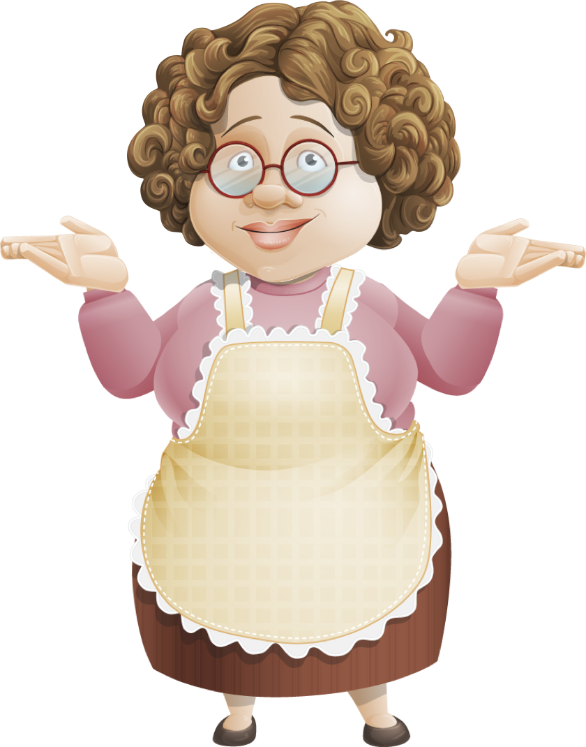

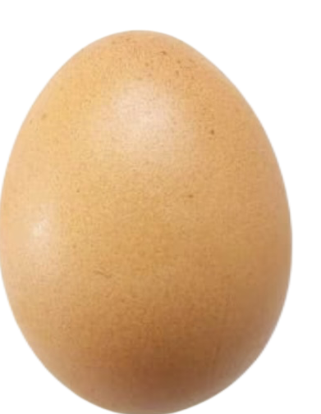

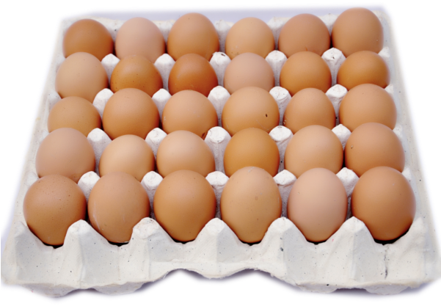
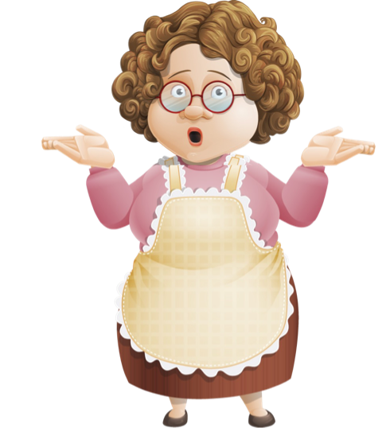
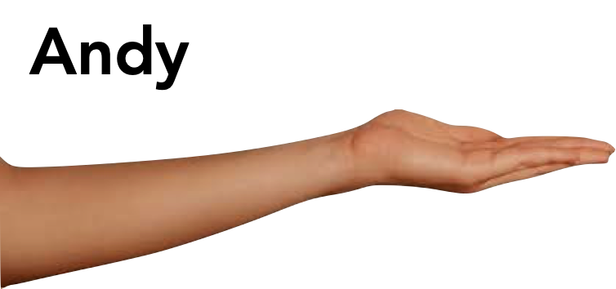
A
Experiment 1
B
Experiment 2
C
Experiment 3
Andy
Suzy
Andy
Suzy
Andy
Suzy
Granny has only one thank-you sticker.
Should she give it to
Andy or Suzy?
Andy
Suzy
time

