Slide 1
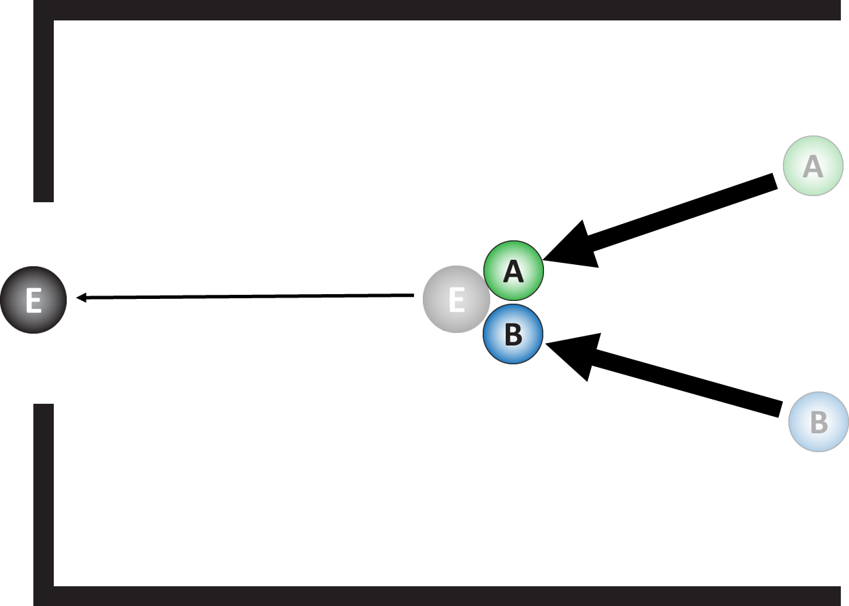
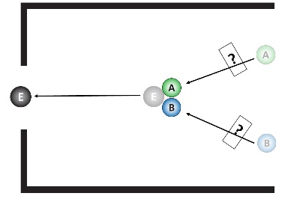
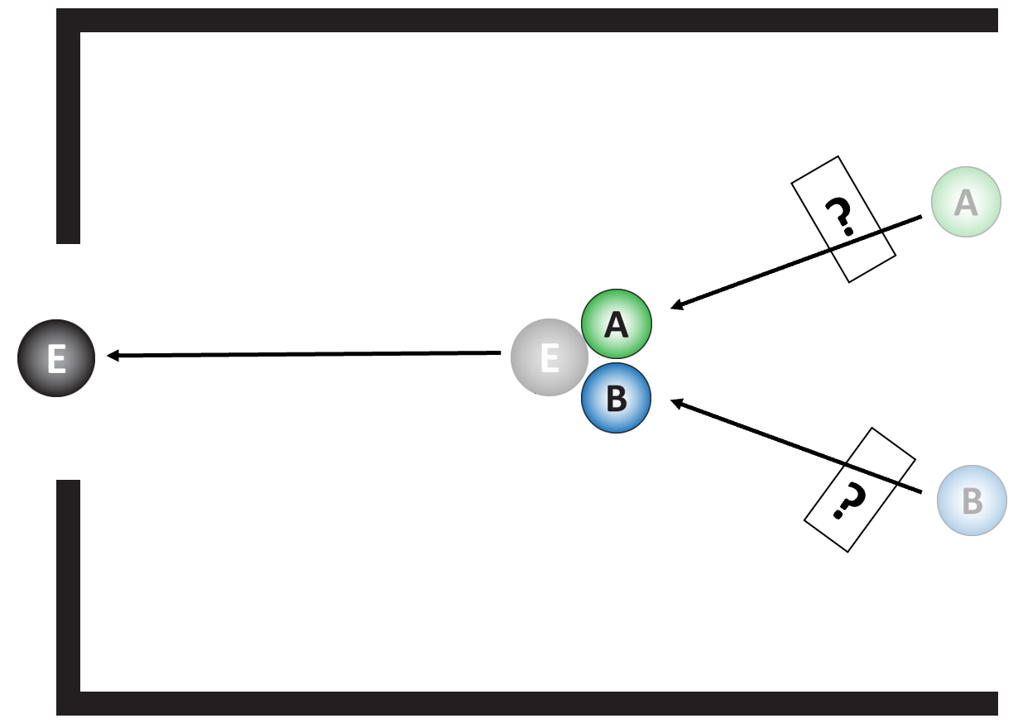
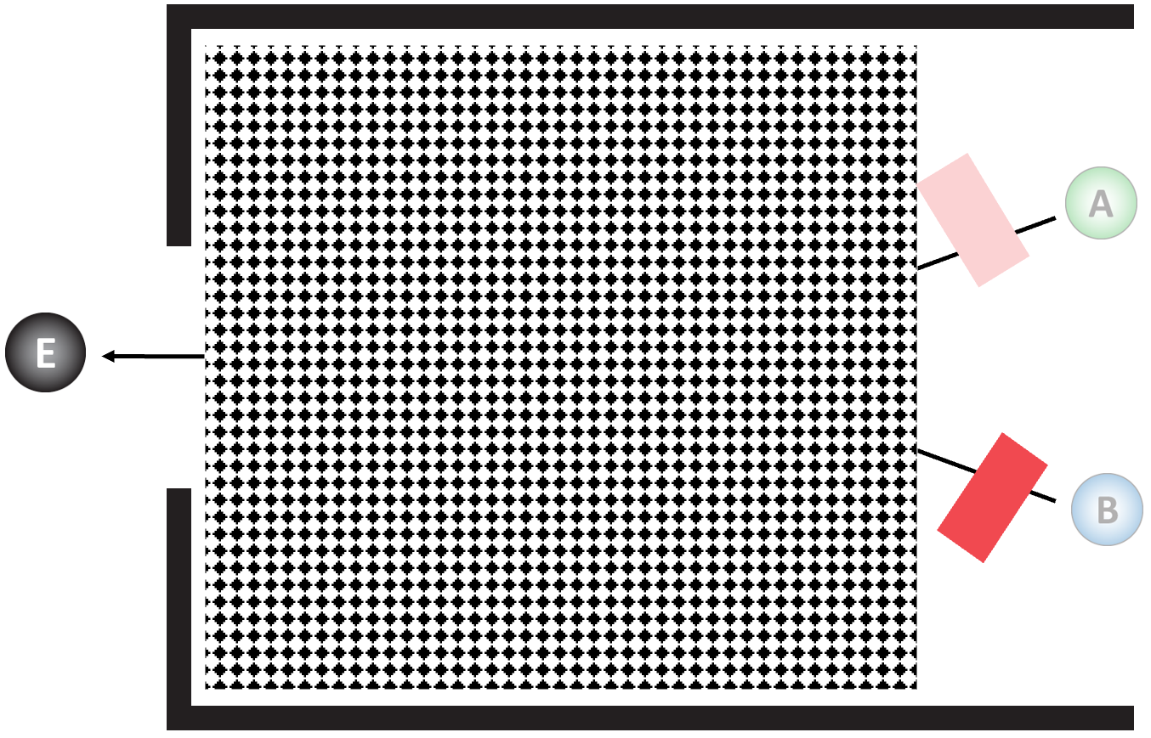
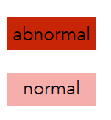
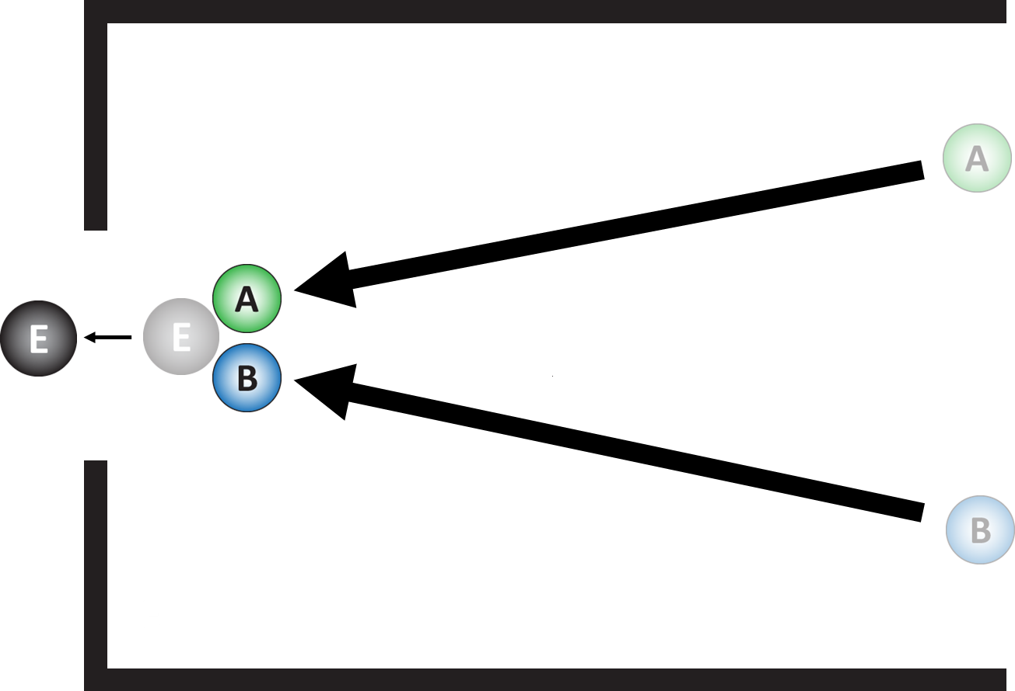

Conjunctive
Conjunctive
Disjunctive
?
?
Normality
Structure
Normality
Structure
Normality
Structure
Causal Explanation
“E because of C.”
?
Causal Explanation
“Ball E went through the gate because ball A went through the block.”
Causal Explanation
“Ball E went through the gate because ball A went through the block.”
Hypothesis 1: Influence of normality and structure on causal explanations.
Hypothesis 2: Inference about normality from causal explanation and structure.
Hypothesis 3: Inference about structure from causal explanation and normality.

