Slide 1
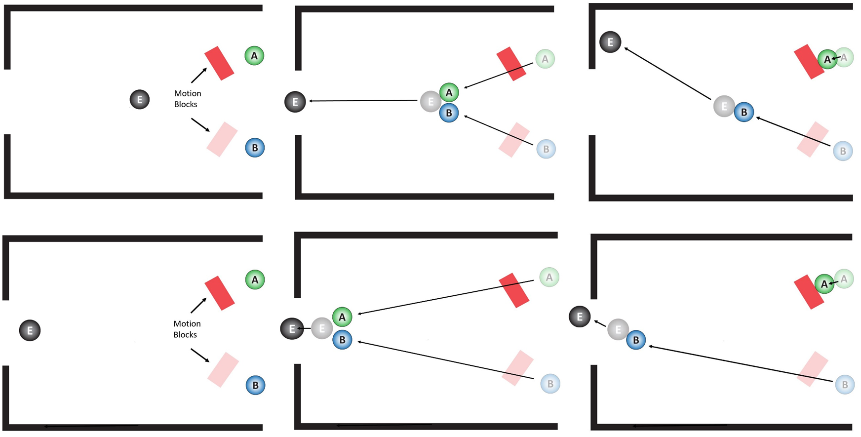
Starting position of the balls
Both balls go through
Only ball B goes through
CONJUNCTIVE
DISJUNCTIVE

