Slide 1
This game is about fishermen.

Slide 2
Each fisherman has a different strength.
Strength=3
Strength=1

Slide 3

Their strength determines how many fish sacks they can carry.
Strength=3
Strength=1

Slide 4


The fishermen always split the earnings after selling their catch.
Strength=3
Strength=1

Slide 5
Here is a map of where the fishermen live
Fisherman A
Fisherman B
A
B
Fishing pond
Fishing pond
Road
C
Fisherman C
Fishing pond

Slide 6
Each fisherman fishes in his own pond
A
B
Fishing pond
Fishing pond
Road
C
Fishing pond

Slide 7

Afterwards they meet to sell their catch
A
B
C

Slide 8
Sometimes the road is blocked by collapsed trees!
A
B
C

Slide 9
Unless the road is cleared, the fish dealer won’t be able to drive in and will have to buy fish from a different town.
A
B
C

Slide 10
Each fisherman’s strength also determines how many trees they can move
Strength=3
Catch 3 sacks of fish
Clear 3 trees from road
OR

Slide 11
All fishermen can see at a distance how many trees are blocking the road.
A
B
Fisherman A
Fisherman B
C
Fisherman C

Slide 12
Each morning each fisherman wakes up and decides whether to fish or to clear the road.
A
B
Fisherman A
Fisherman B
C
Fisherman C

Slide 13
Each activity (fishing or clearing the road) takes up all day, so they can only do one.
A
B
Fisherman A
Fisherman B
C
Fisherman C

Slide 14
However, the fishermen live too far away from each other, so each one decides individually what to do.
A
B
C

Slide 15
All fishermen know how strong the other fishermen are
C:Strength=1
A:Strength=3
B:Strength=2
A:Strength=3
B:Strength=2
C:Strength=1

Slide 16
Next we will show you a few examples. Choose which actions each fisherman should do to maximize the amount of fish sold

Slide 17
Strength
Strength
Choice
Choice
Strength
Choice

Slide 18
Strength
Strength
Choice
Choice
Strength
Choice

Slide 19
Strength
Strength
Choice
Choice
Strength
Choice

Slide 21
Now we will show you some situations where the fishermen didn’t get the full reward. Your task is to judge how responsible each agent is for not selling as many fish as possible

Slide 22
How blameworthy is each fisherman for not selling any fish?
Strength
Strength
Choice
Choice
Blame
Blame
Strength
Choice
0
Blame
Fish sold

Slide 23
How blameworthy is each fisherman for only selling 1 fish?
Strength
Strength
Choice
Choice
Blame
Blame
Strength
Choice
1
Blame
Fish sold

Slide 24
How blameworthy is each fisherman for not selling any fish?
Strength
Strength
Choice
Choice
Blame
Blame
Strength
Choice
0
Blame
Fish sold

Slide 25
Now we will begin the study. Your task will be slightly different. You will get information about how much each agent was blamed, and you will try to figure out the missing information about the situation.

Slide 26
How blameworthy is each fisherman for only selling X fish?
Strength
Strength
Choice
Choice
Blame
Blame
Strength
Choice
3
Blame
Fish sold

Slide 27
SPP demo 1
Strength
Strength
Strength

Slide 28
SPP demo 2
Strength
Strength
Strength

Slide 29
SPP demo 3
?
?
?
?
Strength
Strength
?
?
Strength

Slide 30
How blameworthy is each fisherman for only selling X fish?
Strength
Strength
Choice
Choice
Blame
Blame
Strength
Choice
3
Blame
Fish sold

Slide 31
Here is a map of where the fishermen live

Slide 32
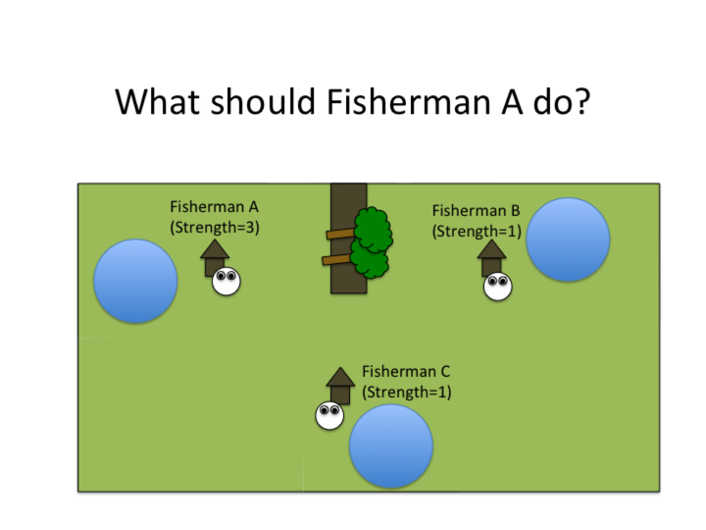
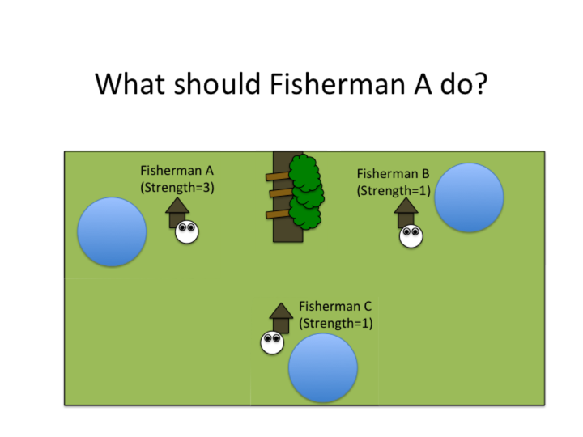
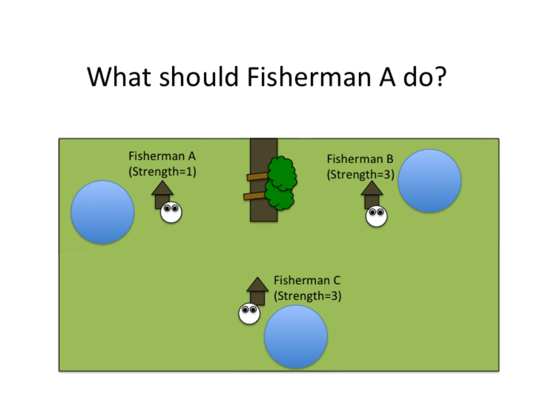

GUIDE
SET 1:
T2_a3b1b1
T3_a3b1b1
SET 2:
T2_a1b3c3
T3_a2b3c3

Slide 33
Here are some examples
Example 1
# of trees blocking:
# of fishermen clearing road:
# of fishermen fishing:
# of trees removed: 2
Road cleared: Yes
Total fish sacs collected: 3
Earnings per fisherman: 3/3
Strength=3
Strength=1
Strength=1

Slide 34
Here are some examples
Example 1
# of trees blocking:
# of fishermen clearing road:
# of fishermen fishing:
# of trees removed: 2
Road cleared: Yes
Total fish sacs collected: 3
Earnings per fisherman: 3/3
Strength=3
Strength=1
Strength=1
Example 2
Strength=3
Strength=1
# of trees blocking:
# of fishermen clearing road:
# of fishermen fishing:
# of trees removed: 2
Road cleared: Yes
Total fish sacs collected: 1
Earnings per fisherman: 1/3
Strength=1

Slide 35
Here are some more examples
Example 3
# of trees blocking:
# of fishermen clearing road: 0
# of fishermen fishing:
# of trees removed: 0
Road cleared: No
Total fish sacs collected: 5
Earnings per fisherman: 0/3 (road blocked)
Strength=3
Strength=1
Strength=1

Slide 36
Here are some more examples
Example 3
# of trees blocking:
# of fishermen clearing road: 0
# of fishermen fishing:
# of trees removed: 0
Road cleared: No
Total fish sacs collected: 5
Earnings per fisherman: 0/3 (road blocked)
Strength=3
Strength=1
Strength=1
Example 4
Strength=3
Strength=1
# of trees blocking:
# of fishermen clearing road:
# of fishermen fishing:
# of trees removed: 3
Road cleared: Yes
Total fish sacs collected: 2
Earnings per fisherman: 2/3
Strength=1

Slide 37
SET2

Slide 38
Here are some examples
Example 1
# of trees blocking:
# of fishermen clearing road:
# of fishermen fishing:
# of trees removed: 2
Road cleared: Yes
Total fish sacs collected: 1
Earnings per fisherman: 1/3
Strength=1
Strength=3
Strength=3

Slide 39
Here are some examples
Example 1
# of trees blocking:
# of fishermen clearing road:
# of fishermen fishing:
# of trees removed: 2
Road cleared: Yes
Total fish sacs collected: 1
Earnings per fisherman: 1/3
Strength=1
Strength=3
Strength=3
Example 2
Strength=1
Strength=3
# of trees blocking:
# of fishermen clearing road:
# of fishermen fishing:
# of trees removed: 2
Road cleared: Yes
Total fish sacs collected: 3
Earnings per fisherman: 3/3
Strength=3

Slide 40
Here are some more examples
Example 3
# of trees blocking:
# of fishermen clearing road: 0
# of fishermen fishing:
# of trees removed: 0
Road cleared: No
Total fish sacs collected: 8
Earnings per fisherman: 0/3 (road blocked)
Strength=2
Strength=3
Strength=3

Slide 41
Here are some more examples
Example 3
# of trees blocking:
# of fishermen clearing road: 0
# of fishermen fishing:
# of trees removed: 0
Road cleared: No
Total fish sacs collected: 7
Earnings per fisherman: 0/3 (road blocked)
Strength=1
Strength=3
Strength=3
Example 4
Strength=2
Strength=3
# of trees blocking:
# of fishermen clearing road:
# of fishermen fishing:
# of trees removed: 3
Road cleared: Yes
Total fish sacs collected: 5
Earnings per fisherman: 5/3
Strength=3

Slide 42
In this task, we will show you different villages, and you’ll have to decide what fisherman A should do
Fisherman A
Fisherman B
Fisherman C

Slide 47
Fisherman A
(Strength=3)
Fisherman B
(Strength=2)
Fisherman C
(Strength=1)

Slide 48
Fisherman A
(Strength=2)
Fisherman B
(Strength=2)
Fisherman C
(Strength=1)

Slide 49
Fisherman A
(Strength=1)
Fisherman B
(Strength=2)
Fisherman C
(Strength=1)

Slide 50
Fisherman A
(Strength=1)
Fisherman B
(Strength=2)
Fisherman C
(Strength=1)

Slide 51
Fisherman A
(Strength=1)
Fisherman B
(Strength=2)
Fisherman C
(Strength=2)

Slide 52
Fisherman A
(Strength=1)
Fisherman B
(Strength=2)
Fisherman C
(Strength=3)

Slide 53
Fisherman A
(Strength=1)
Fisherman B
(Strength=2)
Fisherman C
(Strength=3)

Slide 54
Fisherman A
(Strength=1)
Fisherman B
(Strength=3)
Fisherman C
(Strength=3)

Slide 55
Fisherman A
(Strength=1)
Fisherman B
(Strength=1)
Fisherman C
(Strength=3)

Slide 56
Fisherman A
(Strength=1)
Fisherman B
(Strength=2)
Fisherman C
(Strength=1)

Slide 57
Fisherman A
(Strength=1)
Fisherman B
(Strength=2)
Fisherman C
(Strength=1)

Slide 58
Fisherman A
(Strength=1)
Fisherman B
(Strength=2)
Fisherman C
(Strength=3)

Slide 59
Fisherman A
(Strength=1)
Fisherman B
(Strength=2)
Fisherman C
(Strength=3)

Slide 60
Fisherman A
(Strength=1)
Fisherman B
(Strength=2)
Fisherman C
(Strength=3)

Slide 61
Fisherman A
(Strength=1)
Fisherman B
(Strength=2)
Fisherman C
(Strength=3)

