Slide 1

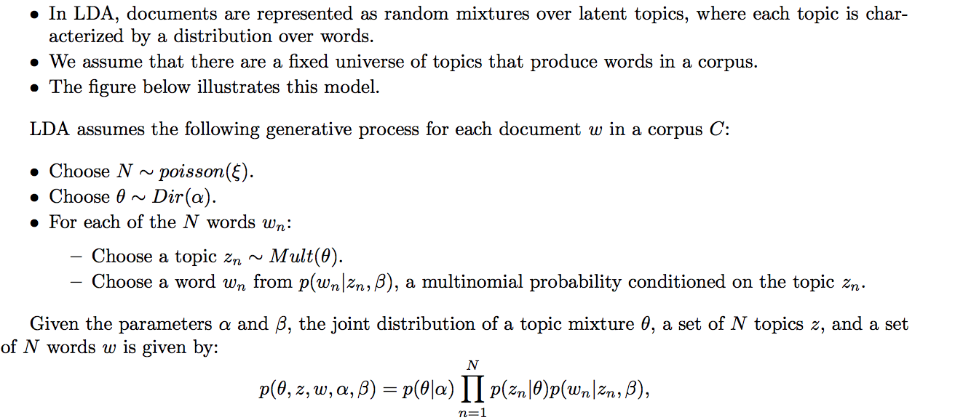
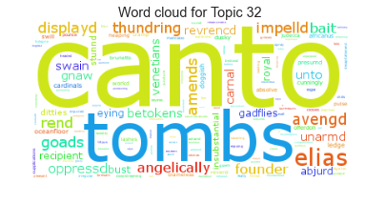
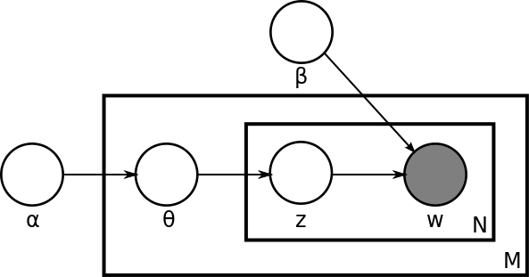
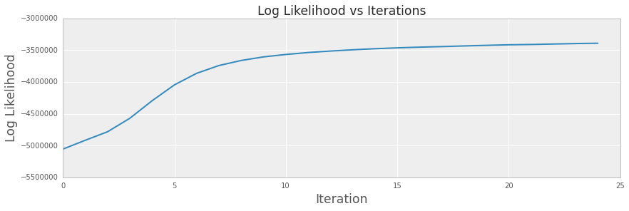
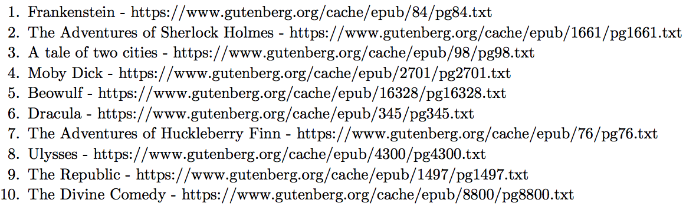
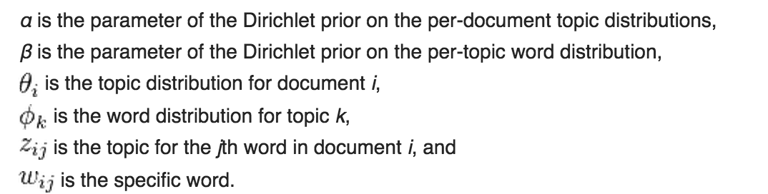
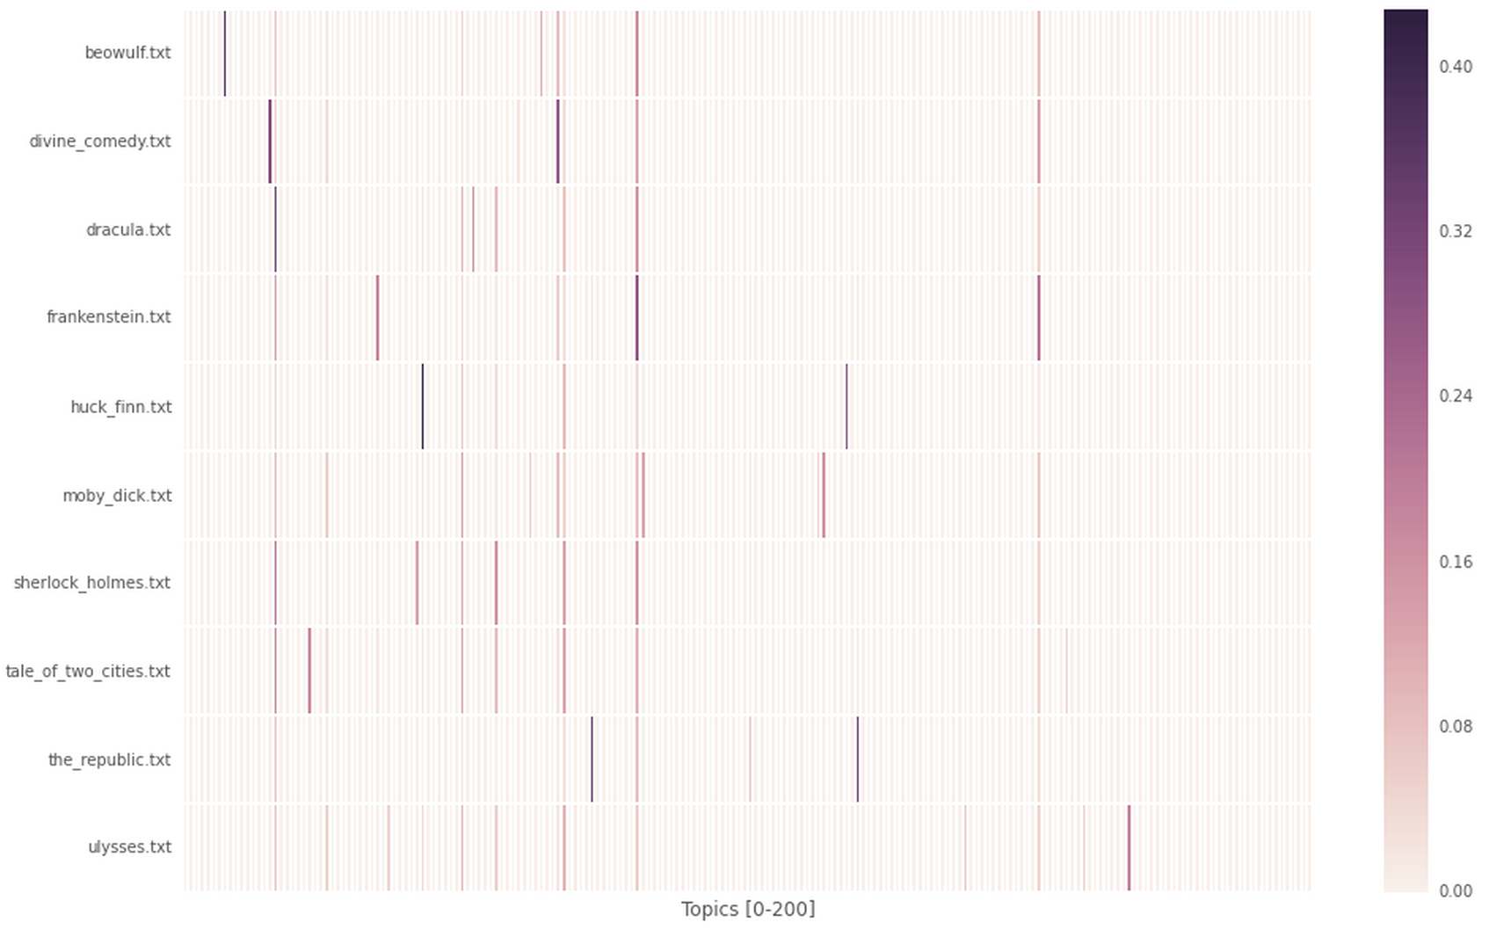

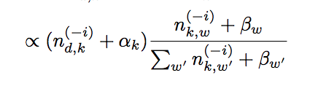
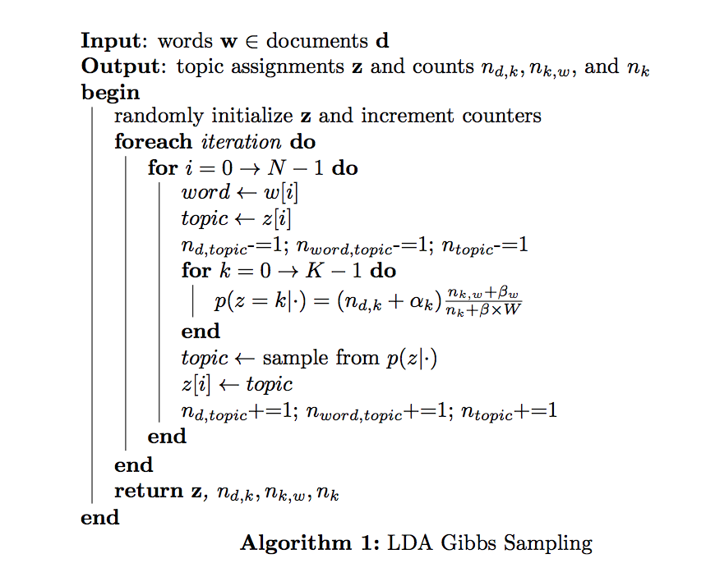
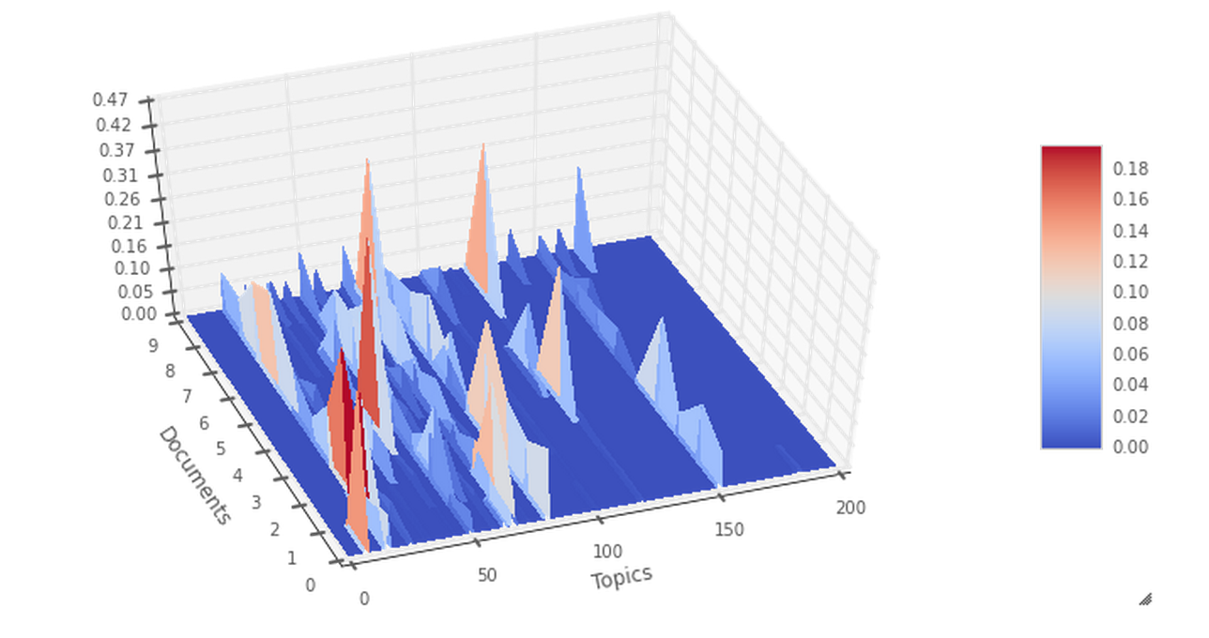

Classification of Books by Thematic Content using Latent Dirichlet Allocation via Gibbs Sampling
Cole Diamond, Raphael Pestourie, Wei Dai
colediamond@g.harvard.edu, pestourie@seas.harvard.edu, weidai@g.harvard.edu
AM 207
Spring 2014
Introduction
LDA is a generative probabilistic model for collections of grouped discrete data. Each group is described as a random mixture over a set of latent topics where each topic is a discrete distribution over the collection’s vocabulary. We use Gibbs sampling to sample from the posterior of the distribution described by LDA to extract thematic content from ten classic novels. We train on half of the pages, and perform inference on the remainder. We use nearest neighbor on the queried topic distibution to query the closest match. We were able to correctly label 80% of our test data with the correct title.
blah blah blah
Data
We source our data from Project Gutenberg. Specifically,
we collect the full text of ten classic novels. We train on
50% of the pages and query the other 50% for
classification. The particular novels and their sources are
listed below.
In LDA, topics are modeled as a distribution over words. The word cloud above depicts the representative words for Topic 32. The larger the word, the greater the weight in describing the topic.
Plate Notation for LDA
We used a variety of diagnostic statistics to verify convergence, one of which was a plot of the log likelihood over time. It is evident our likelihood not only increases but converges after just 15 iterations
Approach
Results
Conclusions
We use Gibbs Sampling to sample from the conditional of the posterior of the Latent Dirichlet Allocation. We classify a document by thematic content by comparing the queried documents topic distribution to our dictionary of topic distributions. The nearest neighbor is chosen.
Our model was able to recover the label of all ten books, yielding a perfect, 100% classification accuracy.
We train an LDA model on half the pages of ten classic books, the other half is used for testing. Given the test data and our model, we perform inference on the new text to determine the topic distribution. We compare the queried topic distribution with our training data, and assign it to the closest match. Our hypothesis that thematic content would be a good signal for identifying texts was valid. We achieved a perfect classification of our query text. Future work may use bigrams or n-grams to map to topics, instead of unigrams
Citations and Links
Heatmap of the distribution of topics over documents in our corpus
Blei, David M and Ng, Andrew Y and Jordan, Michael I, Latent dirichlet allocation. The Journal of machine Learning research, (3):993--1022, 2003
Darling, W. M. A Theoretical and Practical Implementation Tutorial on Topic Modeling and Gibbs Sampling. In Proceedings of the 49th Annual Meeting of the Association for Computational Linguistics: Human Language Technologies, (Portland, Oregon, USA, 2011)
Surface plot of Weight of a Topic over Documents
School of Engineering and Applied Sciences • Institute for Applied Computational Science

