Slide 1

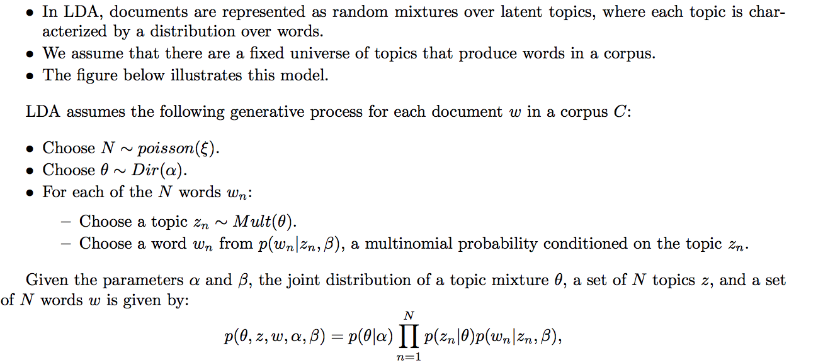
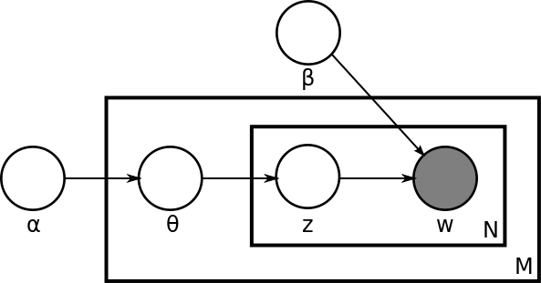
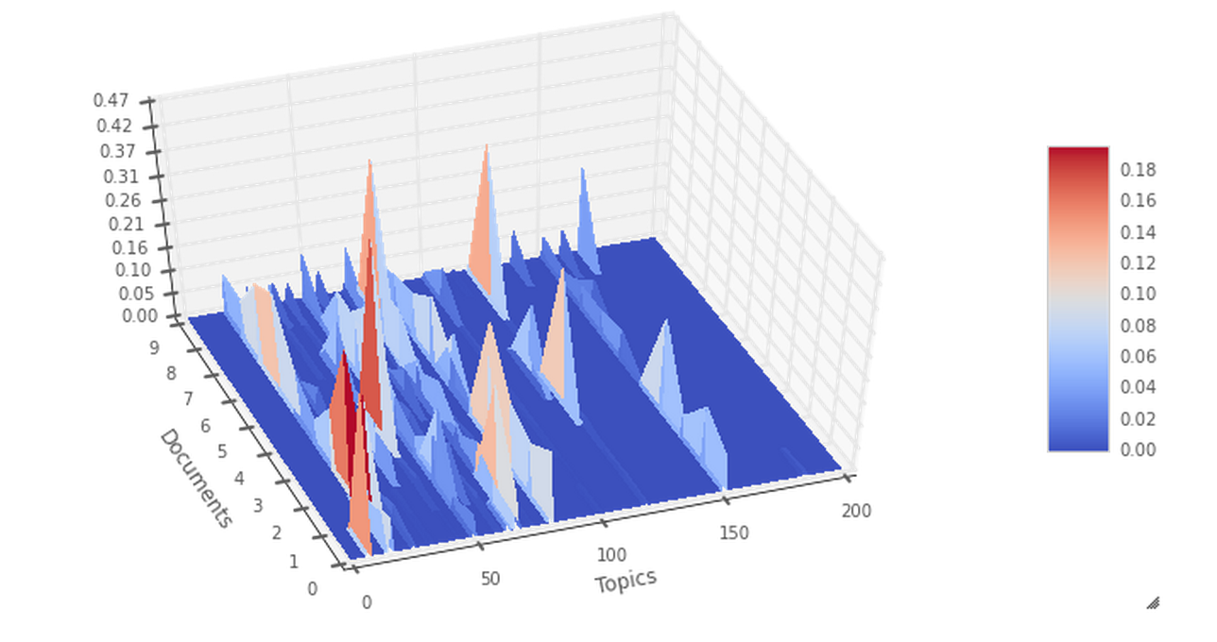
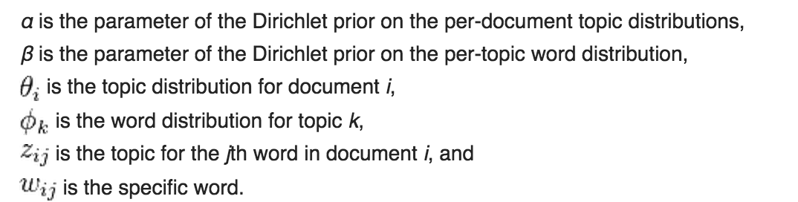

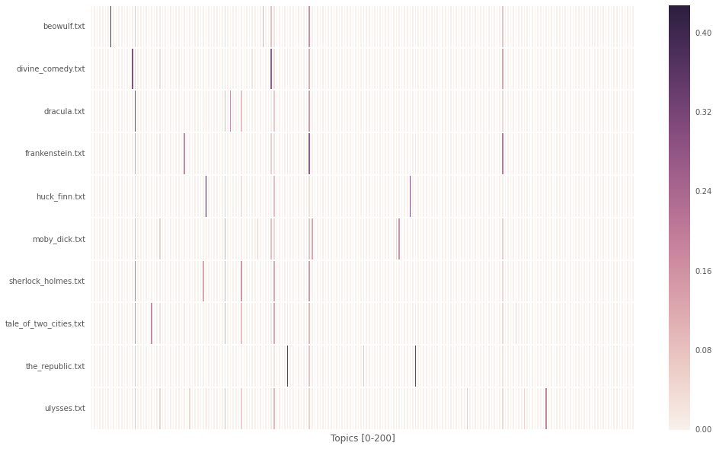
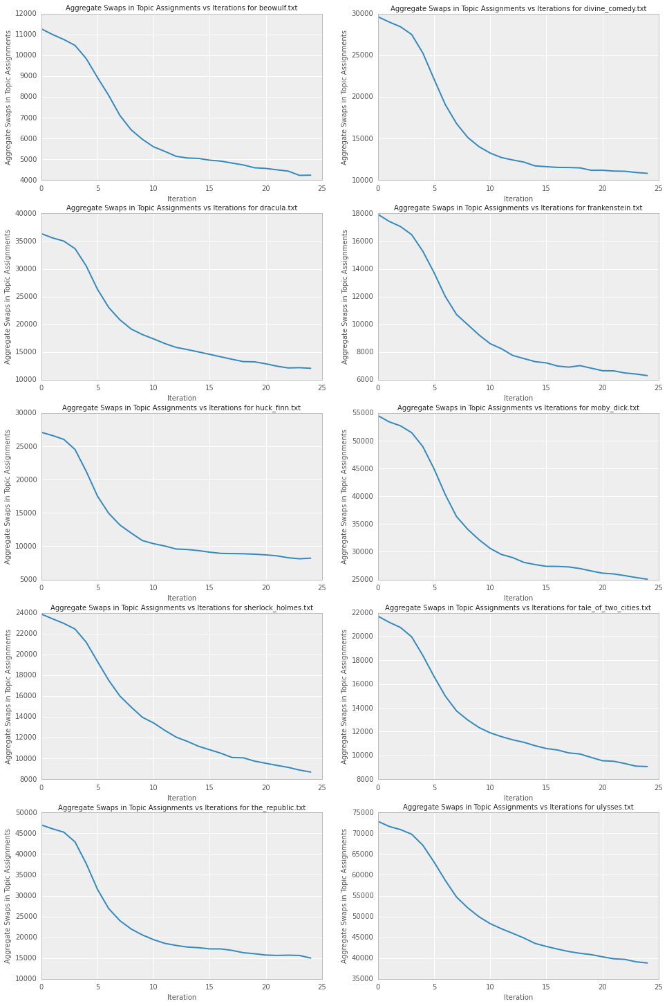

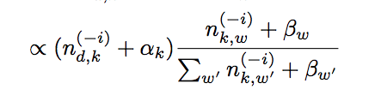
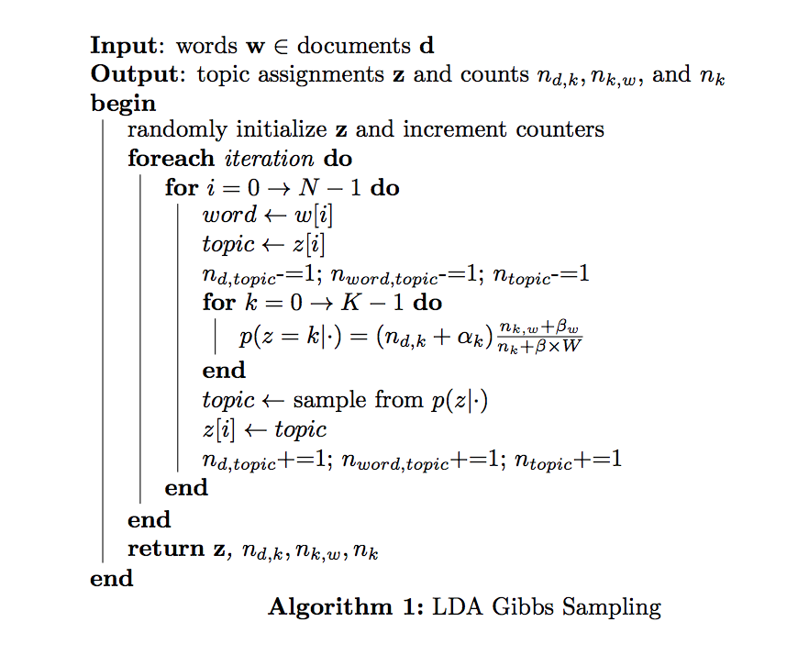
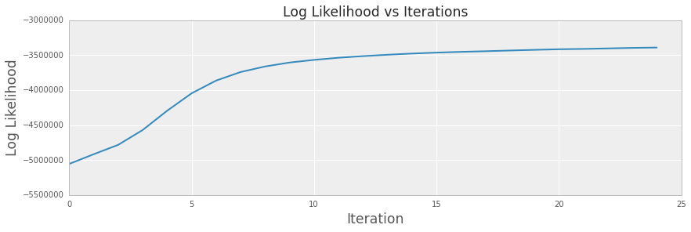

Classification of Books by Thematic Content using Latent Dirichlet Allocation with Collapsed Gibbs Sampling
Cole Diamond, Raphael Pestourie, Wei Dai
colediamond@g.harvard.edu, pestourie@seas.harvard.edu, weidai@g.harvard.edu
AM 207
Spring 2014
Introduction
LDA is a generative mixed membership model for topic recognition using a bag of words approximation. Each document is assigned a distribution over a set of latent topics where each topic is a discrete distribution over the collection’s vocabulary. We use collapsed Gibbs sampling to sample from the posterior of the distribution described by LDA generative model. We extract thematic content from ten classic novels. We train on half of the pages, and perform inference on the other half. We use Euclidian distance between the distributions of topics in order to predict from which book the test text comes from. We achieve 100% accuracy on the test set.
blah blah blah
Data
Visualizations
We source our data from Project Gutenberg. Specifically,
we collect the full text of 10 classic novels. We train on
50% of the pages and query the other 50% for classification.
The novels we used are as followed:
1. Frankenstein, 2. The Adventures of Sherlock Holmes,
3. A Tale of Two Cities, 4. Moby Dick, 5. Beowulf, 6. Dracula, 7. The Adventures of Huckleberry Finn, 8. Ulysses, 9. The Republic, 10. The Divine Comedy
We generated a 3D surface of weights of topics for all 10 documents. As we can see from the figure that there are significant difference in the distribution of weights of topics among 10 different documents.
Results and Diagnostics
Figure 1: Plate Notation for LDA
Our model was able to recover the label of all ten books, yielding a perfect, 100% classification accuracy.
Figure 4: Surface plot of probability mass of a topics
Approach
We used a variety of diagnostic statistics to verify convergence. For each book, we calculated the total number of words whose topic assignment changed between iterations. The shape of the resulting plot suggests convergence.
We use Gibbs Sampling to sample from the conditional of the
posterior of the Latent Dirichlet Allocation. We classify a
document by thematic content by comparing the queried
documents topic distribution to our dictionary of topic
distributions. We use the difference of the frobenius norm as a
metric for topic distritbuion similarity.
Figure 5: Heatmap of topic distribution across documents.
Each document has a unique signature of topic weights
Conclusions
We train an LDA model on half the pages of ten classic books, the other half is used for testing. Given the test data and our model, we perform inference on the new text to determine the topic distribution. We compare the queried topic distribution with our training data, and assign it to the closest match. Our hypothesis that thematic content would be a good signal for identifying texts was valid. We achieved a perfect classification of our query text. Future work may use bigrams or n-grams to map to topics, instead of unigrams
We used a collapsed Gibbs sampling based on our generative model.
Heatmap of the distribution of topics over documents in our corpus
Citations
Blei, David M and Ng, Andrew Y and Jordan, Michael I, Latent dirichlet allocation. The Journal of machine Learning research, (3):993--1022, 2003
Darling, W. M. A Theoretical and Practical Implementation Tutorial on Topic Modeling and Gibbs Sampling. In Proceedings of the 49th Annual Meeting of the Association for Computational Linguistics: Human Language Technologies, (Portland, Oregon, USA, 2011)
Figure 2: Aggregate Topic Assignment Swaps for all 10 Books
Algorithm 1: LDA collapsed Gibbs sampling
Figure 3: The log likelihood increases monotonically and converges after the 15th iteration.
School of Engineering and Applied Sciences • Institute for Applied Computational Science

