Slide 1
How to use LexMapr
For people who have
little to no experience with command line
and
For macOS and Linux users only
and
For IFSAC users only

Slide 2
Outline
Terminal/command-line tutorial | 3
Installing LexMapr into a Conda environment | 6
Running the LexMapr software from your Conda environment | 11
Updating the LexMapr software inside your Conda environment | 17
LexMapr Django: a graphical interface | 18

Slide 3
Open up your terminal
macOs:
cmd + space to open spotlight search
type terminal
hit return
Linux:
ctrl + alt + t

Slide 4
Terminal tutorial
The terminal opens in your Home (also known as ~) directory
Type the following command into your terminal:
ls
This will print out all the sub-directories and files in your home directory

Slide 5
Terminal tutorial
You can change terminal directories with the cd command:
cd Desktop Navigate to your Desktop subdirectory
ls View the contents of your Desktop
cd .. Navigate to the parent directory
ls View the contents of your Home again
If you ever get lost, you can return Home with cd ~

Slide 6
Do you have Conda?
In your terminal, type:
conda -V
If you have Conda, the terminal will tell you your Conda version number
If you do not have Conda, the terminal will tell you the conda command was not found

Slide 7
Install Conda
Go to https://docs.conda.io/en/latest/miniconda.html
Install the appropriate 64-bit bash installer for Python 3.7
In your terminal, navigate to the folder containing the installer
Assuming this was the Downloads folder:
cd ~
cd Downloads

Slide 8
Install Conda
In this folder, we run the installer through a terminal command
macOS:
bash Miniconda3-latest-MacOSX-x86_64.sh
Linux:
bash Miniconda3-latest-Linux-x86_64.sh
Follow the prompts to completion

Slide 9
Bioconda
Bioconda is a channel that allows users to easily install various bioinformatic packages, including LexMapr
Run the following terminal commands to set up Bioconda:
conda config --add channels default
conda config --add channels bioconda
conda config --add channels conda-forge
RUN THESE COMMANDS IN ORDER

Slide 10
Install LexMapr into a Conda environment
Enter the following command from any directory:
conda create -n LexMapr python=3.6 lexmapr
Follow the prompts to completion
This creates a Conda environment called “LexMapr”, that contains a Bioconda installation of LexMapr

Slide 11
Running LexMapr
Whenever you want to run LexMapr, all you have to do is:
Start the terminal
Activate your LexMapr Conda environment:
conda activate LexMapr
Run LexMapr commands
lexmapr {path_to_output_file} -p ifsac

Slide 12
LexMapr input files
LexMapr takes input csv files with the following format:
SampleId,Sample
1,Chicken Breast
2,Baked Potato
3,Canned Corn
4,Frozen Yogurt
5,Apple Pie

Slide 13
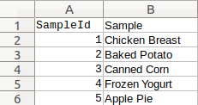
LexMapr input files
Open up Microsoft Excel, Apple Numbers or LibreOffice Calc
Create a spreadsheet like so:
Save as “small_simple.csv”

Slide 14
Running LexMapr
In the terminal, cd to the folder containing small_simple.csv
With the LexMapr Conda environment activated, try:
lexmapr small_simple.csv -p ifsac

Slide 15
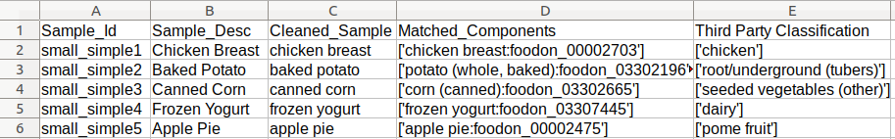
Running LexMapr
A new file called ifsac_output.tsv was just created in the same directory as small_simple.csv
Open it up in Microsoft Excel, Apple Numbers or LibreOffice Calc:

Slide 16
Running LexMapr
You can specify your own output file name by running:
lexmapr {path_to_output_file} -p ifsac -o {path_to_output_file}
e.g.
lexmapr small_simple.csv -p ifsac -o small_simple_output.tsv
Now you results will be in small_simple_output.tsv, not ifsac_output.tsv

Slide 17
Keep LexMapr up-to-date
Keep LexMapr up-to-date by running the following command from any directory:
conda update lexmapr -n LexMapr
Follow the prompts to completion
This updates the lexmapr package installed inside your LexMapr conda environment

Slide 18
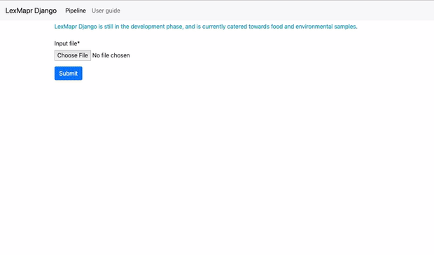
LexMapr Django
https://watson.bccdc.med.ubc.ca/lexmapr/
Django-powered web interface, that allows you to run LexMapr from your browser

