Slide 1
How to use LexMapr
For people who have
little to no experience with command line
and
For macOS and Linux users only

Slide 2
Outline
Terminal/command-line tutorial | 3
Installing LexMapr into a Conda environment | 6
Running the LexMapr software from your Conda environment | 11
Mapping samples against online ontologies | 20
Third-party classification schemes | 40
LexMapr Django: a graphical interface | 41

Slide 3
Open up your terminal
macOs:
cmd + space to open spotlight search
type terminal
hit return
Linux:
ctrl + alt + t

Slide 4
Terminal tutorial
The terminal opens in your Home (also known as ~) directory
Type the following command into your terminal:
ls
This will print out all the sub-directories and files in your home directory

Slide 5
Terminal tutorial
You can change terminal directories with the cd command:
cd Desktop Navigate to your Desktop subdirectory
ls View the contents of your Desktop
cd .. Navigate to the parent directory
ls View the contents of your Home again
If you ever get lost, you can return Home with cd ~

Slide 6
Do you have Conda?
In your terminal, type:
conda -V
If you have Conda, the terminal will tell you your Conda version number
If you do not have Conda, the terminal will tell you the conda command was not found

Slide 7
Install Conda
Go to https://docs.conda.io/en/latest/miniconda.html
Install the appropriate 64-bit bash installer for Python 3.7
In your terminal, navigate to the folder containing the installer
Assuming this was the Downloads folder:
cd ~
cd Downloads

Slide 8
Install Conda
In this folder, we run the installer through a terminal command
macOS:
bash Miniconda3-latest-MacOSX-x86_64.sh
Linux:
bash Miniconda3-latest-Linux-x86_64.sh
Follow the prompts to completion

Slide 9
Bioconda
Bioconda is a channel that allows users to easily install various bioinformatic packages, including LexMapr
Run the following terminal commands to set up Bioconda:
conda config --add channels default
conda config --add channels bioconda
conda config --add channels conda-forge
RUN THESE COMMANDS IN ORDER

Slide 10
Install LexMapr into a Conda environment
Enter the following command from any directory:
conda create -n LexMapr python=3.6 lexmapr
Follow the prompts to completion
This creates a Conda environment called “LexMapr”, that contains a Bioconda installation of LexMapr

Slide 11
Running LexMapr
Whenever you want to run LexMapr, all you have to do is:
Start the terminal
Activate your LexMapr Conda environment:
conda activate LexMapr
Run LexMapr commands
lexmapr --help

Slide 12
LexMapr input files
LexMapr takes input csv files with the following format:
SampleId,Sample
1,Chicken Breast
2,Baked Potato
3,Canned Corn
4,Frozen Yogurt
5,Apple Pie

Slide 13
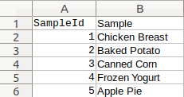
LexMapr input files
Open up Microsoft Excel, Apple Numbers or LibreOffice Calc
Create a spreadsheet like so:
Save as “small_simple.csv”

Slide 14
Running LexMapr
In the terminal, cd to the folder containing small_simple.csv
With the LexMapr Conda environment activated, try:
lexmapr small_simple.csv

Slide 15
Taking a while?
The first run will be slow
LexMapr caches a lookup table on the first run
LexMapr uses this table to make subsequent runs much faster

Slide 16
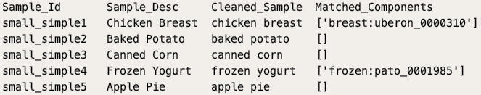
Running LexMapr
Output:

Slide 17
Running LexMapr
You can specify an “output” tsv file for your results to be written to
Saves your results ✔
tsv files can be opened in Excel, Numbers or Calc for easier
viewing ✔
Try:
lexmapr small_simple.csv -o small_simple_output.tsv

Slide 18
Running LexMapr
small_simple_output.tsv was created in the directory
Open it up in Excel, Numbers or Calc for easy viewing of your output, separated into columns

Slide 19
A problem
Output:
Missing matches

Slide 20
Mapping samples against online ontologies
Unless told otherwise, LexMapr maps samples against a highly limited collection of pre-defined resources → missed matches
You should instead map samples against terms of your own choosing
You can do this by supplying LexMapr with a config file

Slide 21
Config files
When running LexMapr, use a config file that specifies the online ontology terms you want to map your samples against
e.g., we could create a config file that tells LexMapr to map against terms belonging to the Food ontology “Foodon”, and use it whenever we run LexMapr on a collection of food samples
Config files can specify terms from:
Entire ontologies
Subsets of ontologies
Multiple ontologies
You re-use config files for multiple runs, or create new config files when you want to switch things up, but you can only provide one config file each time you run LexMapr

Slide 22
Config file format
[
{“ONTOLOGY_IRI_1”:”ROOT_IRI_1”},
{“ONTOLOGY_IRI_2”:”ROOT_IRI_2”},
...,
]

Slide 23
Config file format
[
{“ONTOLOGY_IRI_1”:”ROOT_IRI_1”},
{“ONTOLOGY_IRI_2”:”ROOT_IRI_2”},
...,
]
IRI of ontology you want to map your samples against
e.g., “http://purl.obolibrary.org/obo/foodon.owl”

Slide 24
Ontology refresher
Livestock
Poultry
Swine
Cattle
Turkey
Chicken

Slide 25
Ontology refresher
Livestock
Poultry
Swine
Cattle
What if you only want to match samples against this sub-tree?
Turkey
Chicken

Slide 26
Config file format
[
{“ONTOLOGY_IRI_1”:”ROOT_IRI_1”},
{“ONTOLOGY_IRI_2”:”ROOT_IRI_2”},
...,
]
IRI of the “top” of the sub-tree, within the specified ontology
e.g., the IRI for “poultry or game bird” within FOODON: “http://purl.obolibrary.org/obo/FOODON_03411563”

Slide 27
Create a config file
We’re going to map our small_simple.csv file against everything under “plant food product” in FOODON

Slide 28
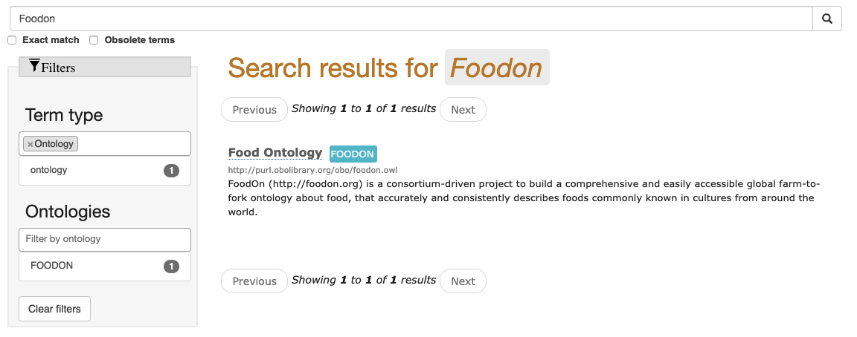
Create a config file
We need IRI values
Go to https://www.ebi.ac.uk/ols/ontologies
Search up “foodon”
Jump to the ontology page when located

Slide 29
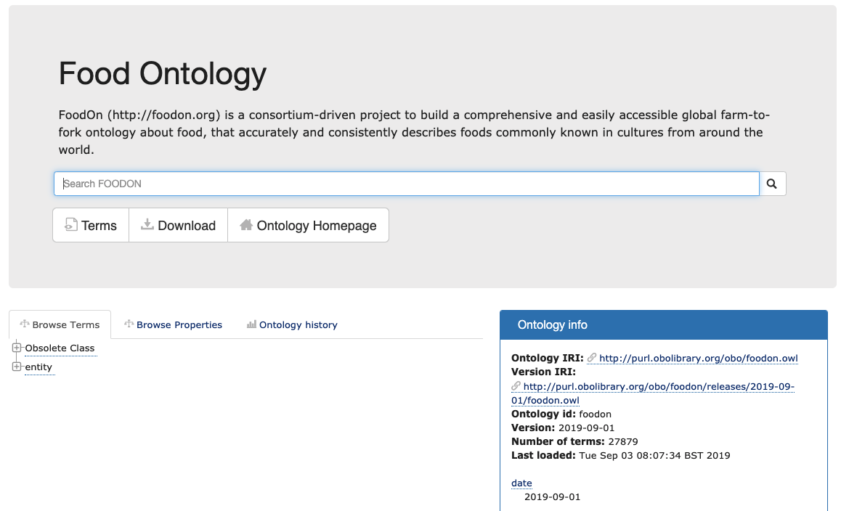
Create a config file
Under the box titled “Ontology info” on the Foodon ontology page, note the Ontology IRI:

Slide 30
Create a config file
Under the box titled “Ontology info” on the Foodon ontology page, note the Ontology IRI:
http://purl.obolibrary.org/obo/foodon.owl
This is your ONTOLOGY_IRI

Slide 31
Create a config file
You can then use the “browse terms” tab, or the search bar, to locate the OLS page for “plant food product”

Slide 32
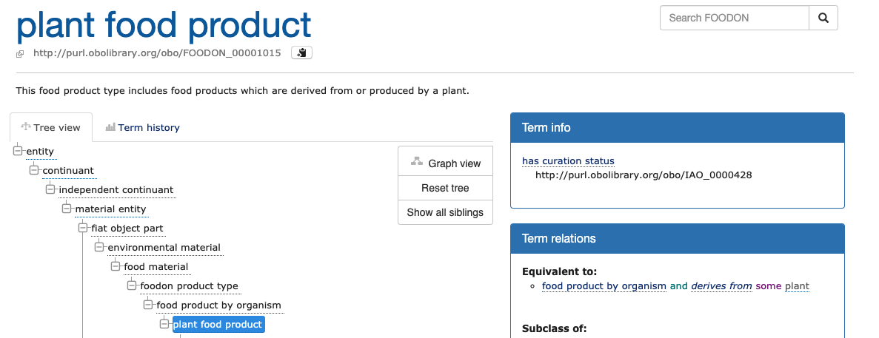
Create a config file
The IRI for “plant food product” is under the title of its OLS page:

Slide 33
Create a config file
The IRI for “plant food product” is under the title of its OLS page:
http://purl.obolibrary.org/obo/FOODON_00001015
This is your ROOT_IRI

Slide 34
Create a config file
Open a text editor, and write the following:
Save the file as small_simple_config.json, in the same folder as small_simple.csv
Notice that we’re using the IRI values we just searched for
So you now have a config file that tells LexMapr to map samples against everything under “plant food product” in Foodon

Slide 35
Create a config file
Note for macOs users:
TextEdit may not allow you to save JSON files
You can use another text editor, or google for an online JSON editor

Slide 36
Mapping samples against online ontologies
In terminal:
Navigate to the folder with small_simple.csv and
small_simple_config.json
With your LexMapr conda environment activated, try:
lexmapr small_simple.csv -c small_simple_config.json -o small_simple_output.tsv
This may take a while, as lexmapr creates a lookup table for each config file (to speed up subsequent runs)

Slide 37
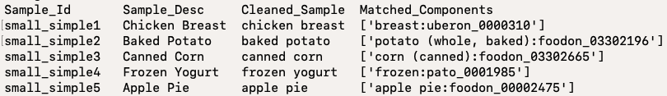
Mapping samples against online ontologies
Output:
That’s better!
But small_simple1 and small_simple4 could be better.

Slide 38
Create a config file
Fetch the IRI values for “meat food product” and “dairy food product” under Foodon the same way, and extend your config file:
Note the commas
Save the file
Your config file now tells LexMapr to map samples against everything under “plant food product”, “meat food product” and “dairy food product” in Foodon

Slide 39
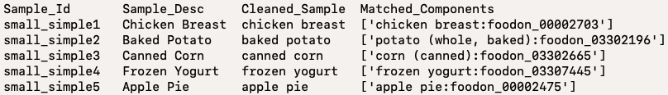
Mapping samples against online ontologies
Run:
The --no-cache flag is needed whenever you update a config file, so LexMapr can update the corresponding lookup table
Output:
Perfect
lexmapr small_simple.csv -c small_simple_config.json -o small_simple_output.tsv --no-cache

Slide 40
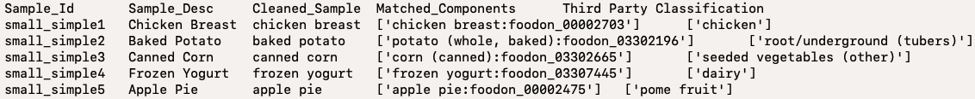
Third-party classification schemes
Try:
lexmapr small_simple.csv -c small_simple_config.json -o small_simple_output.tsv -b
The -b flag classifies all samples into broad categories:
The categories were selected by a third-party, and follow their highly specific classification scheme, which is geared towards food
In the future, LexMapr will allow you to introduce classification schemes of your own

Slide 41
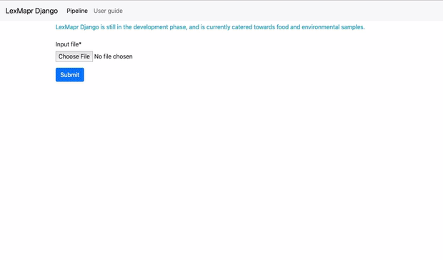
LexMapr Django
https://watson.bccdc.med.ubc.ca/lexmapr/
Django-powered web interface, that allows you to run LexMapr from your browser

Slide 42
LexMapr Django
Not as powerful as the command-line tool yet
Built-in config file specialized for food and environment samples
Cannot specify your own config file
Highly specific third-party classification scheme always used
Will become more powerful in the future

