Slide 1
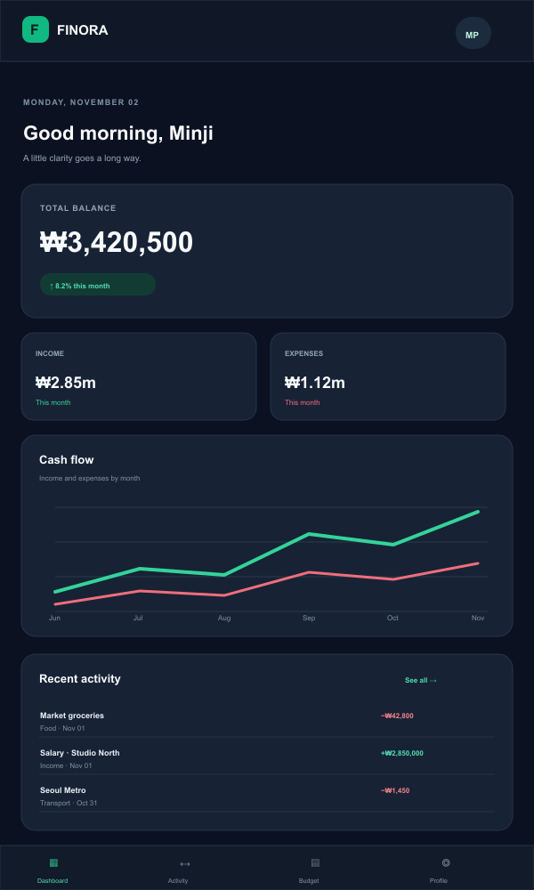
WEB PROGRAMMING · GROUP PROJECT
THIS MONTH
FINORA
Good morning
Available balance
₩1,250,000
INCOME
SPENT
₩1,800,000
₩550,000
Spending by week
Personal Finance Management System
Manage income, budgets, and savings with clarity.
Week 1 2 3 4 5 6

Slide 2
01 / THE IDEA
02
One place to make sense of money
A beginner-friendly tracker brings daily records and monthly plans together.
Record
Plan
Understand
Add income and expenses with a category, date and payment method.
Set monthly category limits and see what remains at a glance.
Review summaries, category charts and savings goal progress.
Useful information first. Clear steps. No finance expertise required.
PERSONAL FINANCE TRACKER / WEB PROGRAMMING
02

Slide 3
02 / PEOPLE & USE
03
Built for people starting a budget
Primary users include university students, young professionals and first-time budgeters.
A typical visit
What users need to know
01
Sign in
Record a purchase quickly
A short form captures the key details without friction.
02
Add records
Know the monthly balance
03
Review dashboard
Income and expenses roll up into a useful summary.
04
Set budget
Spot the biggest category
A category breakdown makes spending patterns visible.
05
Check progress
PERSONAL FINANCE TRACKER / WEB PROGRAMMING
03

Slide 4
03 / PRODUCT MAP
04
Core pages cover everyday money tasks
A focused set of workspaces keeps the experience straightforward.
01
02
03
Dashboard
Transactions
Budgets
Balance, budgets, goals and recent activity
Add, edit, search and filter income and expenses
Set category limits and watch spending progress
04
05
06
Analytics
Savings goals
Profile & settings
Compare cash flow and category trends
Track targets, contributions and progress
Personal details, currency and account preferences
Also included: Login · Registration · Notifications · About · Contact
PERSONAL FINANCE TRACKER / WEB PROGRAMMING
04

Slide 5
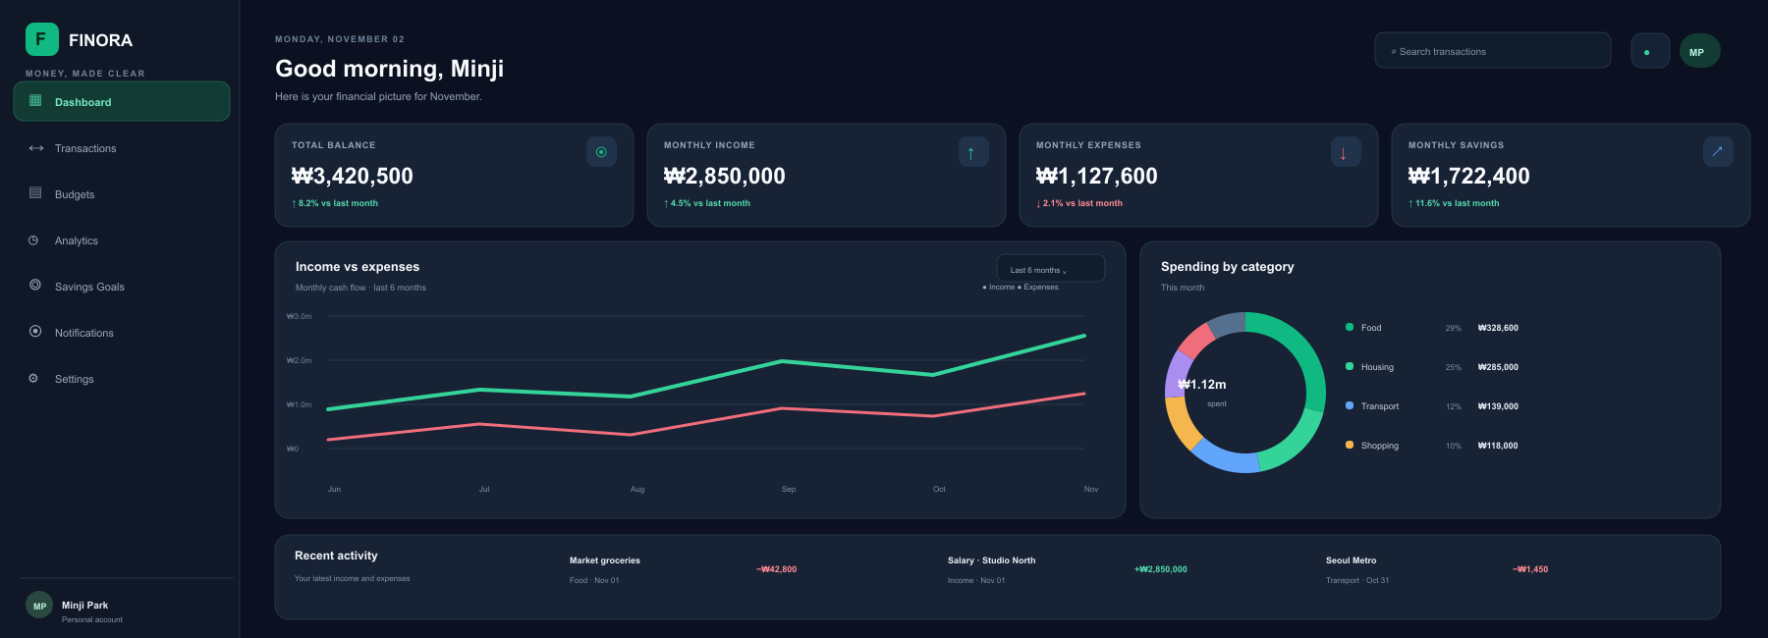
04 / INTERFACE STUDY
05
A FINORA dashboard for everyday decisions
A dark workspace puts balance, cash flow, categories, and recent activity in one view.
penny
Good afternoon, Anar
Here is your month at a glance.
⌂
Overview
TOTAL BALANCE
INCOME
EXPENSES
↔
Transactions
₩1,250,000
₩1,800,000
₩550,000
▤
Budgets
Monthly spending
RECENT ACTIVITY
◷
Reports
₩550,000 of ₩800,000
Lunch · Food
−₩8,500
Subway · Transport
−₩1,450
Part-time work · Income
+₩420,000
PERSONAL FINANCE TRACKER / WEB PROGRAMMING
05

Slide 6
05 / IMPLEMENTATION
06
A realistic stack for a class project
Each layer has a clear responsibility, from the page to persistent records.
FRONTEND
BACKEND
DATA
LIBRARIES
HTML
Node.js
SQLite
Chart.js
Page structure
JavaScript runtime
Users, transactions and budgets
Visual reports
CSS
Express.js
SQL
Lucide
Responsive styling
Routes and API logic
Queries and relationships
Interface icons
JavaScript
Interaction and validation
HTML + CSS + JavaScript / Node.js + Express / SQLite
PERSONAL FINANCE TRACKER / WEB PROGRAMMING
06

Slide 7
06 / UNDER THE HOOD
07
The browser talks to an API, then the database
Express validates requests and reads or writes records in SQLite.
USER
FRONTEND
BACKEND API
DATABASE
→
→
→
Pages & forms
HTML · CSS · JS
Express routes
SQLite records
Example data entities
USERS
TRANSACTIONS
BUDGETS
id · name · email · password_hash
id · user_id · type · amount · category · date
id · user_id · category · limit · month
PERSONAL FINANCE TRACKER / WEB PROGRAMMING
07

Slide 8
07 / TRUST & QUALITY
08
Security belongs in the first version
Even a classroom prototype should model careful handling of financial data.
ACCOUNT SECURITY
DATA PROTECTION
TESTING
—
Hash passwords with bcrypt
—
Validate input on the server
—
Test forms and error states
—
Use sessions or secure tokens
—
Use parameterized SQL queries
—
Test create, read, update and delete
—
Protect authenticated routes
—
Tie every record to its owner
—
Check mobile layout and calculations
DEMO SAFETY
Use fictional sample data. Do not connect real bank accounts.
PERSONAL FINANCE TRACKER / WEB PROGRAMMING
08

Slide 9
08 / BUILD PLAN
09
Five milestones make the work demonstrable
Each stage adds a piece that can be shown and reviewed.
1
2
3
4
5
Plan
Build UI
Add behavior
Build backend
Test & present
Requirements, page map and wireframes
HTML structure, CSS and responsive layout
Forms, validation, charts and filters
API routes, database and authentication
Fix issues, add sample data and prepare demo
Goal: a working full-stack prototype with a clear user journey.
PERSONAL FINANCE TRACKER / WEB PROGRAMMING
09

Slide 10
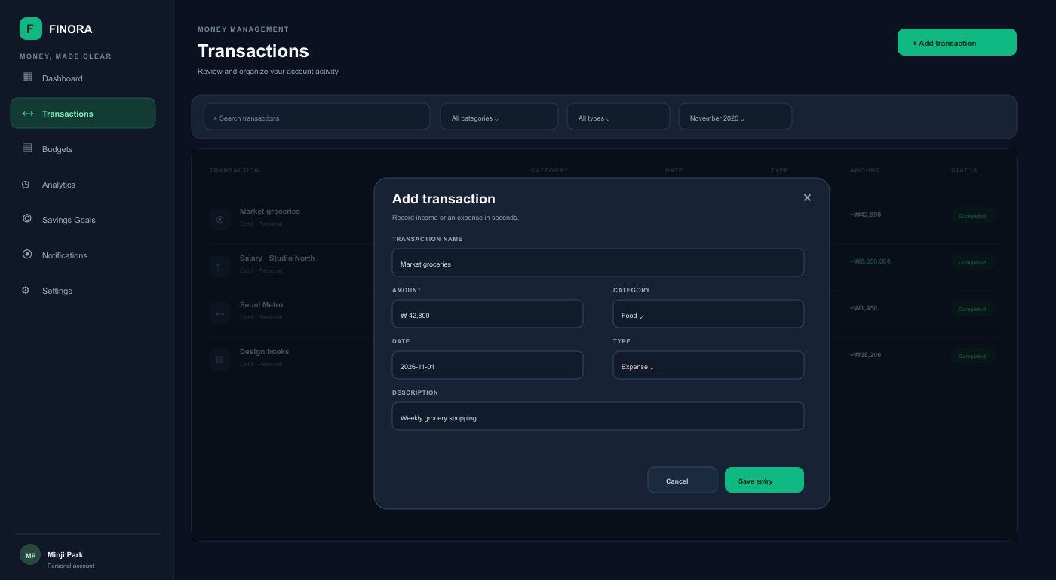
09 / IN-CLASS DEMO
10
A short walkthrough shows the core loop
Use fictional sample data and keep the demo focused on everyday tasks.
01
Log in
Transaction form
Enter the demo account
A quick, readable entry flow
02
Add a transaction
Save a sample expense and category
TYPE
AMOUNT
Review the dashboard
Expense ▾
₩ 8,500
03
Show the updated balance and chart
CATEGORY
DATE
04
Set a budget
Food ▾
2026. 11. 02
Create a limit and show what remains
05
Explore reports
Save transaction
Filter by month and explain the summary
PERSONAL FINANCE TRACKER / WEB PROGRAMMING
10

Slide 11
THANK YOU
A clearer view
of every won.
GROUP MEMBERS
ANKHORGIL
202637470
FINORA
ANAR
Frontend development, backend APIs, database design and practical user experience in one useful web application.
202637018
Questions?
COURSE
Web Programming

