Slide 1
STM32WB – BLE SW Application Architecture
Sequencer
Revision 1
Notes:
Hello, and welcome to this presentation of the STM32WB Application for Bluetooth Low Energy feature.

Slide 2
Sequencer
The sequencer is NOT an operating system
It does not intend to compete versus standard OS but versus standard bare metal implementation
It is an optimized packaging of a while loop bare metal classic implementation
It allows to avoid race conditions which are most of the time faced in bare metal implementation especially when low power mode are implemented

Slide 3
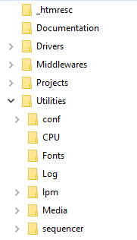
Sequencer
The sequencer provides the following features:
Up to 32 tasks registered
Request a task to be executed
Pause and Resume a task
Wait for a specific event (might be not blocking)
Priority on tasks

Slide 4
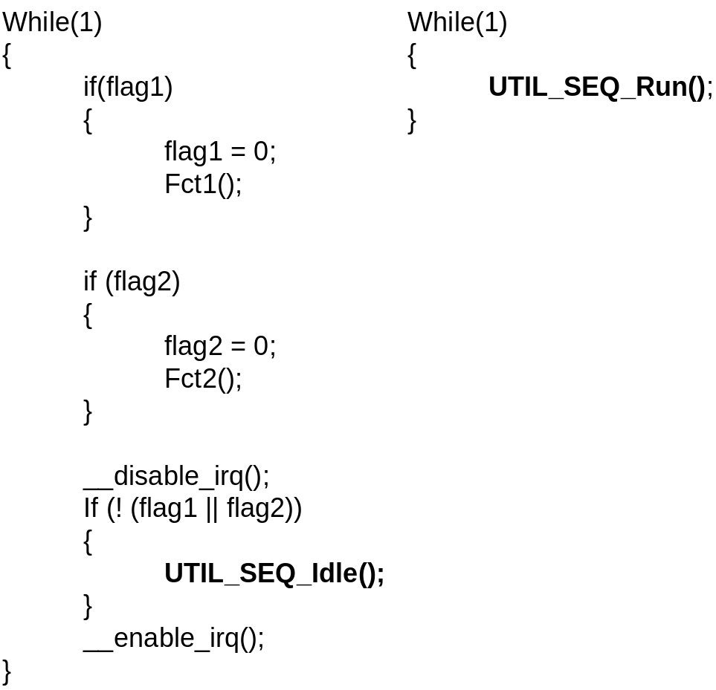
UTIL_SEQ_Run() / UTIL_SEQ_Idle()
UTIL_SEQ_Run() implements the code that is running within a while loop block

Slide 5
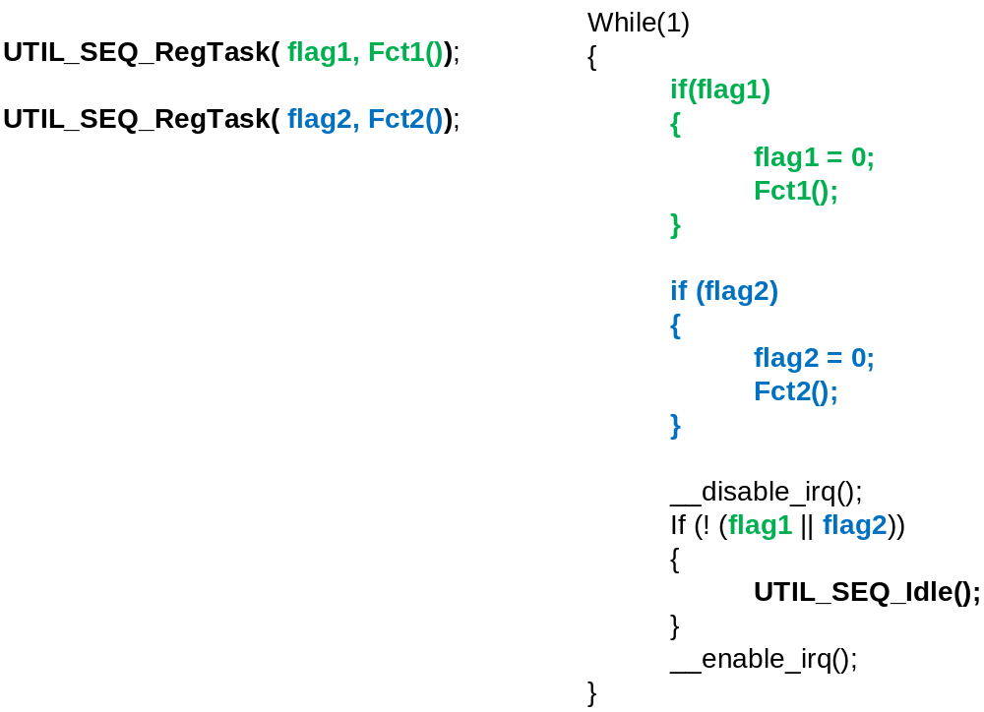
UTIL_SEQ_RegTask()
UTIL_SEQ_RegTask() adds in the while loop the support of a new function

Slide 6
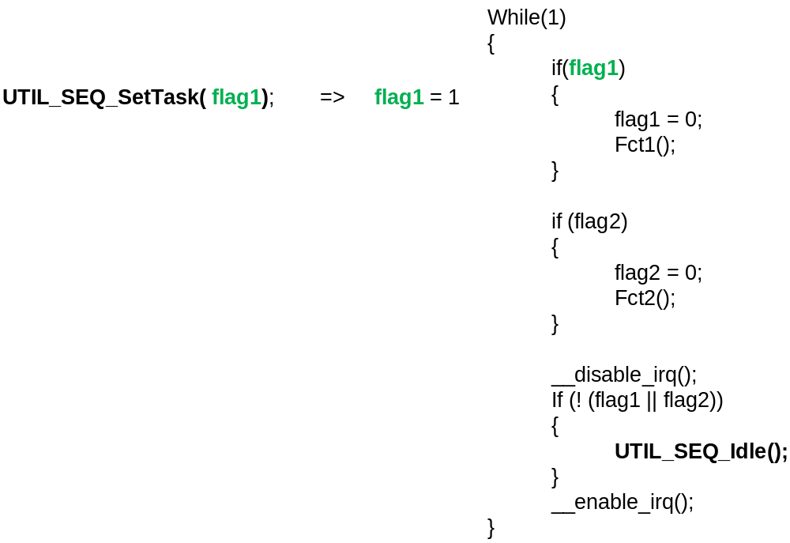
UTIL_SEQ_SetTask()
UTIL_SEQ_SetTask() sets the flag dedicated to the function to be executed in the while loop

Slide 7
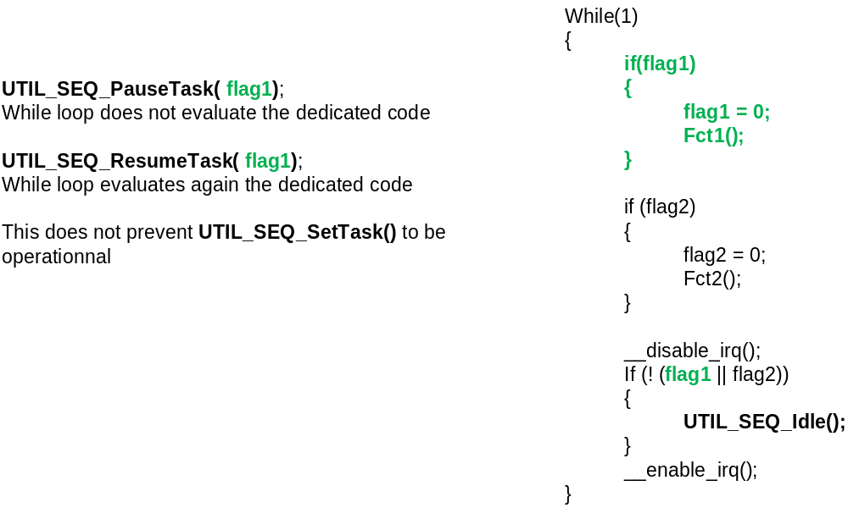
UTIL_SEQ_PauseTask() / UTIL_SEQ_ResumeTask ()
UTIL_SEQ_PauseTask() prevents the function to be executed in the while loop whatever is the value of the related flag
UTIL_SEQ_ResumeTask() allows again the function to be executed if the related flag is set

Slide 8
UTIL_SEQ_WaitEvt / UTIL_SEQ_SetEvt ()
UTIL_SEQ_WaitEvt(Evt_Id) does not return to the caller until UTIL_SEQ_SetEvt (Evt_Id) is called

Slide 9
Overview
Register a task to be executed in the background at any time / any place in the firmware ( before it is requested to be executed)
Enter low power mode when there is nothing to schedule
Request the sequencer to execute a task according to priority in the background. The request may be done at any time / any place in the firmware ( from interrupt handler, function, etc…)
List of API
  UTIL_SEQ_Idle()
  UTIL_SEQ_PreIdle()
  UTIL_SEQ_PostIdle()
  UTIL_SEQ_Run()
  UTIL_SEQ_RegTask()
  UTIL_SEQ_SetTask()
  UTIL_SEQ_PauseTask()
  UTIL_SEQ_ResumeTask()
  UTIL_SEQ_WaitEvt()
  UTIL_SEQ_SetEvt()
  UTIL_SEQ_IsEvtPend()
  UTIL_SEQ_EvtIdle()
Main( void )
{
HAL_Init();
. . .
UTIL_SEQ_RegTask ( Id1, Task1);
UTIL_SEQ_RegTask ( Id2, task2);
. . .
while(1)
{
UTIL_SEQ_Run ();
}
}
void UTIL_SEQ_Idle ( void )
{
UTIL_LPM_EnterLowPower ();
}
void fct ( void )
{
UTIL_SEQ_SetTask ( Id1, Prio0);
}
void fct_IT ( void )
{
UTIL_SEQ_SetTask ( Id2, Prio1);
}
Register tasks to be executed in the background
Enter low power mode when there is nothing to schedule
Request the sequencer to execute Task1 in the background
Request the sequencer to execute Task2 in the background

Slide 10
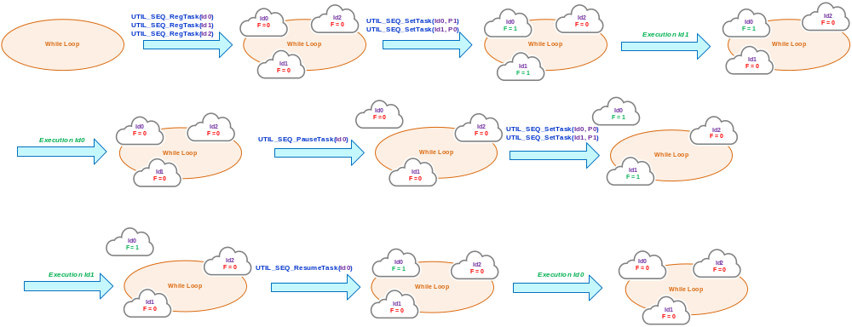
Scheduling
When F = 1, the sequencer executes the task
Prior execution, the sequencer sets back F to ‘0’
Priority P0 is the highest

Slide 11
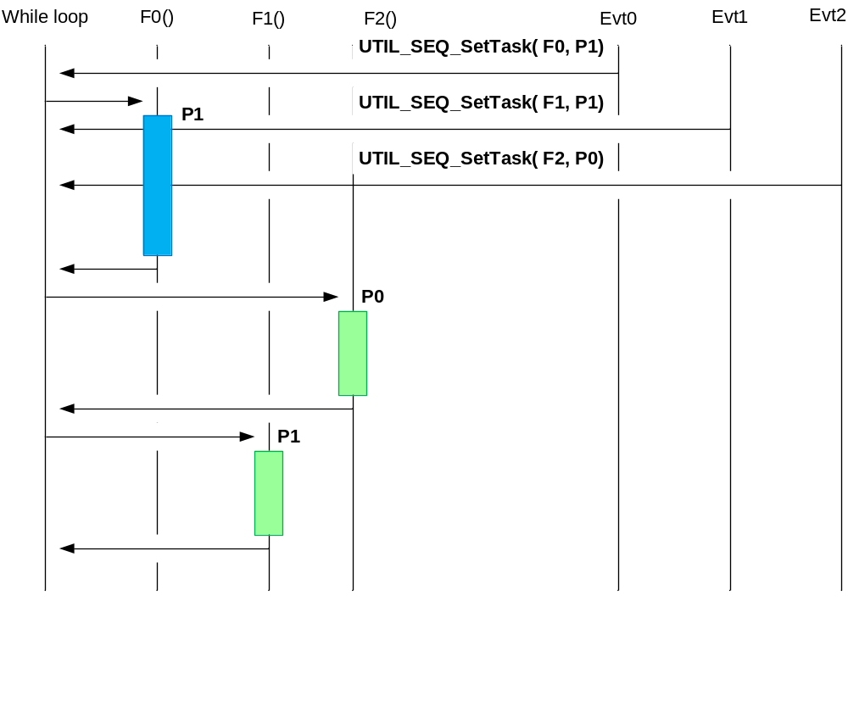
Priority
P0 is higher priority than P1
While F0() is running with priority P1, it is not preempted when F2() is requested with priority P0.
When F0() is finished, the while loop selects the next task according to priority
The priority is set when the task is requested by the user and could be changed on each request
F0() does not stop

Slide 12
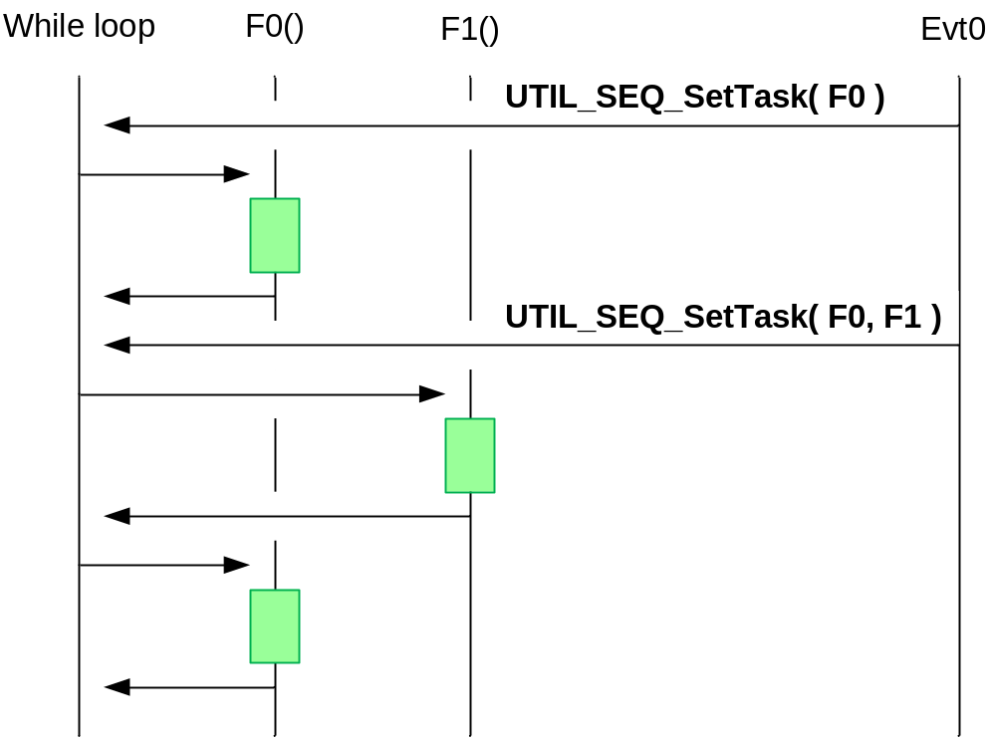
round robin
The round robin mechanism as implemented in the while loop makes sure there is no case that a task (F1) is never executed because a task with the same priority (F0) is always pending at the same time.
All tasks have the same priority

Slide 13
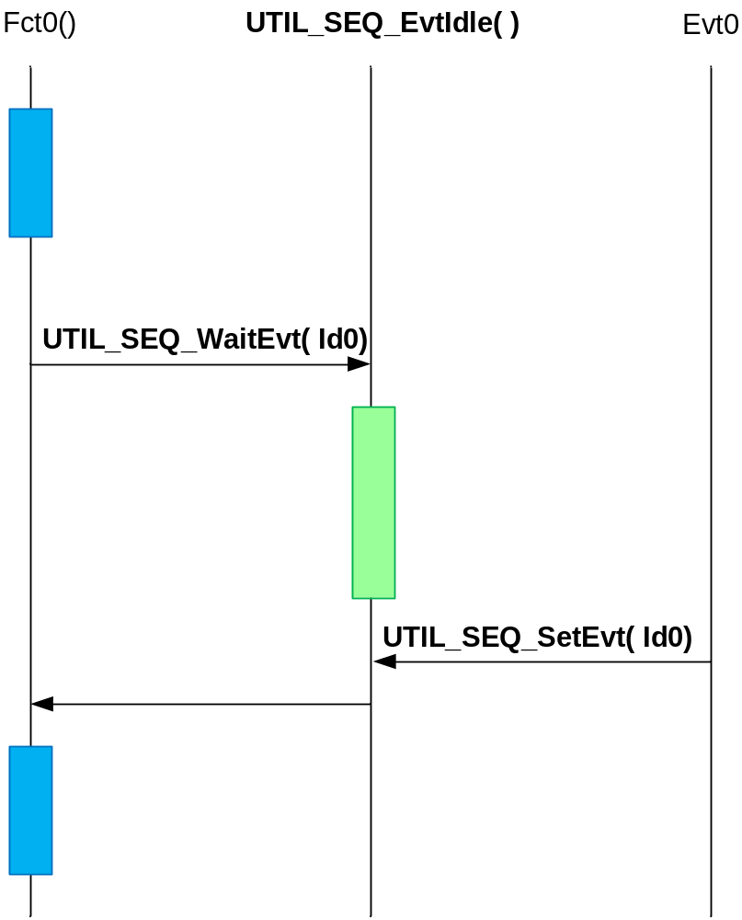
Event (1/2)
Enhanced blocking feature
Fct0() waits for event Id0 before moving forward.
The blocking call is instantiated with UTIL_SEQ_WaitEvt ()
The CPU is looping in UTIL_SEQ_Idle () until the event Id0 is received
The application may run any code in UTIL_SEQ_Idle () or enter Low Power Mode.
Blocking call until event Id0 is received
Run any code or enter Low Power Mode

Slide 14
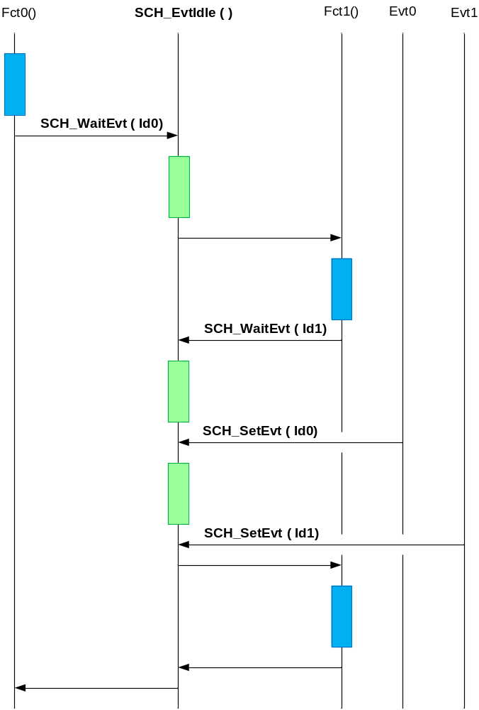
Event (2/2)
Enhanced blocking feature
Fct0() waits for event Id0 before moving forward.
UTIL_SEQ_EvtIdle() while waiting for event Id0 and calls Fct1()
Fct1() waits for event Id1 before moving forward.
UTIL_SEQ_EvtIdle() loops until event Id1 is received
Event Id0 is received but is not currently waited by UTIL_SEQ_EvtIdle ()
Event Id1 is received and UTIL_SEQ_EvtIdle () returns to Fct1().
When Fct1() is over, it returns to UTIL_SEQ_EvtIdle () which is now waiting for event Id0.
As event Id0 has already been received, UTIL_SEQ_EvtIdle() returns to Fct0()

