Slide 1
Search User Behavior:
Expanding The Web Search Frontier
Eugene Agichtein
Mathematics & Computer Science
Emory University

Slide 2


Web Search Ranking
Rank pages using hundreds of features:
Content match
  e.g., page terms, anchor text, term weights
Prior document quality
  e.g., web topology, spam features
Millions of users interact with SEs daily

Slide 3
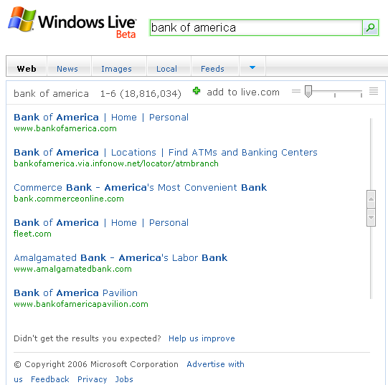
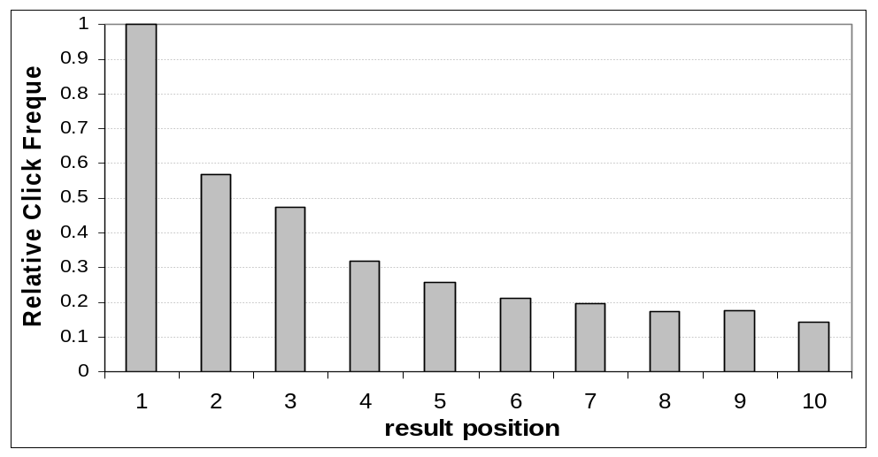
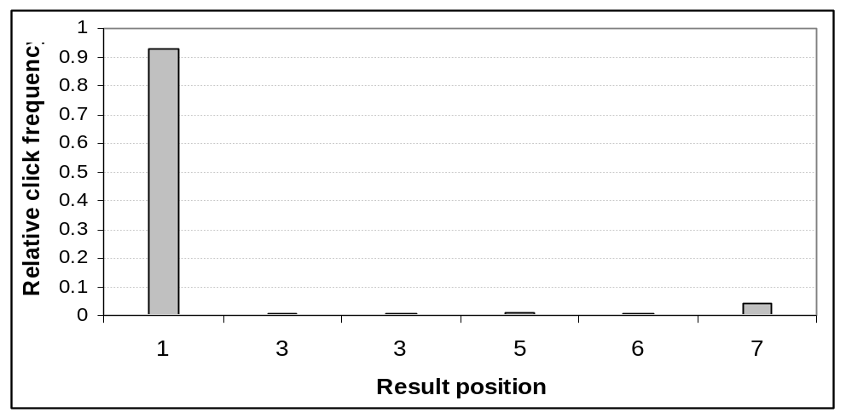
Mining Search User Behavior: “best bet” results for navigational queries
[Agichtein & Zheng, KDD 2006]
Notes:
Result clicks are valuable, and there has been much work attempting to exploit click data for ranking and evaluation. For example navigational query bank of america, the clickthrough of users clearly prefer the first result. But we can do much better than clicks!

Slide 4
Web Search Ranking Revisited:
Rich User Behavior Feature Space
[Agichtein et al., SIGIR2006a, Agichtein et al., SIGIR 2006b, IEEE DEBull Dec. 2006]
Observed and distributional features
  Aggregated over all interactions for each query and result pair
  Distributional features: deviations from the “expected” behavior
Represent user interactions as vectors in user behavior space
  Presentation: what a user sees before a click
  Clickthrough: frequency and timing of clicks
  Browsing: what users do after a click
Mine patterns in search behavior
  To predict user preferences for search results
  Incorporate behavior features into ranking
  Search abuse, query segmentation, …

Slide 5
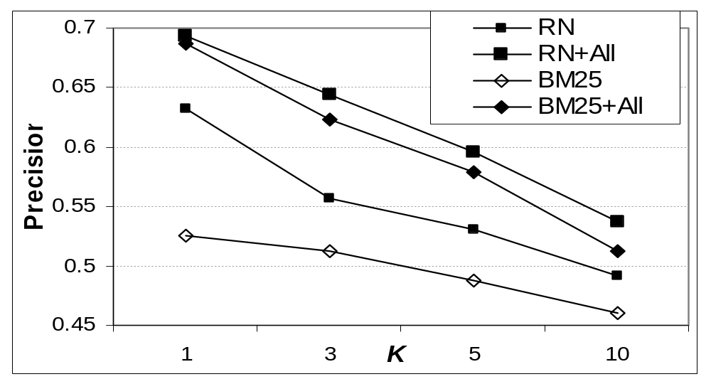
One result: search ranking
From [Agichtein, Brill, & Dumais, SIGIR 2006b]
Method | P@1 | Gain
RN | 0.632
RN+All | 0.693 | 0.061(10%)
BM25 | 0.525
BM25+All | 0.687 | 0.162 (31%)
Notes:
BM25 (keyword-based ranking) + user behavior is better than full model with hundreds of features – keyword, web structure, et al.

Slide 6
Sounds good, but…
Some challenges:
User behavior “in the wild” is not reliable
Difficult to access behavior features at runtime
Aggregation, deviations, over streams required
Interactions are sparse – what about the “tail” queries?
Personalization? – multiply the problems by 1B!
Next:
Author and searcher understanding

Slide 7
Primary References
Improving Web Search Ranking by Incorporating User Behavior, E. Agichtein, E. Brill, and S. Dumais, in SIGIR 2006
Learning User Interaction Models for Predicting Web Search Result Preferences, E. Agichtein, E. Brill, S. Dumais, and R. Ragno, in SIGIR 2006
Identifying ”best bet” web search results by mining past user behavior, E. Agichtein and Z. Zheng, in KDD 2006
Web Information Extraction and User Modeling: Towards Closing the Gap, E. Agichtein, IEEE Data Engineering Bulletin, Dec. 2006
This and other work on Information Extraction and Text Mining:
http://www.mathcs.emory.edu/~eugene/

