Slide 1
Verbosity in Database Manuscripts
Jignesh M. Patel
University of Michigan

Slide 2
Database papers are too darn long!
Jignesh M. Patel
University of Michigan

Slide 3
Background
Read/Write database and bio papers
Increasingly frustrated by how hard it is to get information out of database papers

Slide 4
Typical Topics
SIGMOD: a new data structure for faster searches in P2P
VLDB: a new method for cleaning RFID data
Nucleic Acids Research (NAR): analyze the function of a set of genes
Nature: how unrepaired DNA damage accelerates ageing.
Bio papers are not talking about less complex stuff.

Slide 5


Slide 6
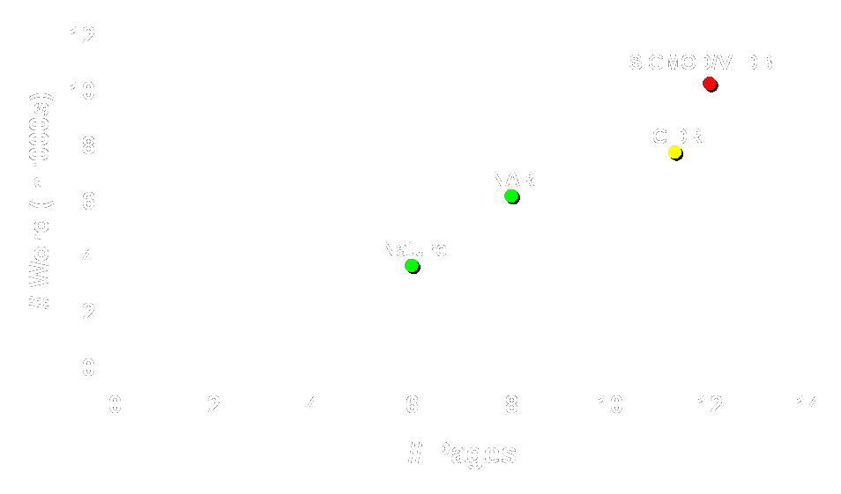

Slide 7
Nucleic Acids Research
Abstract
Introduction
Materials and Methods
Results
Discussion
Acknowledgements
References
Supplementary material
Notice
Well-defined structure
No “Related Works” or “Conclusions”
Gory details that are tangential to the main claims are in the supplementary material.

Slide 8
Nature
“Articles have a summary … of up to 150 words, … it is aimed at readers outside the discipline …”

Slide 9


Call to Action
Optimize paper for the “common” reader
  Not the narrow expert in the specific subarea
  Also, how we can make our work accessible to the general public
Shorter papers: 6-8 pages, with 4 pages supplementary material
  Harder to write the paper, but easier to read
Perhaps CIDR could take the lead

