Slide 1
Memories, Guesses,
& Apologies
Pat Helland
Amazon.Com
Jan 8th, 2007
Personal Opinions about How Computers Suck
Additional Opinions about How to Take
Advantages of their Sucki-ness…

Slide 2
Outline
Newton and Einstein
Inventory and Forklifts
Guessing and Partial Knowledge
Memories and Sharing
Screw-Ups and Apologies
Eventual Consistency and
Crappy Computers

Slide 3


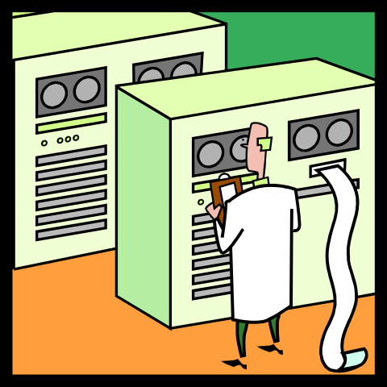
Newton and Einstein
One Notion
of Time!
One Big-Ass
Mainframe
Serializability!!!
Lotsa Tiny, Crappy Machines
Independent Perspectives
Transition from Newton’s to Einstein’s Universe
-- Newton: Time Marches Forward Uniformly Everywhere
Gravity Is Instantaneous
-- Einstein: Time Is Subjective; Knowledge Is Limited

Slide 4
Inventory and Forklifts
Even If the Computer Is Accurate:
  Data Is Entered by People
  Data Is Entered by Sensors
  Decisions Are Made
-- “Jim Wants to Buy a Book”
-- “Hey, We Have One in Nevada!”
-- “Ship It to Him… Should Be There on Tuesday!”
In Preparing the Book for Shipment, the Only Copy Is
Run Over by the Forklift in the Warehouse… Bummer.

Slide 5
Guessing and Partial Knowledge
Computers Have Partial Knowledge
  Will Be Separated from the Real World
  May Be Separated from Other Replicas with Opinions of their Very Own
Computers Do Not Make Decisions!
  They Try to Make Decisions
The Best You Can Do Is a Guess
  Good Guesses; Bad Guesses; No Certainty

Slide 6
Memories and Sharing
It’s Nice to Remember Your Guesses
  Makes It Easier When You Guessed Right
  Makes It Easier When You Guessed Wrong
  Usually, Computers Remember their Guess…
Sharing Your Memories Is Useful
  Replicas, Disaster Protection, Yada-yada-yada
Fidelity of Memories ←→ Cost
  More Money, Less Forgetfulness
  More Replicas
  Longer Latency to Share across Replicas Before
  Emitting Guesses…
Investing in Remembering Well Is a Business Decision
  Should Consider the Cost of Forgetfulness

Slide 7



Screw-Ups and Apologies
I guess I can ship that
book on Wednesday…
Sorry!!! Current guess
is next month!
Oh,
Crap!
Indistinguishable
Behavior!!!
I guess I can ship that
book on Wednesday…
Replica 1
User 1
Sorry!!! Current guess
is next month!
I guessed I would ship the book
User 2
Replica 2
I guess I can ship that
book on Wednesday…

Slide 8
Eventual Consistency and
Crappy Computers
Business Realities Force Apologies
  We Need to Code and/or Use People to Cope
Replication Can Force Apologies
  Same Crap We Already Deal With…
We Try Too Hard as an Industry
  Big, Expensive, Datacenters
  Big, Expensive, Computers
Use Lots of Crappy Computers
  Costs Less than Fewer Big Machines
  Clean Up the Mess when It Happens…

Slide 9
All Computing Is
Memories, Guesses,
and Apologies!
Take Advantage of It!!!

