Slide 1

XML Chemistry

Slide 2
CIDR Headline Story:
XML Chemistry infects the database community, a new money maker on the horizon

Slide 3
XML relationalship
Communities are build out of well-defined building blocks:
Humans and Opponent relationships
<human>
<name> John Doe </name>
<sex> male</sex>
</human>
<human>
<name> Foxy Edge </name>
<sex> male </sex>
</human>
<opponent>
<human>
….
</human>
<human>
…
</human>
</opponent>

Slide 4
XML relationalship
Communities are build out of well-defined building blocks:
Humans and Opponent relationships
<human>
<name> John Doe </name>
<sex> male</sex>
</human>
<human>
<name> Foxy Edge </name>
<sex> male </sex>
</human>
<opponent>
<human>
…
</human>
<human>
…
</human>
</opponent>
XQUERY UPDATE FACILITY

Slide 5
XML relationalship
Communities are build out of well-defined building blocks:
Humans and Opponent relationships
<human>
<name> John Doe </name>
<sex> male</male>
<???>
</human>
<human>
<name> Foxy Edge </name>
<sex> male </male>
<???>
</human>
<opponent>
<???>
<???>
</opponent>

Slide 6
Charged XML structures
Communities are build out of well-defined building blocks:
Humans and Opponent relationships
<human>
<name> John Doe </name>
<sex> male</male>
<charge> +10 volt </charge>
</human>
<human>
<name> Foxy Edge </name>
<sex> male </male>
<charge> +10volt </charge>
</human>
<opponent>
<charge> -10 volt </charge>
<charge> -10 volt </charge>
</opponent>
H⁺
O²⁻
H₂O
H⁺

Slide 7
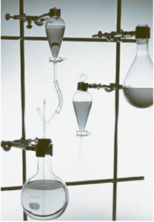
Reactive XML Paradigm
The database can be seen as a reactive container where charged XML structures interact, forming new constellations for a limited amount of time.

Slide 8
Distilling the result
The application needs can be characterized as interested in fuel or to affect the XML cocktail.
  Structural micro-filters
  Catalyst XML structures
  (in-)de-crease the energy

Slide 9
CIDR Headline Story:
XML Chemistry
  Self-organizing database architecture
  Creates a sound probabilistic world to reason, predict and control behaviour
Chemistry-based modelling is a good starting point

Slide 10
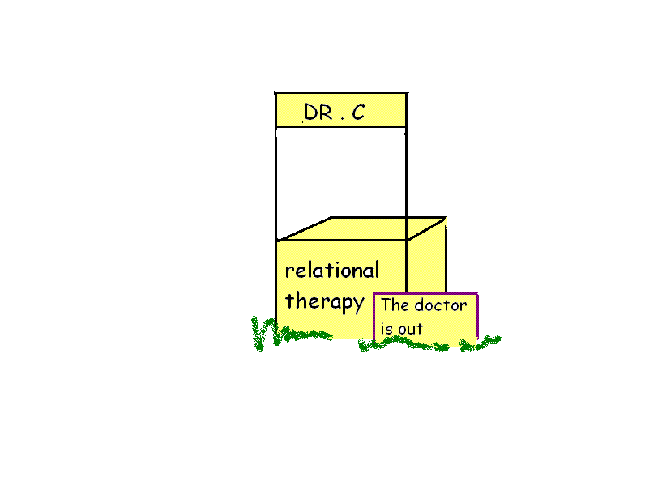

Retired(?) Mr. D. BEMES
Optimizer
headache
Bi-focal worldview
(SQL-XML)
Soft(ware) belly
Too many
data packs
Unstable cluster pc marsh
I can still win the triathlon (!?)

