Slide 1
Tape is Dead
Disk is Tape
Flash is Disk
RAM Locality is King
Jim Gray
Microsoft
December 2006

Slide 2
Tape Is Dead
Disk is Tape
1TB disks are available
10+ TB disks are predicted in 5 years
Unit disk cost: ~$400 → ~$80
But: ~ 5..15 hours to read (sequential)
~15..150 days to read (random)
Need to treat most of disk as
Cold-storage archive

Slide 3
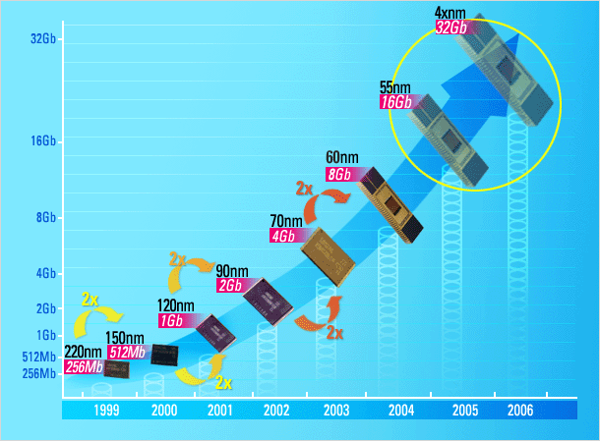

FLASH Storage?
1995 16 Mb NAND flash chips
2005 16 Gb NAND flash
Doubled each year since 1995
Market driven by Phones, Cameras, iPod,…
Low entry-cost,
~$30/chip → ~$3/chip
2012 1 Tb NAND flash
== 128 GB chip
== 1TB or 2TB “disk”
for ~$400
or 128GB disk for $40
or 32GB disk for $5
Samsung prediction

Slide 4
FLASH Some Parameters
5,000 IO/s per chip!
Chip read ~ 20 MB/s
write ~ 10 MB/s
N chips have N x bandwidth
Latency ~ 25 μs to start read,
~ 100 μs to read a “2K page”
~ 2,000 μs to erase
~ 200 μs to write a “2K page”
Power ~ 1W for 8 chips and controller

Slide 5
What’s Wrong With FLASH?
Expensive: $/GB
  50x more than disk today
  Ratio may drop to 10x in 2012
Limited lifetime
  ~100k to 1M writes / page
  requires “wear leveling”
  but, if you have 1B pages,
  then 15,000 years to “use” ½ the pages.
Slow to write
you can only write 0’s,
so erase (set all 1) then write.

Slide 6
Obvious Uses For Flash
PDAs, cameras, iPod, ….
Laptop disks
  power, rugged, quiet, big enough, …
Not so obvious use:
  ARCHIVE for photo/music/..
  because it’s simple to understand.
  Enterprise drives (lots of IO/s per $
  per watt
  per liter )

Slide 7
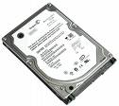
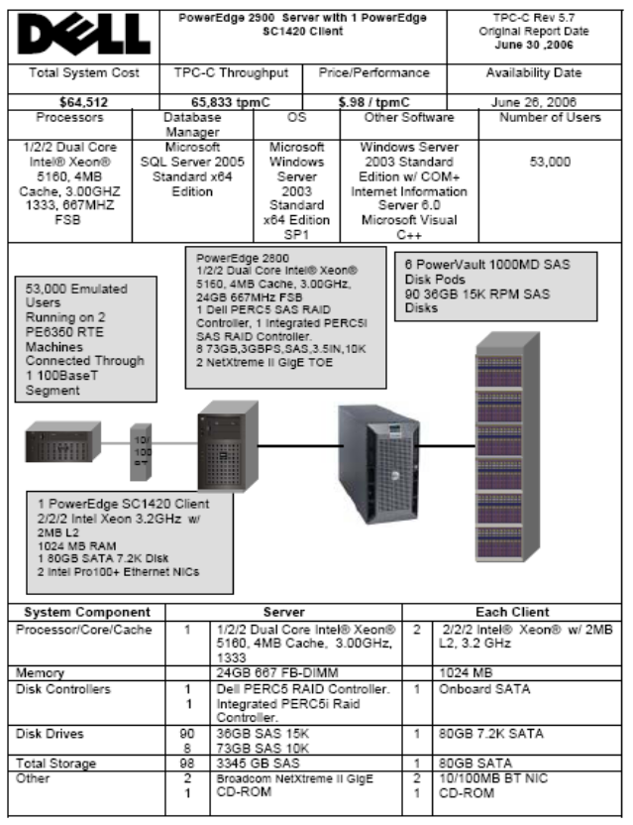
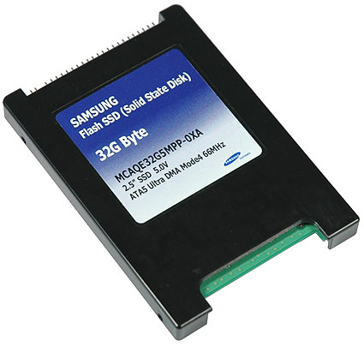
One Could Make a Flash Disk
(or a Flash File System)
6K random reads/sec, 3K random writes/sec
The IO capacity of 30..45 disks
Uses 1 W vs 500W…
Less space, …
See
“A Design for _x000b_High-Performance _x000b_Flash Disks”
Birrell, Isard,
Thacker, Wobber
MSR-TR-2005-176
replace with 1 10TB disk
and 3 FLASH disks

Slide 8
We Are Not There Yet
Current FLASH disks could do much better
on writes (100x better (!))
Algorithms are known but…
This changes many ratios
Access time is 20x less (~200us)
IOps is 100x more
Re-evaluate page sizes MSR-TR-2006-168
FlashDB: Dynamic Self-tuning Database for NAND Flash, Suman Nath, Aman Kansal

Slide 9
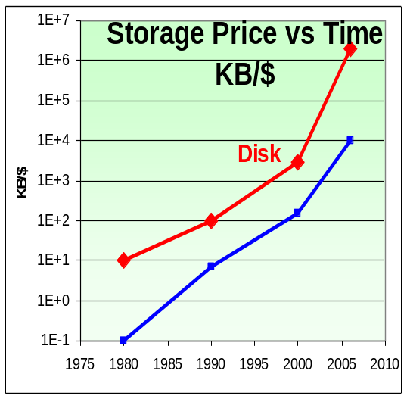
RAM Locality is King
The cpu mostly waits for RAM
Flash / Disk are
100,000 …1,000,000
clocks away from cpu
RAM is ~100 clocks away
unless you have locality (cache).
If you want 1CPI (clock per instruction)
you have to have the data in cache
(program cache is “easy” )
This requires cache conscious
data-structures and algorithms
sequential (or predictable) access patterns
Main Memory DB is going to be common.
100:1
10 years

Slide 10
Tape is Dead
Disk is Tape
Flash is Disk
RAM Locality is King
Jim Gray
Microsoft
December 2006

