Slide 1

Other People’s Data
David Maier & Nicholas B. Rayner
Department of Computer Science
Portland State University

Slide 2
Foreign Dataspaces
Data sources seem to appear by spontaneous generation
Often up to someone else to interpret them
Description can be minimal, lacking or wrong

Slide 3
RxSafe Dataspace
Medication records
  Assisted living facilities, Primary care clinics, Hospital, Pharmacies
Standards for medication information
  National Drug Code Directory (NDCD), FDA, packaged drugs
  RxNorm, NLM, describing clinical drugs
  National Drug File – Reference Terminology (NDF-RT), VA, drug classes

Slide 4
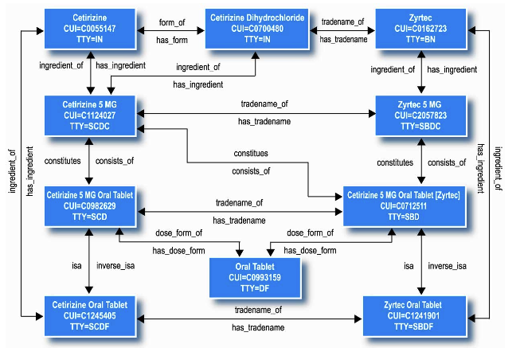
RxNorm Published Structure
[RxNorm: A Guide for the Perplexed, http://www.nlm.nih.gov/umls/rxnorm/rxnorm_guide.pdf]

Slide 5
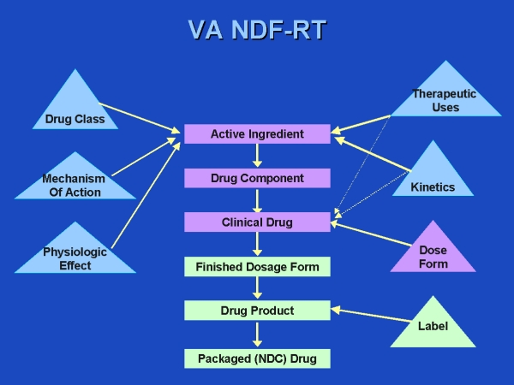
National Drug File – Reference Terminology (NDF-RT)

Slide 6
Issues
Internal properties of sources
  What is a key, foreign key in NDCD
Generic vs. domain-specific structure
Comparability
  Tradename (NDCD) vs. Brand Name (RxNorm)

Slide 7
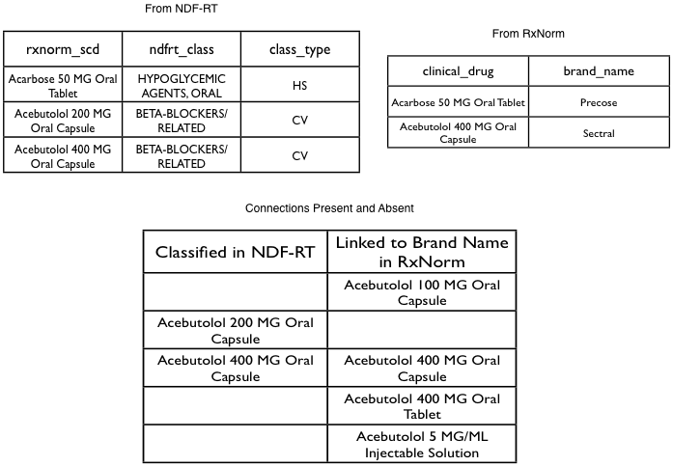
Connectivity: RxNorm and NDF-RT
Classes for 54%
of brand names
(RxNorm of 11/16/05)

Slide 8
Dataspace Profiling
Interactive tool suite (Dataspace Workbench) for dataspace characterization and customization

Slide 9
Architectural Framework
Modules for different property types, with 3 components
  Probe: property verification or inference
    <c1,hasForm,c2>
    c1=clinical drug, c2=dose form
  Switch: customization that exploits property
    hasForm(Clinical_Drug, Dose_Form)
  Check: ensure updates don’t invalidate
    Might be easier than probe

Slide 10
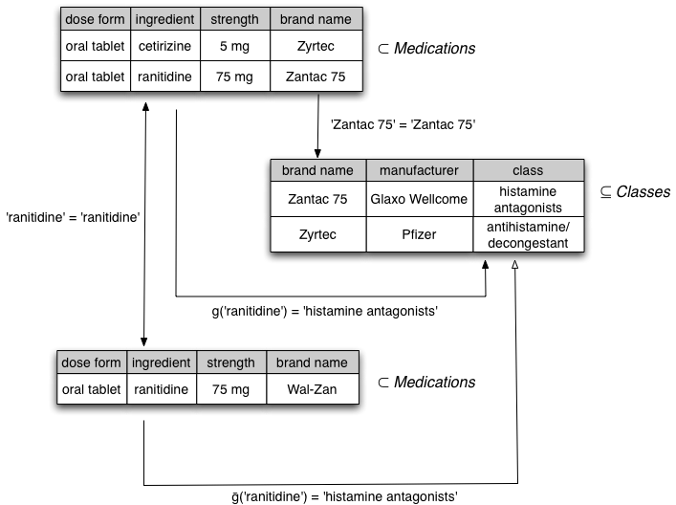
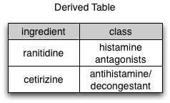
Example Module:
Linking Through Equivalency

Slide 11
What’s the Benefit?
SELECT DISTINCT i.scd, c.class
FROM scd_ing AS i INNER JOIN scd_class AS c ON i.scd = c.scd
WHERE i.scd IN ('Penicillin G 250000 UNT Oral Tablet', 'Ibuprofen 200 MG Oral Capsule', 'Acebutolol 400 MG Oral Capsule');
+--------------------------------+-----------------------+
| scd | class |
+--------------------------------+-----------------------+
| Acebutolol 400 MG Oral Capsule | BETA-BLOCKERS/RELATED |
+--------------------------------+-----------------------+
SELECT DISTINCT i.scd, c.class
FROM scd_ing_lim AS i INNER JOIN scd_ing_lim_scd_class_equivlink AS c ON i.ing = c.ing
WHERE i.scd IN ('Penicillin G 250000 UNT Oral Tablet', 'Ibuprofen 200 MG Oral Capsule', 'Acebutolol 400 MG Oral Capsule');
+-------------------------------------+------------------------------------+
| scd | class |
+-------------------------------------+------------------------------------+
| Acebutolol 400 MG Oral Capsule | BETA-BLOCKERS/RELATED |
| Ibuprofen 200 MG Oral Capsule | NONSALICYLATE NSAIS, ANTIRHEUMATIC |
| Penicillin G 250000 UNT Oral Tablet | PENICILLIN G-RELATED PENICILLINS |
+-------------------------------------+------------------------------------+

