Slide 1
How to make sense out of unstructured data?
Yi Chen
Dept. of Computer Science and Engineering
Arizona State University

Slide 2
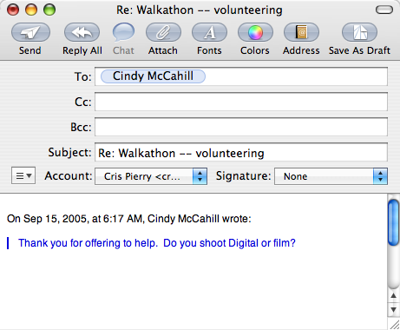
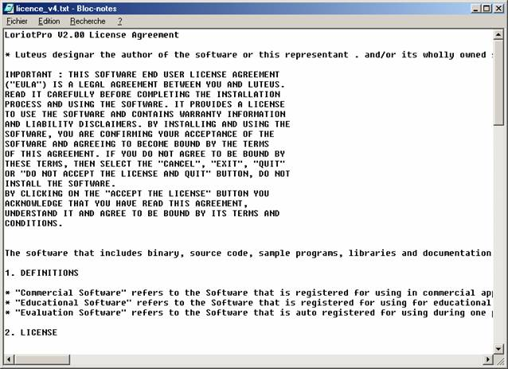



Databases Have Been a Great Success
for managing structured data
But, 85% of the World’s Data is Not in Databases!
Notes:
Most of the data are in free text form (picture)
News articles
Blogs
Emails
Various forms filled out by customers, patients, etc
Text files in personal computers

Slide 3
How to Obtain Information from Unstructured Data?
Efforts have been made by other areas
  Search engines: Google, Yahoo, MSN, Ask,…
  Information extraction (IE)
  [Avatar, TIES, …]
  Natural language processing (NLP)
  [Treebank, UIMA, …]
What can databases do for unstructured data?
XML provides a good basis for representing semi-structured data,
However, challenges remain!!
They produce semi-structured data from texts

Slide 4
Querying Data Generated from IE
Information extraction produces data about specific entities and relationships
Data generated from information extraction are error prone
  incomplete data [Imieliski, Koch,…]
  probabilistic databases [Getoor, Jagadish, Halevy, Subrahmanian, Suciu, Tannen, Widom, …]
  malleable schemas [Chang, Halevy, Ives…]
Query posed by naïve users are inaccurate
  keywords [Agrawal, Chaudhuri, Das, Doan, Gravano, Papakonstantinou, Shanmugasundaram..]
  over- or under-specified queries [Chaudhuri..]
  natural language queries [Jagadish..]
QUIC: a system that handles data incompleteness and query imprecision at the same time for autonomous databases [CIDR 07, ICDE 07]
  Collaborated with Subbarao Kambhampati, Garrett Wolf, Hemal Khatri, Bhaumik Chokshi, Jianchun Fan, and Ullas Nambiar
Notes:
Autotrader, 34% tuples has null value
www.CarsDirect.com, 98%

Slide 5
Querying Data Generated from NLP
Natural language processing generates tree structured data (parse trees)
S
Understanding the lexical structure of a sentence helps query answering
  E.g. find the NP after “Bob” and “with” within an NP
Demands queries similar to but different from XQuery/XPath queries
NP
VP
NP
V
NP
NP
PP
Prep
Det
NP
Alice
saw
Bob
with
a
dog
today
LPath: a query language for linguistic annotation data generated from NLP over text documents [ICDE06]
  Collaborated with Susan Davidson, Steven Bird, Haejoong Lee, and Yifeng Zheng

Slide 6

Challenge
How should we close the loop?
Result 1
Queries
Documents
Revised queries
Result 2
Data bases
Notes:
Why we need to store the documentation into database ( rdbms, xml?)

