Slide 1
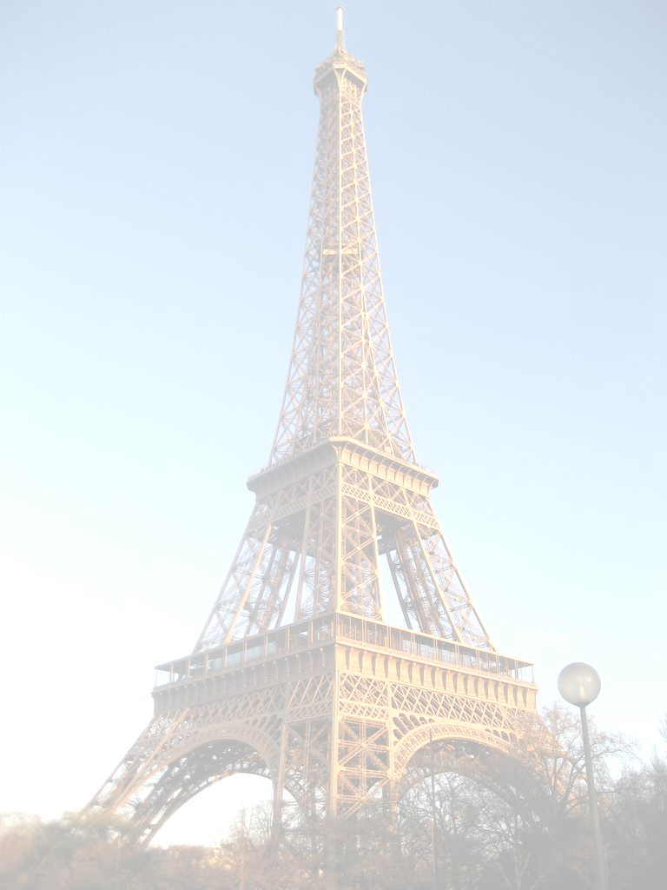
Beyond
cache-consciousness
Stavros Harizopoulos
M.I.T.

Slide 2
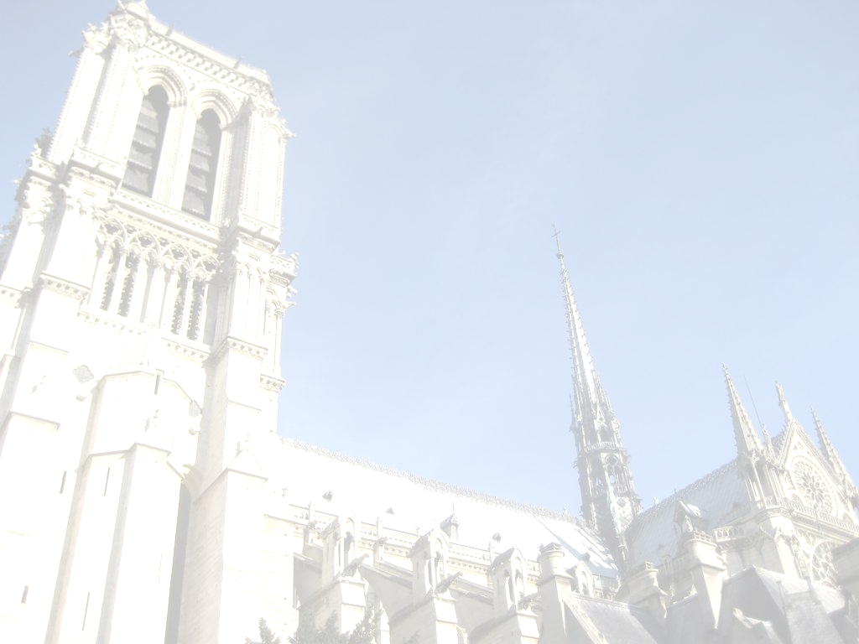
Cache-conscious DB research
Page layouts
Cache partitioning algorithms
Cache-conscious indexes
But is this still the tip
of the iceberg?

Slide 3

Hardware advances
e.g., L2 data prefetcher:
Main Memory
CPU
L2
cache
L1
cache
6GB/sec!!

Slide 4
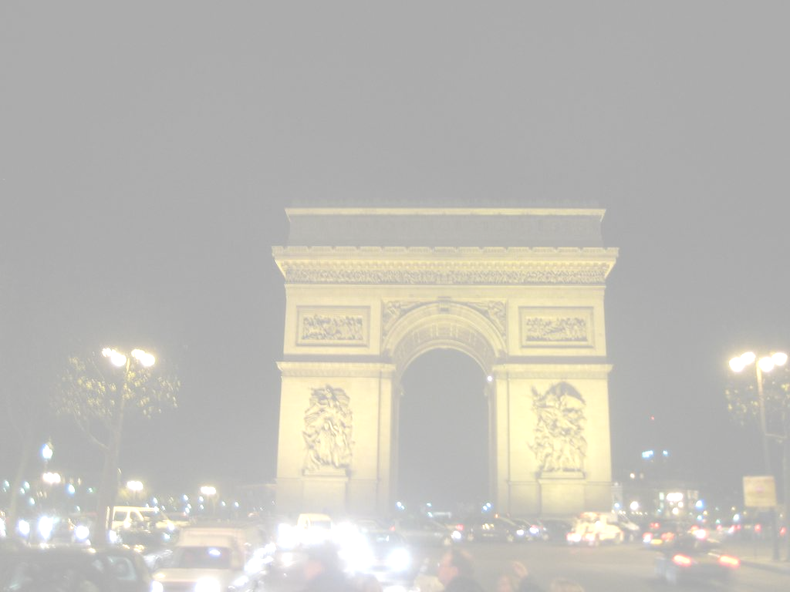

Amdahl’s law
stall #1
at most X%
stall #2
total
CPU time
So, are we reaching a point
of diminishing returns?

Slide 5
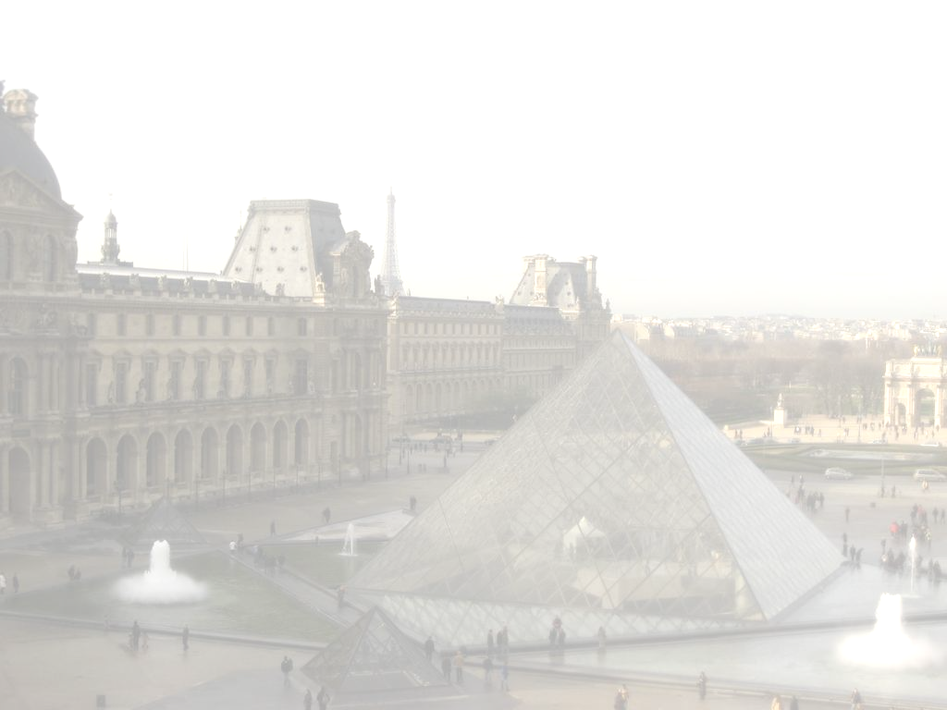
There are more important challenges
Many-core CPUs (think 100s)
  Parallelization (you think this is solved?)
  Resource management
  Scheduling!!
Flash drives
  Flash drives are going to be the new disk drives
  Disk drives are going to be the old tape drives
  Revisit query processing, energy-aware techniques

Slide 6
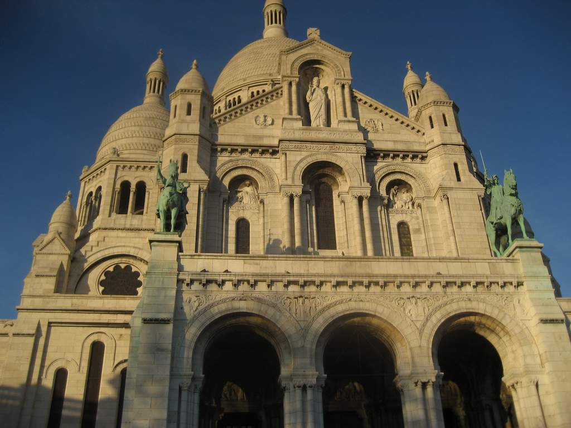
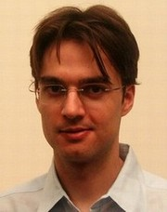
Shameless self-advertising
I am in the job market!
I am interested in both Academia & Labs
US & Europe
PhD @ CMU, PostDoc @ MIT
http://nms.csail.mit.edu/~stavros

