Slide 1
SD-SQL Server : A Scalable Distributed Database System
Witold LITWIN, Soror SAHRI & Thomas SCHWARZ
Witold.litwin@dauphine.fr Soror.sahri@dauphine.fr tjschwarz@scu.edu
Ceria Laboratory Comp. Eng. Dep. Paris-Dauphine University Santa Clara U.

Slide 2

Partitioned Tables
Most DBSs have distributed/parallel versions with partitioned tables
  SQL Server, Oracle, DB2, MySQL, Postgres…

Slide 3
BENEFITS OF PARTITIONING
BENEFITS OF PARTITIONING
Partitioning can provide tremendous benefits to a wide variety of applications by
improving manageability, performance, and availability. It is not unusual for
partitioning to improve the performance of certain queries or maintenance
operations by an order of magnitude. Moreover, partitioning can greatly simplify
common administration tasks.
Partitioning also enables database designers and administrators to tackle some of
the toughest problems posed by cutting-edge applications. Partitioning is a key
tool for building multi-terabyte systems or systems with extremely high
availability requirements.
Partitioning in
Oracle Database 10g Release 2
An Oracle White Paper
May 2005

Slide 4
Hassle of Partitioning
Major DBSs require manual static partitioning
  Including manual repartitioning when tables scale-up
It’s a Big Hassle
  See the literature on Oracle, DB2, SQL Server…
    16 commands for maintenance operations on partitioned tables under Oracle 10g
      With 3 variants per command
    40-page description in Oracle Adm. Booklet
Not for normal users

Slide 5
Scalable (Distributed) Partitioning
Partitioning should be dynamic & automatic
  Like B-tree and VSAM files did for ISAM files
    30 years ago in centralized environment
SD-DBS
  A DBS with scalable (distributed) tables
    Litwin, Schwartz & Risch (2002)
  Forming scalable databases
    Collections of node databases

Slide 6
SD-SQL Server
An experimental SD-DBS
  The first and yet the only
Implements the SD-DBS architecture
  Updatable distributed partitioned views
  Dynamically splitting segmented tables
    Hidden by those views
  Stored procedures of SQL Server
Runs on Microsoft SQL Server
  Up to 250 nodes at present
    In theory

Slide 7
Gross Architecture
User/Application
User/Application
sd_create_table
sd_insert
SD-SQL Server
Managers
SD-SQL
client
SD-SQL
server
SD-SQL
server
SD-SQL
peer
Linked
SQL
Servers
C
S
S
D1_T
P
T
_D1_T
_D1_T
Split
_D1_T
NDBs
D2
Di
Di+1
D1

Slide 8
Application Interface
SDB Creation
  sd_create_scalable_database
  ‘SkyServer’, ‘Dell1’, ‘Server’, 2
  /* Creates the primary SkyServer NDB as well at Dell1*/
SDB Alteration
  sd_create_node_database
  ‘SkyServer’, ‘Ceria’, ‘Client’
SDB Removal
  sd_drop_scalable_database ‘SkyServer’

Slide 9
Scalable Table Management
Scalable Table Creation
  sd_create_table ‘PhotoObj (objid BIGINT PRIMARY KEY…)’, 10000
    No foreign keys yet
Scalable Table Alteration
  sd_alter_table ‘PhotoObj ADD t INT’, 1000
  sd_create_index ‘run_index ON Photoobj (run)’
  sd_drop_index ‘PhotoObj.run_index’
Scalable Table Removal
  sd_drop_table ‘PhotoObj’

Slide 10
Scalable Queries
USE SkyServer /* SQL Server command */
Update
  sd_insert ‘INTO PhotoObj SELECT * FROM
  Ceria5.Skyserver-S.PhotoObj’
Search
  sd_select ‘* FROM PhotoObj’
  sd_select ‘TOP 5000 * INTO PhotoObj1 FROM PhotoObj’, 500

Slide 11
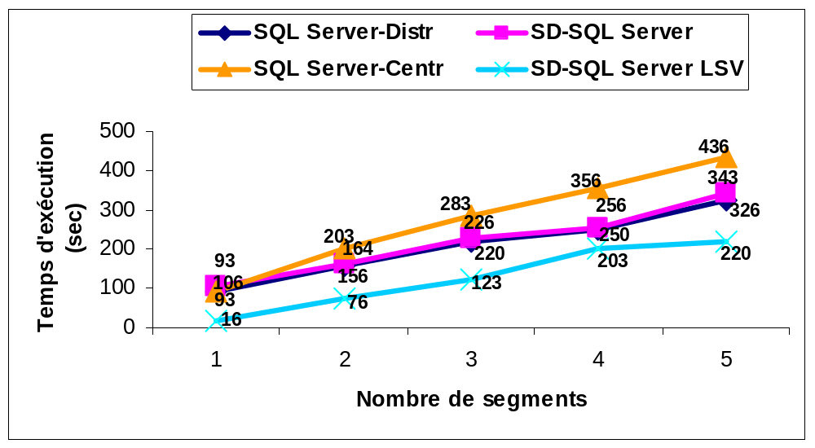
SD-SQL Server / SQL Server
(Q): sd_select ‘COUNT (*) FROM PhotoObj’
Query execution on SQL Server and SD-SQL Server

Slide 12
Conclusion
Scalable tables are now a reality
  with SD-SQL Server
  No more manual repartitioning
    Unlike in any other DBS we know about
Performance analysis proves
  Efficiency of our design
  Immediate utility of SD-SQL Server
See the Web site for papers & video demo

Slide 13
Future Work
SQL Server 2005
Virtual repository of eGov documents
  SQL Server XML View
Foreign keys for scalable tables
More performance measurements
Error processing
High availability
  Parity segments
Application to other DBMSs
  Oracle, DB2, etc.

