Slide 1

Data Management = Data Integration:
A Proof
Alon Halevy

Slide 2
My Gong History
2003: Most Outrageous Idea Award
  Redesign database course;
  SIGMOD Record, December 2003.
2005: Good idea but not funny
  Malleable Schemas, WebDB 2005
2007: Not taking risks
  Bribe.

Slide 3
The Point?
It’s not about Mike, Jim or DeWitt
  Big, middle-aged or hairy.
It’s about Jennifer:
  She was (only) half right.

Slide 4
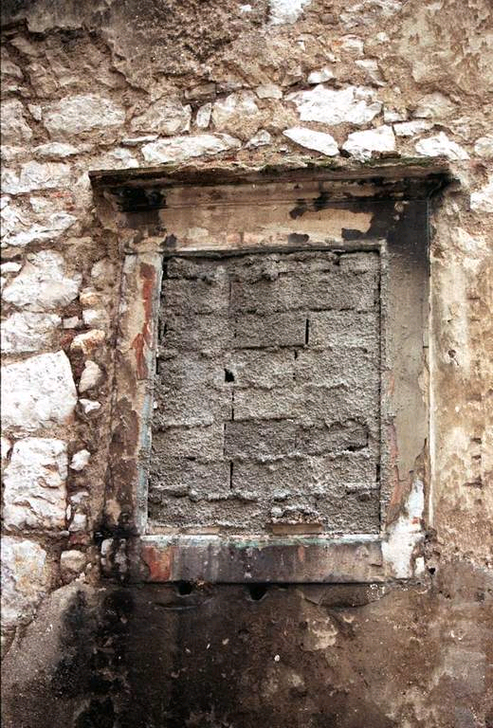
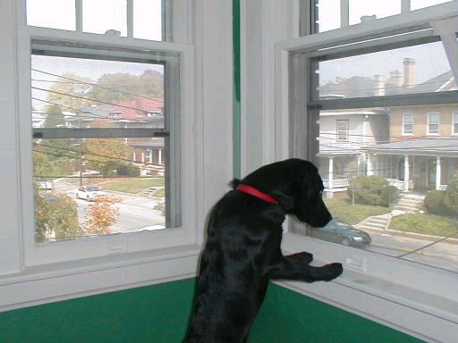
Uncertainty and Lineage
Opening the Database Window

Slide 5
With Uncertainty & Lineage
Little distinction between data integration and ordinary databases!
We’re always getting external data from multiple sources.
  Database(space) systems need to be aware of the data’s origin, heritage and baggage.
  Q.E.D

