Slide 1
To All the M.A.P.-to-Be:
Think Big– How Big?
System Driven– What System?
Kevin C. Chang

Slide 2
Why making fun of myself doing “gong show”?
I got a mission…

Slide 3
To finish our talk…
Since Gerhard only gave 5 minutes for our demo talk...

Slide 4
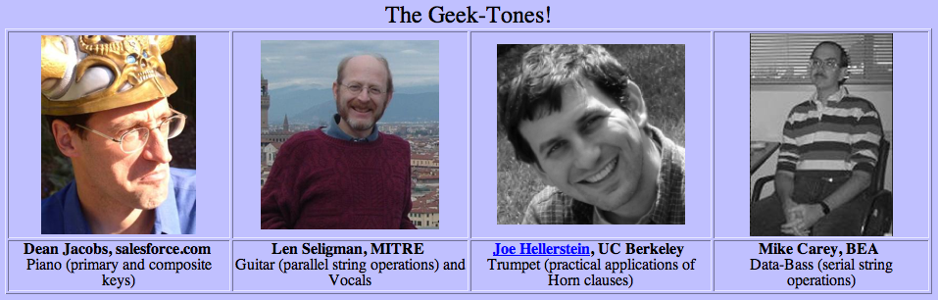


To dispute what I learned from CIDR’05:
Being a M.A.P.
(Male Asst. Prof.)
is like a “Wonderful World.”

Slide 5
To share my humble M.A.P. experience:
You are totally in charge of pushing your dream.
Graduate students are pretty cheap, they get TA support anyway.
Undergraduates are plenty, and all it takes is a letter of recommendation.
Nobody bosses you what to do– The chair is only allowed to bother you once every 3 year.

Slide 6
How can life be any better?
You can
think big, and
build fun systems!
Saw the many cool demos today?

Slide 7
But, …
Think Big.
How Big?
System Driven.
What System?

Slide 8
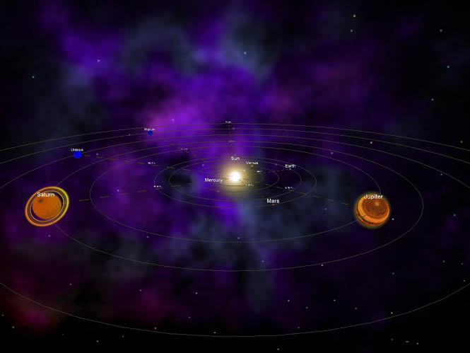
The biggest system under the sun is probably…
the Web.

Slide 9
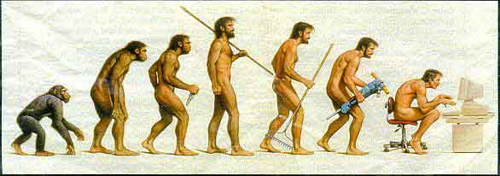
The Evolution Road Map: Web Info. Engine

Slide 10








1. The Search Age: 1995 -- 2005

Slide 11



























2. The Integration Age: 2000 -- 2010
Large-Scale Integration over Deep/Surface Web

Slide 12
What next?
What do search and integration lead to?

Slide 13
3. The Mining Age: Beyond Finding Entities
Web Mining Engine

Slide 14
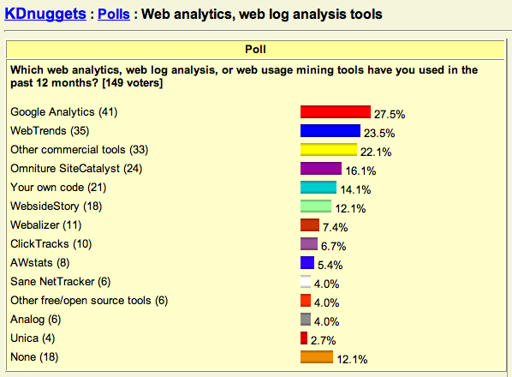

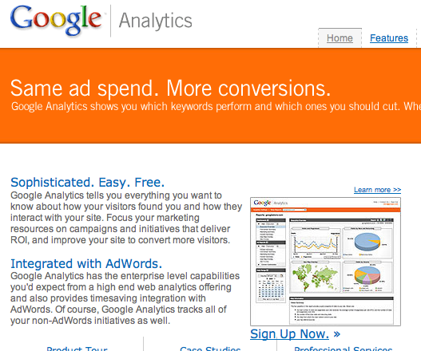
Lesson #1: Most Used Web Mining Tool?
mining

Slide 15


Lesson #2: Mining in the middle, for any info access.
Deep Web
Surface Web
mining
Access
Structure
Mining
Search
Integration

Slide 16
My Prediction:
One so powerful cannot remain forever inside.
mining
outside

Slide 17
What do I mean by a Web Mining Engine?
Web Mining Engines:
Mining as primary functions
Mining for end users
Mining
Search
Integration

Slide 18
What will such a Mining Engine be?
Mining
Search
Integration
Students will figure out!
Another advantage of M.A.P.

Slide 19
Thank You!
And,
Illinois is recruiting
(M|F).A.P.!

