Slide 1
Data-Driven Processing in
Sensor Networks
Adam Silberstein, Rebecca Braynard,
Gregory Filpus, Gavino Puggioni, Alan Gelfand,
Kamesh Munagala, Jun Yang
Duke University

Slide 2
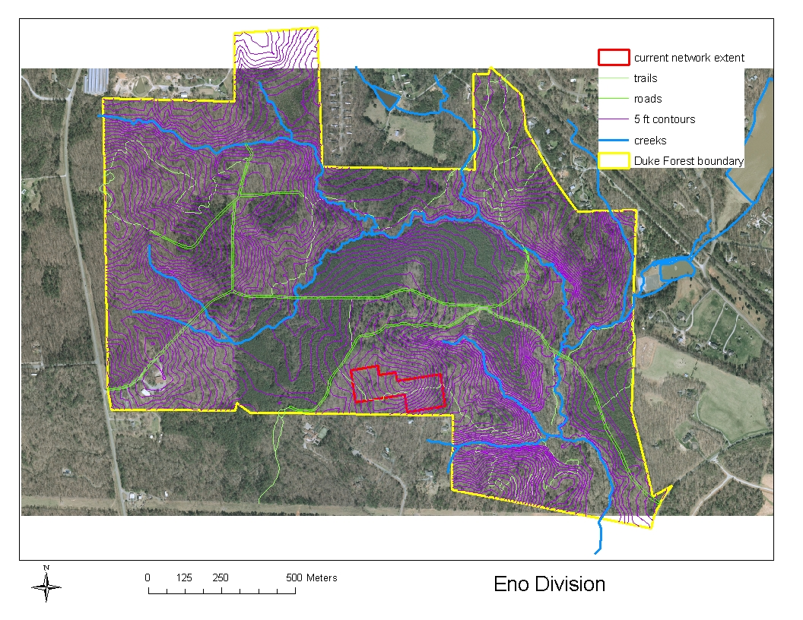
Forest Monitoring
Notes:
Work is motivated by this project of learning about forest growth.
Collaboration with ecologists from School of Environment, statisticians, computer scientists
We have a deployment in Duke Forest
Red outlines current deployment but it will grow
Purple lines are 5 foot contours
Blue are creeks
So this is an interesting area with wet spots, dry spots, etc.
Types of sensors: light, temperature, soil moisture…working on sap flow

Slide 3
Data Acquisition
Goal: Understand forest growth
One query: continuous SELECT *
  Not amenable to in-network aggregation
Existing solutions
  Continuous reporting
    Too much radio transmission
  Model-driven acquisition [Deshpande et al. VLDB 04]
    Do not initially have a model we trust to substitute for the actual data
Notes:
Jim’s quote at bottom
We have interesting directions to pursue, but we expect broad applicability
don’t forget Clark’s quote

Slide 4
Data-Driven Approach
Insight: Use models, but don’t count
on them
  E.g., use models to optimize data collection, but not at the expense of correctness
Efficiency
Correctness
Worse
Better
Model quality
Notes:
Maybe remove design philosophy
Design Philosophy
Simple code in-network
Sophisticated planning/processing out-of-network

Slide 5
Outline
Issues in data-driven processing
  In-network suppression based on models
  Coping with failure
  App./comm. layer interaction
Goals for this talk
  Introduce basic data-driven techniques
  Expose the trade-offs we can control in a principled way
Notes:
Maybe remove goals and just mention will be coming back to idea of trade-offs throughout talk

Slide 6
Suppression Scheme
Scheme = graph of suppression links
Each is an agreement between an updater and an observer to synch a set of values over time
  Function f_{enc} at updater dictates what, if any, report is sent
  Function f_{dec} at observer specifies how to update values with each report
  (or lack thereof)
E.g: value-based temporal
suppression: a link between
each node and root syncs
time series of x_{t} (value) and
x*_{t} (copy) such that |x_{t} – x*_{t}| · ε
f_{dec}
if r_{t} received:
x*_{t} Ã x*_{t-1} + r_{t}
else:
x*_{t} Ã x*_{t-1}
Root (observer)
r_{t}
Node (updater)
if (|x_{t} — x_{t’}| > ε):
transmit r_{t} Ã x_{t} — x_{t’}
x_{t’} Ã x_{t}
# else report suppressed
f_{enc}
Notes:
Suppression is main technique for avoiding continuous data stream
Made up of links which synchronize values between pair of nodes
We hope to often not need to send messages to maintain synchrony
Here is example of value-based temporal suppression. If node’s value has not changed beyond epsilon since transmitted. That is what this logic is.
Think of this scheme as encoding very simple model. If root doesn’t hear from node it can predict current value as equaling old value
We can also encode more complicated models and synchronize a set of values: I.e., perhaps a reading and 2-3 model parameters.
functional description of suppression link (contract between updater and observer) synchronize set of values
add more to f_dec on graphic
general idea, state value-based temporal suppression
Very simple model (note and end)
In general, we design enough suppression links such that the ones terminating at the root are sufficient to produce the query result.
|x_t — x^*_t| < \epsilon
x^*_t = x^*_{t-1}+r_t

Slide 7
Failure
Failure adds ambiguity to suppression
  Is missing report a suppression or failure?
How can we cope with failure?
System-level: e.g., re-transmit
Application-level: e.g., add redundancy for temporal suppression
  Counter: append report number
  Timestamp: append last n report times
  History: append last n report times+readings
Notes:
System-level reduces number of failed messages
Application redundancy reduces impact of failed messages
Stop here and ask: the goal of suppression is to remove redundancy. Now we’re saying add it back in to handle failure. So should we just not bother at all?
Answer: we could do that and use all the naturally-occurring redundancy to help reconstruct the values. But we have no control over that level of redundancy.
By removing it, we add it back in a controlled, tunable way. For example, if some suppression links are totally reliable, no need to augment them with redundancy.
Failure killer to supp. schemes: ambiguity
How do we deal with failure: low-level vs. application level
-explain each (examples for app)
Show 2 graphs
-failure low vs. failure high
-redundancy vs. failure protection
-argue against using natural redundancy

Slide 8
An Observation
Goal of suppression was to remove redundancy
If we now add redundancy back in, what is the point of suppression?
Naturally-occurring
redundancy
No control of
cost-reliability tradeoff
Explicit
redundancy
Possible control of
cost-reliability tradeoff
vs.

Slide 9
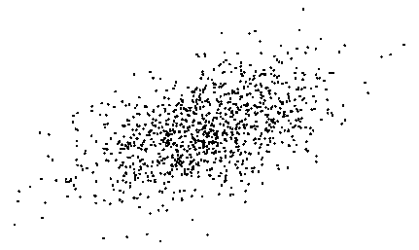

Failure Example
Temporal suppression with ε = 0.3
{x₁, x₂, x₃, x₄} = {–2.5, –3.5, –3.7, –2.7}
Root receives {–2.5, ?, ?, –2.7}
Model-based
reconstruction:
root assumes data is
from a known AR(1)
Just data
???
No knowledge
of suppression
x₃
x₃
x₂
x₂
Knowledge of
suppression +
Timestamp
redundancy
x₂ 2 [-3.0, -2.2]
x₃
x₃
x₃ 2 [x₂ – 0.3, x₂ + 0.3]
x₂
x₂
x₂

Slide 10
Limiting reliance on models
When publishing sensor data
Don’t just publish results of model-based reconstruction
  Incorrect model will lead to wrong results
Publish actual data received
AND publish suppression schemes
  Translate to hard bounds on missing data
  Suppression can be model-based, but here incorrect model won’t lead to wrong data
Notes:
Move to back up
Ask Jun: How would we modify BaySail to have a very informative prior; say we were very sure we know the parameter values ahead of time.
-If know parameters, don’t update them in Bayesian. Just use them.
-Or just more informative priors. Lower variances to start with.
-Explain from hdr standpoint. Want 80% confidence…informative prior doesn’t need lots of redundancy, but uninformative does.
-What needs to be published…known for sure…known from models. Data-Driven makes a distinction
Make this more like that last slide, point to different places on line

Slide 11
Coordinating Efforts
Lower cost
Better failure coping
System-level
Application-level
Insufficient
Reasonable
Overkill
Notes:
Draw more overkills. Lots of system-level, with any amount of application
New title for this and next slide

Slide 12
App./Comm. Interaction
Applications want more control over communication
  Benefit: reduced message size & number
  Cost: more restrictive routes, & more vulnerability to intermediate node failures
Milestone optimization framework
  Set milestone nodes where messages must go through (and converge)
  Comm. layer has freedom routing between
Notes:
More complicated applications, such as suppression schemes, may be asking more of communication.
Example, all nodes-to-root ok, but those that gather readings in network, esp. hierarchically require point-to-point communication.
3. Benefit, more in-network processing for compression/suppression. Cost, more restrictive routes, more vulnerable to failures
milestone allows for smooth trading off of these things. Not extremes of no in-network convergence, or rigid routing tree.
also, we can then do costing with them
TAG is opportunistic. Give in-network join example.

Slide 13
Milestones
?
?
?
No milestones (e.g. only
node-to-root messages)
All milestones (i.e. compile-
time fixed routing tree)
More milestones
More application control/opt. opportunities
Less communication flexibility

Slide 14
Conclusion
Data-driven processing for continuous data collection
  With the data as ground truth
  Without continuous transmission
Techniques & issues
  Model-based suppression
  Coping with failure
  Managing interaction between app./comm.
Take-away points
  Use models in a controlled way
  Expose tradeoffs to enable flexible design
Notes:
HERE IS THE MAIN POINT TO MAKE
we tried to take out redundancy+models to make things perfect. but then we need them again to be realistic. but when we add them
back in, we do it in controlled way and understand their influence.

Slide 15
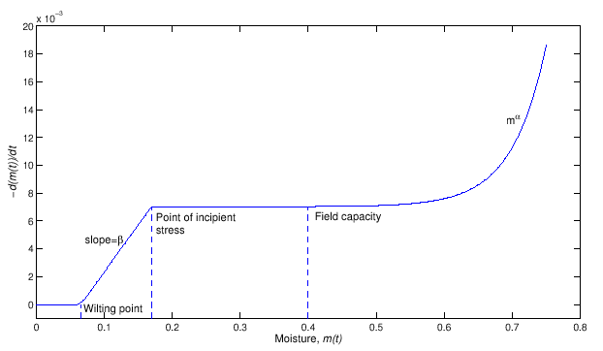
Suppression & Models
Soil Moisture Model
How do we incorporate into
suppression schemes?
Exponential Regression
Model: x_{t} = α_{t} x_{t-1} + β_{t}
Synchronize: X = {x_{t}, α_{t}, β_{t}}; X* = {x*_{t}, α*_{t}, β*_{t}}
f_{enc}: Choose from (1) suppress, (2) parameter update,
(3) value update
f_{dec}: Choose from (1) make prediction, (2) update model &
make prediction, (3) store outlier
Notes:
Drop this and hint at on previous slide
what do alpha and beta correspond to?
check on calc.
make this more general
synchronizing both readings and parameters in this example. we can do this in a suppression link also
General Definition, encoder decoder functions
-syncing two copies of X vector (values themselves, or parameters (that might be used for predicting values)
These present a graph of communication flow in the network (there are rules about no cyclical dependencies in paper)
We can incorporate models. value-based temporal is simple model. We can make fancier temporal versions, and spatio-temporal versions.
x_t = \alpha_t x_{t-1} + \beta_t
X={x_t, \alpha_t, \beta_t}, X^*={x^*_t, \alpha^*_t, \beta^*_t}

Slide 16
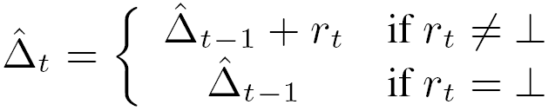
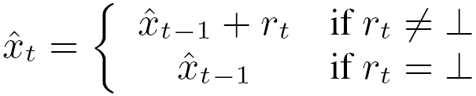
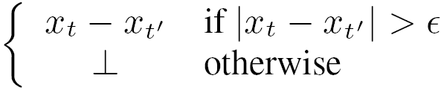
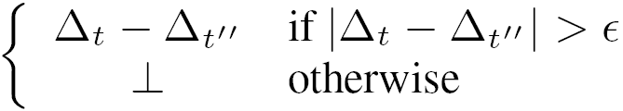
Conch SS
f_{dec}
Root
f_{dec}
f_{enc}
f_{enc}

Slide 17
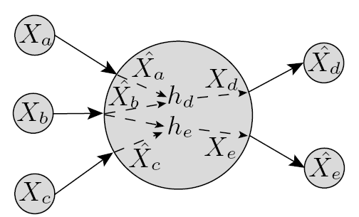
Sample SS Graph
h functions produce outgoing X vectors
h’s define dependencies between
suppression links

Slide 18
Redundancy
Naturally-occurring redundancy
  Single node transmitting same/correlated readings repeatedly over time
  Multiple nodes transmitting same/correlated readings at same time
  No Control!
Explicit Redundancy
  Trade-off redundancy, energy cost
  Separately tune redundancy level in each part of network

Slide 19
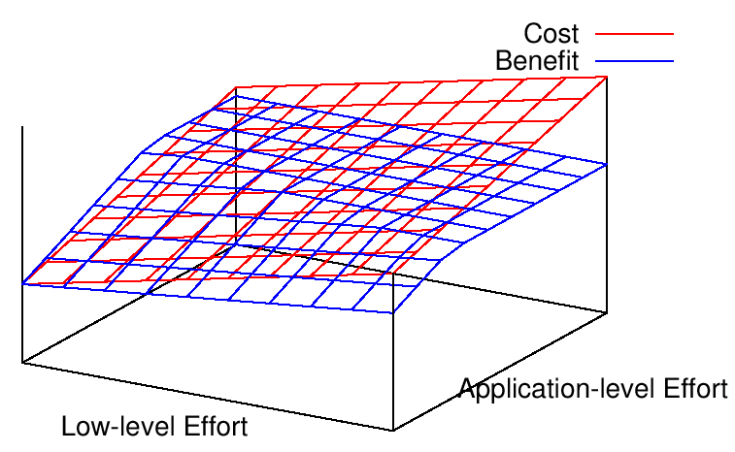
Trade-off
Whatever failure-coping strategy is used,
coordinate effort between layers

