Slide 1

Re-thinking Data Management for Storage-Centric Sensor Networks
Deepak Ganesan
University of Massachusetts Amherst
With: Yanlei Diao, Gaurav Mathur, Prashant Shenoy
Notes:
My goal in this talk is two-fold - case for re-thinking data management in light of recent technology trends, and provide a glimpse of a system that we are designing that exploits these trends.

Slide 2



Sensor Network Data Management
Live Data Management: Queries on current or recent data.
  Applications:
    Real-time feeds/queries: Weather, Fire, Volcano
    Detection and Notification: Intruder, Vehicle
  Techniques:
    Push-down Filters/Triggers: TinyDB, Cougar, Diffusion, …
    Acquisitional Query Processing: TinyDB, BBQ, PRESTO, …
Archival Data Management: Queries on historical data
  Applications:
    Scientific analysis of past events: Weather, Seismic, …
    Historical trends: Traffic analysis, habitat monitoring
Our focus is on designing an efficient archival data management architecture for sensor networks
Notes:
Live - recently sampled data - data loses value after a short time.

Slide 3
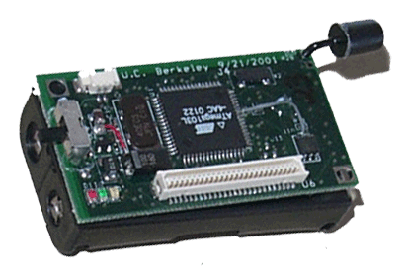
Archival Querying in Sensor Networks
Data Gathering with centralized archival query processing
  Efficient for low data rate sensors such as weather sensors (temp, humidity, …).
  Inefficient energy-wise for “rich” sensor data (acoustic, video, high-rate vibration).
Internet
DBMS
Gateway
Lossless aggregation
Notes:
Lossy aggregation - loses information

Slide 4
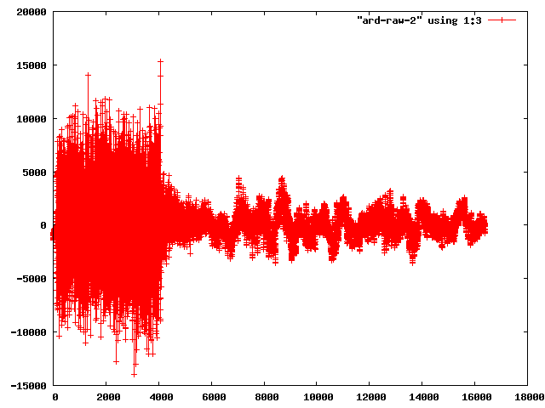
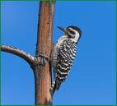
Archival Querying in Sensor Networks
Store data locally at sensors and push queries into the sensor network
  Flash memory energy-efficiency.
  Limited capabilities of sensor platforms.
Internet
Gateway
Push query to sensors
Flash Memory
Acoustic stream
Image stream
Notes:
Two reasons why such an approach was considered inefficient or impractical
A number of sensor plaforms have emerged that are both energy-efficient and have sufficient processing/memory resources.
We believe that even low-end sensors will have sufficient capability to do some limited in-network qp.

Slide 5
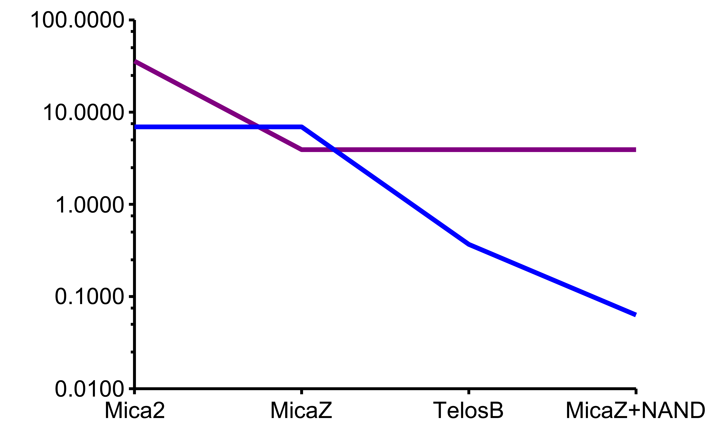
Technology Trends in Storage
CC1000
Communication
CC2420
Energy Cost (uJ/byte)
Atmel NOR
Storage
Telos STM NOR
Micron NAND
128MB
Generation of Sensor Platform
Notes:
Last one is a NAND-flash equipped board that we designed

Slide 6

StonesDB Goals
Our goal is to design a distributed sensor database for archival data management that:
  Supports energy-efficient sensor data storage, indexing, and aging by optimizing for flash memories.
  Supports energy-efficient processing of SQL-type queries, as well as data mining and search queries.
  Is configurable to heterogeneous sensor platforms with different memory and processing constraints.
Notes:
Highlight a couple of challenges

Slide 7
Optimize for Flash and RAM Constraints
Flash Memory Constraints
  Data cannot be over-written, only erased
  Pages can often only be erased in blocks (16-64KB)
  Unlike magnetic disks, cannot modify in-place
Challenges:
  Energy: Organize data on flash to minimize read/write/erase operations
  Memory: Minimize use of memory for flash database.
Memory
~4-10 KB
2. Modify in-memory
1. Load block
Into Memory
3. Save block back
Erase
block
~16-64 KB
Notes:
Physical layer challenges

Slide 8
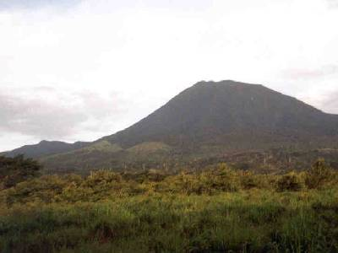
Support Rich Archival Querying Capability
SQL-style Queries: Min, max, count, average, median, top-k, contour, track, etc
Similarity Search: Was a bird matching signature S observed last week?
Wireless Sensor Network
Classification Queries: What type of vehicles (truck, car, tank, …) were observed in the field in the last month?
Signal Processing: Perform an FFT to find the mode of vibration signal between time <t1,t2>?
Notes:
Querying challenges.

Slide 9
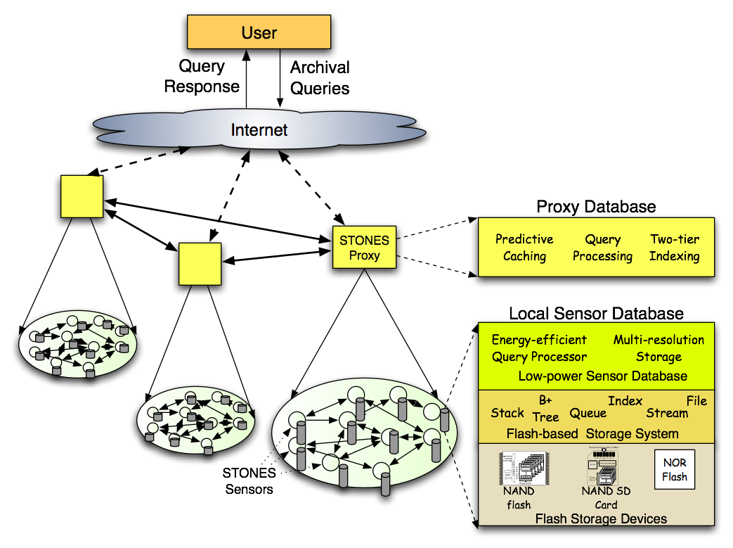
StonesDB Architecture
Notes:
StonesDB has both a distributed layer which runs at the proxy and local stack which runs at each sensor.
Example to illustrate…

Slide 10
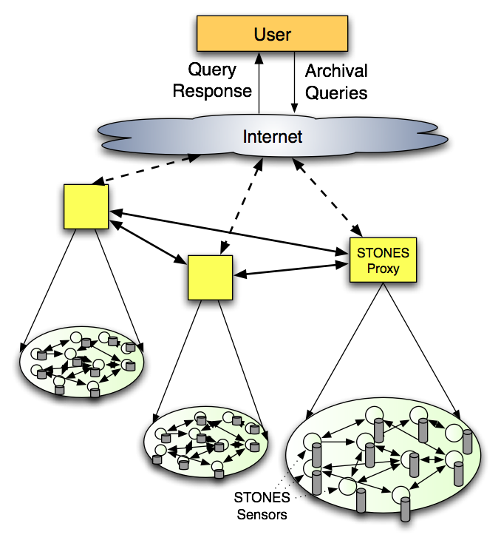
StonesDB: System Operation
Image Retrieval: Return images taken last month with at least two birds one of which is a bird of type A.
Proxy Cache of Image Summaries
Identify “best” sensors to forward query.
Provide hints to reduce search complexity at sensor.
Notes:
Camera sensor network for habitat monitoring
Summary - low-res, feature, count of objects, color histogram, or others.
Proxy performs two optimizations
Limit which nodes the query is forwarded to, thereby reducing energy cost
Provide hints to limit what part of locally stored data needs to be searched.

Slide 11

StonesDB: System Operation
Image Retrieval: Return images taken last month with at least two birds one of which is a bird of type A.
Query Engine
Partitioned Access Methods
Notes:
what index is available to answer this query?
Among possible query plans, which is most energy-efficient? First evaluate temporal predicate or first evaluate predicate on number of objects.

Slide 12

Research Issues
Local Database Layer
  Reduce updates for indexing and aging.
  New cost models for self-tuning sensor databases.
  Energy-optimized query processing.
  Query processing over aged data.
Distributed Database Layer
  What summaries are relevant to queries?
  What remainder queries to send to sensors?
  What resolution of summaries to cache?
Notes:
Updates - as mentioned before, in-place updates are expensive. Need to reduce them for indexing as well as deletion/aging.
Aging - after long time of storing images
Cost model - index vs sequential scan
- Once proxy processes query in summary, what remainder queries need to be sent to sensors?

Slide 13
The End
STONES: STOrage-centric Networked Embedded Systems
http://sensors.cs.umass.edu/projects/stones
Notes:
Flash cards - designed to optimize wear-leveling, not energy-efficiency.

