Slide 1
Cache-Oblivious
Query Processing
Bingsheng He, Qiong Luo
{saven, luo}@cse.ust.hk
Department of Computer Science & Engineering
Hong Kong University of Science & Technology
Notes:
Good afternoon, ladies and gentlemen. It is my honor to give a presentation here. Our topic is cache-oblivious query processing.

Slide 2
Cache-Oblivious Algorithms
[Frigo et al., FOCS 1999]
Assuming no knowledge about cache parameter values, e.g., cache size
Optimal cache complexity
  For an ideal cache model
    Two-level hierarchy: cache on top of memory
    Automatic, optimal cache replacement
    Fully associative
  For more realistic cache models as well
Notes:
First of all, let me give a brief introduction on cache-oblivious algorithms and nested-loop joins. Cache-oblivious algorithms were proposed by Frigo in 1999. These algorithms assume no knowledge about cache parameter values. However, cache-oblivious algorithms can have optimal cache complexity both for an ideal cache model and for more realistic cache models as well, for example, the IO model. The cache complexity is defined to be the asymptotical number of block transfers between the cache and the memory incurred by the algorithm.
This ideal cache model assumes a simplified two-level hierarchy, the cache on top of the memory. The cache uses an automatic, optimal cache replacement. And the cache is fully associative. Each memory block can be loaded into an arbitrary cache line.
Frigo showed that, if an algorithm has an optimal cache complexity in the cache-oblivious model, this optimality holds on all levels of a memory hierarchy.

Slide 3
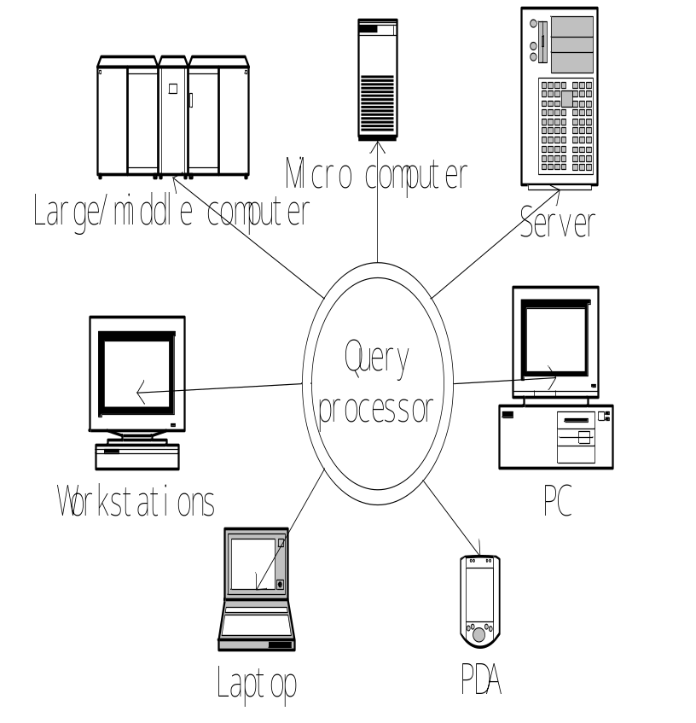
Motivation
Relational database systems have too many knobs to tune for performance.
Tuning may be difficult, ineffective, and sometimes infeasible.
The memory hierarchy becomes increasingly complex.
Notes:
So, why do we study cache-oblivious algorithms in relational query processing. First, relational database systems have too many knobs to tune for performance. This increases the ownership cost of the relational databases. Second, the memory hierarchy becomes increasingly complex. More levels and more advanced features are being deployed to various machines. Third, tuning may be difficult, ineffective and sometimes infeasible. For example, it is difficult to deploy a query processor to a wide range of machines, say, PDA, Laptop, PC, Server, Micro Computer. Different characteristics of the machines make the tuning difficult.

Slide 4
Memory Hierarchy
Main
memory
Registers
L1
L2
Disk
CPU
Our focus: CPU caches
Capacity | 256 B | 8 KB | 512 KB | 2 GB | 80 GB
Block size | 8 B | 64 B | 128 B | 4 KB
Access time | <1 cyc | 2 cyc | 10 cyc | 376 cyc | ~10,000cyc
Notes:
Here is a typical memory hierarchy in modern machines. The hierarchy consists of registers, L1 and L2 caches, main memory, and disk. More levels may appear. For example, Itanium of the Intel has a L3 cache.
Memories at different levels have different sizes and access times. From left to right, the capacity and the block size of the memory level increases, and the access time of the memory level increases as well. We consider in-memory query processing and focus on the L1 and L2 caches, because CPU caches are typically managed by hardware. It is difficult, if possible to manage by software.

Slide 5
Cache-Conscious (CC) Techniques
Aware of cache parameters of a target level in a specific memory hierarchy
  Cache block size, e.g., B+-trees
  Cache capacity, e.g., blocked NLJ
Achieve a high performance with correct parameter values
Notes:
A traditional way to optimize the performance of the memory hierarchy is to use cache-conscious techniques. These techniques are aware of cache parameters of a target level in a specific memory hierarchy. For example, a B+tree has a node size equal to the block size. The blocked NLJ set the block size of the inner relation to be the cache capacity.
These techniques can achieve a high performance with correct parameter values.

Slide 6
Tuning the parameter is difficult
The best parameter value varies with the platform.
It may be none of the cache parameters of the platform.
It may vary with different data and algorithmic characteristics.
Notes:
From these results, we can see that tuning the block size is difficult. The best parameter value varies with the platform. It may be none of the cache parameters of the platform.
It may vary with different data and algorithmic characteristics. Therefore, even with the knowledge of the cache parameters, the performance of cache-conscious algorithms needs to be tuned carefully.

Slide 7
Our Goal
To automatically and consistently achieve a good performance on various memory hierarchies at all times
Notes:
Instead of using cache-conscious techniques, we consider using cache-oblivious techniques. Our goal is to automatically and consistently achieve a good performance on various memory hierarchies at all times

Slide 8
Challenges
How to optimize query processing cache-obliviously?
  Divide-and-conquer methodology
  Amortization methodology
How to achieve a comparable overall performance with fine-tuned cache-conscious algorithms?
  Work complexity
  Recursion overhead
Notes:
To achieve our goal, we identified two technical challenges. The first one is how to optimize the query processing cache-obliviously. The second is how to achieve a comparable overall performance with fine-tuned cache-conscious algorithms. For the first challenge of optimizing query processing cache-obliviously, we consider the divide-and-conquer methodology and the amortization methodolgy. In this methodology, a problem is recursively divided into multiple smaller sub-problems. At some point of the recursion, a sub-problem fits into the cache. With divide and conquer, we develop our cache-oblivious algorithms having the same cache complexity as the cache-conscious algorithms. The amortization methodology is used to reduce the average cost per operation for a set of operations, even though the cost of a single operation may be high.
For the second challenge of improving the overall performance on the real machines, we consider three issues. The first one is work complexity. We hope our algorithms have the same work complexity as the cache-conscious algorithms. That is, our algorithms have the same conventional running time in a RAM model as the cache-conscious algorithms. The second issue is to reduce the recursion overhead.

Slide 9
Divide-and-conquer
Fit into the cache
Reuse
Notes:
The divide-and-conquer methodology is widely used in general cache-oblivious algorithms, because it usually results in a good cache performance. In this figure, we have recursive partitioning. In each pass, a relation is divided into two subrelations. At some point of the recursion, the subrelation can fit into the cache, even though the cache capacity is unknown. Once the relation fits into the cache, it is reused in the partitioning afterwards.

Slide 10
Amortization
Reduce the average cost for a set of operations
A buffer hierarchy
  Buffer sizes are recursively defined.
R
Partitioner
Buffer
Partition
Notes:
Database operations often involved a set of similar operations. For example, recursive partitioning consists of multiple passes of binary partitioning. We design a buffer hierarchy, as shown in the right figure. The buffer size is recursively defined. We use this buffer hierarchy to improve the cache performance of recursive partitioning.

Slide 11
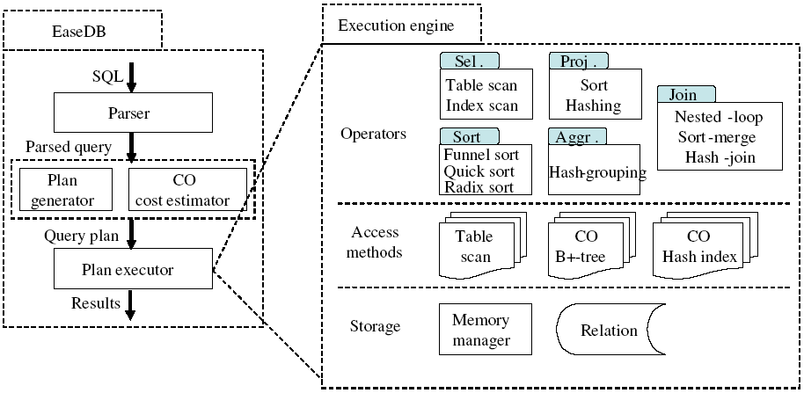
EaseDB: System Architecture
Notes:
In this figure, we have the system architecture of our cache-oblivious query processor. It supports a common set of relational operators. All query processing data structures and algorithms match the cache complexity of their cache-conscious counterpart.

Slide 12
Limitations
Employ sophisticated data structures and mechanisms.
Require some automatic and machine-independent optimization to improve their efficiency.
Notes:
Without knowledge of any cache parameters, cache-oblivious techniques usually employ sophisticated data structures and mechanisms, e.g., our buffer hierarchy, in order to achieve the same cache complexity as their cache-conscious counterpart. Moreover, they require some automatic and machine-independent optimization to improve their efficiency. For instance, a suitable base case size improves the efficiency, but it must be estimated in a cache-oblivious way.

Slide 13
Opportunities
Storage models
Transactions
New architectural features
  CMP/SMT
  GPUs
  Transactional memory
Notes:
Cache-oblivious algorithms are self-organizing. The first opportunity is to design a suitable storage model for our query processor. We will consider column-based and PAX-style storage models. The second one is to investigate the transaction processing. It is interesting to investigate how to support transaction processing without knowledge of cache block size. The third opportunity is to study our query processor on new architecture features. For example, CMP/SMT, GPU and transactional memory.

Slide 14
Conclusion
First cache-oblivious query processor
Complexity results on our CO alg.
Empirical results of our CO alg. on three hardware platforms in comparison with their CC counterparts
http://www.cse.ust.hk/cactus/
Notes:
As conclusion, we have developed the first cache-oblivious query processor. We have given the complexity results on our query processing algorithms. The cache complexity of our alg. matches that of their cache-conscious counterparts. We have conducted our experiments on three hardware platforms. Empirical results show that the performance of our CO algorithms is similar to or better than the fine-tuned CC alg. For more information, you may refer to our project website, cactus.

