Slide 1
Database Servers on Chip Multiprocessors: Limitations and Opportunities
Nikos Hardavellas
With Ippokratis Pandis, Ryan Johnson, Naju Mancheril,
Anastassia Ailamaki, Babak Falsafi

Slide 2
Hardware Integration Trends
traditional
multiprocessors
chip
multiprocessors
core
core
core
core
L1
L1
L1
L1
L2
L2
L2
Memory
Memory
Moore’s Law: 2x trans. = 2x cores, 2x caches
Trends to use larger but slower caches
Notes:
Processor designers are constantly looking for new ways to exploit the transistors available on chip more efficiently. As Moore’s Law continues, we have moved from the era of pipelined architectures (80’s) to the era of ILP (90’s), and more recently we entered the era of multi-threaded and multi-core processors. This shift poses an imminent technical and research challenge of adapting high-performance data management software to a shifting hardware landscape, as modern DBMS are optimized primarily for pipelined and ILP architectures.
At the same time, technological advancements have allowed on-chip sizes to increase, leading to large but slow caches. In this work we investigate the combined effects of these two trends on DBMS performance.

Slide 3
Contributions
We show that:
L2 caches growing bigger and slower
Bottleneck shifts from Mem to L2
DBMS absolute performance drops
Must enhance DBMS L1 locality
HW parallelism scales exponentially
DBMS cannot exploit parallelism under light load
Need inherent DBMS parallelism

Slide 4
Methodology
Flexus simulator (developed at CMU)
  Cycle-accurate, full-system
OLTP: TPC-C, 100wh, in memory
DSS: TPC-H throughput, 1GB db, in memory
  Scan- and join-bound queries (1, 6, 13, 16)
Saturated: 64/16 clients (OLTP/DSS)
Unsaturated (light load): 1 client

Slide 5
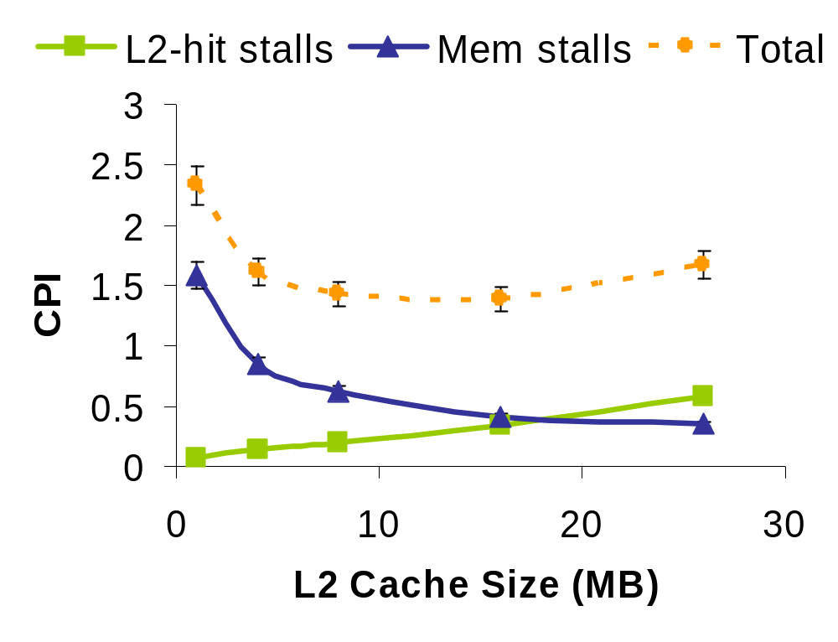
Observation #1
Bottleneck Shift to L2-hit Stalls
Xeon 7100 (2006)
PIII Xeon 500 (1999)
Itanium2 9050 (2006)
Bottleneck shift from Mem stalls to L2-hit stalls
Notes:
To drive the points home, we first look at the how the performance bottlenecks shift when the L2 cache size increases on a 4-core CMP running DSS. Explain axis, lines. Performance studies in the recent literature are on the left side of the graph (1-4 MB) where Mem stalls are the dominant execution time component and L2-hit stalls are virtually non-existent. Since then, however, as we move to the right side in this graph, L2-hit stalls have risen from oblivion to become the dominant execution time component.
As shown in the paper, the bottleneck shift to L2-hit stalls has severe ramifications to DBMS performance. Instead of obtaining significant speedup (up to 1.7x) due to lower miss rates as cache size increases, the increased cache latency causes performance to degrade by up to 30%. At the largest cache size we simulated, only half of the potential performance is realized by the system.

Slide 6
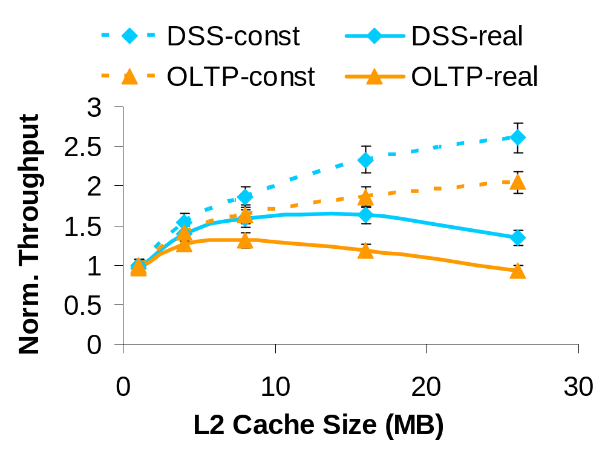
Impact of L2-hit Stalls
Increasing cache size reduces throughput
Must enhance L1 locality
Notes:
Shifting the bottleneck to L2-hit stalls has severe ramifications to DBMS performance. Explain axis, lines. Instead of obtaining significant speedup due to lower miss rates as cache size increases, the increased cache latency causes performance to degrade by up to 30%. At the largest cache size we simulated, only half of the potential performance is realized by the system, which is a significant loss.

Slide 7
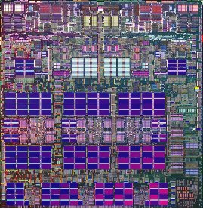
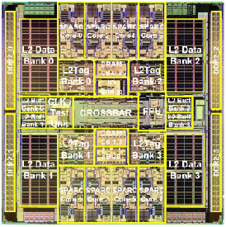
Observation #2
Parallelism in Modern CMPs
Fat Camp (FC)
wide-issue, OOO
e.g., IBM Power5
Lean Camp (LC)
in-order, multi-threaded
e.g., Sun UltraSparc T1
one core
FC: parallelism within thread, LC: across threads
Notes:
cite in brackets
To address stalls, chip designers follow two distinct schools of thought, OOO execution and multithreading, which have found their way in CMP as well. Thus, we divide CMPs into two camps, the FC which includes CMPs built out of wide-issue OOO cores (e.g., Power5) and the LC which includes CMPs built out of simple in-order MT cores (e.g., Niagara). The naming scheme is prompted by the relative sizes of the individual cores, depicted by the red squares. The two camps exhibit different behavior on the same workloads.

Slide 8
How Camps Address Stalls
computation
data stall
Saturated
Unsaturated
LC
thread1
thread2
thread3
FC
thread1
thread2
thread3
LC: stalls can dominate under unsaturated
FC: stalls exposed in all cases
Notes:
TODO: make FC 3-wide. Collapse. Fix indentation. Animate.
Time goes from left to right. Each box represents an instruction slot (1 processor cycle), yellow denotes a miss, green denotes data stall cycles, and black is useful instructions executing. When running an unsaturated workload, e.g., a single thread, a LC core utilizes only one hardware context and executes the program sequentially, stalling the processor for every miss. On the contrary, a FC core can exploit the available ILP to overlap stalls with computation or execute more instructions in a single cycle, leading to faster execution time. However, when there is an abundance of threads, the LC core exploits TLP (which is abundant in DB workloads) to overlap stalls with other stalls or computation, while FC is constrained by the limited ILP available in DB workloads. Unsaturated workloads suffer primarily from lack of parallelism, as both entire cores in the CMP as well as hardware contexts within each core are idling. Increasing the number of available threads by decomposing a single request into multiple sub-tasks may improve performance significantly. Saturated workloads, on the other hand, suffer primarily from exposed data stalls, which can be alleviated by enhancing the locality of the first-level cache.

Slide 9
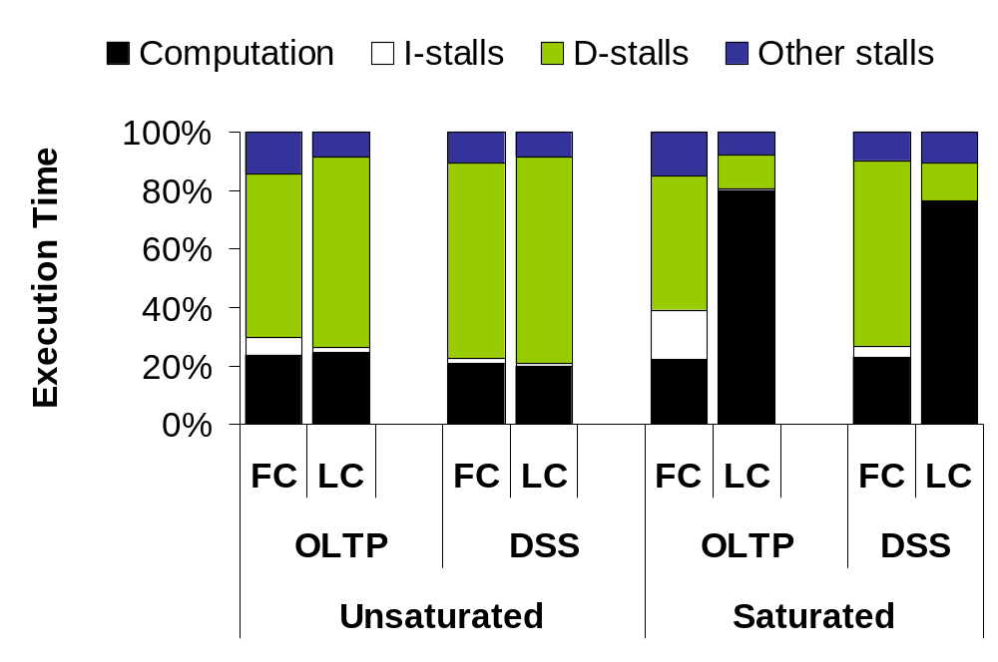
Prevalence of Data Stalls
DBMS need parallelism & L1D locality
Notes:
corroborate ranganathan, cite
We investigate the different behavior of the two camps by characterizing their execution time on OLTP and DSS workloads. On the x-axis we have the FC and LC CMPs for each workload configuration. We run both unsaturated workloads, essentially looking at single-thread performance, and saturated workloads where there is an abundance of software threads for the processors to execute. The y-axis is % excution time. We observe that data stalls dominate execution on all combinations of CMP designs and workloads by at least 64%, except LC/saturated. While LC outperforms FC for saturated workloads, the exact opposite is happening when running unsaturated workloads. The different execution behavior of each configuration allows us to devise a list of requirements for modern DBMS to attain maximum performance.

Slide 10
Impact
L2 caches growing bigger and slower
HW parallelism scales exponentially
  Bottlenecks shift, data stalls are exposed
DBMS must provide both
  Fine-grain parallelism across and within queries
  L1 locality
http://www.cs.cmu.edu/~stageddb/
Notes:
[...] We believe that staged DBMS are uniquely positioned to address the constantly shifting performance bottlenecks. Staged DBMS decompose a request into multiple sub-tasks that can execute in parallel in a pipelined fashion, naturally providing more parallelism. Because staged DBMS are constructed in a modular way and the modules are exposed to the execution system, the runtime environment can make intelligent mapping of resources and scheduling decisions to enhance locality, thereby improving performance.

