Slide 1

The CompleteSearch Engine:
Interactive, Efficient, and Towards IR&DB integration
CIDR 2007 in Asilomar, California, 8th January 2007
Holger Bast
Max-Planck-Institut für Informatik
Saarbrücken, Germany
joint work with Ingmar Weber

Slide 2
IR versus DB (simplified view)
IR system (search engine)
  single data structure and query algorithm, optimized for ranked retrieval on textual data
  ✓ highly compressible and high locality of access
  ✓ ranking is an integral part
  ✗ can't do even simple selects, joins, etc.
DB system (relational)
  variety of indices and query algorithms, to suit all sorts of complex queries on structured data
  ✗ space overhead and limited locality of access
  ✗ no integrated ranked retrieval
  ✓ can do complex selects, joins, … (SQL)
scales very well
but special-purpose
general-purpose
but slow on large data

Slide 3
Our contribution (in a nutshell)
The CompleteSearch engine
  novel data structure and query algorithm for
  context-sensitive prefix search and completion
  ✓ highly compressible and high locality of access
  ✓ IR-style ranked retrieval
  ✓ DB-style selects and joins
  ✓ natural blend of the two
  ✓ subsecond query times for up to a terabyte on a single machine
  ✗ no transactions, recovery, etc.
  ✗ for low dynamics (few insertions/deletions)
  ✗ other open issues at the end of the talk …
fairly general-purpose
and scales very well

Slide 4
Context-Sensitive Prefix Search & Completion
D3
Q D
A
D74
J W Q
Data is given as
  documents containing words
  documents have ids (D1, D2, …)
  words have ids (A, B, C, …)
Query
  given a sorted list of doc ids
  and a range of word ids
D17
B W
U K A
D43
D Q
D1
A O E W H
D92
P U D E M
D27
K L D F
D53
J D E A
D78
K L S
D4
K L K A B
D9
E E R
D2
B F A
D32
I L S D H
D88
P A E G Q
D13
A O E W H
D98
E B A S
D13 D17 D88 …
C D E F G H

Slide 5
Context-Sensitive Prefix Search & Completion
D3
Q D
A
D74
J W Q
Data is given as
  documents containing words
  documents have ids (D1, D2, …)
  words have ids (A, B, C, …)
Query
  given a sorted list of doc ids
  and a range of word ids
Answer
  all matching word-in-doc pairs
  with scores
D17
B W
U K A
D17
B W
U K A
D43
D Q
D1
A O E W H
D92
P U D E M
D27
K L D F
D53
J D E A
D78
K L S
D4
K L K A B
D9
E E R
D88
P A E G Q
D2
B F A
D32
I L S D H
D88
P A E G Q
D13
A O E W H
D98
E B A S
D13
A O E W H
D13 D17 D88 …
C D E F G H
D13
E
D88
E
D88
G
…
…
0.5 0.2 0.7 …

Slide 6
Index data structure (previous work)
Basic Idea: precompute lists of word-in-document pairs for ranges of words
D5 | D15 | D15 | D37 | D39 | D39 | D39 | D67 | D95 | D98 | …
A | R | T | F | D | K | L | B | E | A | …
AutoTree (SPIRE'06)
  hierarchies of ranges, relative bit vectors
  output sensitive: one item output every O(1) steps
  only good in main memory (bit rank data structure)
Half-inverted index (SIGIR'06)
  flat partitioning into equal-size blocks, entropy encoding
  very good compressibility
  very good locality of access (data accessed in large blocks)
No time for that, sorry!

Slide 7
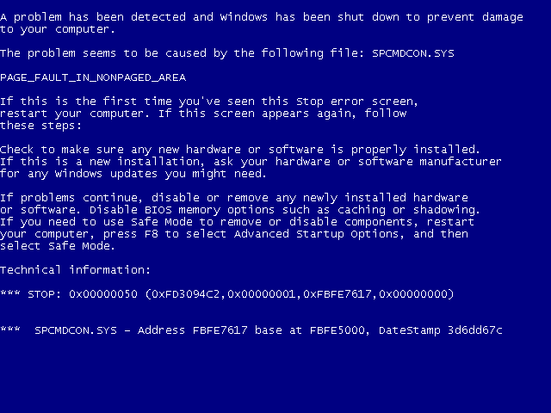

Slide 8
Supported queries (examples)
Full-text search with autocompletion (SIGIR'06)
  cidr con*
Add structured data via special words
  conference:sigmod
  author:gerhard_weikum
  year:2005
Select … Where … queries
  conference:sigmod author:*
Join queries
  launch conference:sigmod author:* and conference:sigir author:* and intersect the set of completions (not documents)
  syntax is author[conference:sigmod conference:sigir]
Mixed IR/DB queries
  continuous query processing author:*
  author[conference:sigir conference:sigmod] query optimization
Gerhard Weikum | SIGMOD | 2005 | paper #23876
Surajit Chaudhuri | SIGMOD | 2005 | paper #23876
Gerhard Weikum | SIGIR | 2006 | paper #31457
Ralitsa Angelova | SIGIR | 2006 | paper #31457
… | … | … | …

Slide 9

Efficiency
Index size
  theoretical guarantee:
    space consumption is within 1+ε of data entropy
  empirical results (on TREC Terabyte):
    raw data: 426 GB index size: 4.9 GB
Query time
  theoretical guarantee:
    each query ≈ a scan of ε ∙ #docs items (compressed)
  empirical results (on TREC Terabyte):
    average / maximal query time: 0.11 secs / 0.86 secs
Note:
  100 disk seeks take about half a second
  in that time can read 200 MB of data, if compressed on disk
  assuming 5ms seek time, 50 MB/s transfer rate, compression factor 8

Slide 10
Conclusions
Summary
  mechanism for context-sensitive prefix search and completion
  very efficient in space and time, scales very well
  combines IR-style ranked retrieval with DB-style selects and joins
On our TODO list
  achieve both output-sensitivity and locality of access
  integrate top-k query processing
  find out which SQL queries can be supported efficiently?
  deal with high dynamics (many insertions/deletions)

Slide 11
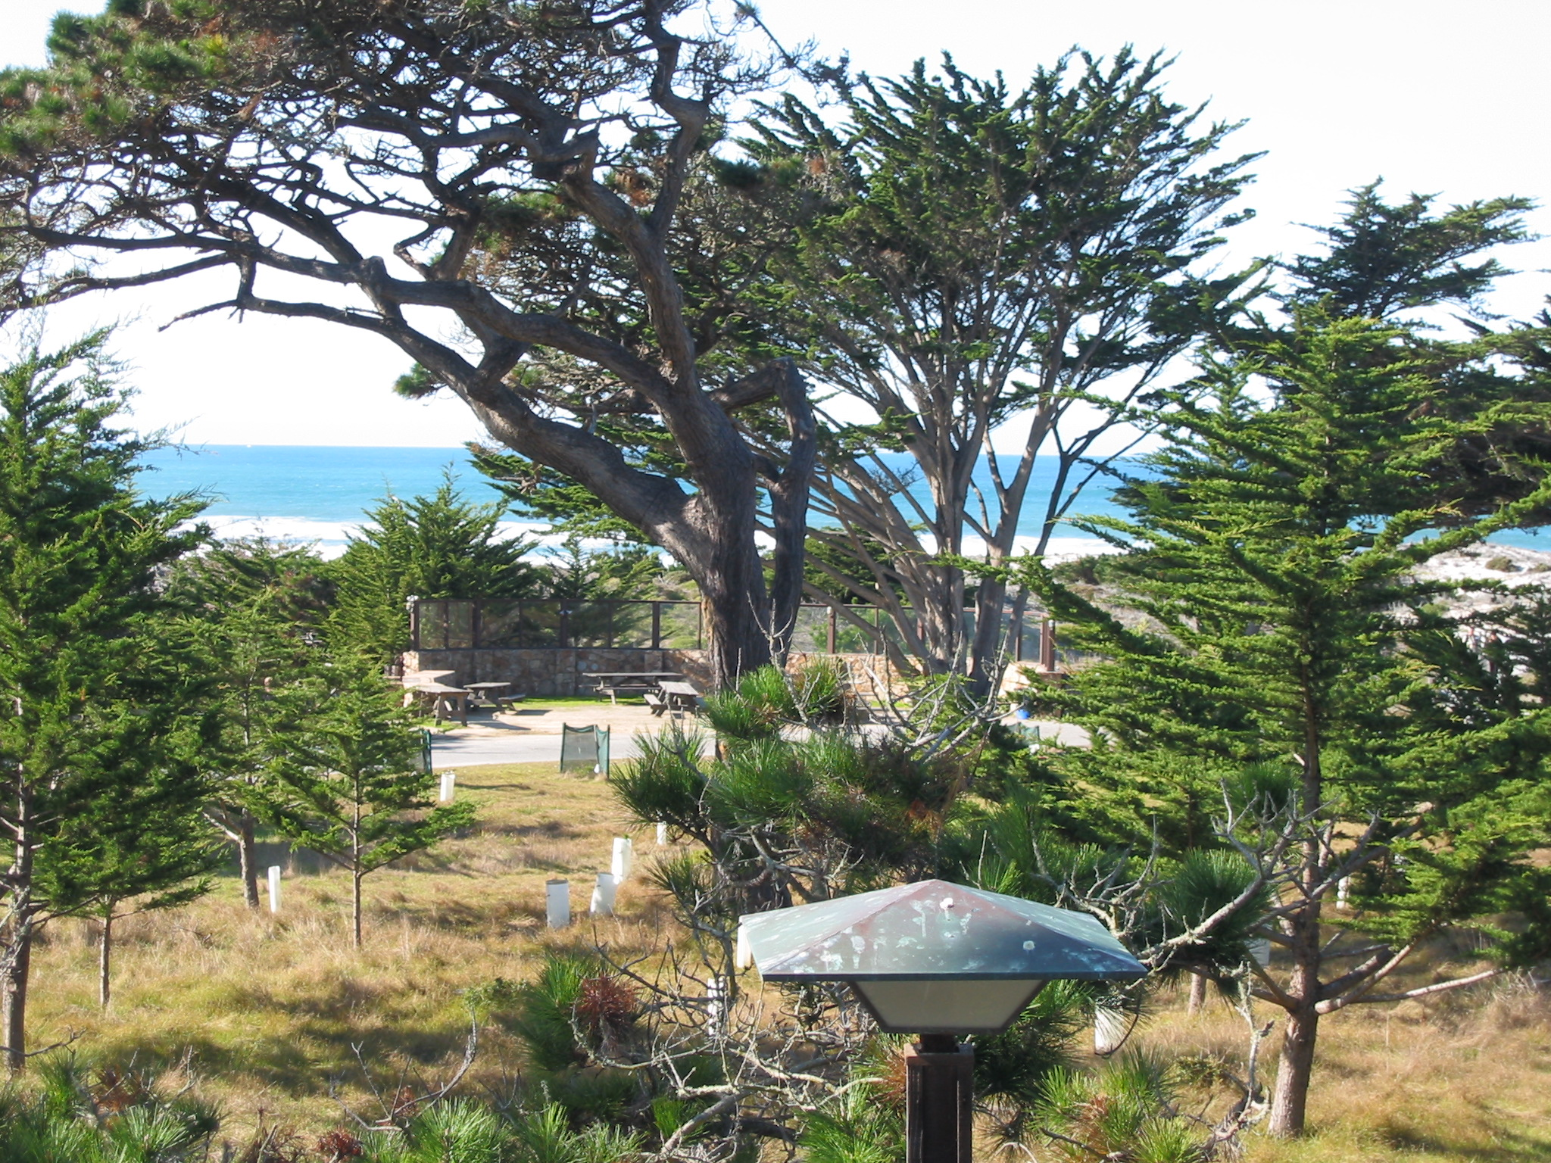
Conclusions
Summary
  mechanism for context-sensitive prefix search and completion
  very efficient in space and time, scales very well
  combines IR-style ranked retrieval with DB-style selects and joins
On our TODO list
  achieve both output-sensitivity and locality of access
  integrate top-k query processing
  find out which SQL queries can be supported efficiently?
  deal with high dynamics (many insertions/deletions)
Thank you!

