Slide 1
Efficient and Flexible Information Retrieval Using MonetDB/X100
Sándor Héman
CWI, Amsterdam
Marcin Zukowski, Arjen de Vries, Peter Boncz
January 08, 2007

Slide 2
Background
Process query-intensive workloads over large datasets efficiently within a DBMS
Application Areas
  Information Retrieval
  Data mining
  Scientific data analysis

Slide 3
MonetDB/X100 Highlights
Vectorized query engine
Transparent, light-weight compression

Slide 4
Keyword Search
Inverted index: TD(termid, docid, score)
TopN(
Project(
MergeJoin(
RangeSelect( TD1=TD, TD1.termid=10 ),
RangeSelect( TD2=TD, TD2.termid=42 ),
TD1.docid = TD2.docid),
[docid = TD1.docid,
score = TD1.scoreQ + TD2.scoreQ]),
[score DESC],
20
)

Slide 5
Keyword Search
Inverted index: TD(termid, docid, score)
TopN(
Project(
MergeJoin(
RangeSelect( TD1=TD, TD1.termid=10 ),
RangeSelect( TD2=TD, TD2.termid=42 ),
TD1.docid = TD2.docid),
[docid = TD1.docid,
score = TD1.scoreQ + TD2.scoreQ]),
[score DESC],
20
)

Slide 6
Keyword Search
Inverted index: TD(termid, docid, score)
TopN(
Project(
MergeJoin(
RangeSelect( TD1=TD, TD1.termid=10 ),
RangeSelect( TD2=TD, TD2.termid=42 ),
TD1.docid = TD2.docid),
[docid = TD1.docid,
score = TD1.scoreQ + TD2.scoreQ]),
[score DESC],
20
)

Slide 7
Keyword Search
Inverted index: TD(termid, docid, score)
TopN(
Project(
MergeJoin(
RangeSelect( TD1=TD, TD1.termid=10 ),
RangeSelect( TD2=TD, TD2.termid=42 ),
TD1.docid = TD2.docid),
[docid = TD1.docid,
score = TD1.scoreQ + TD2.scoreQ]),
[score DESC],
20
)

Slide 8
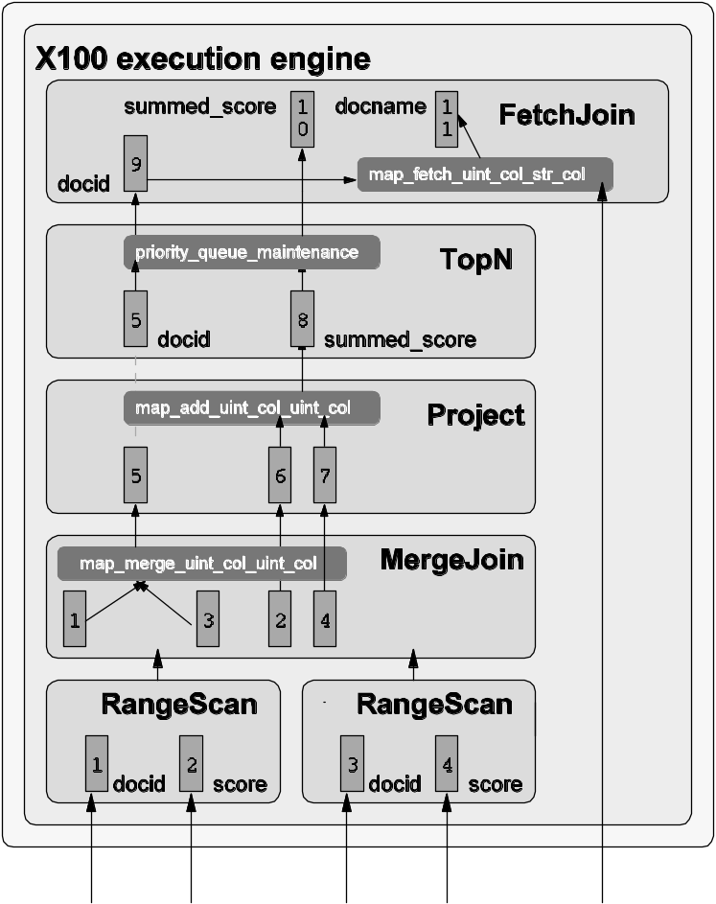
Vectorized Execution [CIDR05]
Volcano based iterator pipeline
Each next() call returns collection of column-vectors of tuples
  Amortize overheads
  Introduce parallelism
  Stay in CPU Cache
Vectors

Slide 9
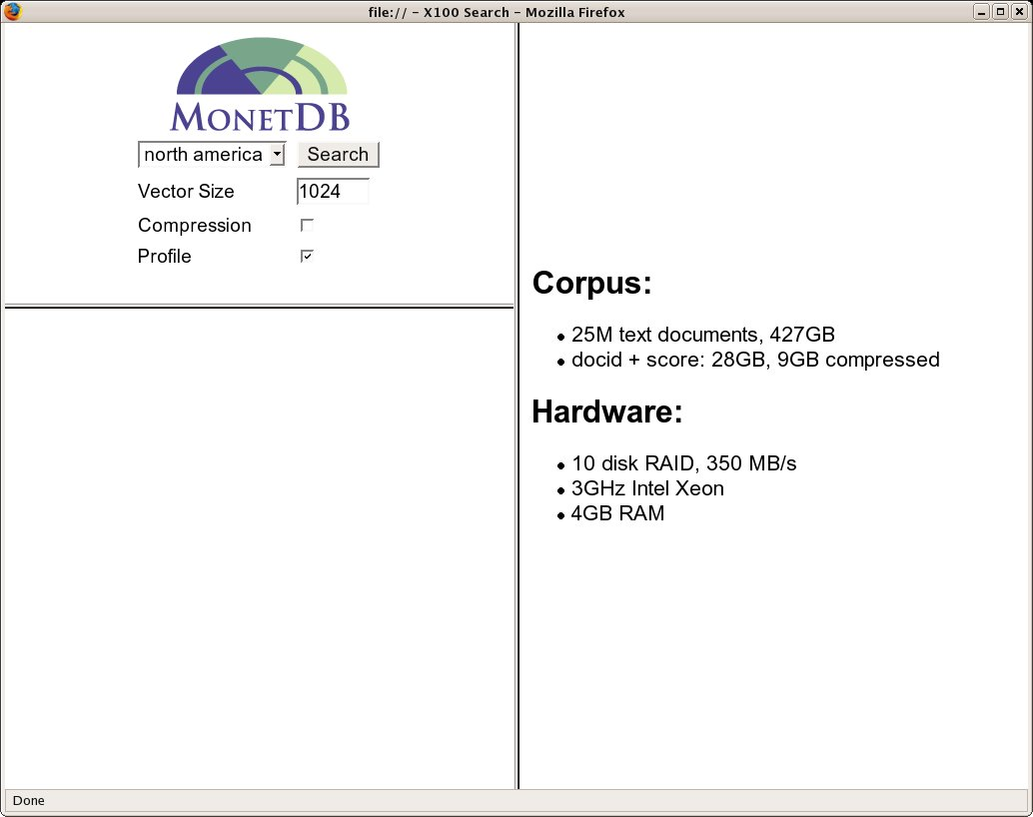

Slide 10
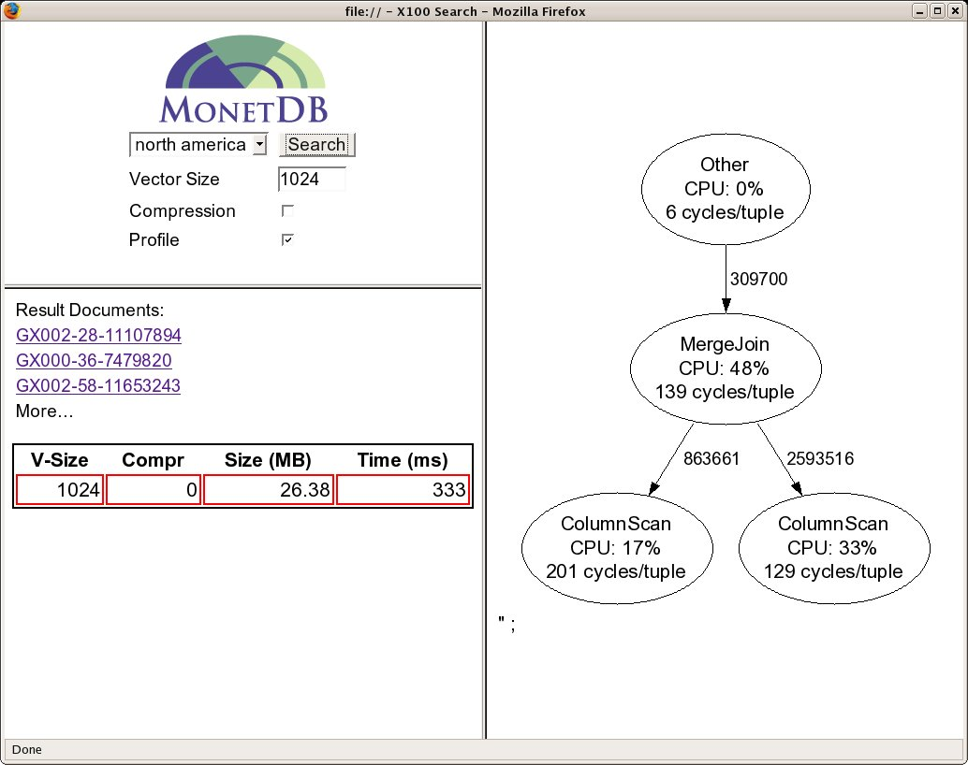

Slide 11
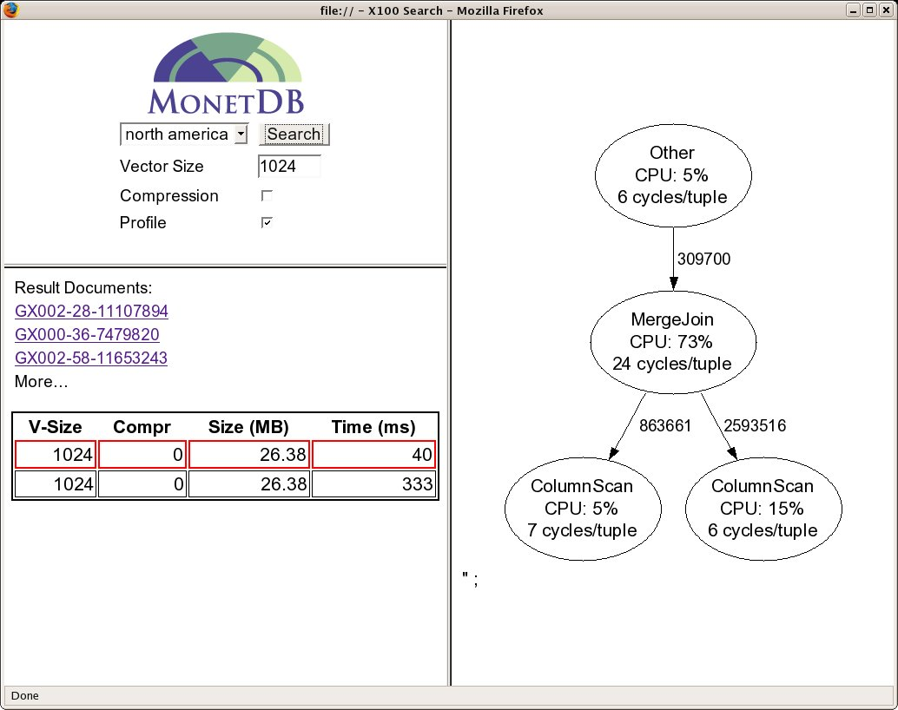

Slide 12
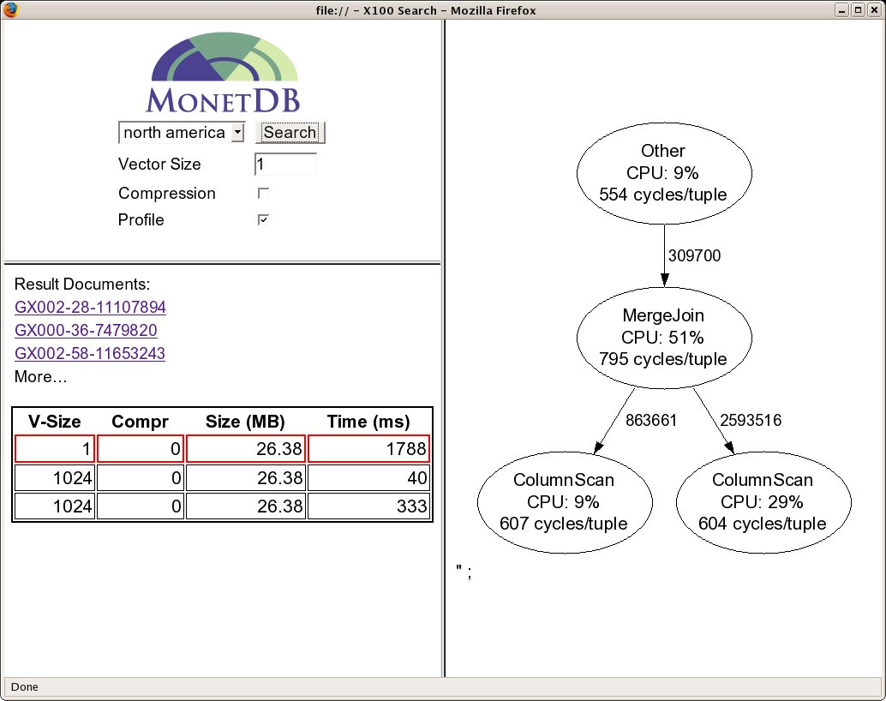

Slide 13
Light-Weight Compression
Compressed buffer-manager pages:
  Increase I/O bandwidth
  Increase BM capacity
Favor speed over compression ratio
  CPU-efficient algorithms
    >1 GB/s decompression speed
  Minimize main-memory overhead
    RAM-CPU Cache decompression

Slide 14
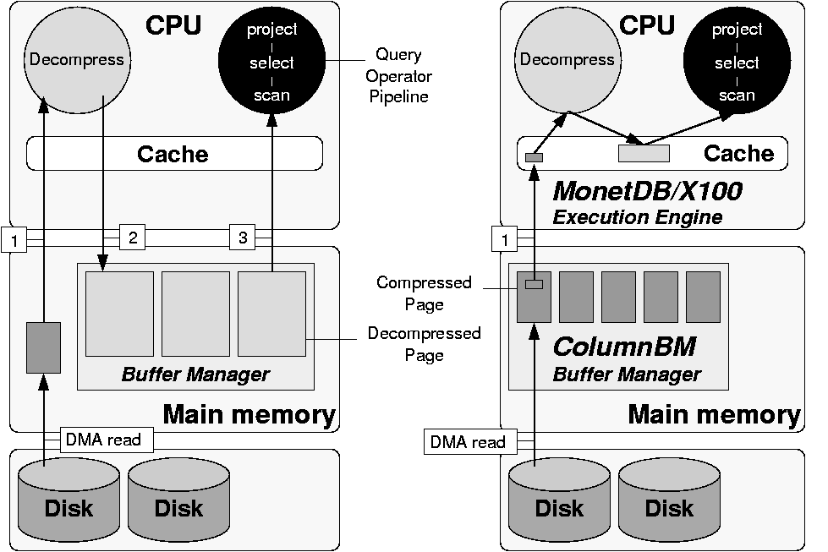
Naïve Decompression
Read and decompress page
Write back to RAM
Read for processing

Slide 15
RAM-Cache Decompression
Read and decompress page at vector granularity, on-demand

Slide 16


Slide 17


Slide 18
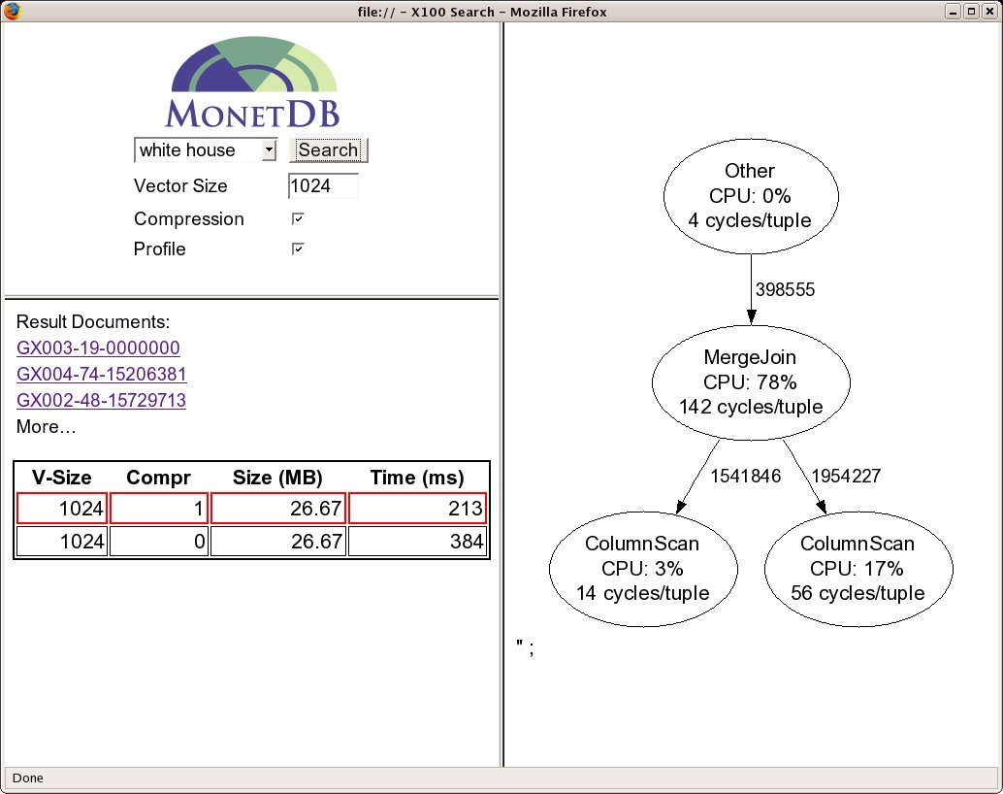

Slide 19
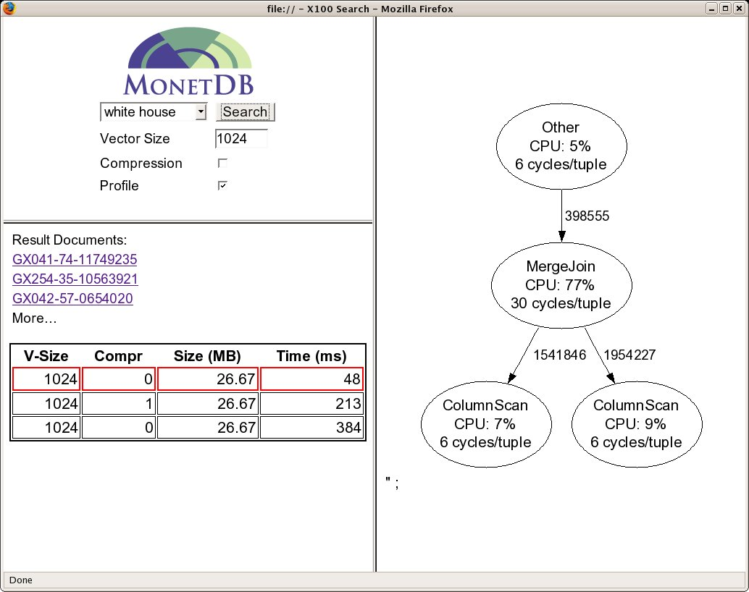

Slide 20
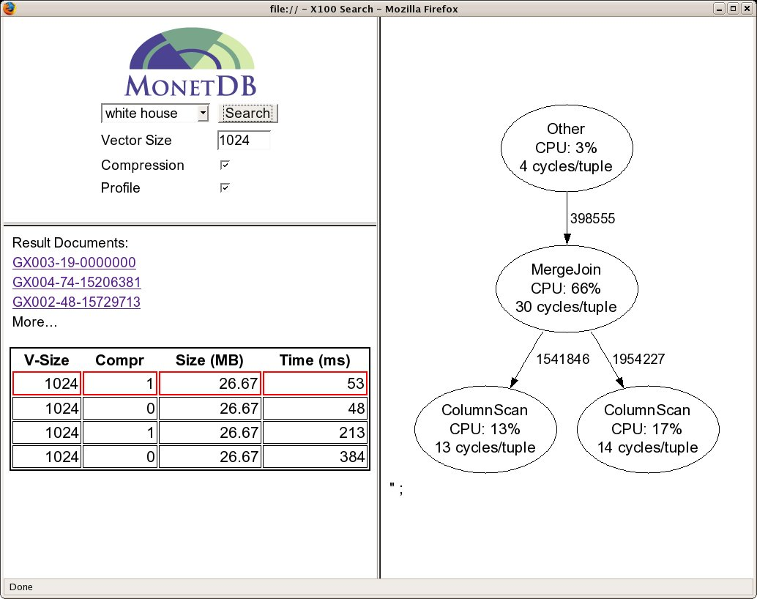

Slide 21
2006 TREC TeraByte Track
X100 compared to custom IR systems
Others prune index
System | #CPUs | P@20 | Throughput (q/s) | Throughput /CPU
X100 | 16 | 0.47 | 186 | 13
X100 | 1 | 0.47 | 13 | 13
Wumpus | 1 | 0.41 | 77 | 77
MPI | 2 | 0.43 | 34 | 17
Melbourne Univ | 1 | 0.49 | 18 | 18

Slide 22
Thanks!

Slide 23
MonetDB/X100 in Action
Corpus:
  25M text documents, 427GB
  docid + score: 28GB, 9GB compressed
Hardware:
  3GHz Intel Xeon
  4GB RAM
  10 disk RAID, 350 MB/s

Slide 24
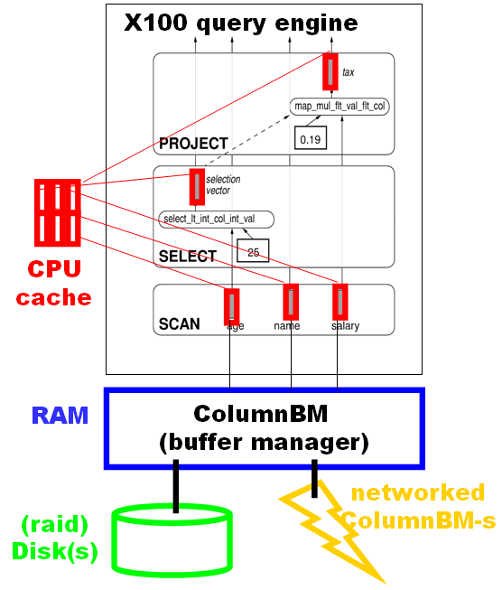
MonetDB/X100 [CIDR’05]
Vector-at-a-time instead of
tuple-at-a-time Volcano
Vector = Array of Values (100-1000)
Vectorized Primitives
Array Computations
Loop Pipelinable ➔ very fast
Less Function call overhead
Vectors are Cache Resident
RAM considered secondary storage

Slide 25
MonetDB/X100 [CIDR’05]
Vector-at-a-time instead of
tuple-at-a-time Volcano
Vector = Array of Values (100-1000)
Vectorized Primitives
Array Computations
Loop Pipelinable ➔ very fast
Less Function call overhead
Vectors are Cache Resident
RAM considered secondary storage
decompress

Slide 26
MonetDB/X100 [CIDR’05]
Vector-at-a-time instead of
tuple-at-a-time Volcano
Vector = Array of Values (100-1000)
Vectorized Primitives
Array Computations
Loop Pipelinable ➔ very fast
Less Function call overhead
Vectors are Cache Resident
RAM considered secondary storage
decompress

Slide 27
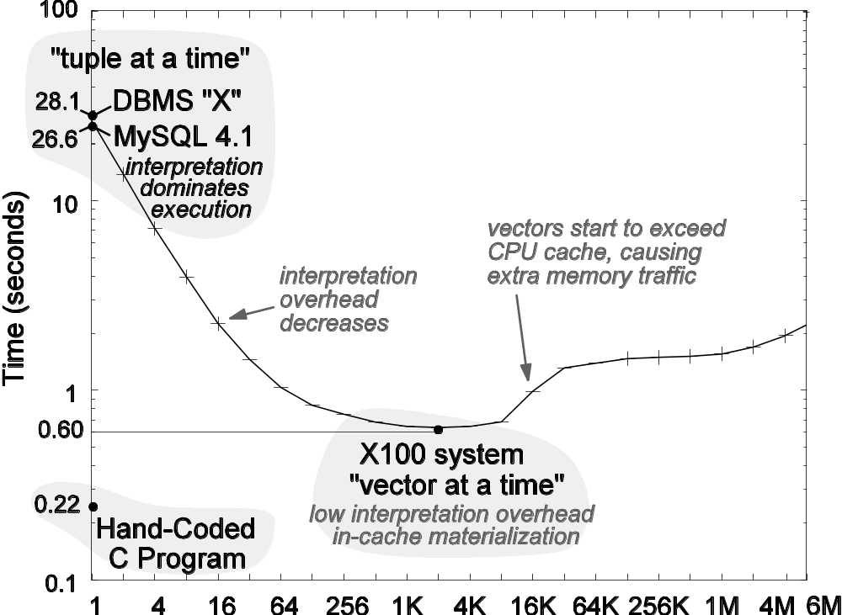
Vector Size vs Execution Time

Slide 28
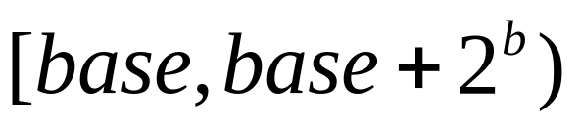
Compression
docid: PFOR-DELTA
  Encode deltas as a b-bit offset from an arbitrary base value:
  deltas within
  get encoded
  deltas outside range are stored as uncompressed exceptions
score: Okapi -> quantize -> PFOR compress

Slide 29
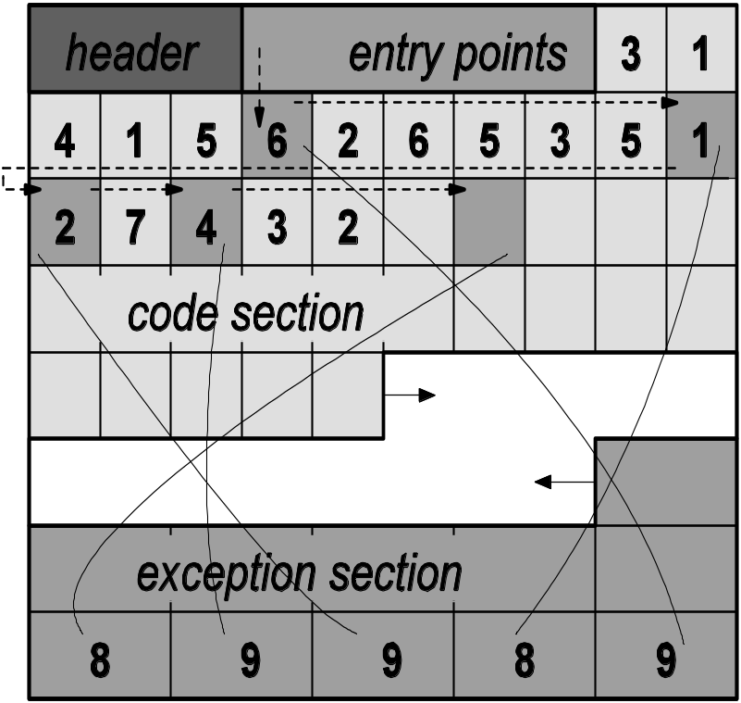
Compressed Block Layout
Forward growing section of bit-packed b-bit code words

Slide 30
Compressed Block Layout
Forward growing section of bit-packed b-bit code words
Backwards growing exception list

Slide 31
Naïve Decompression
Mark ( ) exception positions
for(i=0; i < n; i++) {
if (in[i] == ) {
out[i] = exc[--j]
} else {
out[i]=DECODE(in[i])
}
}

Slide 32
Patched Decompression
Link exceptions into patch-list
Decode:
for(i=0; i < n; i++) {
out[i]=DECODE(in[i]);
}

Slide 33
Patched Decompression
Link exceptions into patch-list
Decode:
for(i=0; i < n; i++) {
out[i]=DECODE(in[i]);
}
Patch:
for(i=first_exc;
i<n; i += in[i]) {
out[i] = exc[--j];
}

Slide 34
Patched Decompression
Link exceptions into patch-list
Decode:
for(i=0; i < n; i++) {
out[i]=DECODE(in[i]);
}
Patch:
for(i=first_exc;
i<n; i += in[i]) {
out[i] = exc[--j];
}

Slide 35
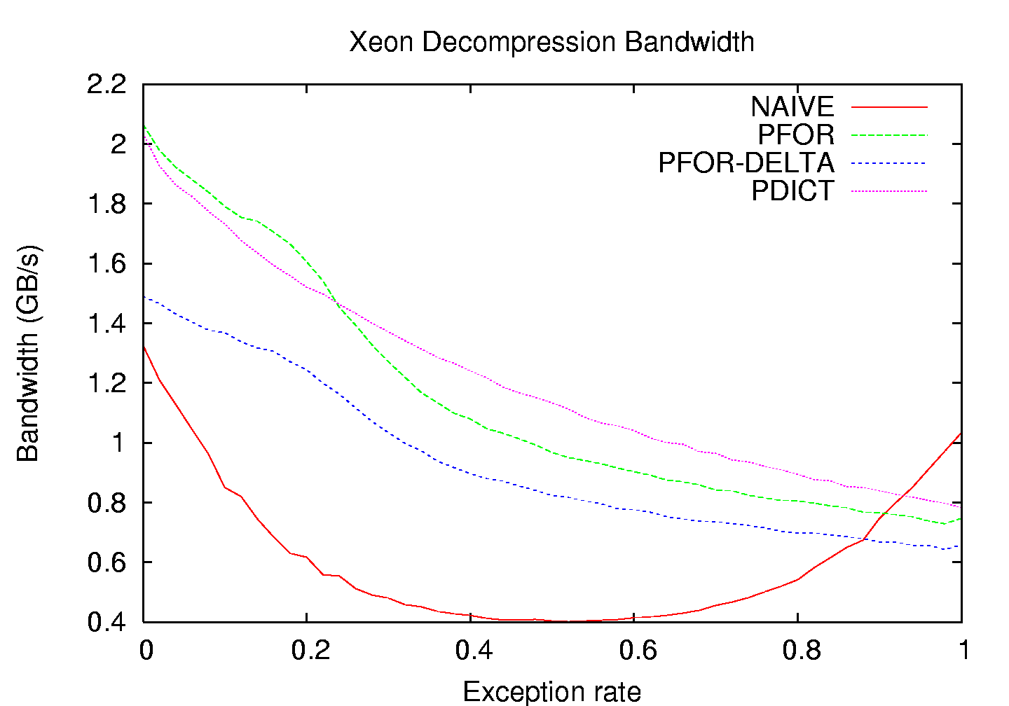
Patch Bandwidth

