Slide 1
Predicate-Based Indexing of
Enterprise Web Applications
Cristian Duda, David Graf, Donald Kossmann
ETH Zurich

Slide 2
Enterprise Search: Possible Approaches
“Do It Yourself” (e.g., SAP, Oracle)
  + App vendors know the semantics of their application
  - Everybody impements their own search engine
  - Cross Application Search is difficult
“Google for Web Applications” (generic ESE)
  + generic (for all applications)
  + enables cross-application search
  - need to teach the semantics of the app to the search engine
  - nobody knows how to do it

Slide 3
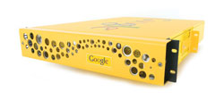
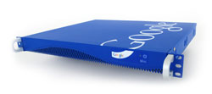
Enterprise Search: Current Status
Search up to 50,000 documents for just $1,995. | Search up to 30 million documents New! Improved search results relevance, security and access to more content.
The Google Mini delivers cost-effective, high-quality search for your public website, intranet, and file servers – and you can be up and running in less than an hour. Supports from 50,000 to 300,000 documents. Learn more. | The Google Search Appliance provides robust, scalable and secure search across virtually all the information in your company. Starts at $30,000 for search across 500,000 documents. Learn more.

Slide 4
Enterprise Application Search
Search up to 50,000 documents for just $1,995. | Search up to 30 million documents New! Improved search results relevance, security and access to more content.
The Google Mini delivers cost-effective, high-quality search for your public website, intranet, and file servers – and you can be up and running in less than an hour. Supports from 50,000 to 300,000 documents. Learn more. | The Google Search Appliance provides robust, scalable and secure search across virtually all the information in your company. Starts at $30,000 for search across 500,000 documents. Learn more.

Slide 5
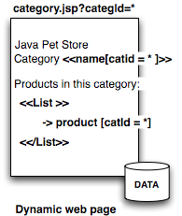
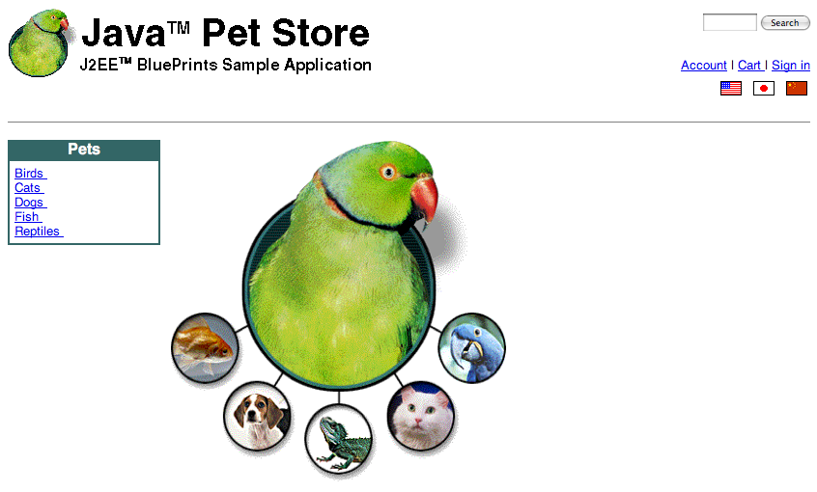
Enteprise Application Search
Data
User View
JSP file
SAP,
...
id | name | type
1 | parrot | green
2
title.english=PetStore
Property file
Database
<item part=“1”>
<name>Snake</name>
<quantity>1</quantity>
<USPrice>60.30</USPrice>
</item>
XML Message

Slide 6
Enterprise Search Engine (ESE)
Challenges:
1. Userview assembled in a non-trivial way (not WYSIWYG)
2. References to Web Pages are complex:
    URL
    function
    parameters
    context (workflow, security)
This is not Google!
1. Google is WYSIWYG
2. Google references are simple URIs
This is not Hidden Web!
  1. The app developer collaborates and teaches the semantics of the app to the ESE
  2. The ESE has full access to all data sources

Slide 7
Enterprise Search Engine:
Solution
Rules and Patterns
  a handful of patterns are enough to describe the mapping from raw view to user view declaratively (semi-automatic)
Crawl the data sources (automatic)
Normalize the data (automatic)
Predicate-based indexing (automatic)
Predicate-based query processing (automatic)

Slide 8
Predicate-based Index
Google... |  |  | ESE
Doc Id | Keyword | Score | Predicate
d1 | java | 7 | true
d1 | pet | 1 | true
d1 | store | 1 | true
d1 | parrot | 1 | $catid=1
d1 | finch | 1 | $catid=1
d1 | iguana | 1 | $catid=2
d1 | rattlesnake | 1 | $catid=2
d2 | male | 1 | $itemid=1
d2 | female | 1 | $itemid=1

Slide 9
Demo!
Indexing
Query Processing
Result Generation
Use Case:
  Sun’s Java Pet Store Application

Slide 10
The Application
JSP Application developed by Sun
Uses Dynamic JSP Pages + Database
Sun uses it to showcase the capabilities of their J2EE platform

Slide 11
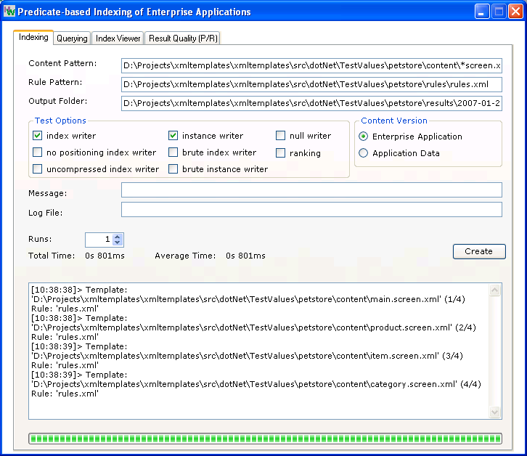
Indexing (using our GUI)
JSP Files
Rules from app. developer
Index location
Indexed files

Slide 12
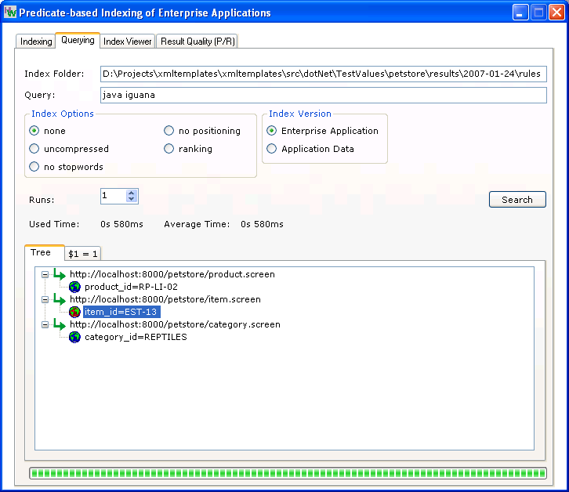
Query Processing (using our GUI)
The queried Index
Query
Results
(URL+additional info)

Slide 13
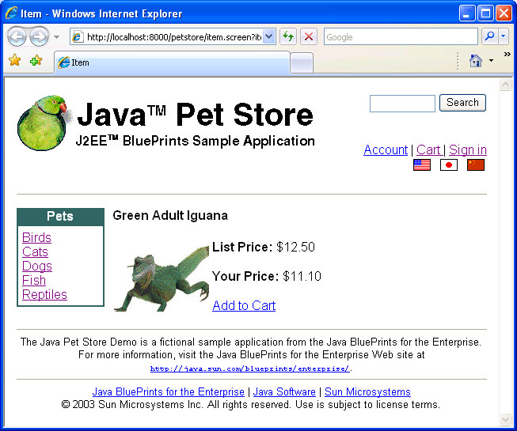
Result presentation
Query:
java iguana
1
Dbl click on query result
2
Web page (user view) is displayed in browser.

Slide 14
Result presentation
Only appears in the JSP file
Only appears in the database
Query:
java iguana
Our ESE understood the combination between the two data sources !
The ESE combined the two data sources just as the application would have done

Slide 15
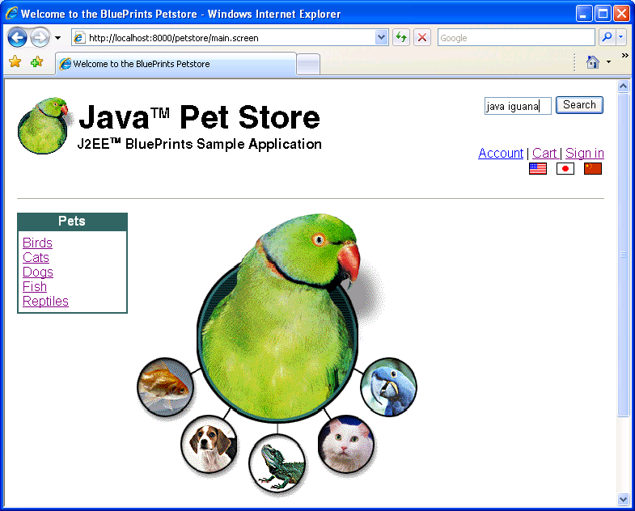
Something funny
The application also has a search functionality, but…

Slide 16
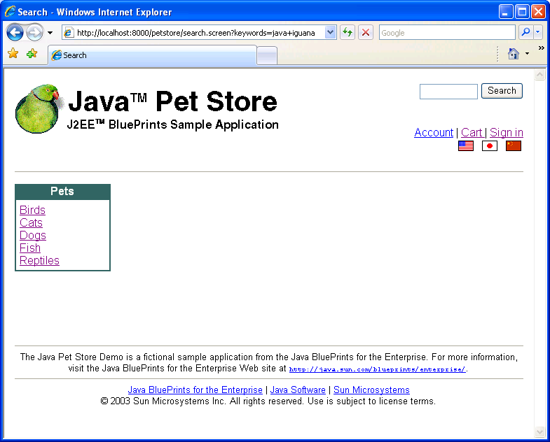
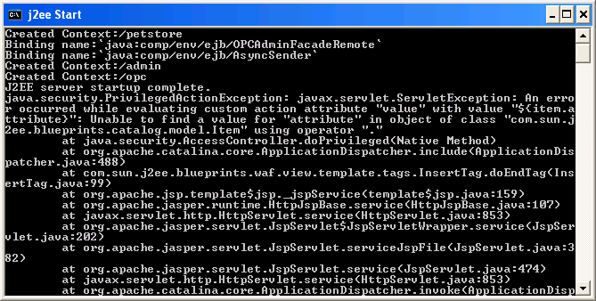
Something funny
The application’s search box is broken ☺
No Results!

Slide 17
Details:
http://www.dbis.ethz.ch/research/current_projects/appdata
Contacts:
Cristian Duda ETH Zurich, Switzerland cristian.duda at inf.ethz.ch
Donald Kossmann ETH Zurich, Switzerland kossmann at inf.ethz.ch

