Slide 1
One Table Stores All: Enabling Painless Free-and-Easy Data Publishing and Sharing
Bei Yu¹, Guoliang Li², Beng Chin Ooi¹, Li-zhu Zhou²
¹National University of Singapore
²Tsinghua University

Slide 2
Folksonomy (folk+taxonomy)
Examples
  Delicious http://del.icio.us/
  Flickr http://www.flickr.com/
  Google Base http://base.google.com/
  YouTube http://www.youtube.com/
Internet-based information sharing methodology
  Users collaboratively publish information resources, e.g., webpages, photos, using self-defined metadata
  Users collaborative behavior decides the data semantics
  System categorize information resources based on user-defined metadata, to facilitate searching, browsing, etc..

Slide 3
Our Attempt
Devise a general system framework for supporting folksonomy-based data sharing
Allows rich and flexible structure of the metadata (called data units) for describing published resources
Categorize data units
Efficiently store all data units
Provide browsing and querying services

Slide 4
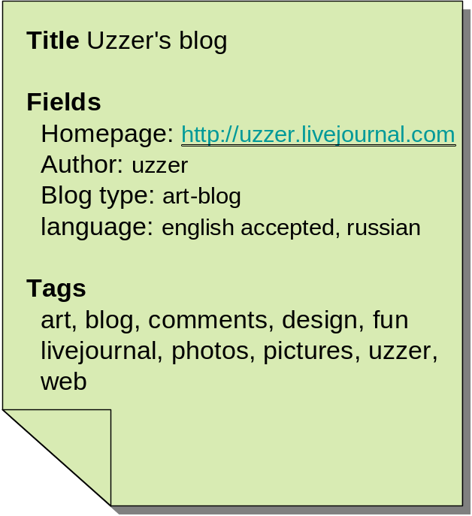
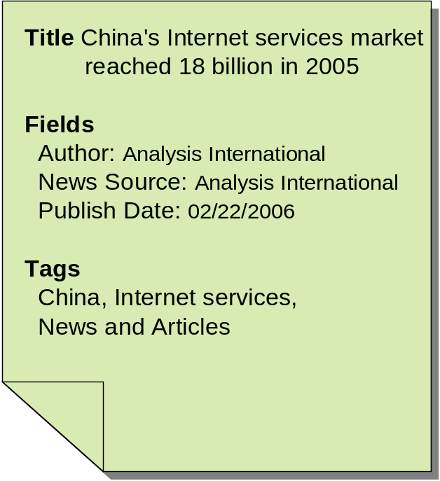
Data Units
The metadata, called data unit, consists of user-created title, fields (attributes and values), tags

Slide 5
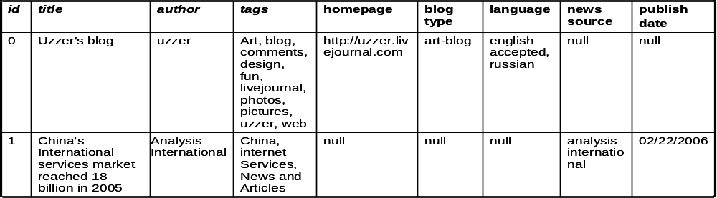
Data Model
A generic relational table for storing all data units, e.g.
A set of virtual relations (VR) as views over the generic table, as querying interface, e.g.
VR1
VR2

Slide 6
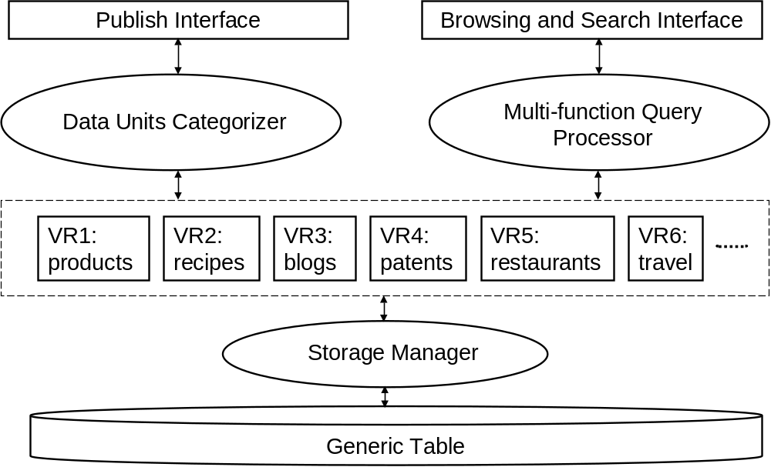
System Framework
queries

Slide 7
Data Units Categorizer
Constructs and maintains VRs dynamically as data units are published constantly
  Clustering based on attributes and tags
  VR ≡ Cluster of data units with similar topics
Need an on-line one pass clustering model
  Accepts a data unit u, and extracts its attributes and tags
  Compare u with existing VRs, and assigns it to the ones that results in a match
  If no suitable VR for u, create a new VR with u as the only tuple

Slide 8
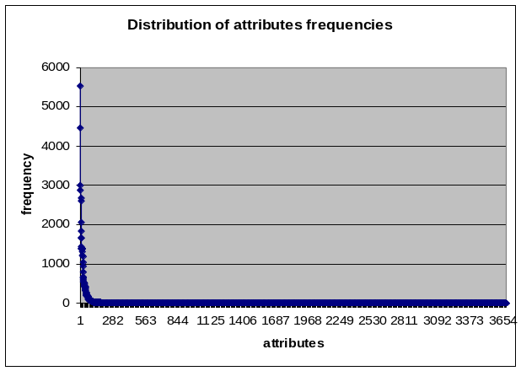
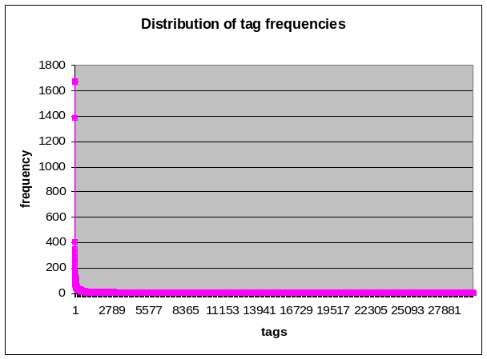
Challenges for Categorizing
Uncontrolled vocabulary for both attributes and tags
Large portion of “noise”, very infrequent
The number of unique attributes and tags keeps growing
Problems with synonyms, polysemy, etc.

Slide 9
Our Current Approach
Characterize each VR with sets of popular attributes (PAS) and tags (PTS), for representing the dominating features
Compare new data units with PAS and PTS, for limiting the affect of “noise”
Maintain PAS and PTS when assigning each new data unit

Slide 10
Storage Manager
Function
  Store and index the generic table (very sparse)
  maintain mappings with VRs
Challenge
  Space efficiency
  Scalable over the number of attributes and data volume
  Be efficient for both retrieval and update

Slide 11
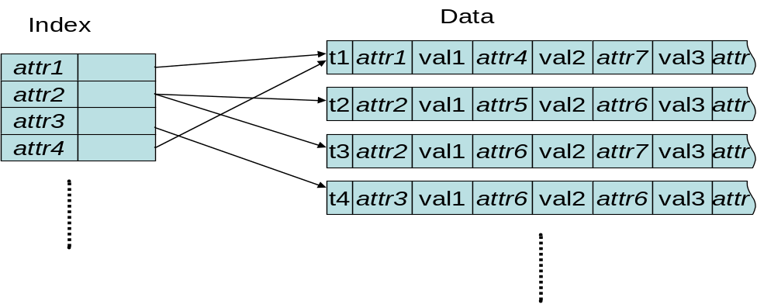
Storage with Sparse Table
Only storing non-null values for each tuple
Build inverted index over attributes for processing attribute-based queries
Build inverted index over keywords for processing keyword queries
Other approaches? Bitmap index?

Slide 12
Browsing and Query Processing
The VRs are ordered based on popularity for browsing
  May be presented in different views, e.g., based on attributes or based on tags
Support both keyword query and structured query
  Inverted index
Effective ranking

Slide 13
Conclusion
We have presented the design for a folksonomy-based data sharing system
We devise a generic table data model for representing and storing the data units
Future work
  Port the system into P2P networks

