Slide 1
The Data Ring: Community Content Sharing
Serge Abiteboul (INRIA)
Alkis Polyzotis (UC Santa Cruz)

Slide 2
Motivation
Content sharing community: A group of users that share and query information within some domain
  Examples: UCSC genome browser, Flickr
Interesting data management problem
  Shared information is heterogeneous, distributed, and dynamic
  Large body of previous research
Distinguishing point: users are not database savvy
Challenge: Enable non-experts to easily create and maintain content sharing communities

Slide 3

The Data Ring
P2P DBMS for content sharing communities
  Each peer exports data or services
  The ring supports declarative queries over the shared resources
Goal: build communities in a “declarative” fashion
The data ring is responsible for the indexing/replication/organization of the shared information
Happy user

Slide 4
The Data Ring v0.1
Topological layer
  Repository of XML views and services
  Declarative queries
Physical layer
  Physical structures
  Distributed query plans
  Autonomic administration

Slide 5


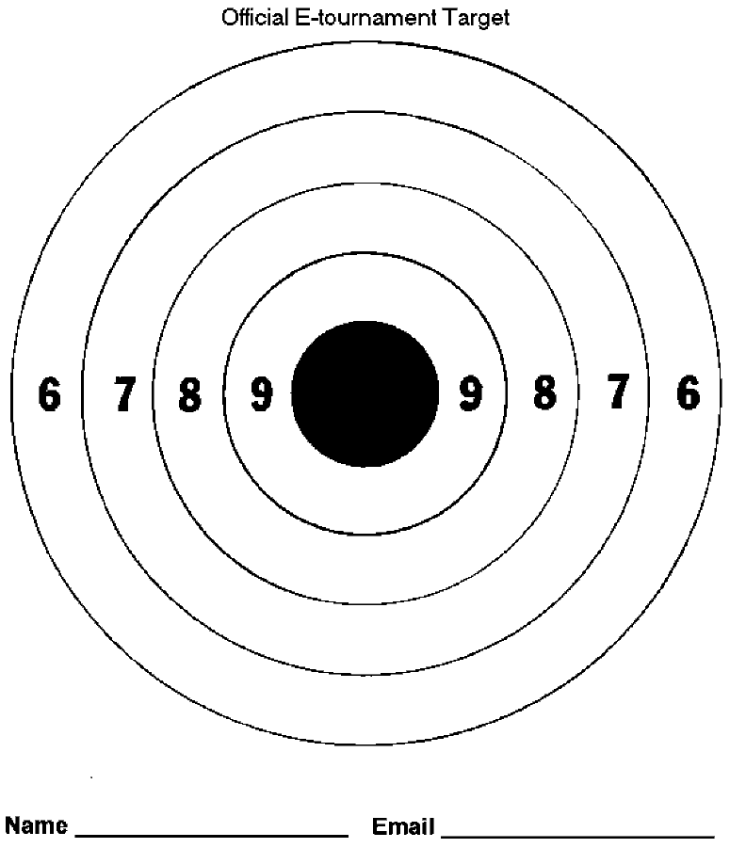
Outline
A formalism for distributed query optimization
Autonomic administration
Outlook on research problems
Outrageous statements

Slide 6
Problem #1: A formalism for distributed query optimization

Slide 7
Motivation
What made the relational model successful:
  A logic for describing tables
  An algebra for query optimization
We need the equivalent for trees and services in a distributed context
  A logic for describing distributed XML data and services
  An algebra for optimizing queries

Slide 8
Desiderata for description logic
Seamless transition between data and services
  Example: what is the phone number of CIDR’s PC chair?
    +49 681 9325 500
    Look up Gerhard Weikum in MPI’s phonebook_x0008__x0008_
Support for streams
  Streams are essential for subscription services
  They are also necessary to support recursion

Slide 9
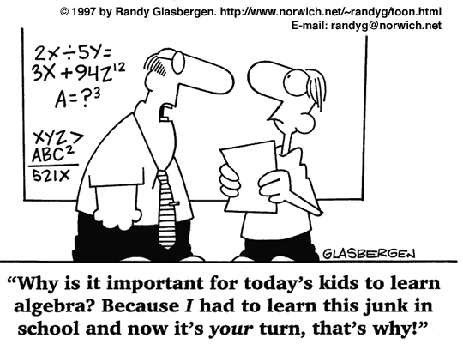
Desiderata for algebra
Be amenable to rewrites
Capture the topology of distributed computation
Allow transition between logical and physical state
  Re-optimization or partial optimization
  Error recovery

Slide 10
Starting point: AXML
AXML: XML tree with embedded web service calls
AXML can serve as the description logic
  It combines intentional (XML) with extensional (services) data
  It supports (push and pull) streams as a core concept
AXML can also provide the foundation for the algebra
  A distributed plan is a workflow of services => an AXML doc
  Rewrite rules are transformations on AXML documents
Disclaimer: AXML is not a complete solution
<directory>
<dep name="Toy">
<sc>www.xyz.com/GetPersonel(“Toy”)</sc>
</dep>
</directory>

Slide 11
Problem #2: Autonomic administration

Slide 12
Motivation
Users are not database experts
Users are averse to too many “knobs”
There is no central authority that can be responsible for administration
The data ring is self-administrated

Slide 13
What should be automated
Monitoring
  Logs and statistics on system operation
  Models of system performance
Tuning
  Enrichment of physical layer with access structures
  Automatic maintenance of meta-data
Healing
  Recovery from peer and network failures
  Recovery from unexpected anomalies

Slide 14
Some issues
System integration
Distribution
  The tunable state is distributed
  There is no central synchronization for the tuning
On-line tuning
Distributed vs. local tuning
Data activation for files
  Data lives in its natural habitat
  Meta-data and physical schema evolves in the DB

Slide 15
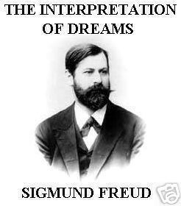
Is there any hope?
There is no alternative!
  Self-administration is not a gadget but a necessity
Some technology already exists
  E.g., self-tuning for relational databases, machine-learning
The power of parallelism

Slide 16
Conclusions
Realizing the data ring involves several challenging and interesting problems
A lot of existing technology to leverage and lots of open issues to tackle
Some progress already being made
  On-line tuning
  Algebra for distributed queries
  P2P indexing
We hope to find more help!

Slide 17
Questions?

Slide 18
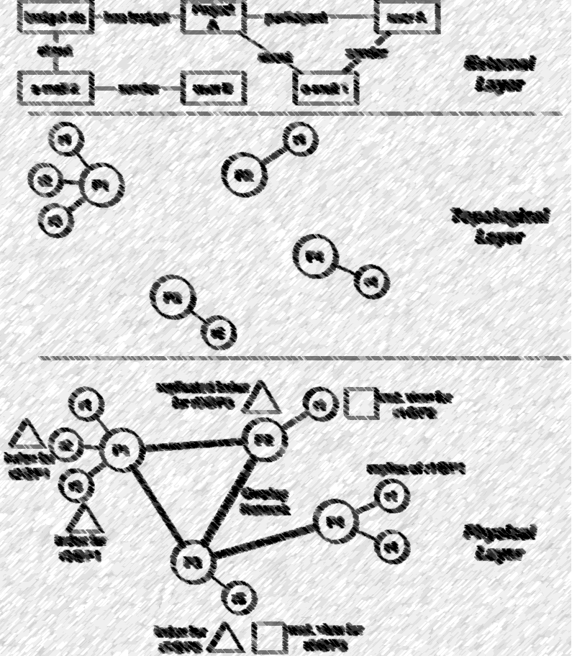
Data abstraction in the data ring
External Layer
Topological Layer
Physical Layer

Slide 19

Data abstraction in the data ring
Topological Layer
Every peer exports a set of resources
  A resource is a data item or a service
  We use XML+WSDL to describe resources
Peers can issue declarative queries (one-shot and continuous) over the shared resources

Slide 20
Data abstraction in the data ring
Physical Layer
Physical structures for query processing
  Eg., data catalog, indices, views, replicas
Support for distributed query plans

Slide 21
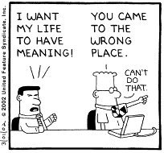
Data abstraction in the data ring
External Layer
Semantically richer data models and query languages
  E.g., a la dataspaces [FHM05]

Slide 22
Data abstraction in the data ring
Motivation: data independence
Our initial focus is on topological plus physical
  Necessary for a basic set of services
  Essential for the external layer
We hope to leverage on-going research on the external layer
External Layer
Topological Layer
Physical Layer

Slide 23
Data activation for files
Scientists prefer to keep data on the file system
  Convenience vs overhead of using a database
One approach: in-situ query processing
  Data lives in the file system, processing logic lives in DBMS
Use data activation to speed up processing
  E.g., instantiate indices or store contents in a relational DB
  Similar to relational database tuning but more complex

Slide 24
An algebraic rewrite

Slide 25
Algebraic plans

