Slide 1
“One Size Fits All”
An Idea Whose Time Has Come and Gone by
Michael Stonebraker
Notes:
1

Slide 2
Co-conspirators
StreamBase benchmarking: John Lifter
Vertica benchmarking: Chuck Bear
ASAP design and benchmarking: Stavros Harizopoulos*, Jennie Rogers, Tingjien Ge
4* wizard DBA: Nabil Hachem
Kibitzers: Ugur Cetintemal, Stan Zdonik, Mitch Cherniack
* Looking for a job

Slide 3
Current DBMS Gold Standard
Store fields in one record contiguously on disk
Use B-tree indexing
Use small (e.g. 4K) disk blocks
Align fields on byte or word boundaries
Conventional (row-oriented) query optimizer and executor

Slide 4
Terminology -- “Row Store”
Record 1
Record 2
Record 3
Record 4
E.g. DB2, Oracle, Sybase, SQLServer, …

Slide 5
Row Stores
Can insert and delete a record in one physical write
Good for business data processing (the IMS market of the 1970s)
And that was what System R and Ingres were gunning for

Slide 6
Extensions to Row Stores Over the Years
Architectural stuff (Shared nothing, shared disk)
Object relational stuff (user-defined types and functions)
XML stuff
Warehouse stuff (materialized views, bit map indexes)
….

Slide 7
Assertion
There are at least 4 (non trivial) markets where a row store can be clobbered by a specialized architecture
“Clobbered” means X10 performance or more

Slide 8
In the Paper….
Performance bakeoff numbers that validate the assertion for
    Data warehouses
    Stream processing
    Scientific and intel data bases
And a fluffy argument that assertion is also true for text (Google. Yahoo, …)

Slide 9
Data Warehouses
Two apples-to-apples benchmarks
    Real customer telco app (Vertica vs an appliance)
    Variant of TPC-H (Vertica vs an elephant)
Using professionally tuned software
On common hardware (in the elephant case)

Slide 10
Telco Call Detail Benchmark
Vertica 47X a popular appliance on 1/7 the resources and 1/100 the hardware cost
Why?
    Queries read 6-7 of 212 columns -- column stores have a huge advantage
    Compression – column stores compress better than row stores

Slide 11
Telco Call Detail Benchmark
Why?
    Indexing/ordering – appliance doesn’t do any
    Vertica executor runs on compressed data
      Less main memory data copying
      Better L2 cache performance

Slide 12
Skinny Fact Table (simplified TPC-H)
Vertica 8X a very popular row store in ½ the space (same materialized views)
Vertica 35X the same row store with equal space budget (actually 2/3)
Both systems used partitioning, compression,and were tuned by wizards

Slide 13
Why 8X?
Less data read
Better compression
Less main memory copying
Better L2 cache performance

Slide 14
Stream Processing
Virtual feed
    Create a “first arriver” Wall Street composite feed
Split adjusted price
    From a Tick feed and a Split feed, produce “split adjusted price” feed
Both of these are real customer POCs
(as opposed to Linear Road)

Slide 15
Stream Processing Results
StreamBase 25X an elephant
      If required state implemented as an RDBMS table
  StreamBase 7X an elephant
      If required state implemented as local variables in a data base procedure (i.e. no use of the DBMS)

Slide 16
Why?
Embedded application – not client - server
Compile operations to machine code, not an intermediate form
Optimized for pushing 1 record through a workflow – not joining 1M records to 1M records
    Operations don’t queue results – directly call next operator
Time windows as basic primitive

Slide 17
A Note in Passing
Some stream engines are implemented on top of DBMS technology
    i.e. filters, join performed by the embedded DBMS
    i.e. time windows implemented as DBMS tables
Costs more than one order of magnitude in performance
    Lose elephant advantage!

Slide 18
Another Note in Passing….
StreamSQL is the obvious paradigm to mix
real time processing with lookup of state information
Select T.symbol, price = T.price * S.factor, T.volume, T.time
From Ticks T, Storage S
Where S.symbol = T.symbol

Slide 19
Third Area – Scientific and Intel Apps
Artificial (simple) benchmark
Comparing
    ASAP (new Brown/Brandeis/MIT prototype)
    Matlab
    An elephant
On some simple array calculations
    But arrays are big

Slide 20
Scientific and Intel Results
ASAP > 100X the elephant
ASAP ~ 10X Matlab (high variance)

Slide 21
Why?
Chunky Store
    Fundamental storage unit is an “array chunk” (reminiscent of Sarawagi’s work)
    Regular and irregular indexes
    Sparse and dense arrays

Slide 22
Why?
Compression
    Regular indexes not stored
    Delta compression in any direction (reminiscent of MPEG)

Slide 23
Why?
Standard array operations as primitives, plus:
    regrid
    locate
    pivot
Not simulated on top of relational primitives

Slide 24
Other stuff
Seamless integration of real time and stored state (Intel guys go ga-ga)
    StreamSQL for arrays!
    Lineage (simpler, more efficient, model than Trio)
    Uncertainty (different than Trio)

Slide 25
ASAP
Real-time stuff adapted from Aurora/Borealis
    Demo-able
New storage system from scratch
    Enough works to get some numbers

Slide 26
Demo
Two video cameras: IR and conventional
Forward the better image on a frame-by-frame basis as lighting changes

Slide 27
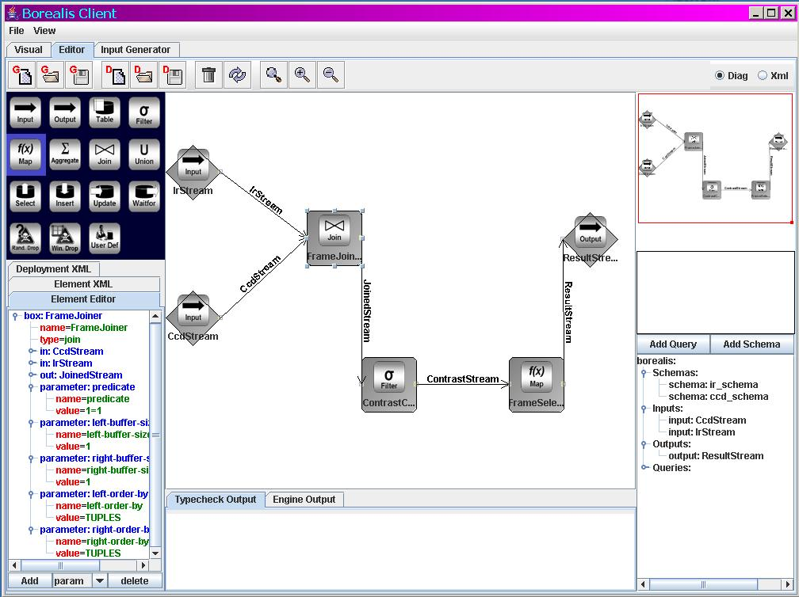
Query Network

Slide 28
Text
Search guys don’t use DBMSs
    Too slow
    No need for XACTS
    Run only one query
    No need for 100% precision
    ….

Slide 29
So What is an RDBMS Elephant to do?
Yawn
    Always been high end specialization for a few crazy lunatics
K engines united by a common parser
    StreamSQL is a step in this direction

Slide 30
So What is an RDBMS Elephant to do?
Data federations of incompatible systems
    Full employment act for CS folks forever
  A new (much more general storage engine)
    E.g. morph between rows, columns and chunks

Slide 31
Obvious Research Agenda
Find a market where OSFA doesn’t work and customers are in pain
Figure out what does

Slide 32
More General Issue
Fast stream processing engines don’t use the standard system software stack (web servers, app servers, DBMS)
How many other refactorings of system software capabilities are there?

Slide 33
The Curse
May you live in interesting times

