Slide 1




Smoothing the ROI Curve for Scientific Data Management Applications
Bill Howe
David Maier
Laura Bright
Notes:
As mentioned, I recently defended my dissertation, and now I work at the Center for Coastal Margin Observation and Prediction, a new NSF Science and Technology Center, where I’m acting as a kind of embedded reporter among oceanographers. This is joint work with David Maier at Portland State University, and Laura Bright at Thetus Corporation, and all of us are near Portland, Oregon.

Slide 2
Motivation
“Physical Scientists aren’t using databases!”
who don’t know Jim Gray
Notes:
Early on as a student I read that scientists don’t use databases. After some time working in this area, I discovered that this statement is not quite true. The correct statement is that scientists who do not know Jim Gray are not using databases. Still, that leaves a lot of scientists, so there is still some work to do.

Slide 3
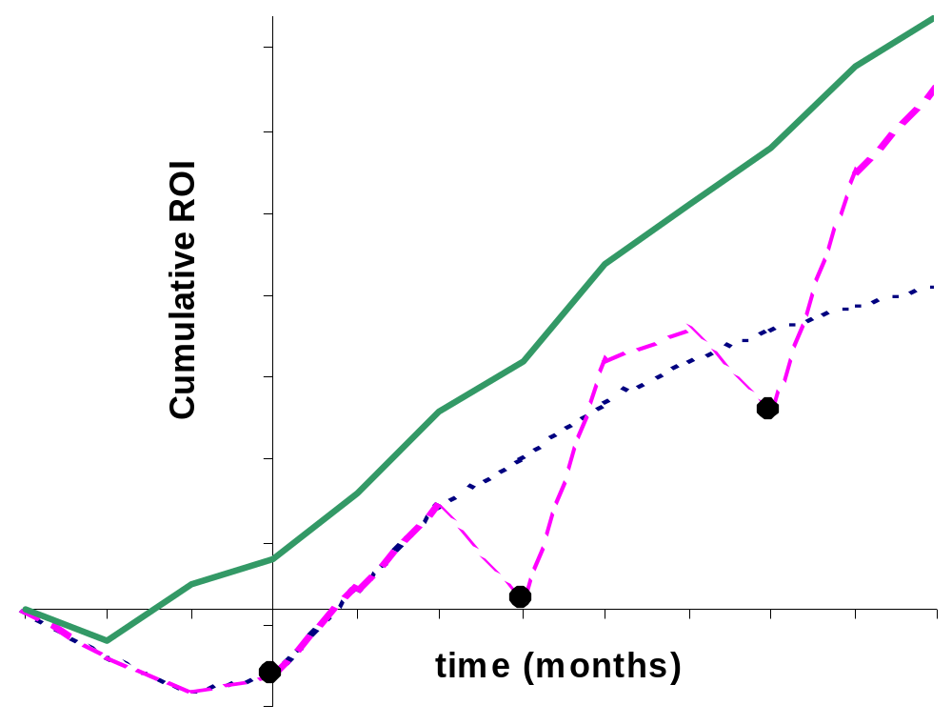
ROI Shape as Success Indicator
T = Time spent on non-science data tasks
ROI(X) = ∑ T(status quo) – T(X)
continuous-release
multi-release
single-release
Notes:
This slide is intended to convince you that a smooth return on investment is desirable in scientific data applications, but I’m going to assume you agree with this assertion, and refer you to the paper otherwise.
We find that scientific data processing applications are developed ad hoc, without lengthy design phases.
As others have noted at this conference, conventional database software is not conducive to this style of development; logical and physical database design must be completed prior to realizing any return on the investment.
We define return on investent in this domain as the reduction in time spent on non-science data tasks; that is, finding datasets, transforming datasets, reformatting files, etc.
So: A large-scale, single-release deployment incurs an initially negative ROI, as scientists attend schema design meetings, learn new interfaces and endure a period of instability. A multi-release cycle undergoes periodic dips in ROI associated with each release, but may compensate by addressing new requirements and incorporating new technology. A smooth ROI at the top reflects continuous improvement, and we argue in the paper that this style is especially appropriate for scientific applications.
-1 The single-release curve is sub-linear to reflect the opportunity cost of sticking with the status quo – new technologies may have become available.
-1 The developers lamented the fact that they were always “putting out fires,” but the applications met requirements.
-1 We speculate that this development style is crucial for scientific applications.
-2 Particularly true for scientific data management: now why is that. Because requirements are necessarily changing – its science.
-2 Different goals: Large commercial IT projects intended to be transformative – software is sold on the promise to reengineer your business procedures in some significant way. The procedures are the science in many fields – we need to augment them and not replace them.

Slide 4
Ironing the ROI Curve
Goal: Transformative services
… by 5:00 pm
Rubrics:
  Pay-as-you-go (“earn as you learn”?)
  Let many flowers blossom
    Postpone or obviate selection between competing solutions
  Specialize to the current instance
    “Extreme schema design”
  Strive for zero configuration
    Don’t replace simple programming with complex configuration
  Operate on in-situ data
    Let them keep their files, at least initially
Notes:
So we adopt a modest goal: Transformative data services….by 5:00 pm.
We offer the following rubrics as smoothings strategies:
The term “pay-as-you-go” is relevant, though it only seems to capture the expenditure of effort, so perhaps “earn as you learn” is better.
Let many flowers blossom: Postpone or obviate selection between competing solutions
allow competing solutions to be deployed – multiple schemas, multiple UIs, multiple APIs. When you can’t decide, do both.
Specialize to the current instance: “Extreme schema design” analagous to extreme programming
Strive for zero configuration: Don’t trade programming tasks for configuration tasks: in scientific domains, it’s easier to find a perl hacker than a DBA.
Operate on in situ data: Let them keep their files, at least initially
The data to be managed are complex objects: a simulation run, a sensor stream, a oceanographic cruise along with cruise plans. Any schema you design also consists of complex objects. Mapping between these two such that semantics are preserved is not something that can be done quickly. Drop the structure and semantics, lump everything together, and rediscover semantics
If step one is “Write a program to convert all your data into a Load all your data into my database,” you’re sunk. In fact, if step one is even “copy all your data to this machine”, you’ll hear crickets.
The database community prefers general solutions. We tend to cast everything as one of three or four data types: relations, trees, now streams, maybe graphs with RDF.
These general data models require respecialization by the application developer: Write a schema, ETL procedures to populate the schema, programs rewritten to query the database. A performance analysis is a separate step and may further delay deployment.
So do we recommend hacking everything together ad hoc? …no.

Slide 5
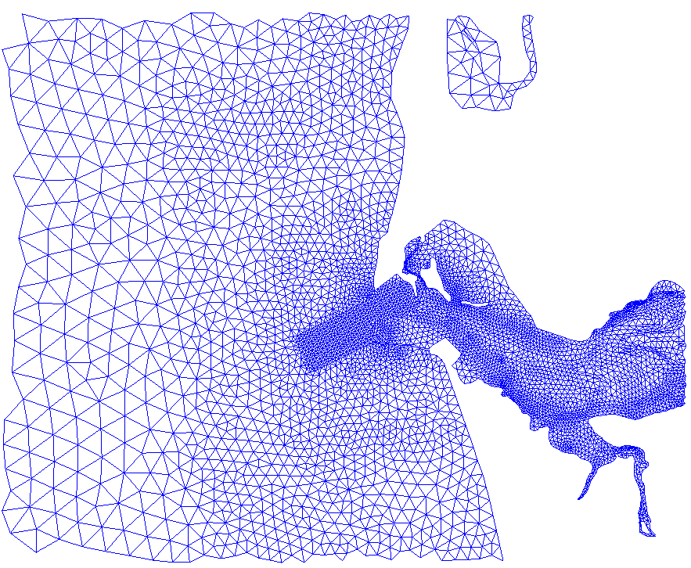
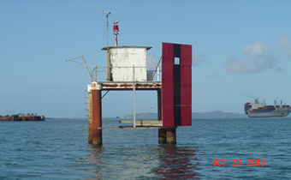
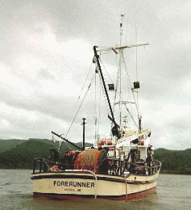
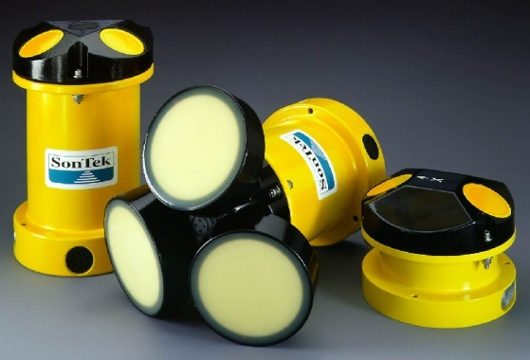
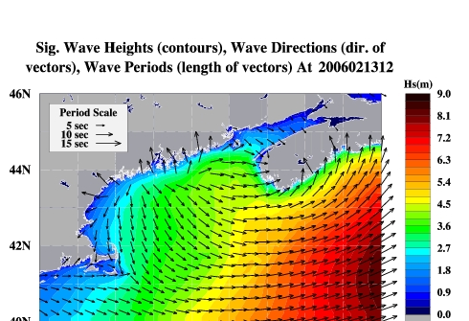
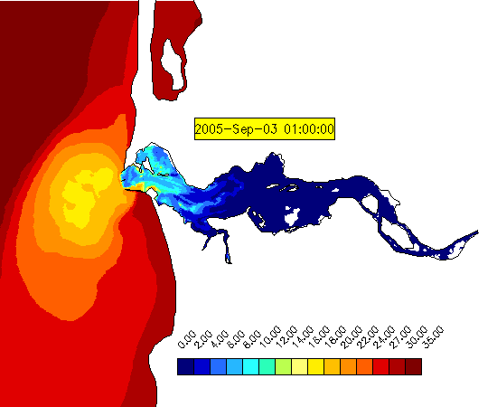
Example: Environmental Observation and Forecasting System
Observations via Sensor Networks
Circulation Models
Downloaded forcings: Atmosphere, River, Global Ocean
-Datasets
-Scripts
-Data products
-Configuration files
-Log files
-Annotations
Data Products
1M files; some DBs
…/anim-sal_estuary_7.gif
Notes:
An example is an environmental observation and forecasting system, whereby Ocean circulation models are fed by observations from sensor networks as well as forcings for the atmosphere, river discharge, and global ocean dynamics
Data products, such as the animation at the lower right are derived from the results of these simulations and consumed by researchers, commercial interests, and policy makers, and the public.
Now, this pipeline is manifested as a collection of files, as well as some tuples in databases.
We want to allow declarative access to these resources. We ask the data creators to write scripts that parse file names, access any file header information, lookup information in their databases or in “nearby” files to produce a stream of resource, property, value triples.
For example, at the lower right, the creator of this file has encoded some information about the file in its name: What do you think that means?
Sensor networks where the entire stack is under our control: Motes -> TinyOS -> TinyDB -> Query interface.
Metadata is vendor and model specific for deep ocean sensors; missing metadata is attached in the pipeline.
Inaccessible sensor emplacements.

Slide 6
Harvesting (Prop,Val) pairs
Variable = “salt”
Depth = “7”
…/anim-sal_estuary_7.gif
Type = “Animation”
Region = “Estuary”
path
prop
value
…/anim-sal_estuary_7.gif
depth
7
  7.5M triples describing 1M files
…/anim-sal_estuary_7.gif
variable
salt
…/anim-sal_estuary_7.gif
region
estuary
…/anim-sal_estuary_7.gif
type
anim
Notes:
We find that it’s an animation, it’s a visualization of salinity, it displays the estuary as opposed to a different region.
We take these streams of triples, derive a schema for them in a manner similar to what was presented in a talk yesterday, and present the metdata back to the data owners.

Slide 7
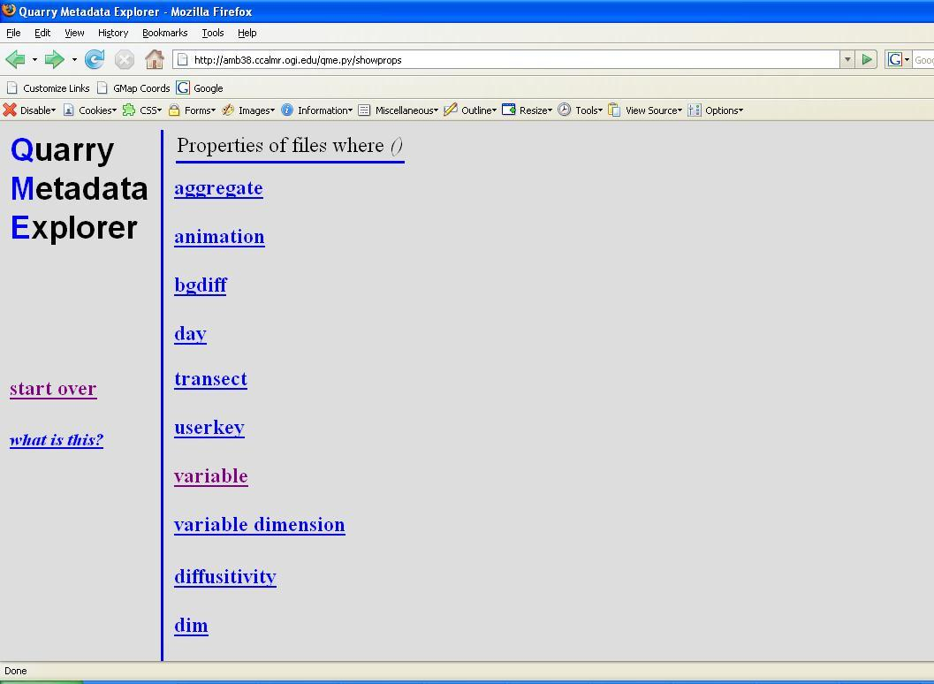
Example: Quarry
Notes:
Here’s a simple interface for browsing the metadata.
The top level is a list of all the unique properties in the system; these could be ranked or organized into a tag cloud if desired.
We select the property “variable”

Slide 8
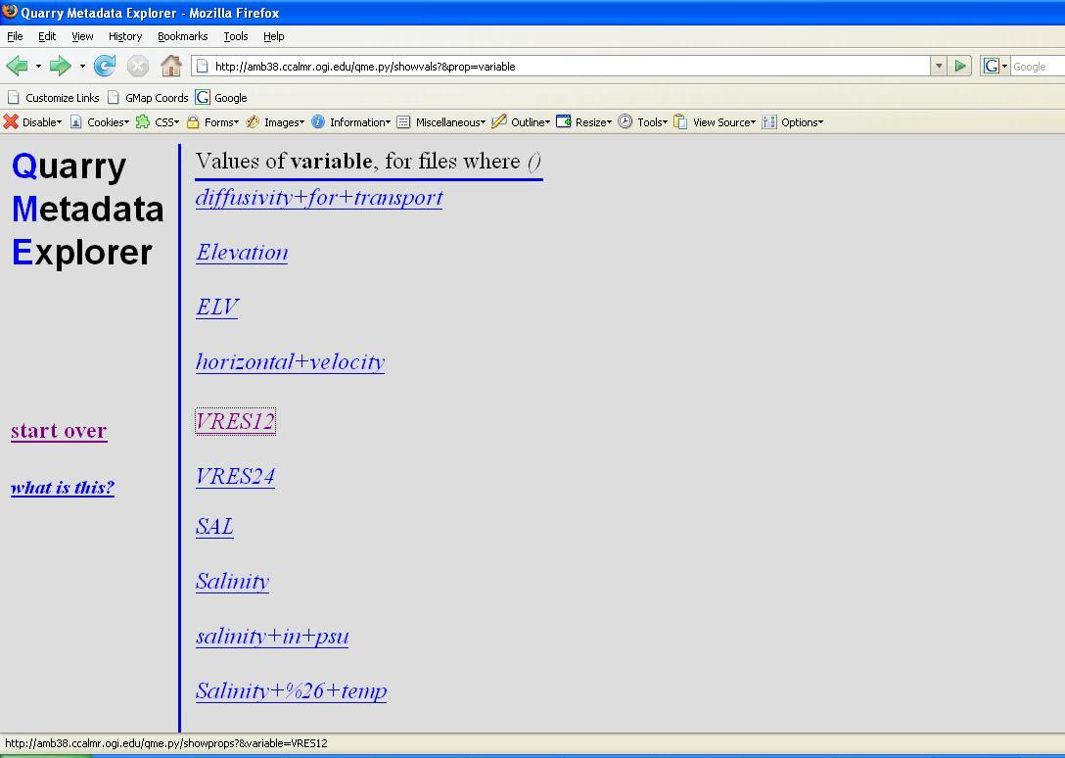
Example: Quarry (2)
Notes:
and we see a list of values for the property variable. Now, notice that we have some cruft here: there is a value capital “SAL”, “Salinity” spelled out, “salinity in psu”, and some combination of salinity with temperature. Let me return to this issue in a moment. Continuing, perhaps we select VRES12 since we do not know what that means.

Slide 9
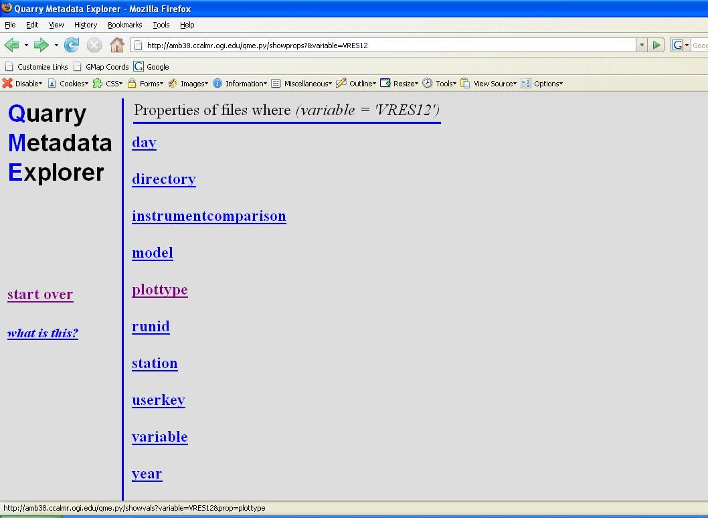
Example: Quarry (3)
Notes:
And now we see all unique properties for any file that matches the condition “Variable = VRES12”
continuing, we select a property “plottype”

Slide 10
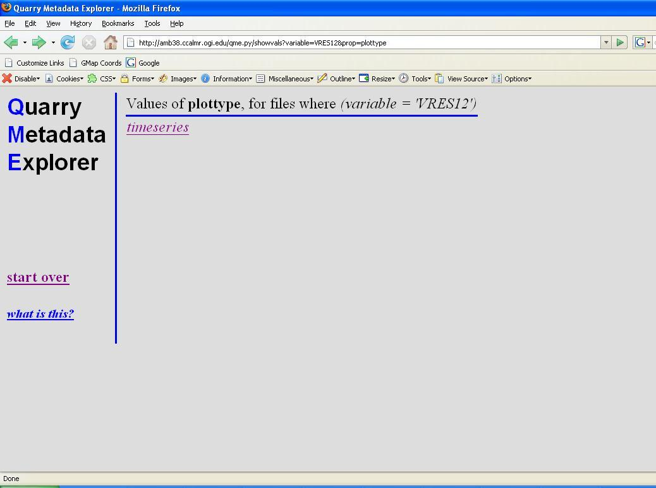
Example: Quarry (4)
Notes:
and find that e

Slide 11
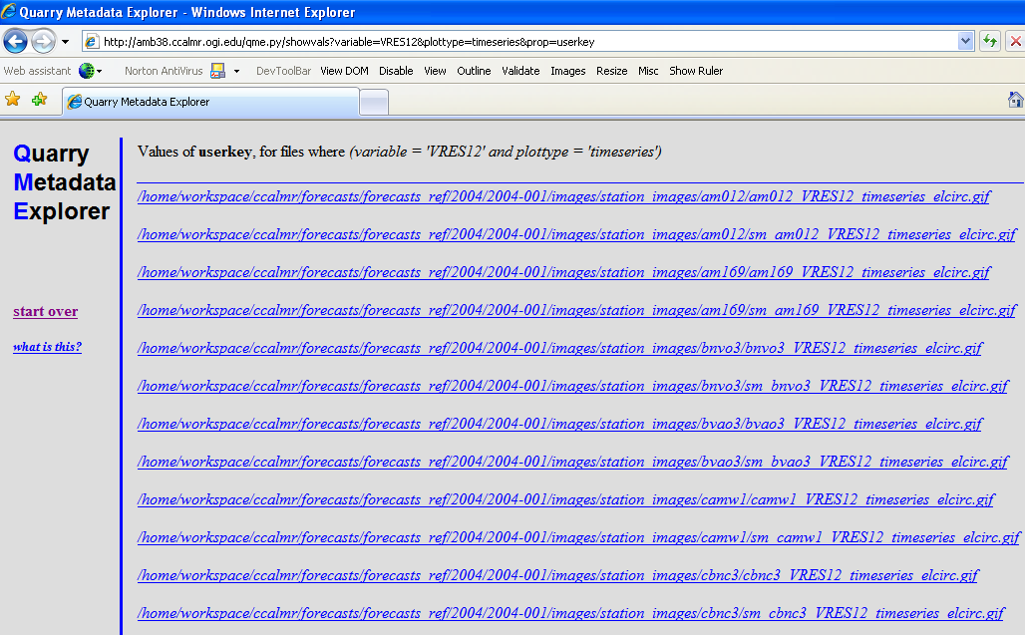
Example: Quarry (5)
Notes:
and at any time we can access a list of resources that meet the current criteria.

Slide 12
Quarry: Summary
Browse-oriented rather than query-oriented
  narrow API (GetProperties, GetValues, a few others)
  interactive performance
No time for thorough schema design; data owners just write scripts emitting (resource, prop, value) triples
Derive a schema automatically
Simple API insulates apps from this dynamic schema
near-zero configuration
specialize to the current instance
pay-as-you-go
in situ data
Notes:
zero configuration. Conjunctive queries over 30M triples can be answered interactively on modest hardware by resources by signature – each signature bcomes a table. We also use aggressive and predictive caching to handle trouble spots.
specialize to the current instance: don’t try to find the best schema to handle all data; don’t clean all the data prior to serving it. Serve it as is and let the scientists eat their own dogfood.
pay-as-you-go…Again, not all data cleaning need be done up front. Some data idiosyncrasies may never be fixed if they don’t cause a problem. If you do need to fix something…just change your scripts and reindex everything. When you see “sal” “salinity” and “salinity in psu”, you’ll be motivated to coalesce the three
in situ data. We don’t disturb the original files. The metadata layer is superimposed on the real data.

Slide 13
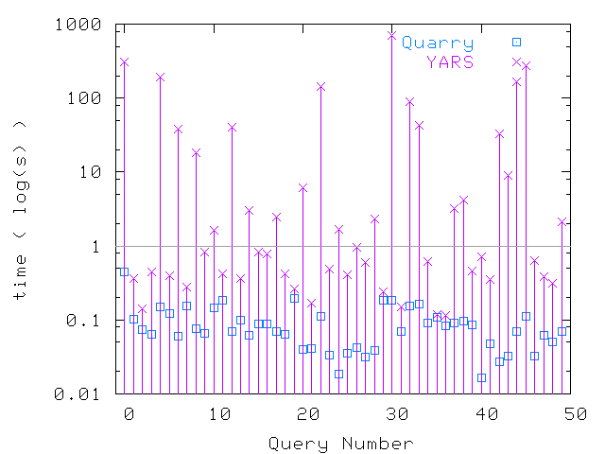
Experimental Results: Queries
3.6M triples
606k resources
149 signatures
Notes:
observe few signatures for many resources.
The talk yesterday on Black box approach for cardinality estimation found 77 query templates for 1.4M queries.
(note: optimization technique for service oriented architectures?)
note the range of the x axis….50 random queries with varying number of terms and we never had a slow response time
YARS queries occasionally spike

Slide 14
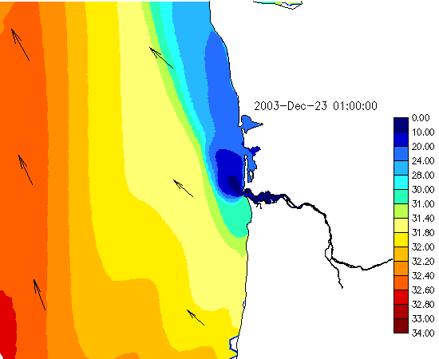
Example: Foreman
~20 daily forecasts of coastal regions worldwide; expected to grow to 100+
“Factory” metaphor for managing the daily runs
Harvest existing log files
Permute existing inputs to add value
Bright, Maier, CIDR 2005
Bright, Maier, SSDBM 2005
Bright, Maier, Howe, SciFlow 2006
zero configuration
in situ data
let many flowers blossom
Notes:
Foreman: Production planning, process analysis (?)
Research agenda here was efficient scheduling of forecasts, forensics, diagnostics
zero configuration: we pick up new forecasts automatically; no need to insert tuples or anything.
in situ: We work with data in its “natural habitat”
We deploy lots of overlapping features

Slide 15
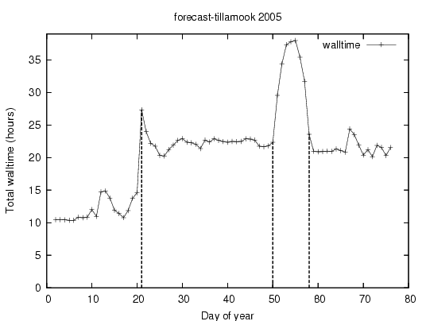
Foreman
Number of timesteps
doubles
?
cascading
delays
Notes:
different color arrow with question mark
Permutation of inputs is a value-add.

Slide 16
Other Examples
Incremental deployment of an algebra for simulation results
Automatically generated access methods for ad hoc file formats
Howe, Maier, VLDB 2004
Howe, Maier, VLDB Journal 2005
Howe, Maier, Data Eng. Bulletin 2004
Howe, Maier, SSDBM 2005

Slide 17
Acknowledgements
Thanks to Antonio Baptista and Paul Turner
http://www.stccmop.org

Slide 18
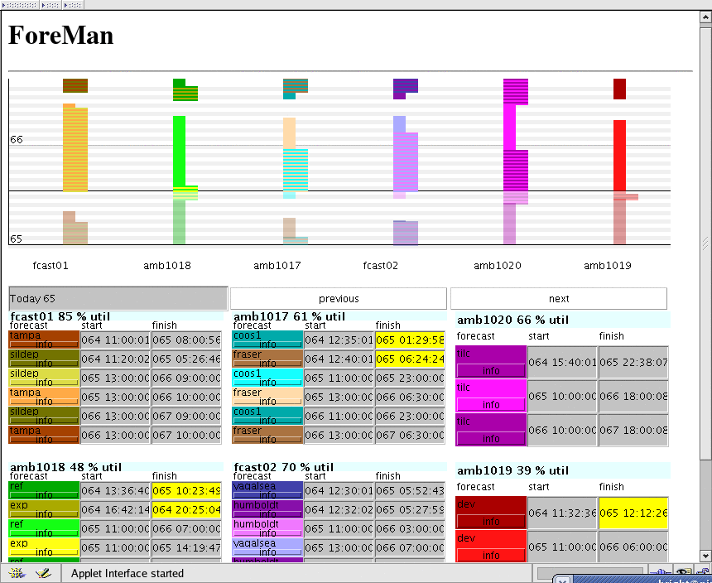
Foreman Screenshot

Slide 19
Experimental Results
Yet Another RDF Store (YARS)
  Several B-Tree indexes:
    rpv → _, pv → r, vr → p, etc.
  authors report good performance against Redland and Sesame
    ~3M triples, single term queries
We investigate simple multi-term queries
?s <p0> <o0>
?s <p1> <o1>
:
?s <pn> <on>

Slide 20
Quarry Architecture
4. derive schema
1. Collection scripts
filesystem
3. db
2. triples
5. publish
6. query and browse via signatures
web

Slide 21
A Narrower Interface
SQL statements
Database APIs
Load Strategies
Data formats/models
specialized
schema
filesystem
Collection scripts
generic
schema
filesystem
RDF triples
Notes:
Changing requirements, changing encodings, new applications, new users all translate to new or changed collection scripts. Data Managers

Slide 22
Computing Signatures
r0
p0
v(0,0)
r0
p0
v(0,0)
r2
p1
v(2,1)
p1
v(0,1)
r0
p2
v(0,2)
External Sort
p2
v(0,2)
r0
p1
v(0,1)
r1
p1
v(1,1)
r1
p3
v(1,3)
p3
v(1,3)
r1
p1
v(1,1)
r2
p1
v(1,1)
r2
p3
v(2,3)
p3
v(1,3)
Nest
r0
hash(S0)
p0, p1, p2
v(0,0), v(0,1), v(0,2)
r1
hash(S1)
p1, p3
v(1,1), v(1,3)
r2
hash(S2)
p1, p3
v(1,1), v(1,3)

Slide 23
Computing Signatures
hash(S0)
p0, p1, p2
r0
v(0,0), v(0,1), v(0,2)
hash(S1)
p1, p3
r1
v(1,1), v(1,3)
r2
v(1,1), v(1,3)
signatures
hash(S0)
sighash
signature
rsrc
p0
p1
p2
hash(S0)
p0, p1, p2
r0
v(0,0)
v(0,1)
v(0,2)
hash(S1)
p1, p3
hash(S1)
rsrc
p1
p3
r1
v(1,1)
v(1,3)
r2
v(1,1)
v(1,3)
Notes:
Store it all in a relational database

Slide 24
Quarry API: Canonical Application
all unique properties
p
all unique values of parent property
v
all properties of resources satisfying p=v
Every path from a root represents a conjunctive query
Notes:
Imagine a fully matyerialized tree of properties and values. Each node has one path from the root representing a boolean condition satisfied by all nodes in its subtree

